Slide 1
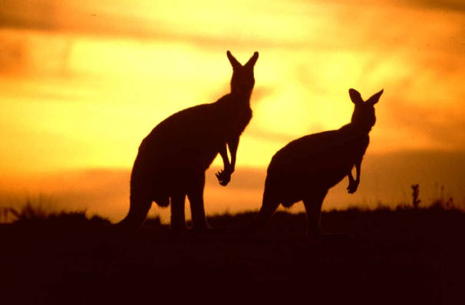
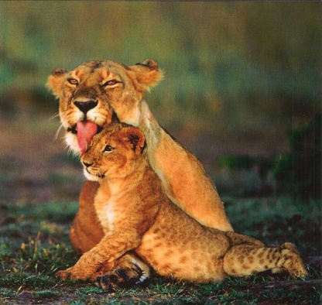
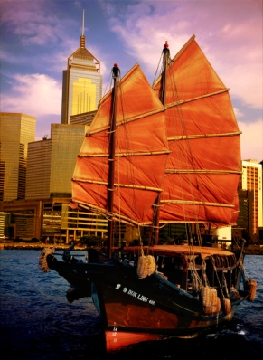
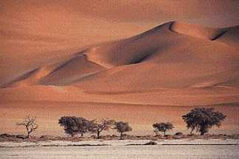
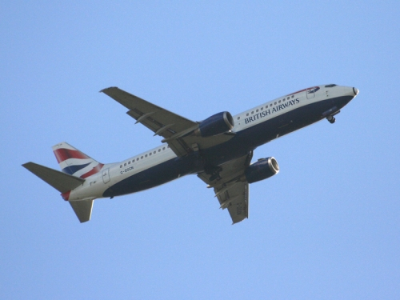
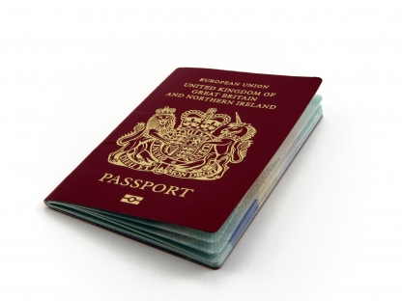
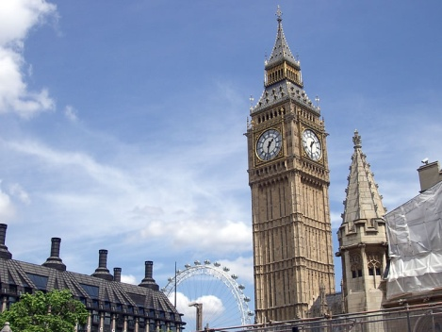
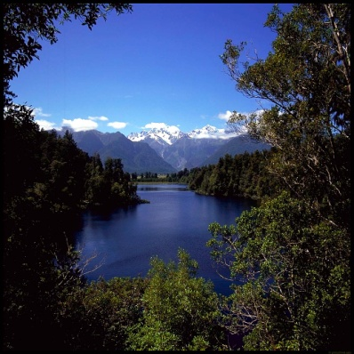
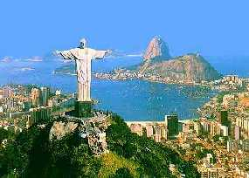
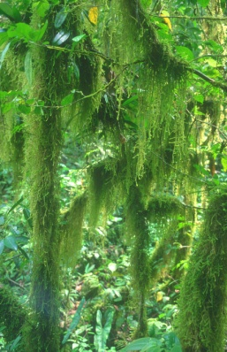
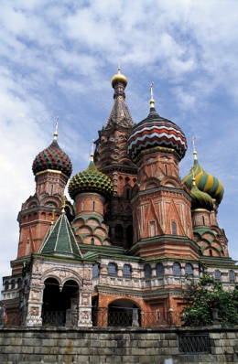
Electives are not holidays Dr Mike Barrett Electives Director

Slide 2
Electives
Details on the Intranet Electives website
…time for learning about Medicine and this should have high priority. It is important to note that the minimum time to be spent on elective is 7 weeks. The holiday aspect of the elective is very much a secondary priority.

Slide 3
Electives
What to do
Where to go
Sources of funding
Planning
Assessing Risks
Documentation
On your elective
After you return
Thanks to Dr Ola Markiewicz for some slides

Slide 4
Electives
Occupational Health Claire O’Brien

Slide 5
Electives Team
Dr Michael Barrett (SAFB) – Electives Director
Dr Etienne Horner (St Mary’s) - Deputy
Wendy Pearson (FEO, St Mary’s) - Electives administrator
Martin Kenton (FEO, St Mary’s) – Grants and Travel Awards
The Electives evening
Prizes awarded for best presentations selected on basis of detailed Elective reports

Slide 6
What is elective?
Different healthcare systems
Working and living abroad or UK
Helping in a developing country
Furthering skills and interests in research or particular speciality
How does culture affect healthcare?

Slide 7
What to do and where to go?
Important questions:
How much money have you got?
Do you know what you want to do as a career?
Who do you want to go with?
Are you an experienced traveller?
You must know the answer to these questions inside out!
Reflect and re-evaluate your ideas, concerns and expectations!

Slide 8
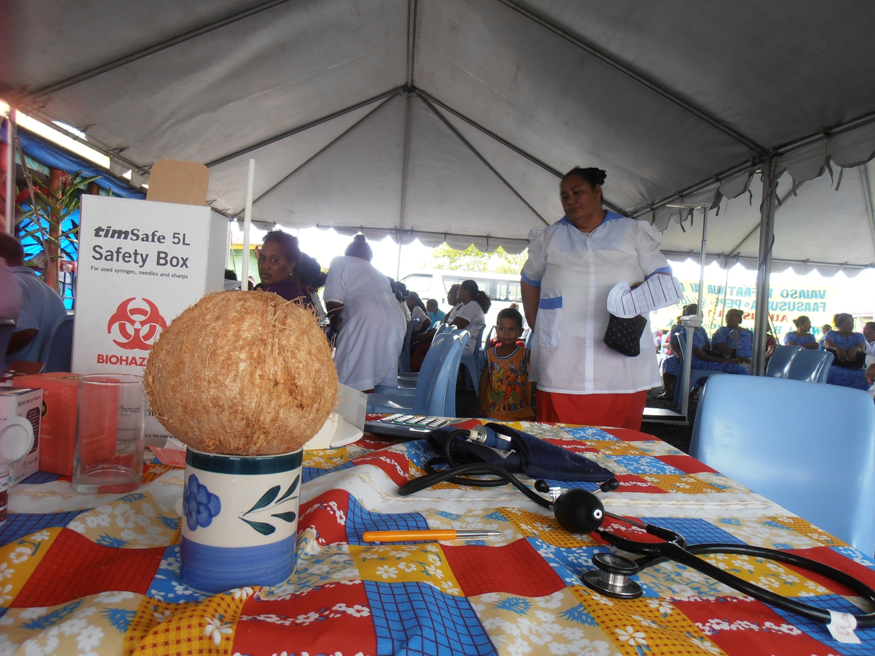
The Medical Bit
Opportunity to gain experience in fields of interest
Improve your clinical skills
Do more of something you didn’t get much of at medical school
Get experience in your future career
Help make a difference

Slide 9
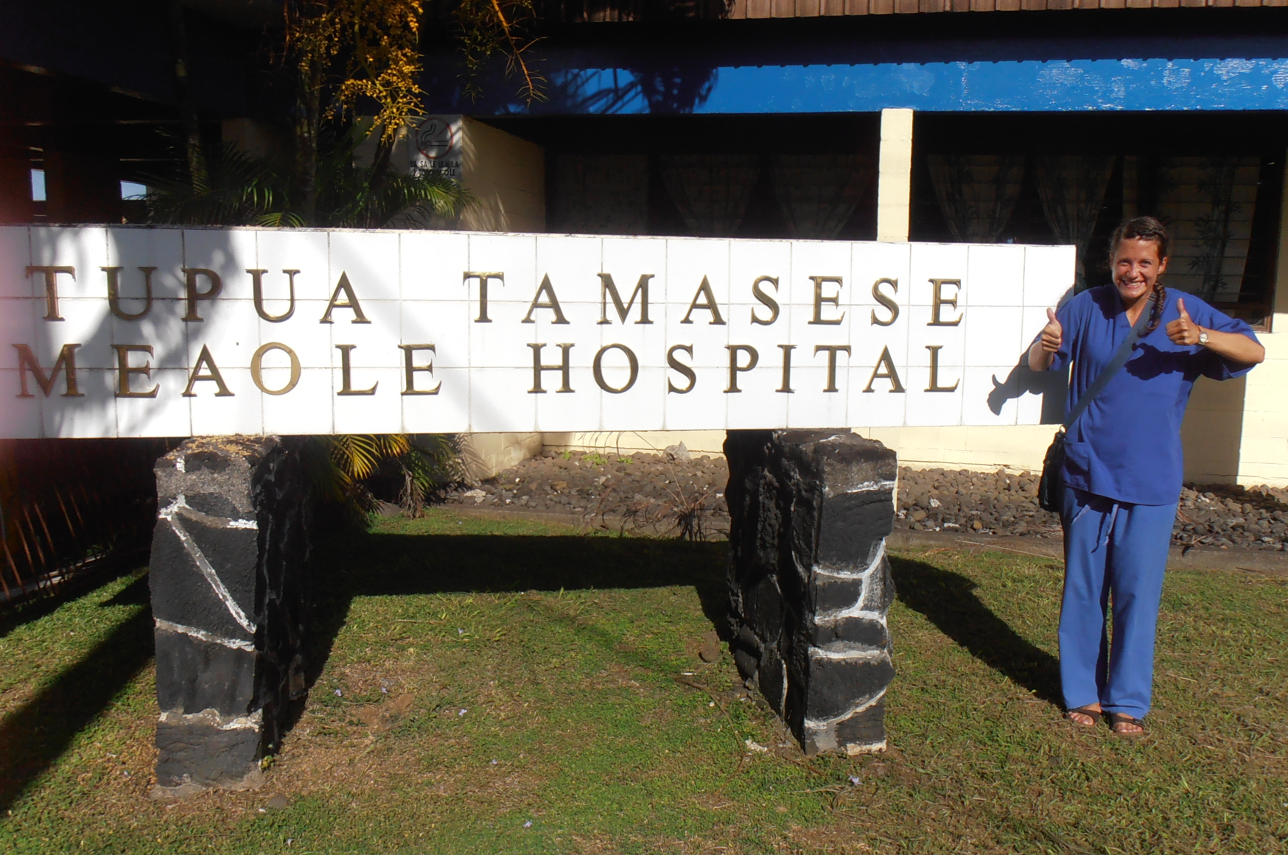
What type of experience will you get?
What sort of healthcare system is it?
What are the main disease burdens?
With other medical students?
Imperial
Elective
Home
How much is the elective fee?
Can I do a project as part of or all of my elective?

Slide 10
Practicalities
Climate
Language
How to get there
Is it safe?
Political / Biological / Social
Will you enjoy being there?
Local customs (e.g. poverty, caste)
Where will you stay?
Hotel / Hostel / Hospital accommodation / Halls
Family (your own or a host family)

Slide 11
Have some Fun
What part of the world do you want to visit?
What else do you want to do?
Where do you want to travel?
Accommodation?
Who do you want to go with?

Slide 12
Getting started
Electives intranet
Elective reports (FEO St Mary’s)
Reports
Spreadsheet summary online of locations and types of placements
Google “Medical Electives”
Speak to people

Slide 13
How much should I budget?
Need to know how much you want to spend
Never underestimate cost of living in a developing country
Travel to and from the country
Accommodation
Trips
Visas
Insurance
Petrol + licence for rented vehicles
Suitable clothing and Toiletries
Any recommended & desirable PPE
Emergency money

Slide 14
Money
Professional loans
Student loan
ICSMSU & ICSM Alumni Association Elective Awards
Elective grants
Check the intranet
Check out deadlines and apply early
Set funds aside now (SAVE!)
Buy essentials over time, rather than in panic
Bank of Mum and Dad

Slide 15
Problems
‘My elective has fallen through’
Be flexible!
Don’t panic – plenty of opportunities you can take up at short notice
Avoid this as best as you can by PLANNING EARLY
Have a Plan B!
‘I get to my elective and its not what I expected’
Cope with the unexpected – be flexible
Make the most of opportunities available to you
‘I can’t go abroad’
Plenty of fantastic opportunities in the UK!

Slide 16
Before you go
Photocopy/scan documents and send to family members and yourself
Keep copies online
Check your itinerary
Give people your itinerary
Vaccinations! see OH presentation
Visas - allow enough time to apply and collect
Travel insurance
Read College’s insurance policy
Take copy of College Cover note

Slide 17
Electives reports
Read those from students who have visited the areas previously (FEO St Mary’s)
Help those that follow by giving good details of your experience in your report
Write up your report promptly
Consider talking about your elective at the Electives Evening in October 2014

Slide 18
Tips
Map out timeline of things to do
Some students suggest having a separate bank account for savings
Plan early – or Sit in a queue at the embassy waiting for a visa whilst revising for Finals
Keep a diary of your experiences and reflections – travelling experiences & medical
Write a good report!
Do not ignore Wendy’s emails – they are important
Read the OH forms and guidance carefully

Slide 19
More Tips
Check FCO Travel Advice for all regions being visited – updated as problems arise
Working in or travelling through malaria-prone areas (includes your holiday time)
You MUST check with Occupational Health in good time

Slide 20
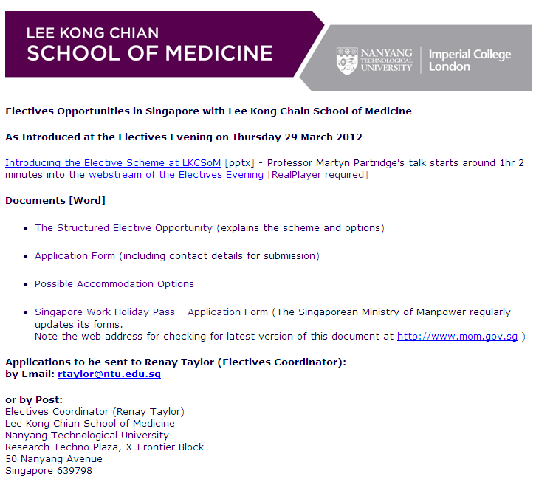
Sales pitch!

Slide 21
Processes
Understand what the elective study period is about
Where you can go, what you can do
Discuss it with Personal Tutor
What about an Elective project?
Travel issues
Financing the elective, including School of Medicine Awards
Travel to/through infection-risk areas
What can curtail or prevent your elective?
Understand your limitations
Assess the risks
Approval of the plan
Insurance – covered under College policy, but may need indemnity cover, extra cover for high risk sports

Slide 22
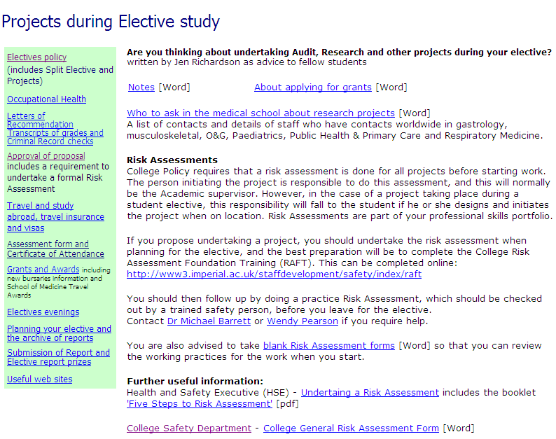
Project?

Slide 23
Split Electives
Important to learn about healthcare in a different country or different scenario (UK), and this takes time
Electives in more than one country, in particular when those countries are not adjacent or in the same part of the world are discouraged but reviewed on a case-by-case basis
Undesirable to spend large proportions of elective period travelling between countries

Slide 24
Changes for Electives for 2012-13 and beyond
Complete reorganisation of Final Year
Electives now are AFTER Finals
Elective remains a serious component of the course
Failure at Finals allows for a shortened elective and return for remedial attachments prior to Resits. Passing the Resit allows start of F1 in August.
Returning from Elective compulsory Preparedness to Practice Course
However, holiday + Elective = 11 weeks (currently)

Slide 25
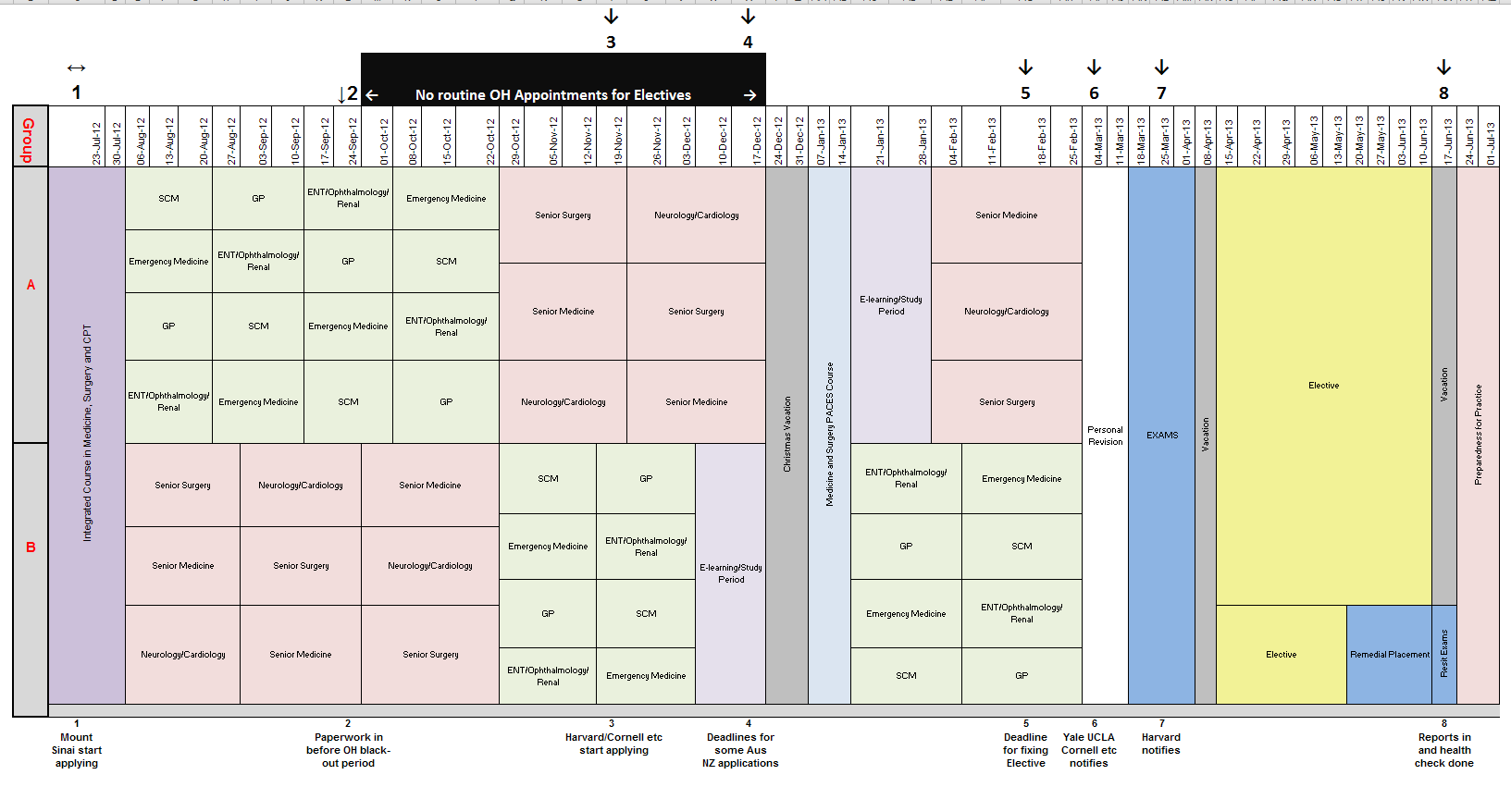
Final Year Course Map 2012-13
Mount Sinai apply
Paperwork in before OH blackout
Harvard & Cornell apply
Some AUS NZ SA apply 15 months ahead
Deadline for all plans
Yale UCLA notify
Harvard notify
All reports in and health check done

Slide 26
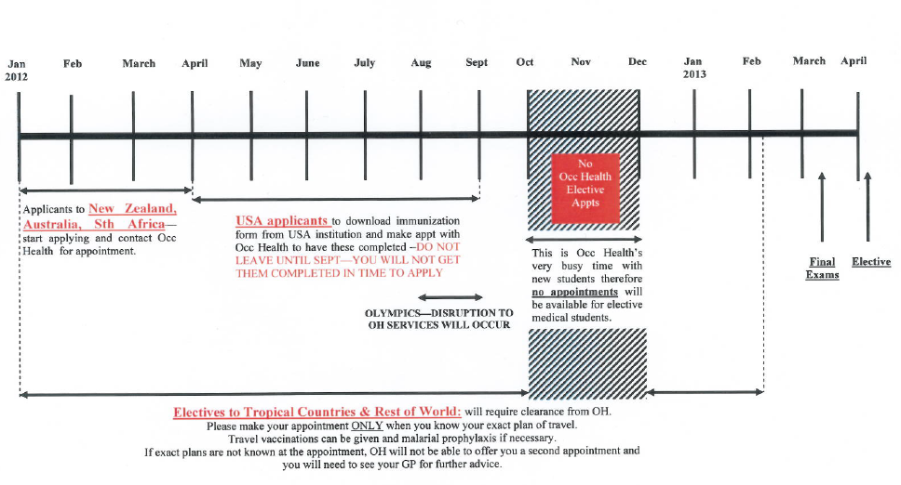
Timing OH appointments plus more demands for toxicology screening
When do start to get busy?

Slide 27
ELECTIVES 2013 DROP IN
Drop-In sessions on Wednesday afternoons will be organised throughout the year
Paperwork (approval forms and confirmation of your elective) to be checked and signed
Queries to be answered
Letters/forms to be organised
Dr Mike Barrett Wendy Pearson Electives Director Electives Administrator

Slide 28
School of Medicine Elective Travel Awards
For students on Elective April-June
Types of Award (you may apply under each category) A. Contribution to the life of the School of Medicine B. Financial hardship C. Project
Deadline for submitting the application
Details on the intranet: https://education.med.imperial.ac.uk/Electives/travelawards.htm

Slide 29
About the Awards
Purpose
To support students in undertaking their elective
Does the Elective have to be confirmed before I can apply for an Award?
No, but do provide details by when the confirmation of the place, +/or project details, are expected.
When are Awards determined?
May in your Year 5. Lots of competition for awards - do not make elective plans in expectation of an award. Decision of the Elective Awards Group is final, and there is no right of appeal

Slide 30
Understand the Risks
Assess the 1° risks, e.g.
Infection risks
Travel and local custom
Accommodation
Work out how to reduce the risk, e.g.
HIV PEP, PPE, vaccinations
Types of transport, travel with others
Pass the exams to enjoy your time
Complete the Risk Assessment/Approval Form

Slide 31
Emergency Situations
How can we contact you?
Do you have personal health problems?
Carefully assess any demands for you to give blood
Local security issues
FCO advice
College may require you to leave the area quickly: if so, there will be NO discussion
Emergency funds in your budget or accessed readily, in case you are required to travel home at short notice
FCO/College Advice
Personal/family
Check Travel Insurance for these eventualities

Slide 32
What if I have an accident?
Get yourself checked out immediately
Will you need assessment for HIV-PEP?
Let us know in case OH can assist with immediate advice
Report it to us formally as soon as you can – see intranet for details of how to report an accident

Slide 33
Completing the Elective
Satisfactorily completing :
Requires Submission of a completed report, attendance report from host, and…
Requires Completion of a health check assessment upon return
Mainly covering exposure to TB
NHS requires all those returning from high risk areas/working with patients with TB to be assessed for continuing clinical practice

Slide 34
ELECTIVES 2013 DROP IN
Drop-In sessions on Wednesday afternoons will be organised throughout the year
Paperwork (approval forms and confirmation of your elective) to be checked and signed
Queries to be answered
Letters/forms to be organised
Dr Mike Barrett Wendy Pearson Electives Director Electives Administrator

Slide 35
Any Questions?

