Slide 1
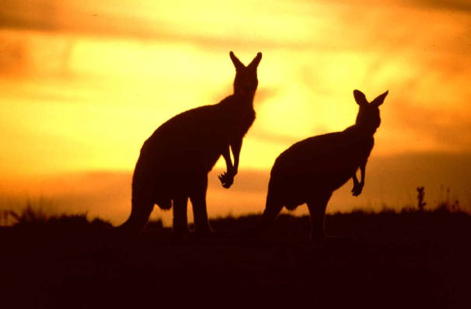
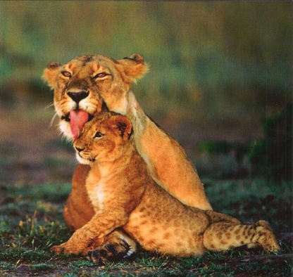
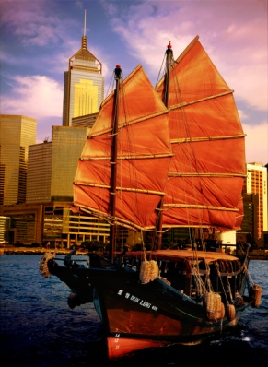
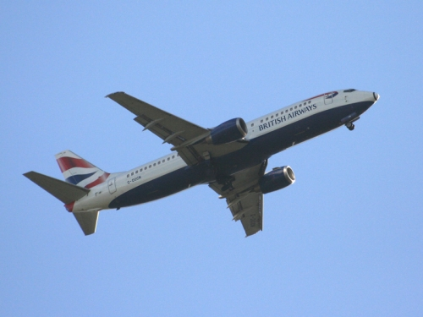
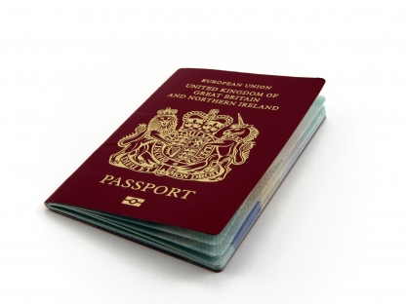
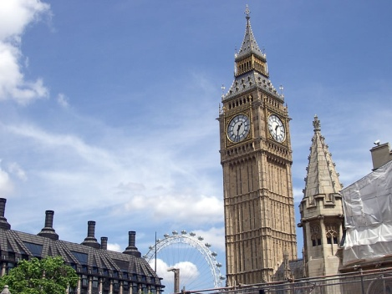
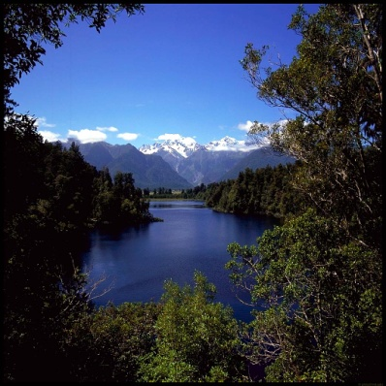
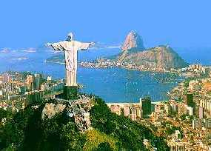
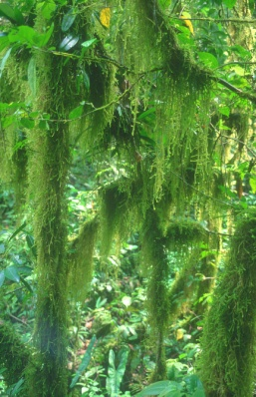
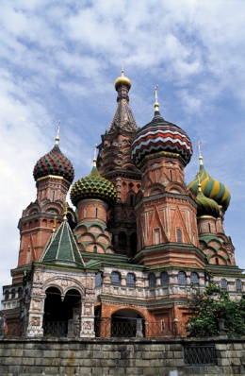
Electives Evening 29th March 2012

Slide 2
TALKS
Introduction Dr Mike Barrett
Research Electives Prof Alison McGregor
Occupational Health Claire O’Brien
Wesleyan Medical Sickness James Cameron
Medical Protection Society Kristi Smith-Edhouse
Medical Defence Union Zaina Reinink
Opportunities in Singapore Prof Martyn Partridge
Student Presentations
South Africa Oliver Brown
New Zealand Abigail Morbi
Venezuela Robert Shaw
Stanford, USA Yizhou Wan
Tanzania Natasha Newlands
UK Claudia Craven
Organising your Elective Ola Markiewicz
Prize Winning presentations Dr Mike Barrett

Slide 3
Electives Evening
What an elective is all about
Electives Team
Dr Michael Barrett (SAFB) – Electives Director
Dr Etienne Horner (St Mary’s) - Deputy
Wendy Pearson (FEO, St Mary’s) - Electives administrator
Martin Kenton (FEO, St Mary’s) – Grants and Travel Awards
The Electives evening
Show you what can be achieved and where you can get advice
Prizes awarded for best presentations selected on basis of detailed Elective reports

Slide 4
Electives
Details on the Intranet Electives website
…time for learning about Medicine and this should have high priority. It is important to note that the minimum time to be spent on elective is 7 weeks. The holiday aspect of the elective is very much a secondary priority.

Slide 5
Electives
Important to learn about healthcare in a different country, and this takes time
Electives in more than one country, in particular when those countries are not adjacent or in the same part of the world are discouraged.
Undesirable to spend large proportions of elective period travelling from one country to the next

Slide 6
Processes
Understand what the elective study period is about
Where you can go, what you can do
Discuss it with Personal Tutor
What about an Elective project?
Travel issues
Financing the elective, including School of Medicine Awards
Travel to/through infection-risk areas
What can curtail or prevent your elective?
Understand your limitations
Assess the risks
Approval of the plan
Insurance – covered under College policy, but may need indemnity cover, extra cover for high risk sports

Slide 7
ELECTIVES 2013 DROP IN
Small meeting room next to FEO, St Mary’s campus
Wednesday 4th April 2pm-5pm More Drop-In sessions will be organised
Paperwork (approval forms and confirmation of your elective) to be checked and signed
Queries to be answered
Letters/forms to be organised
Dr Mike Barrett Wendy Pearson Electives Director Electives Administrator

Slide 8
Changes for Electives for 2012-13 and beyond
Complete reorganisation of Final Year
Electives now are AFTER Finals
Elective remains a serious component of the course
Failure at finals allows for a shortened elective and return for remedial attachments prior to Resits. Passing the Resit allows start of F1 in August.
Returning from Elective to job-shadow and then compulsory Practical Medicine Course

Slide 9
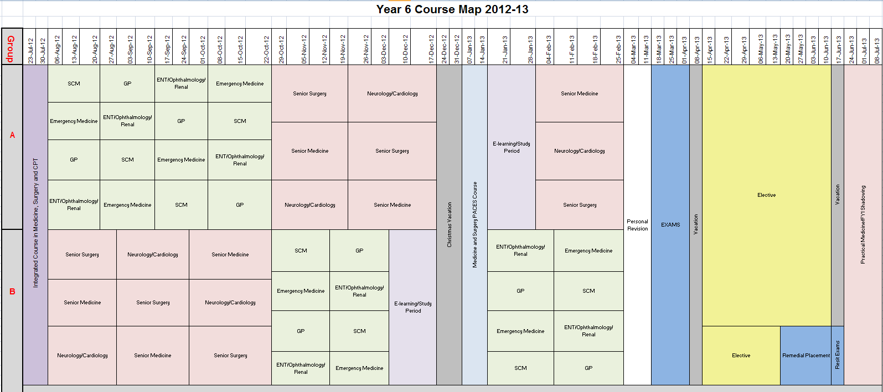

Slide 10
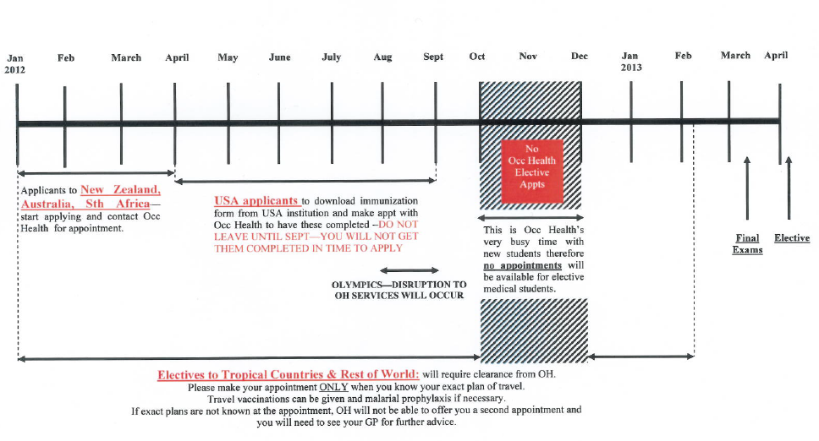
Timing OH appointments plus more demands for toxicology screening
When do start to get busy?

Slide 11
School of Medicine Elective Travel Awards 2012-13
For students on Elective April-June 2013
Types of Award (you may apply under each category) A. Contribution to the life of the School of Medicine B. Financial hardship C. Project
Deadline for submitting the application
Hard copy –FEO CX St Mary's campuses by 3pm, Monday 2nd April 2012
Email - feo-nwtfs@imperial.ac.uk by 12 noon, Wednesday 11th April 2012
Details on the intranet: https://education.med.imperial.ac.uk/Electives/travelawards.htm

Slide 12
About the Awards
Purpose
To support students in undertaking their elective
Does the Elective have to be confirmed before I can apply for an Award?
No, but do provide details by when the confirmation of the place, +/or project details, are expected.
When are Awards determined?
May. Lots of competition for awards - do not make elective plans in expectation of an award. The decision of the Elective Awards Group is final, and there is no right of appeal

Slide 13
Understand the Risks
Assess the 1° risks, e.g.
Infection risks
Travel and local custom
Accommodation
Work out how to reduce the risk, e.g.
HIV PEP, PPE, vaccinations
Types of transport, travel with others
Pass the exams to enjoy your time
Complete the Risk Assessment/Approval Form

Slide 14
Emergency Situations
How can we contact you?
Do you have personal health problems?
Carefully assess demands to give blood
Local security issues
FCO advice
College may require you to leave the area quickly: if so, there will be NO discussion
Emergency funds in your budget or accessed readily, in case you are required to travel home at short notice
FCO/College Advice
Personal/family
Check Travel Insurance for these eventualities

Slide 15
Electives reports
Read those from students who have visited the areas previously (FEO St Mary’s)
Help those that follow by giving good details of your experience in your report
Write up your report promptly
Consider talking about your electives at the Electives Evening in October 2013

Slide 16
Completing the Elective
Satisfactorily completing requires:
Submission of a completed report, attendance report, and…
Completion of a health quiz
Mainly covering exposure to TB
NHS now requires all those returning from high risk areas/working with patients with TB to be assessed for continuing clinical practice

Slide 17
The TALKS
Introduction Dr Mike Barrett
Research Electives Prof Alison McGregor
Occupational Health Claire O’Brien
Wesleyan Medical Sickness James Cameron
Medical Protection Society Kristi Smith-Edhouse
Medical Defence Union Zaina Reinink
Opportunities in Singapore Prof Martyn Partridge
Student Presentations
South Africa Oliver Brown
New Zealand Abigail Morbi
Venezuela Robert Shaw
Stanford, USA Yizhou Wan
Tanzania Natasha Newlands
UK Claudia Craven
Organising your Elective Dr Ola Markiewicz
Prize Winning presentations Dr Mike Barrett

