Slide 1
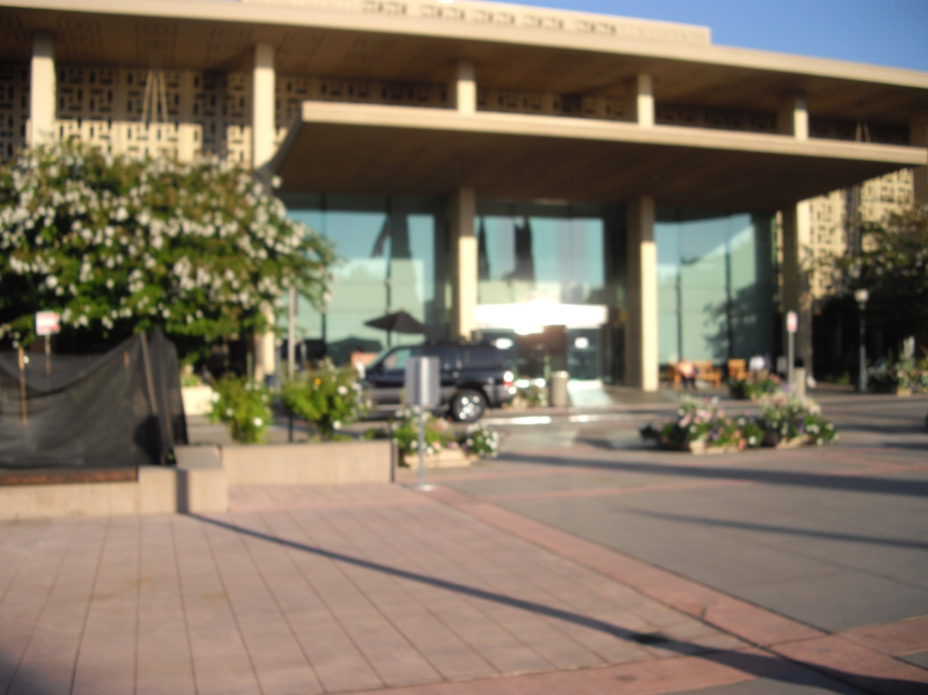
Elective at Stanford University USA
2012
yizhou.wan06@imperial.ac.uk

Slide 2
Overview
Why I chose the USA.
Why I chose a combined research and clinical elective.
How to organise an US elective.
Accommodation and costs.
The research project.
Typical days.
Reflections on the US health system.
Travelling in California.

Slide 3
Why I chose the USA
Experience all the debate about the US health system.
Explore medical practice at an internationally renowned health centre.
Already have previous experience in a ‘developing/rural’ hospitals.
Live in the sunny west coast.

Slide 4
Why I chose a combined research and clinical elective
Always wanted to pursue academic medicine as part of career.
Develop skills in basic lab methods and techniques.
Academic medicine is the norm at large US institutions.
Greater freedom to tailor my own elective opportunities.

Slide 5
How to organise an US elective
Start early- application deadlines usu. in April or 6/12 prior to start.
Clinical clerkship vs. Research + Observership.
Many formal clerkships require USMLE step 1.
Fees can range from $150-$3100.
Email potential supervisors using faculty websites- act keen!

Slide 6
Accommodation and costs
Stanford Medical Center and the Stanford University campus is located in Northern California approximately 60 km southeast of San Francisco.
to sublet a room on campus- $880/month.
Sponsored by supervisor.
Flights- £750 return to SF.
Minicab from Airport to Stanford- $40.
Groceries-$60.
Wellcome Trust elective research grant-
£1000.

Slide 7
The Research Project
Offered a project with Dr AJ Wong MD director of Stanford Brain Tumor Research Labs.
discoverer of an important cell receptor in glioblastoma pathogenesis
Epidermal Growth Factor Receptor variant III (EGFRvIII) termed LEEK.
Potential role of EGFRvIII in promoting CSC formation.

Slide 8
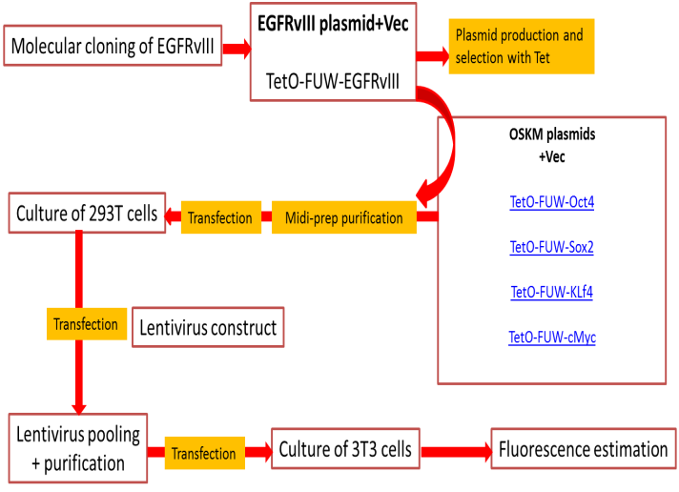
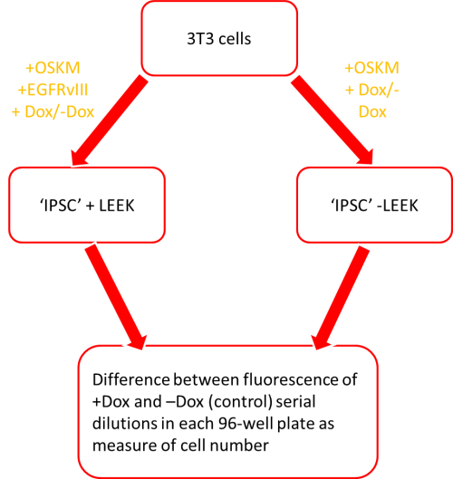
Methods

Slide 9
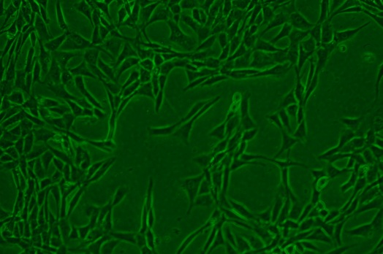
Results

Slide 10
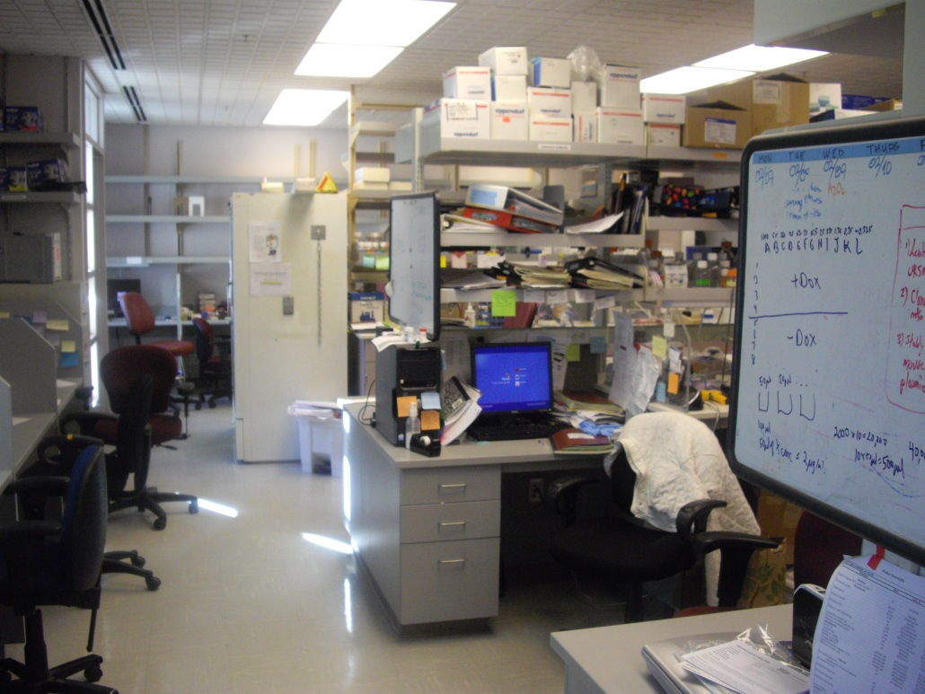
Typical days- Research
7 am- wake up and breakfast.
8 am- morning lab meeting.
8.30- 12.30 pm- lab work.
13.00-15.00 pm- afternoon lab meeting.
15.00- onwards- days finished depending on experiments.

Slide 11
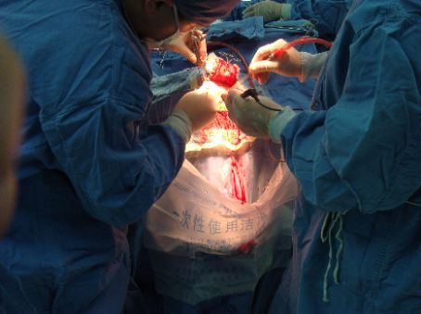
Typical day- Neurosurgery
5.00 am- wake up.
6.00 am- morning
handover/ward round.
7.00 am- Grand round (+breakfast)/neuroradiology teaching.
8.00 am- Theatres.
13.00 pm- ward round.
15.00 pm- Theatres.
20.00 pm- Evening ward round.

Slide 12
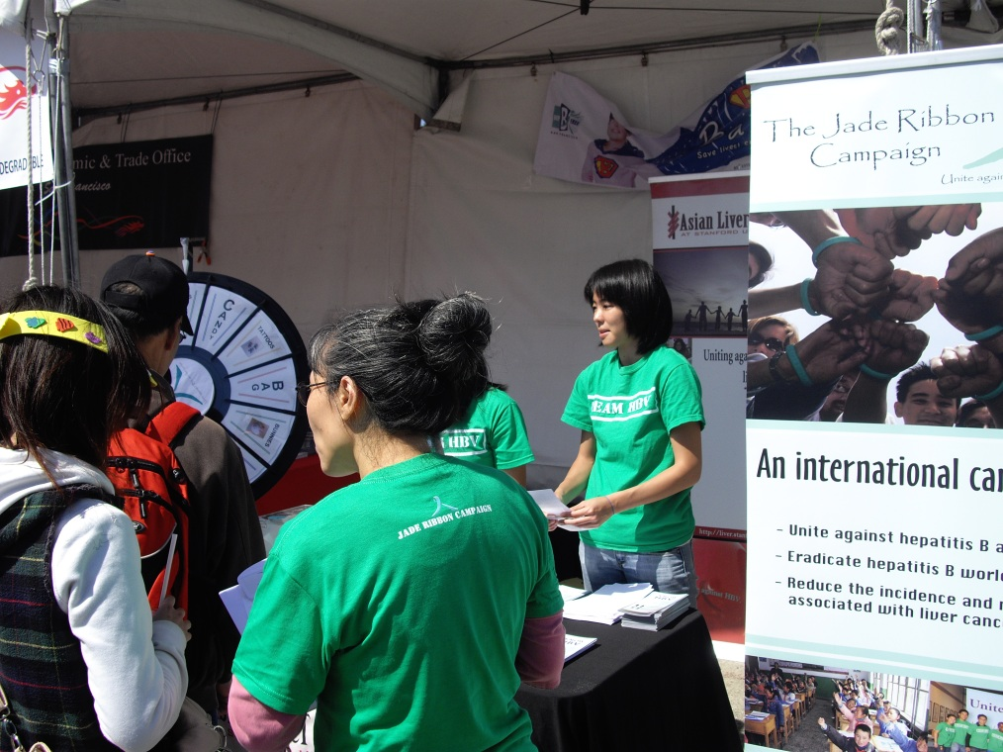
Saturday Stanford Pacific Free clinic
Ophthalmology and general medicine clinics for patients with inadequate health insurance.
Staffed by medical students and usu. 2 senior residents.
Wide variety of clinical exposure.
Very independent.
Great fun, get involved with the whole USA.
Speaking Spanish is an advantage!
Advocacy work with the Stanford University Asian Liver Center.

Slide 13
Reflections on the US health system
US doctors very positive about the NHS.
Medical students very hardworking and mature.
Research is the norm at large institutions.
Dynamic intellectual atmosphere.
Lots of independent work and motivation.
Wide gulf between rich and poor.

Slide 14
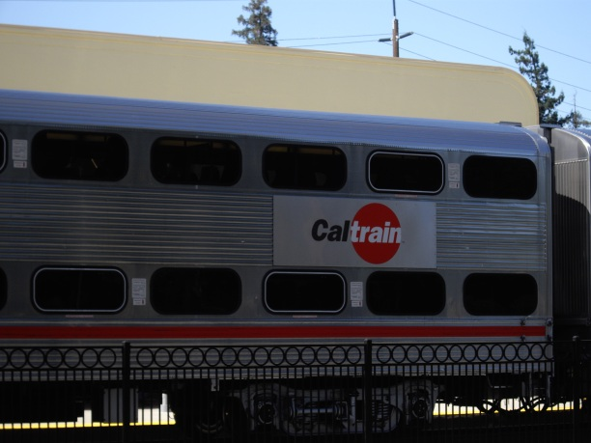
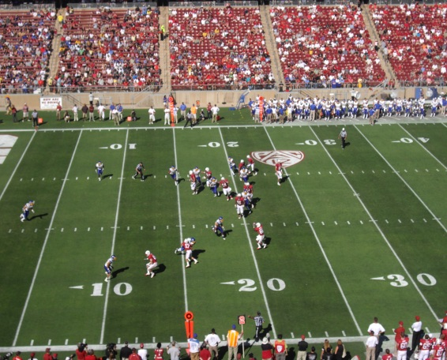
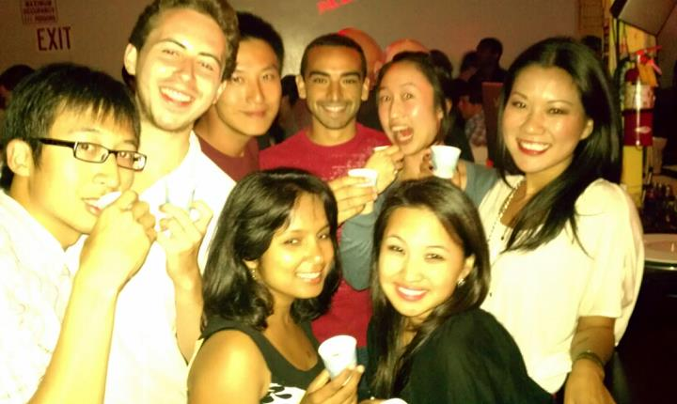
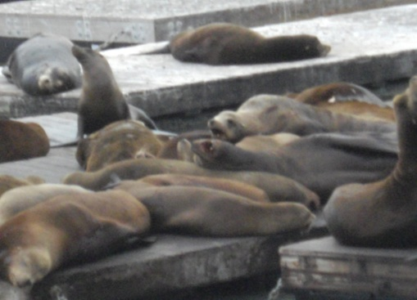
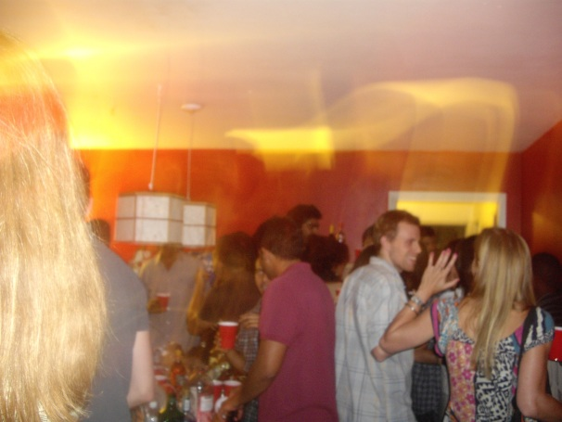
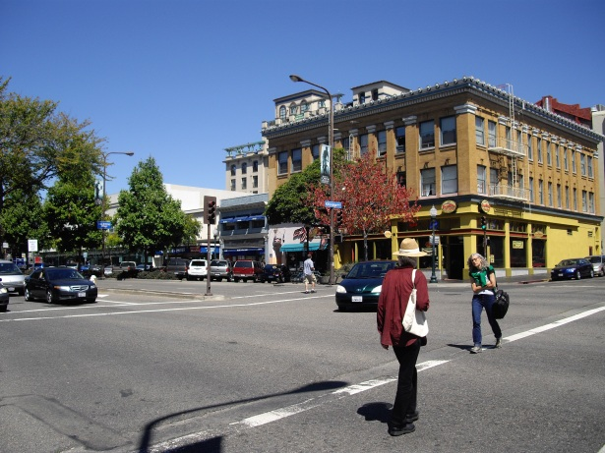
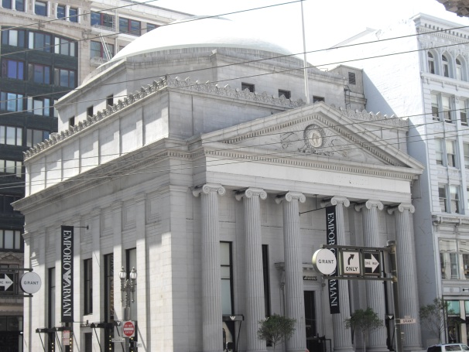
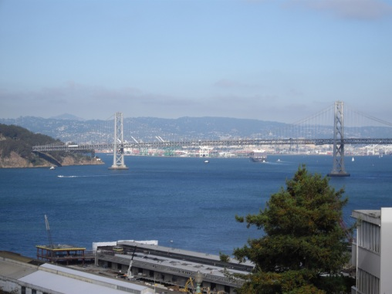
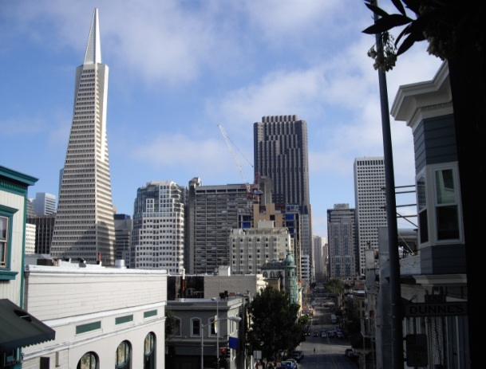
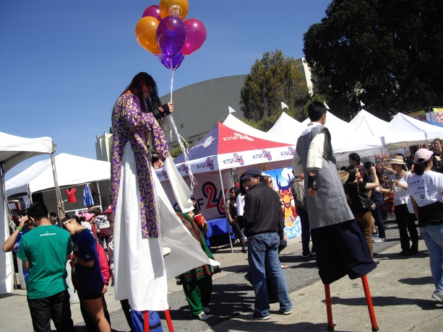
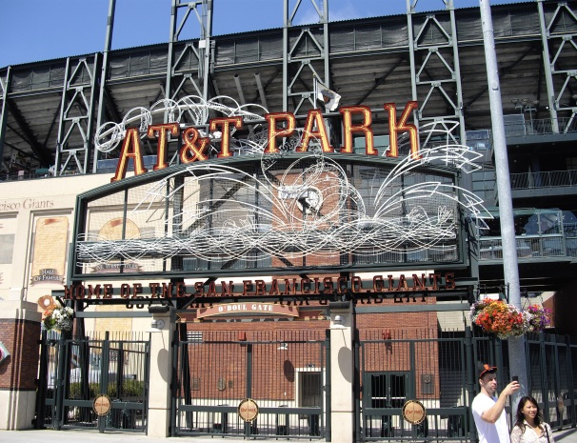
Travelling in California

