Slide 1
Electives Evening
Venezuela
Robert Shaw

Slide 2
What Was An Elective For Me?
Opportunity to get more experience in a specific area of medicine
Opportunity to experience working abroad and in a different medical system
Chance to meet other medical students and doctors and exchange points of view

Slide 3
Thinking About My Elective
Developing Country vs Developed Country
Climate and Disease-burden
City vs Rural
Type of hospital
Private, State-run, University, Charitable

Slide 4
Organising my Elective
Internet search and reading previous Elective Reports at St Mary’s FEO
Contacted the hospital via email and submitted the extensive application form by post
Months of hassling the admin department in Venezuela
Evening Spanish course

Slide 5
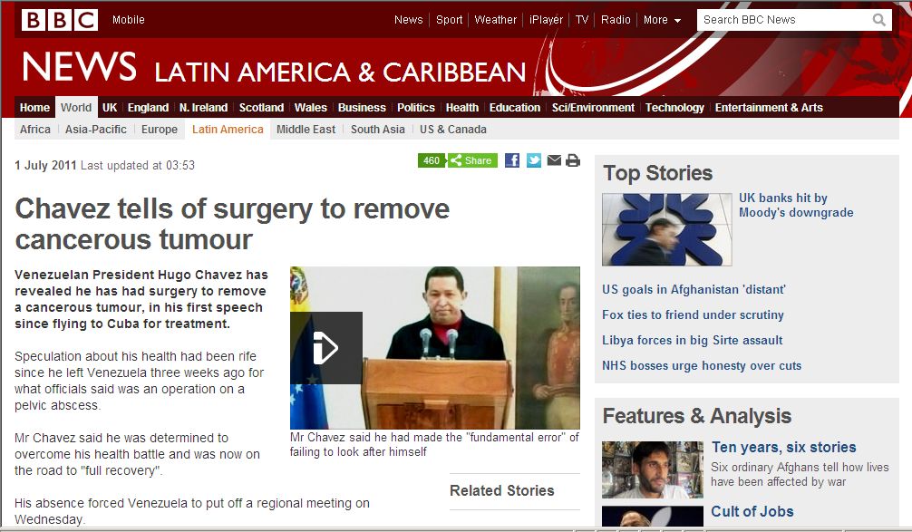
Why Venezuela?
Developing Country with a Tropical Climate
Tropical medicine + Infectious Disease
South America
Like America, but South

Slide 6
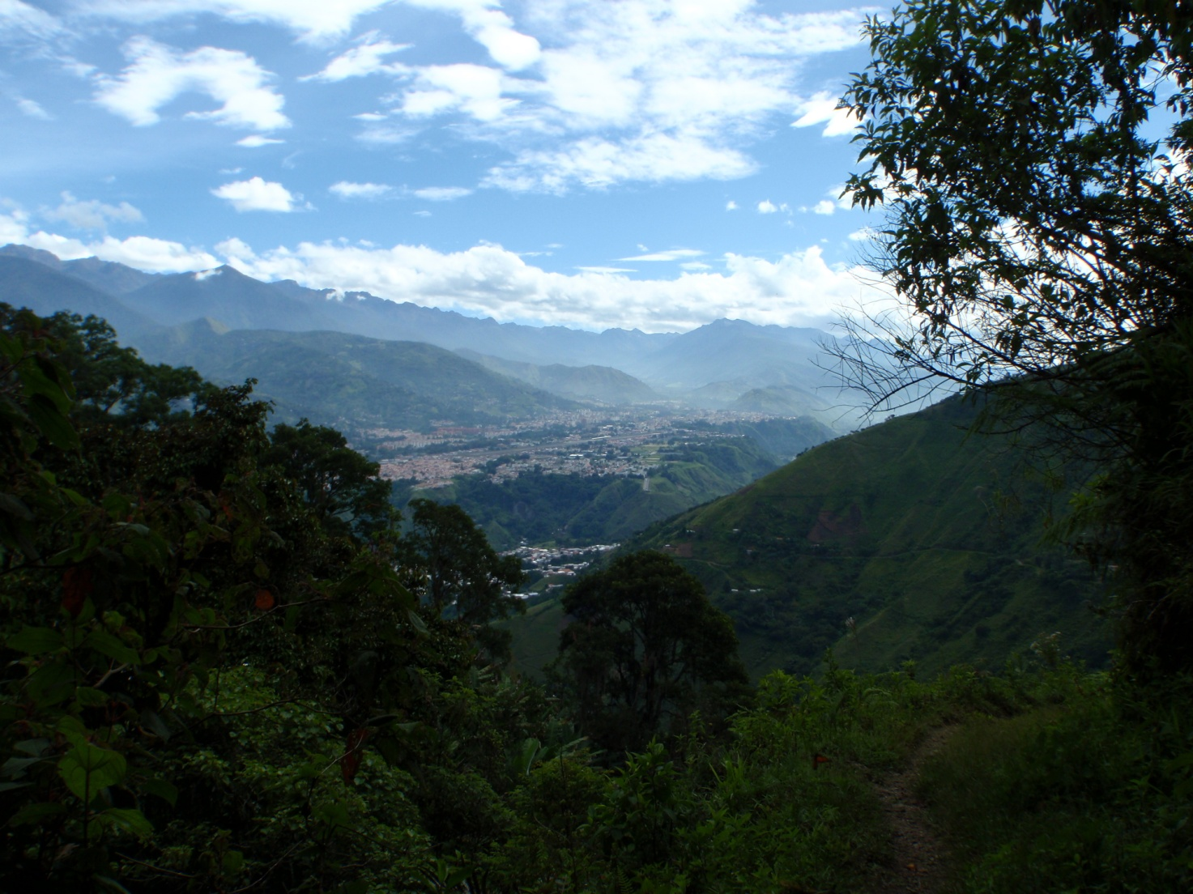
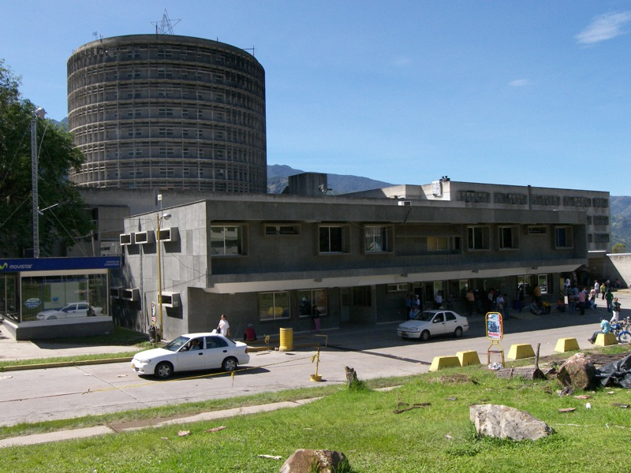
Merida – Instituto Autonomo Hospital Universidad de Los Andes

Slide 7
Elective Plan
7 weeks in hospital with 2 weeks travel
2 weeks Microbiology
2 weeks Adult Emergency Medicine
2 weeks Paediatric Emergency Medicine
1 week Obstetric Emergency Medicine
3 weeks Adult Emergency Medicine
1 week Intensive Care
2 weeks Paediatric Inpatients + Emergency Medicine
1 week Rural Hospital

Slide 8
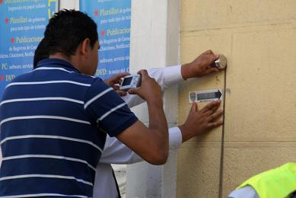
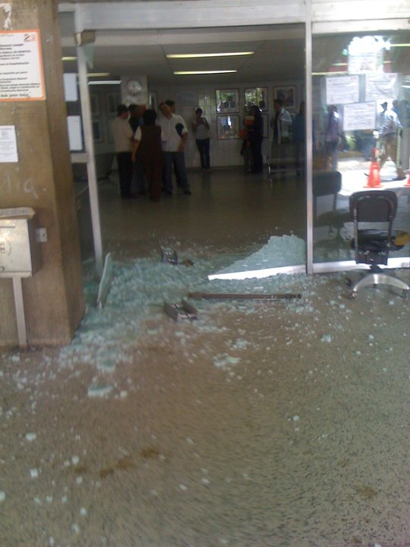
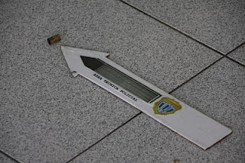
My first day...

Slide 9
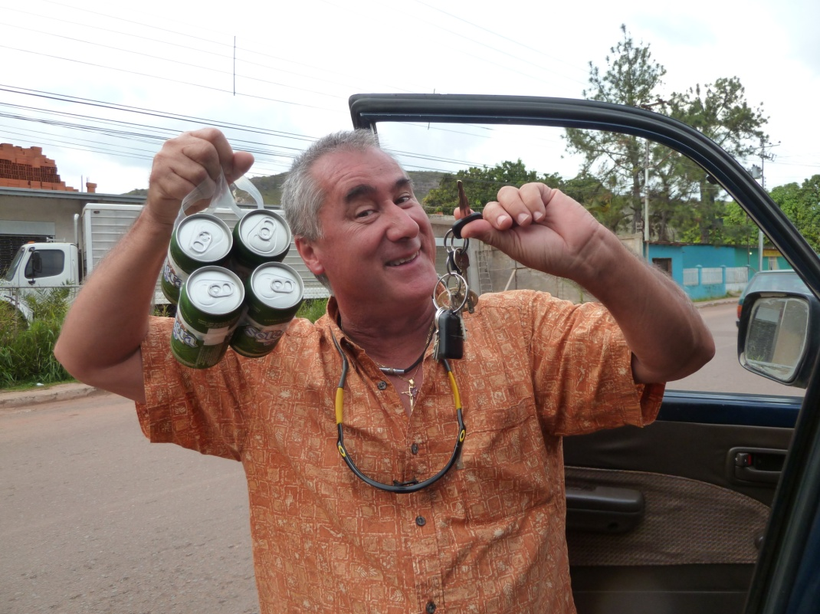
Adult Emergency
Disease burden
RTC
EtOH
CVA
Psychiatric
Clinical skills
History + Examination
Venepuncture
ABGs
Central Lines
Intubation
Suturing

Slide 10
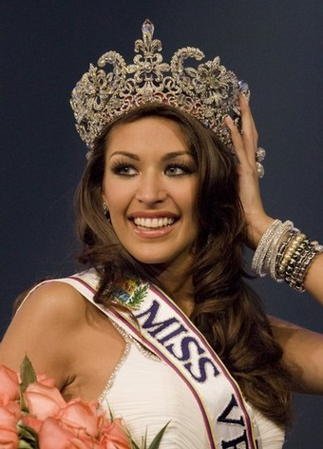
Intensive Care
17 year old girl, ↓GCS, cyanosed, O₂sats 75%
Background: SLE
Biopolymer injection 6/12 ago into breasts and buttocks
Tx: Bilateral mastectomy

Slide 11
Paediatrics
Inpatients
Erlichiosis
Chediak-Higashi
Emergency Medicine
Typical paediatric case-load
Child health
Parasitic infections

Slide 12
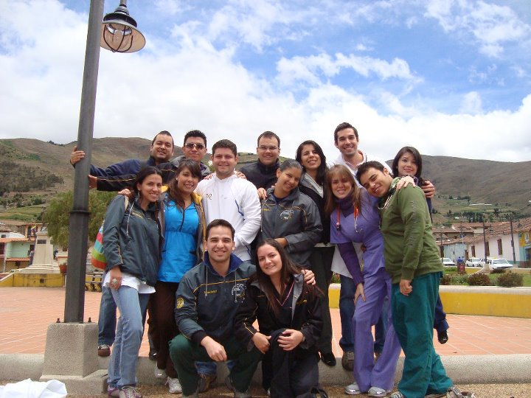
Mucuchies Rural Hospital
GP-type case-load
Students in charge

Slide 13
What have I gained?
Clinical skills
History taking, Examination, Management
Practical procedure experience
ABGs, Suturing, CVPs, Central lines, Intubation
Better understanding of “tropical medicine”
More of an appreciation of the NHS and medical infrastructure
A chance to refresh myself and come back invigorated for final year
2 weeks of beautiful travels

Slide 14
Would I do things differently?

Slide 15
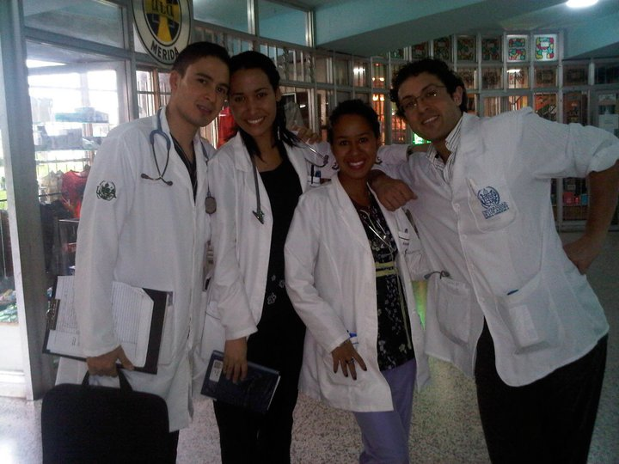

Slide 16
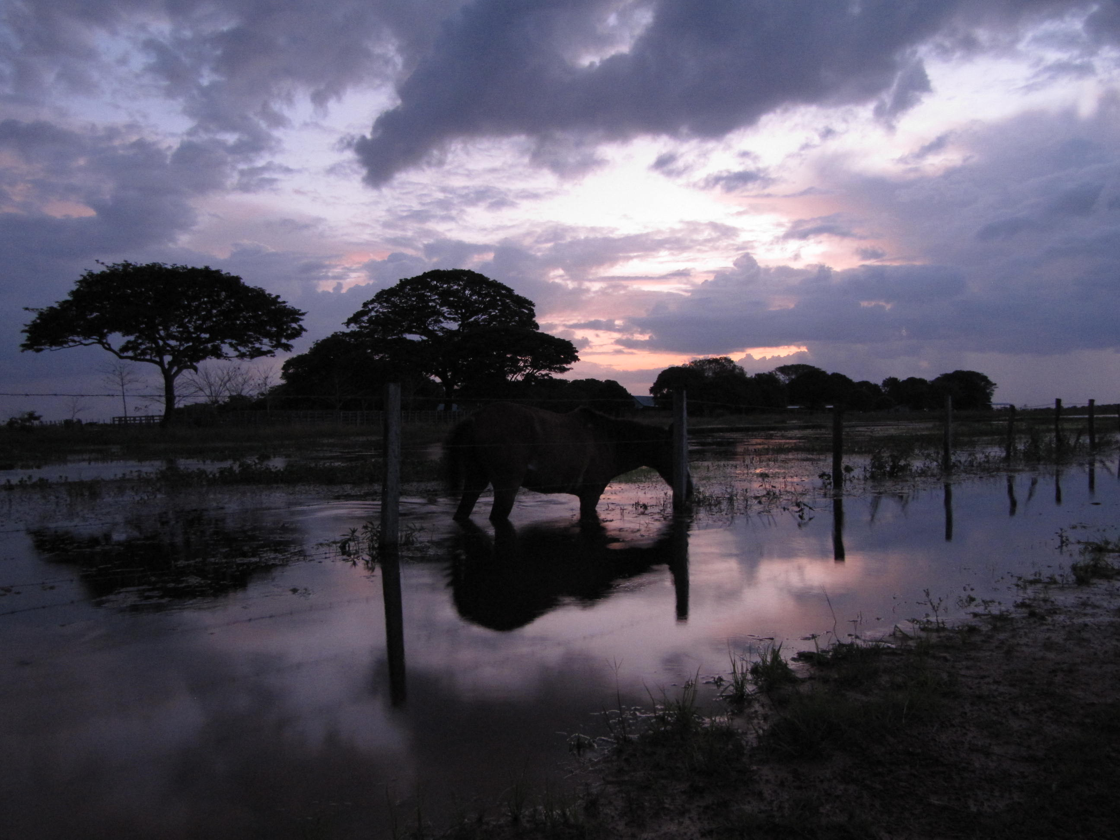

Slide 17
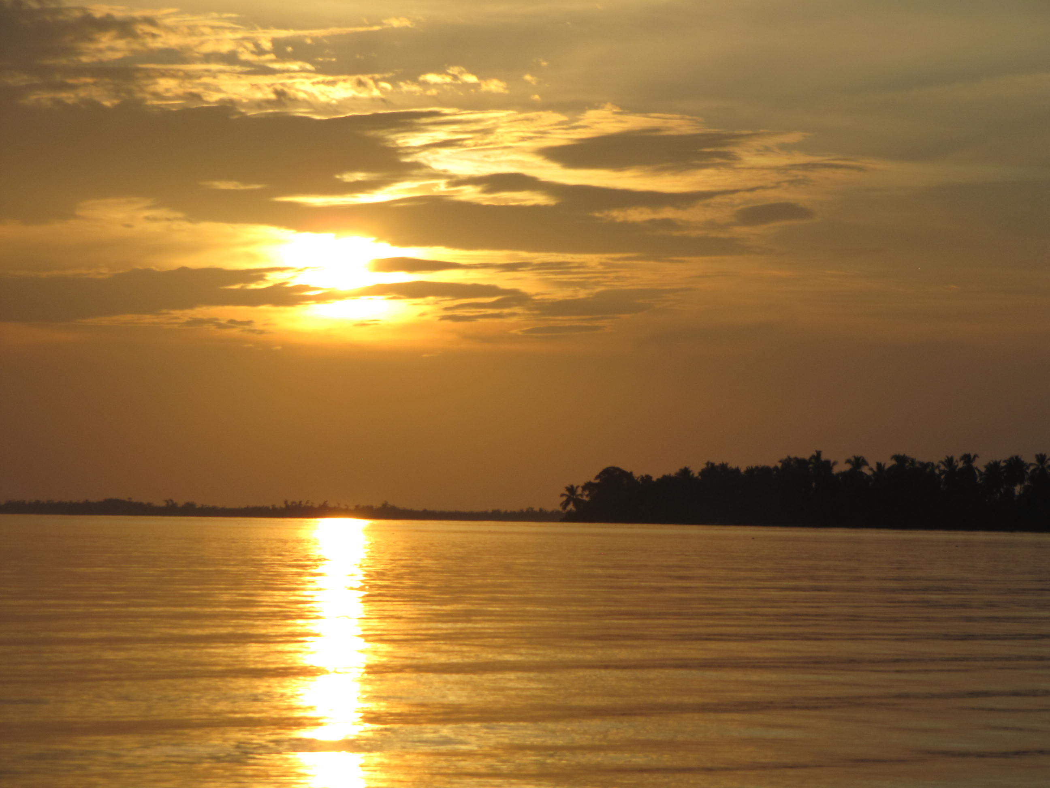

Slide 18
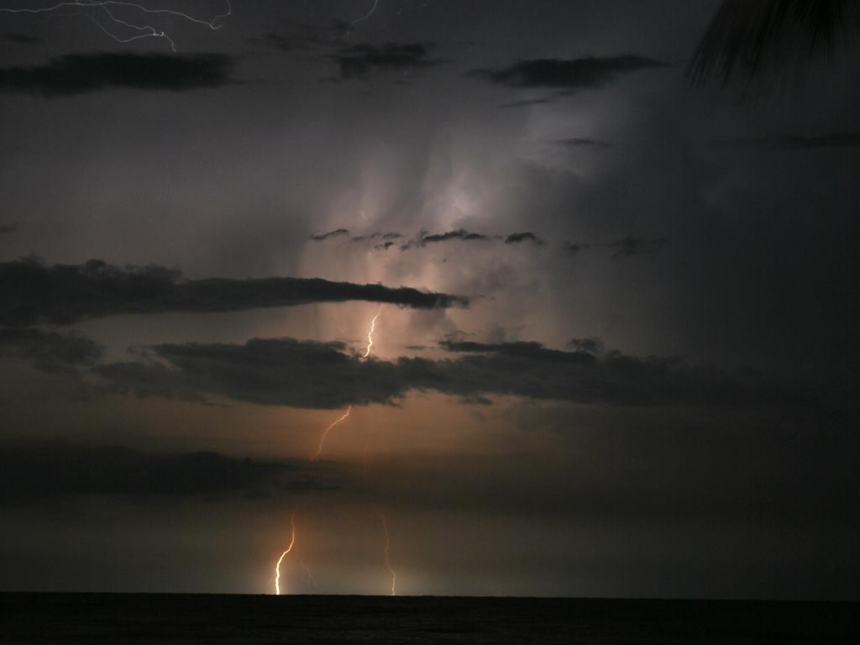

Slide 19
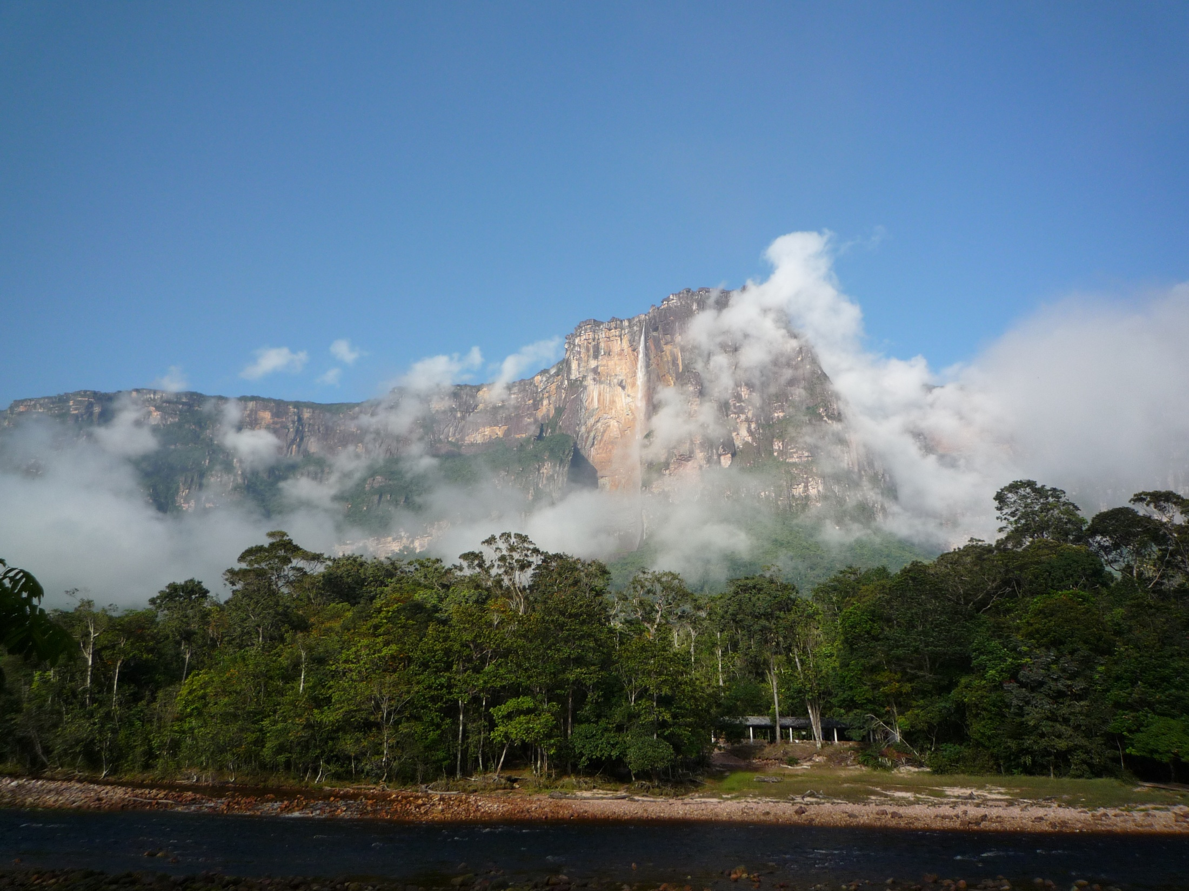

Slide 20
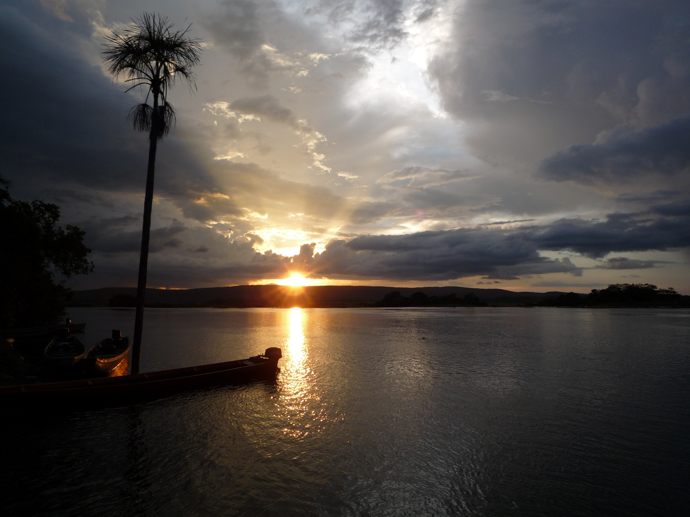

Slide 21
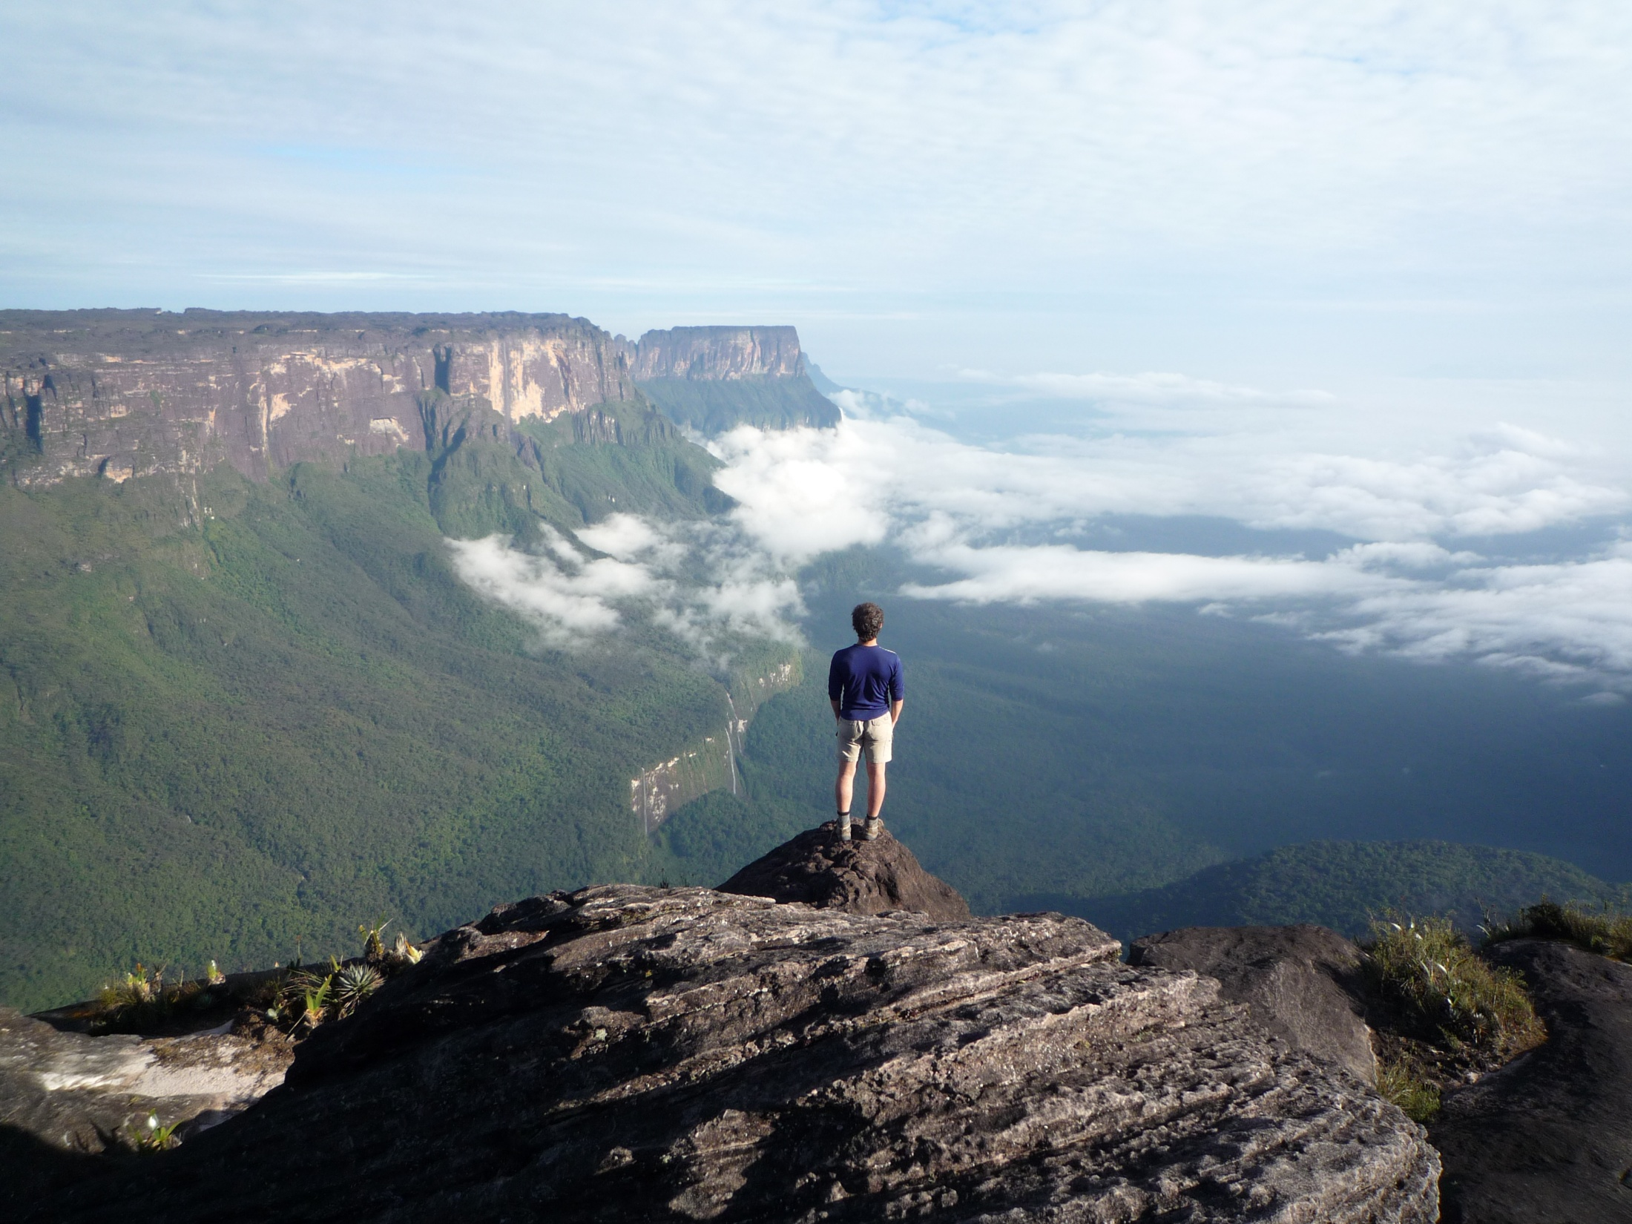
Thank you

