Slide 1
Organising Your Elective
Ola Markiewicz
Final Year Medical Student
March 2012

Slide 2
Content
What is elective?
What to do and where to go?
Getting started
Money
Problems
Before you go
Tips
Questions

Slide 3
What is elective?
Different healthcare systems
Working and living abroad
Helping in a developing country
Furthering skills and interests in research or particular speciality
How does culture affect healthcare?

Slide 4
Imagine....
Notes:
This is what you will be like until very soon before your elective

Slide 5
What to do and where to go?
Important questions:
How much money have you got?
Do you know what you want to do as a career?
Who do you want to go with?
Are you an experienced traveller?
You must know the answer to these questions inside out!
Reflect and re-evaluate your ideas, concerns and expectations!

Slide 6
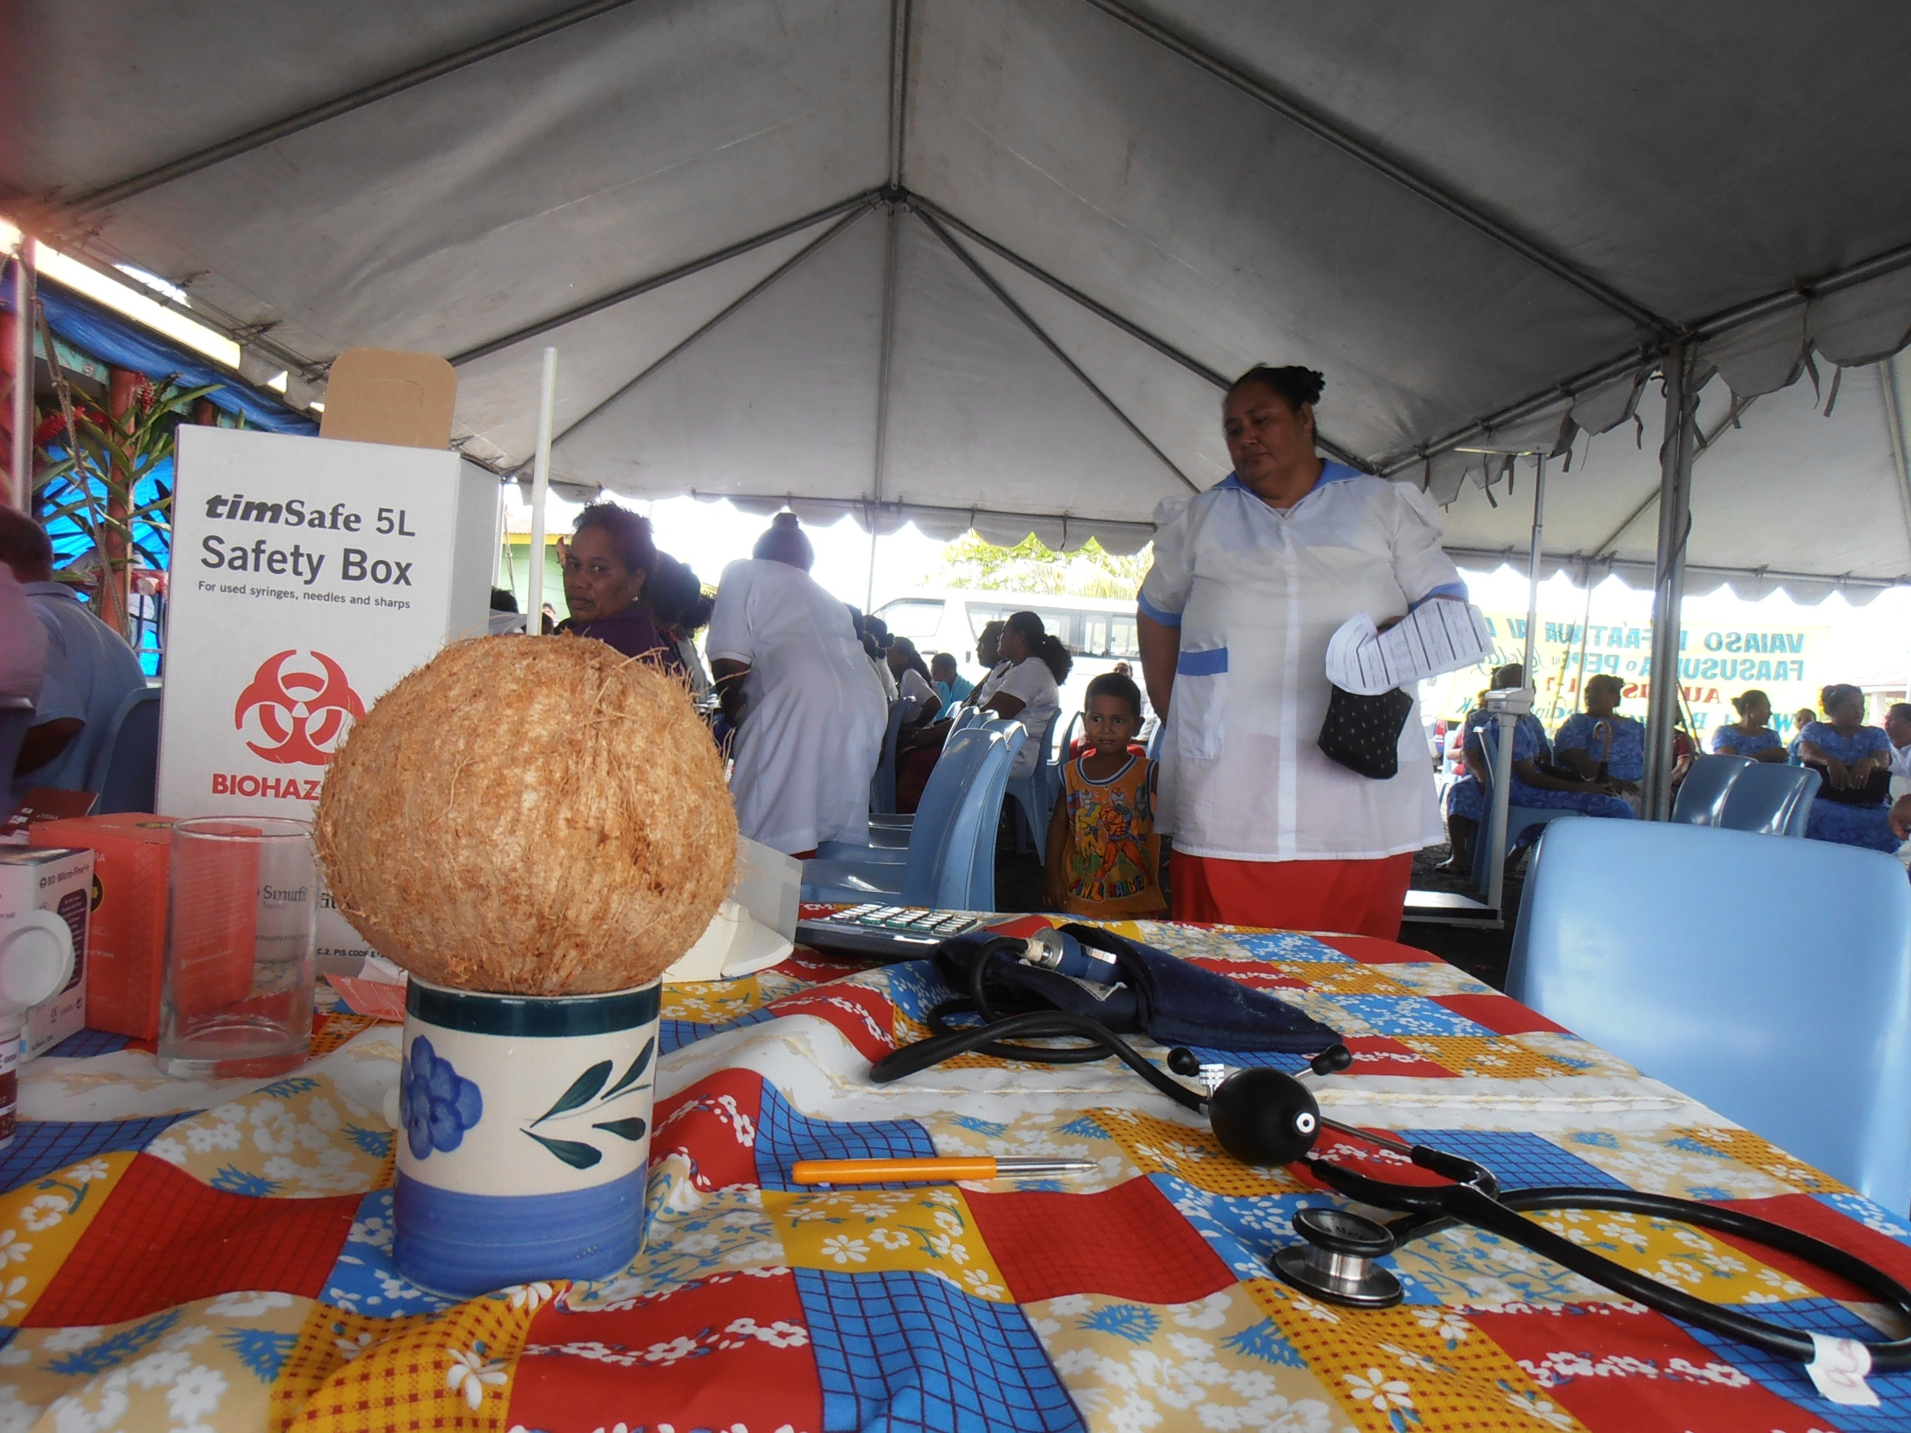
The Medical Bit
Opportunity to find out more and gain experience in fields of interest
Hone your clinical skills
Do more of something you didn’t get much of at medical school
Get experience in your future career
Make a difference

Slide 7
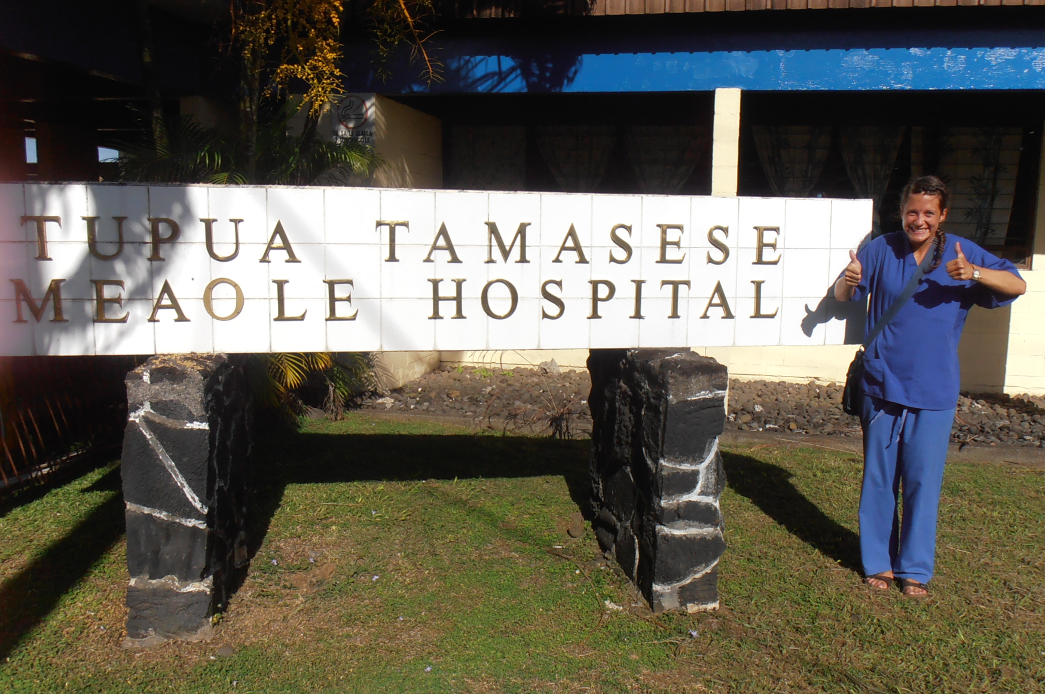
The Hospital Bit
What sort of healthcare system is it?
What are the main disease burdens?
Will there be other medical students?
Imperial
Elective
Home
How much is the elective fee?

Slide 8
The Practical Bit
Time of year and climate
Language
How to get there
Is it safe?
Political
Biological
Social
Will you enjoy being there?
Where will you stay?
Hotel
Hostel
Family (your own or a host family)
Hospital accommodation
Halls
Notes:
How to get there – expensive, far, how many flights (challenge for me to get to samoa + fear of flying!)
I’d been to india the year before for 1 month and loved it while travelling but I was knackered by the end, and couldnt imagine doing it for over 2 months and be expected to go into hospital, be honest with yourself!

Slide 9
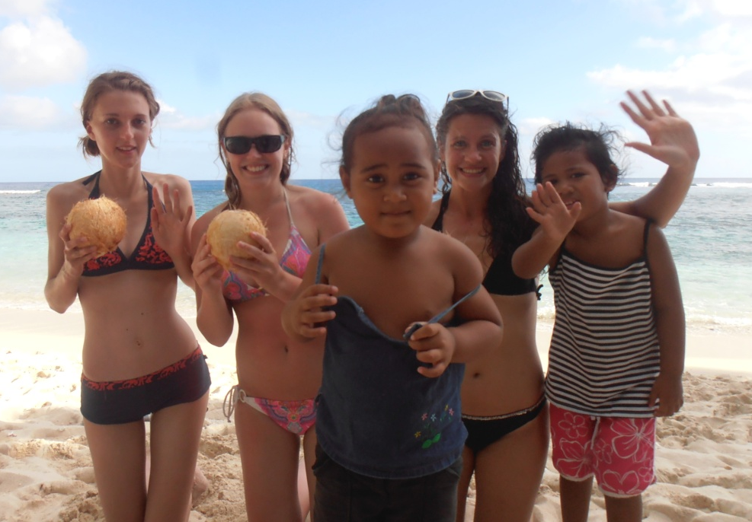
The FUN Bit!
What part of the world do you want to visit?
Where do you want to travel?
Accommodation?
Who do you want to go with?
A friend
Lots of friends
Alone

Slide 10
Getting started
Start thinking about these questions
Visit the intranet
Elective reports
Google “Medical Electives”
Speak to people

Slide 12
Budget
Need to know how much you want to spend
Do not underestimate how much living in a developing country may cost
Travel to and from the country
Accommodation
Trips
Visas
Insurance
Petrol + licence for rented vehicles
Toiletries

Slide 13
Money
Professional loans (do banks still do them?)
Student loan (yours will be less!)
ICSMSU & ICSM Alumni Association Elective Awards
Elective grants
Royal Society of Medicine
Check the intranet!
Some tips:
Start putting some money aside now!
Buy things in bits and bobs so you don’t have to do it all in one chunk at the end
Google and make a note of all the deadlines for applying for grants

Slide 14
Problems
‘My elective has fallen through’
Be flexible! Might have been the best thing that ever happened to you!
Don’t panic – it happens and there are plenty of opportunities you can take up at surprisingly short notice
Avoid this as best as you can by PLANNING EARLY and at least THINKING about a plan B
‘I get to my elective and its not what I expected’
Again – be flexible
Make the most of opportunities available to you, if you can’t beat them join them
‘I can’t go abroad’
Plenty of fantastic opportunities in the UK!

Slide 15
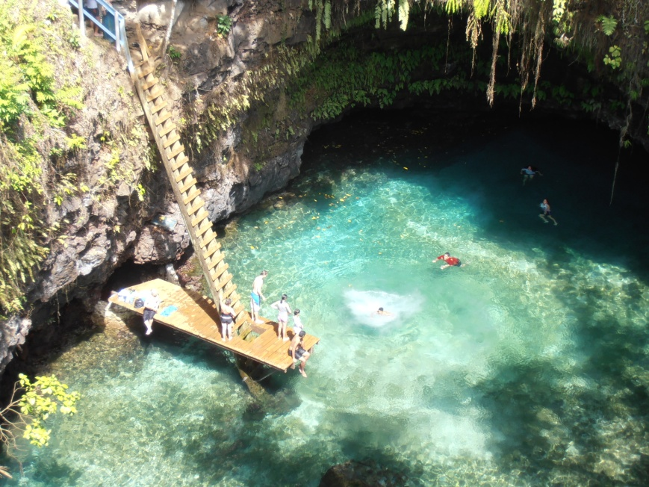
Before you go
Photocopy documents and send to family members and yourself
Give people your itinerary
Check your itinerary
Vaccinations!
Travel insurance
Read IC’s insurance policy

Slide 16
Tips
Make a timeline of all the things you need to do for your elective – it will give you something to get excited about!
Have a separate bank account for savings – 2 accounts is useful when you’re away anyway
Plan early – you do not want to be sitting in a queue at the embassy waiting for a visa when you should be revising for your finals
Be flexible
Keep a diary – travelling experiences, medical experiences
Write a good report!
Do not ignore Wendy’s emails – they are important
Read the occupational health forms carefully

Slide 17
Any questions?

