Slide 1
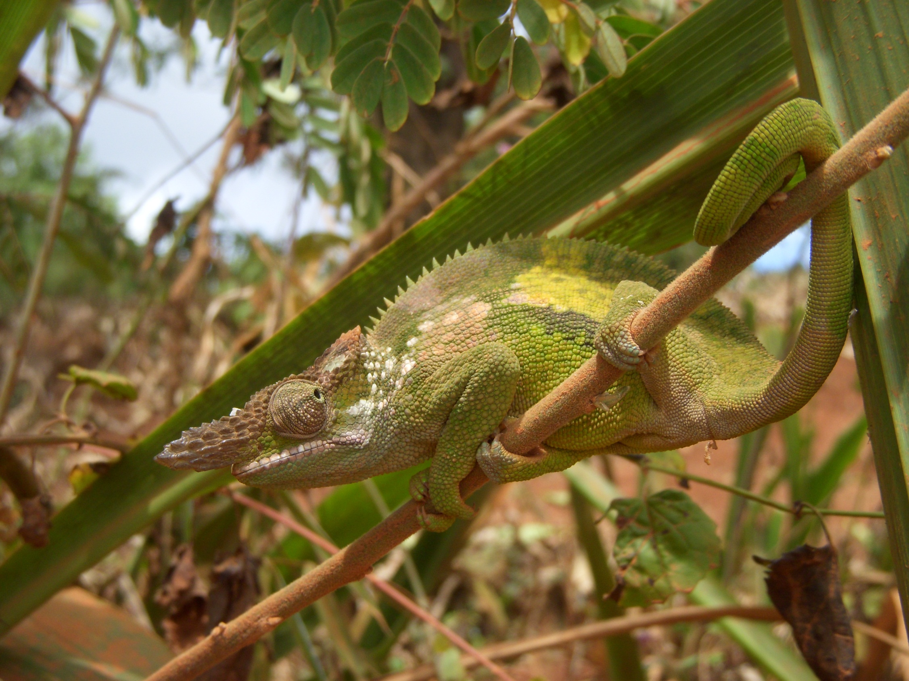
Tanzania Natasha Newlands
Notes:
Introduction
Content
Evidence of clinical experience and value gained
Style of delivery, including clarity and use of illustrations/photos
Pace
Timekeeping – this is particularly important as you will lose marks by going overtime!

Slide 2
What I’m going to cover
Why choose Tanzania?
The Hospital and Outreach clinics
One day in Internal Medicine
Some Cases
Facilities in Moshi
What else is there to do in Tanzania?
Elective tips

Slide 3
Why did I choose Tanzania?
Interest
Life in the third world
Examine patients with signs
Tropical diseases
Different culture
Practical
Medical teams speak in English
Quite Safe

Slide 4
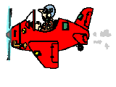
The beginning…

Slide 5
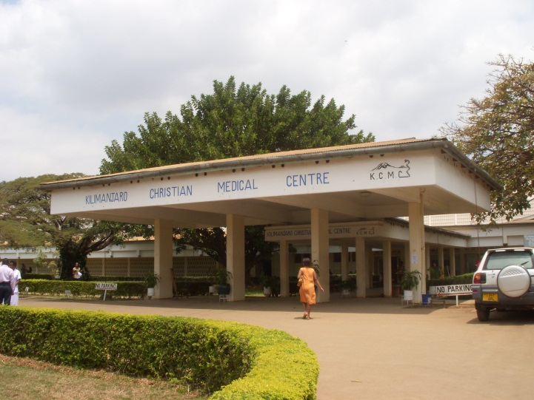
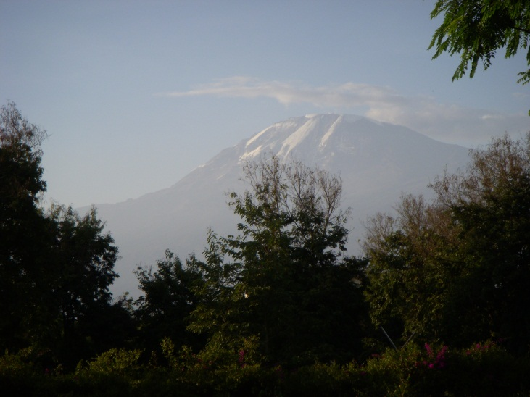
Kilimanjaro Christian Medical Centre
Large government hospital
In the foothills of Mt. Kilimanjaro

Slide 6
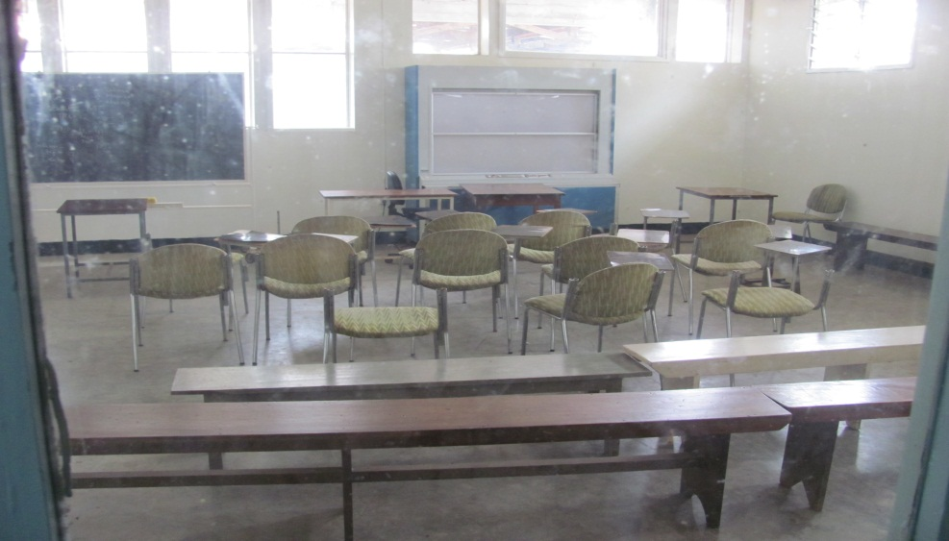
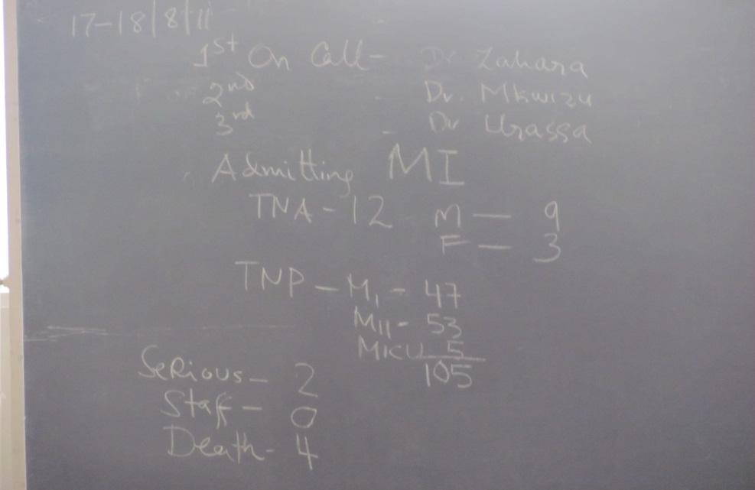
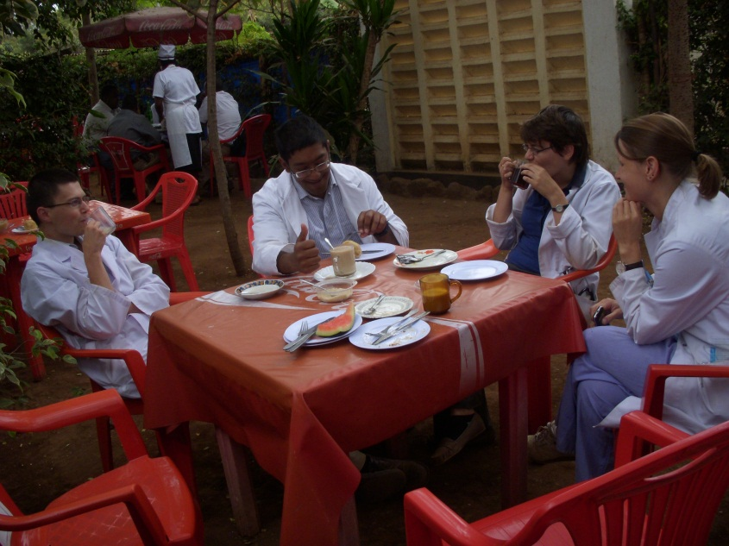
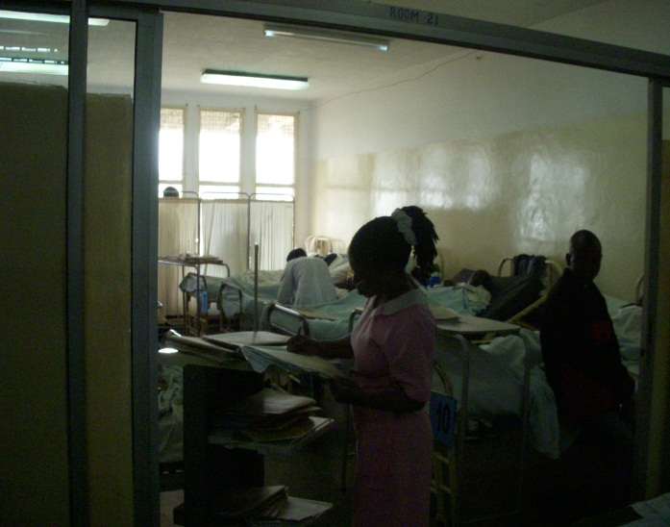
Internal Medicine
Morning Report
Breakfast
Ward round

Slide 7
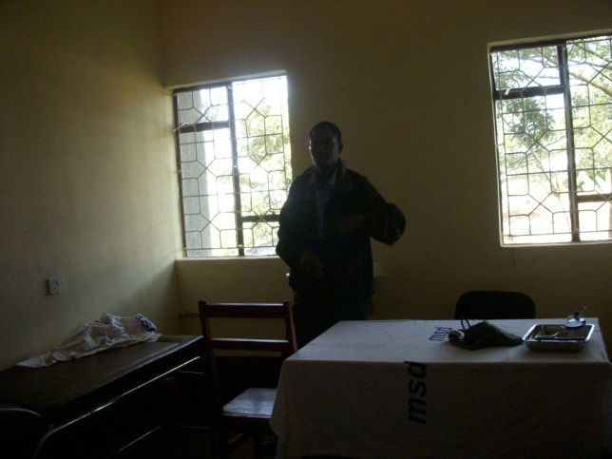
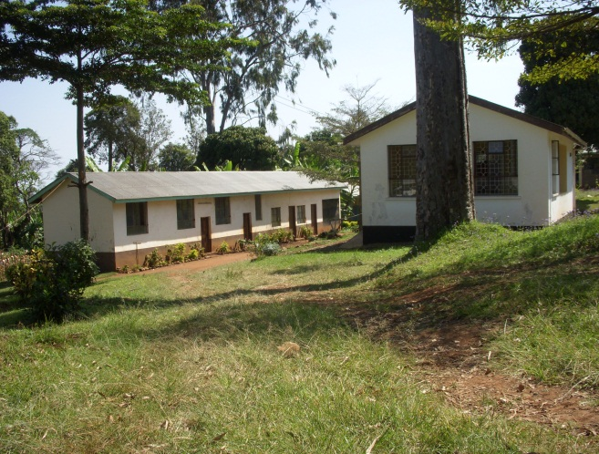
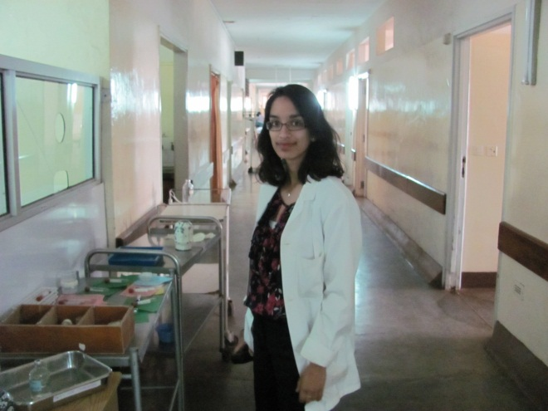
Outreach placements
Poverty- 60% of the population live on less than $2 a day.
Poor transport links
Solution: Take medical teams out in to the community

Slide 8
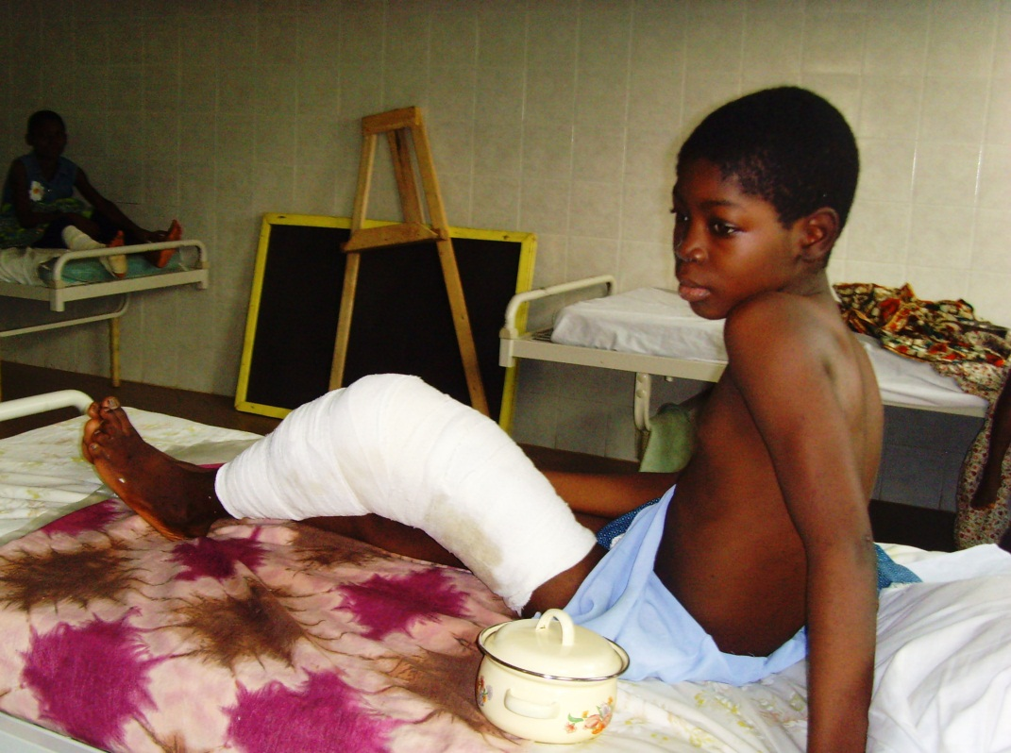
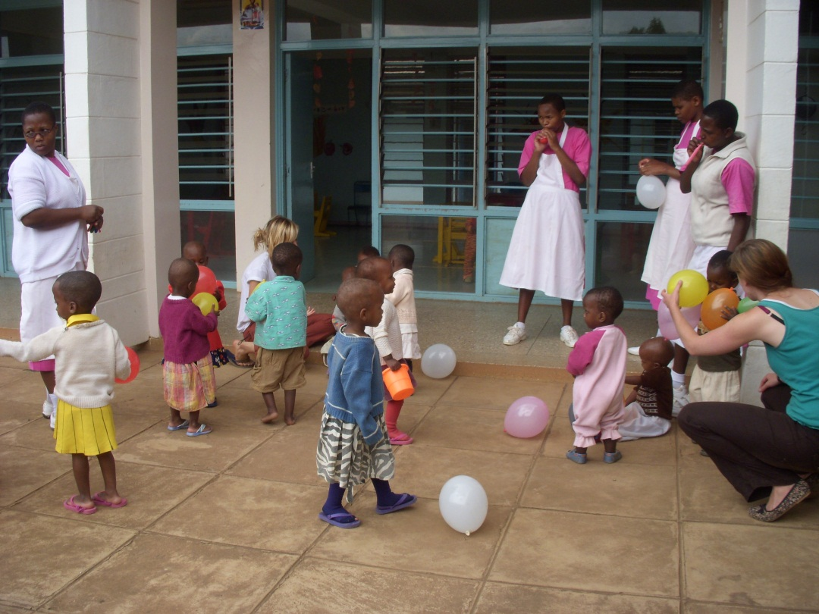
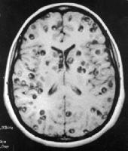
Communicable Disease
HIV/AIDS
Vertical Transmission
Immune Reconstitution Inflammatory Syndrome (IRIS)
Orphanages
Neurocysticercosis
Hydatid disease

Slide 9
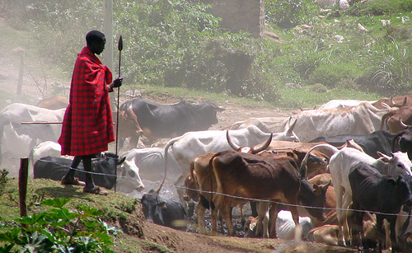
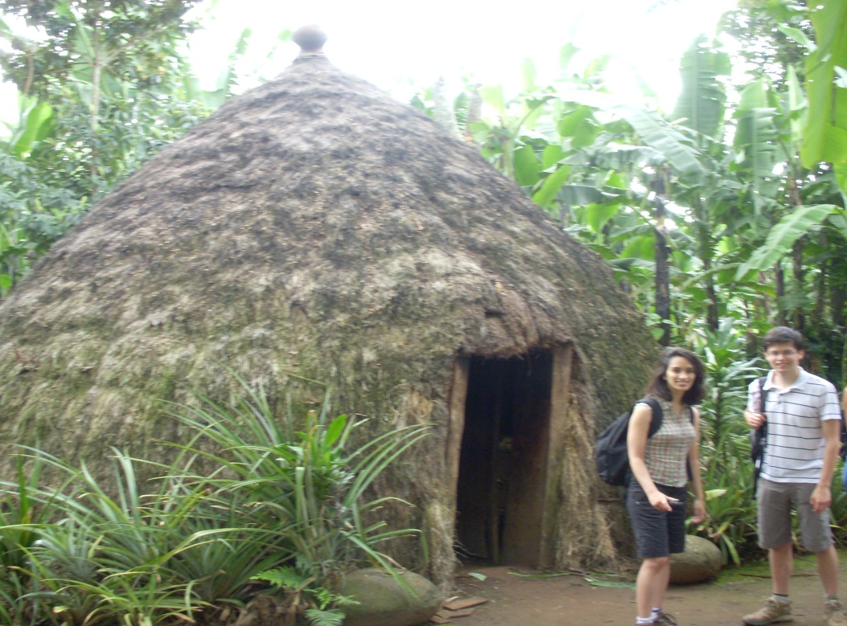
Masai Herdsman
Chagga Village

Slide 10
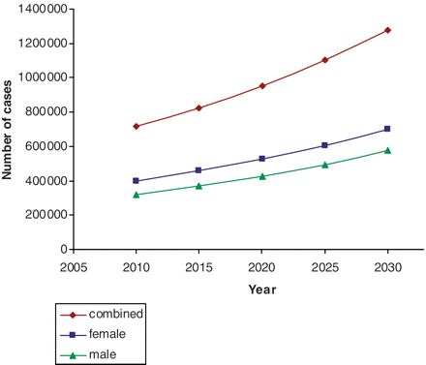
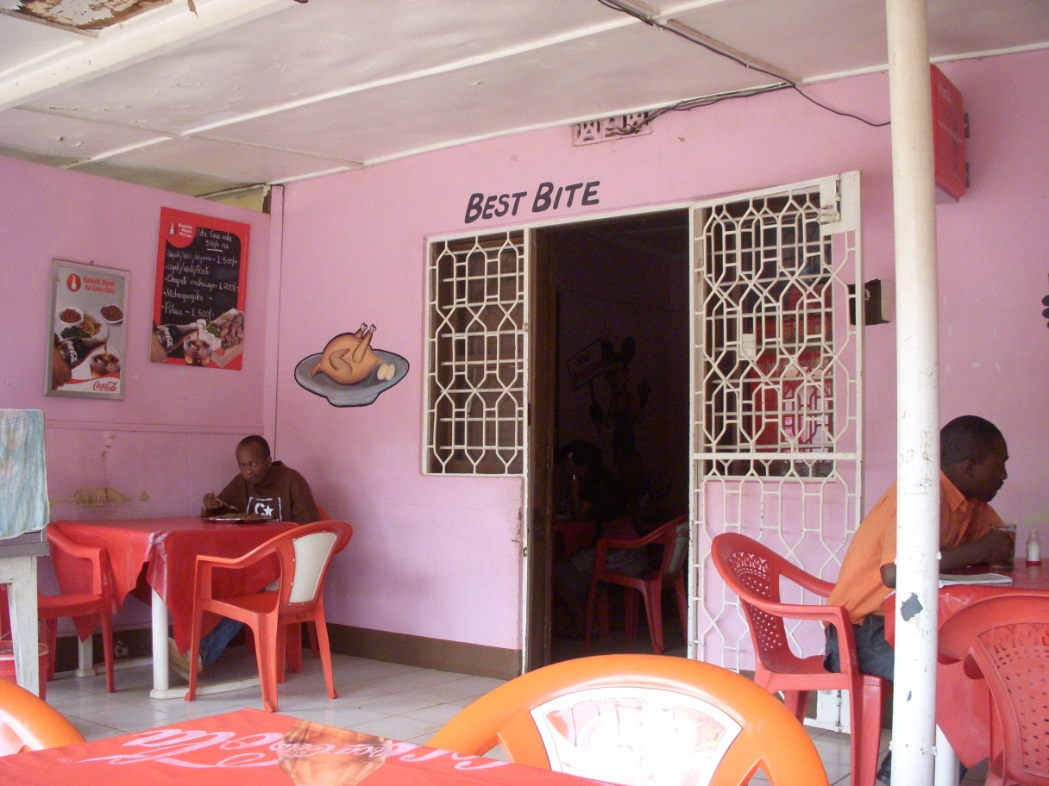
Non-Communicable Disease
Cardiovascular Disease
Stroke
Hypertension
Diabetes
Cancer

Slide 11
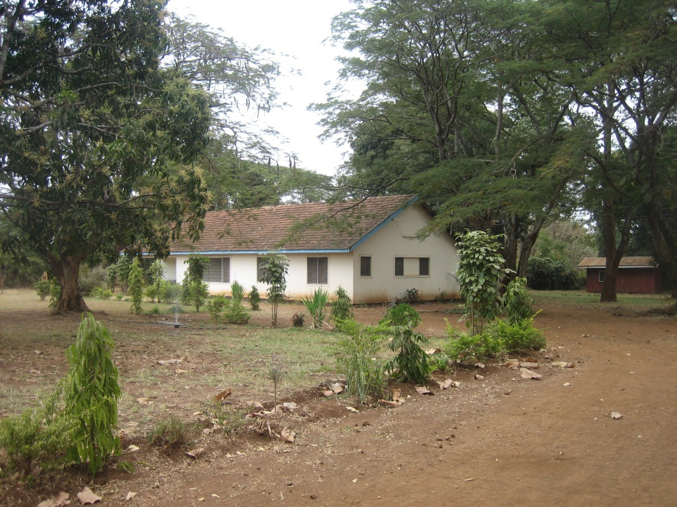
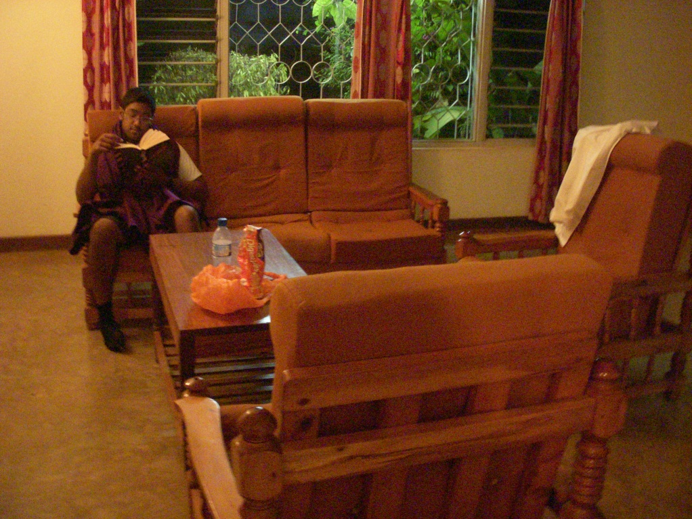
Accommodation and Moshi Town
House on the Doctors’ Compound
Lounge when the power was on!

Slide 12
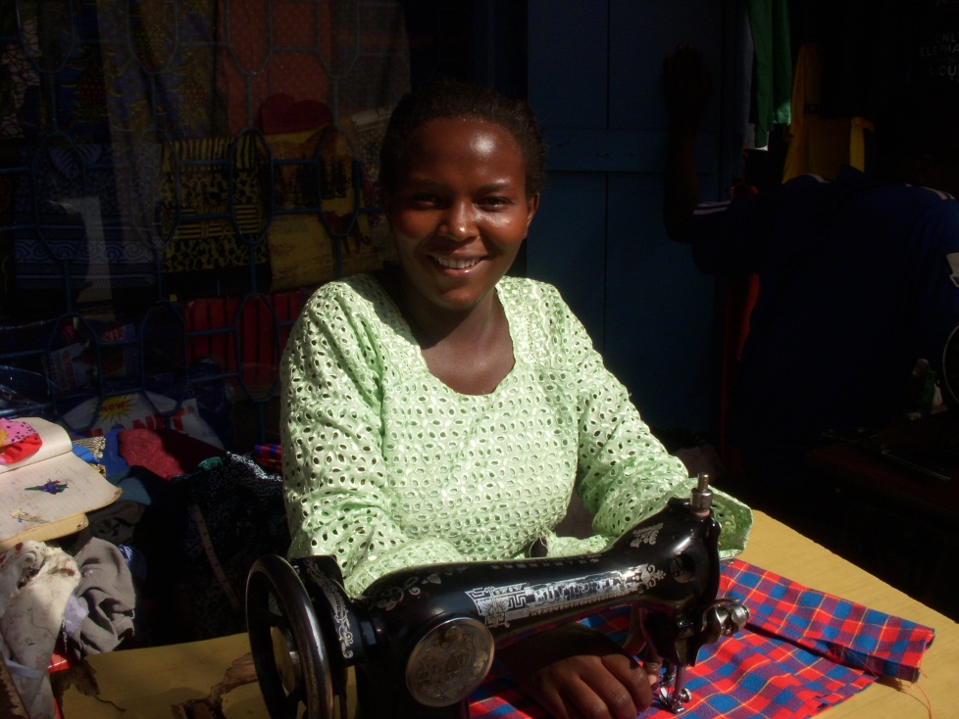
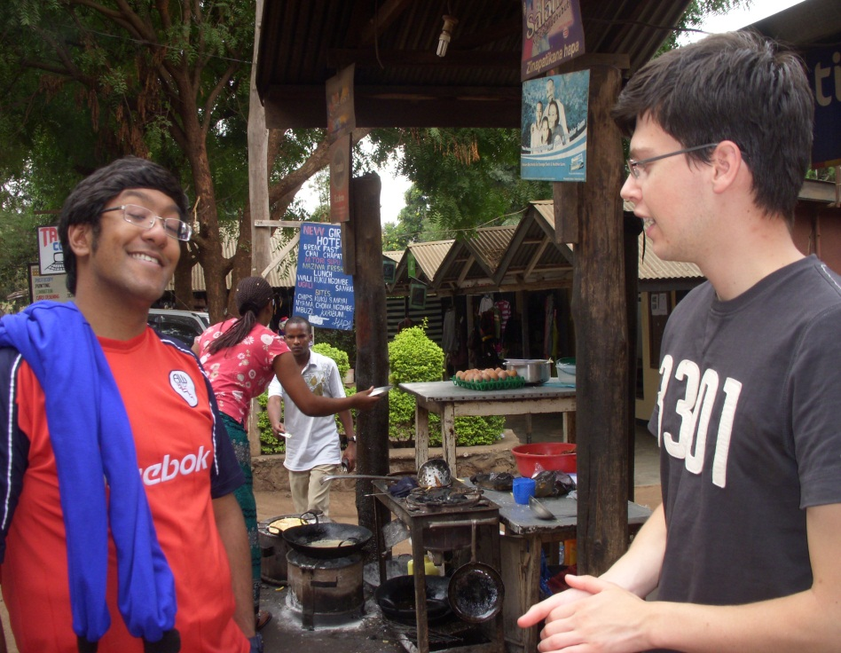
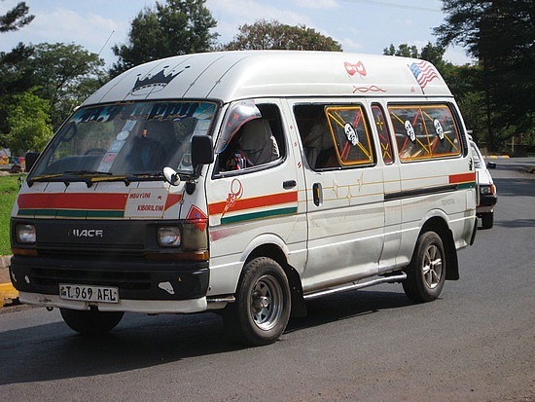
Accommodation and Moshi Town
Tailor made clothes
Chip omelette

Slide 13
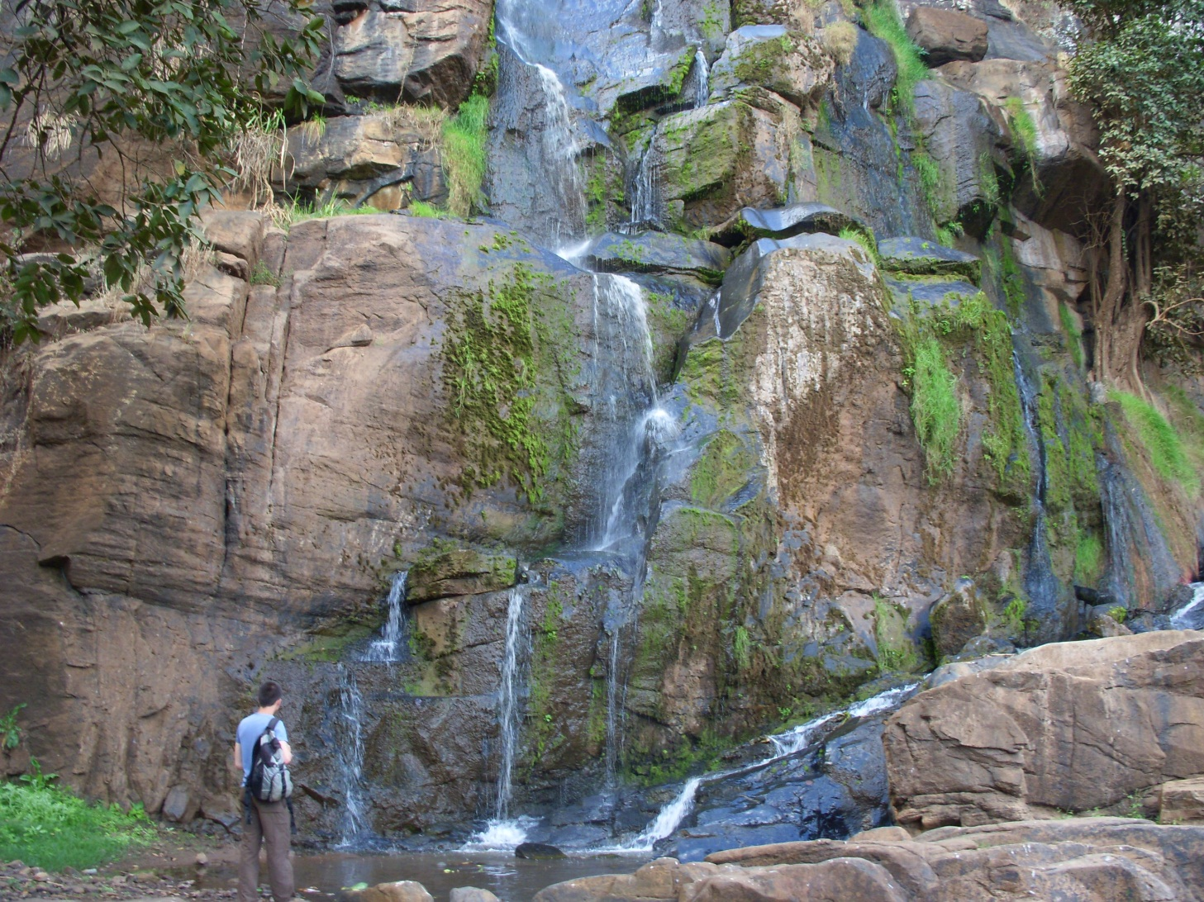
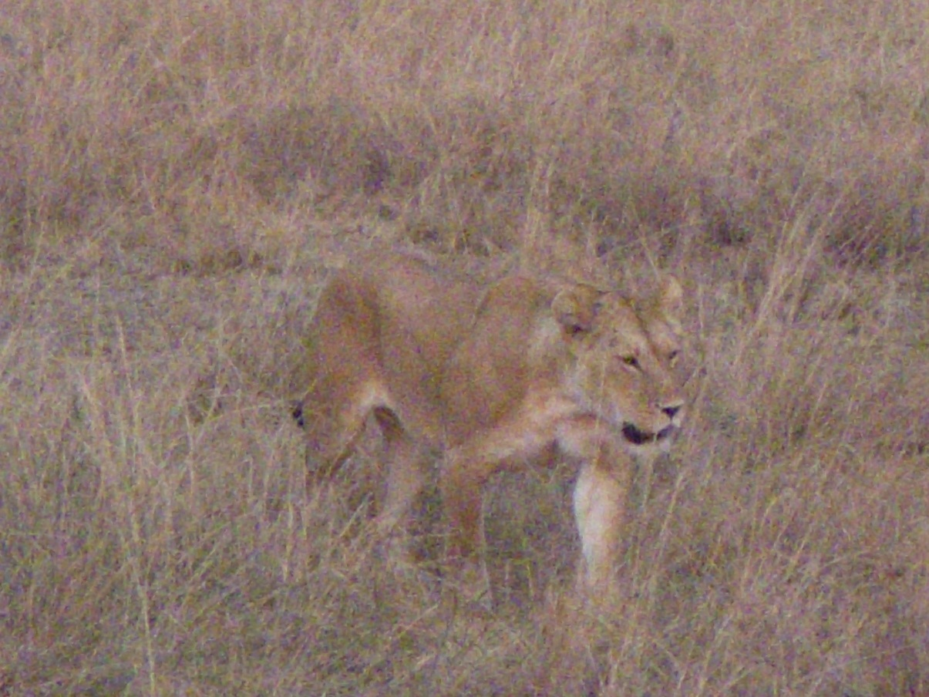
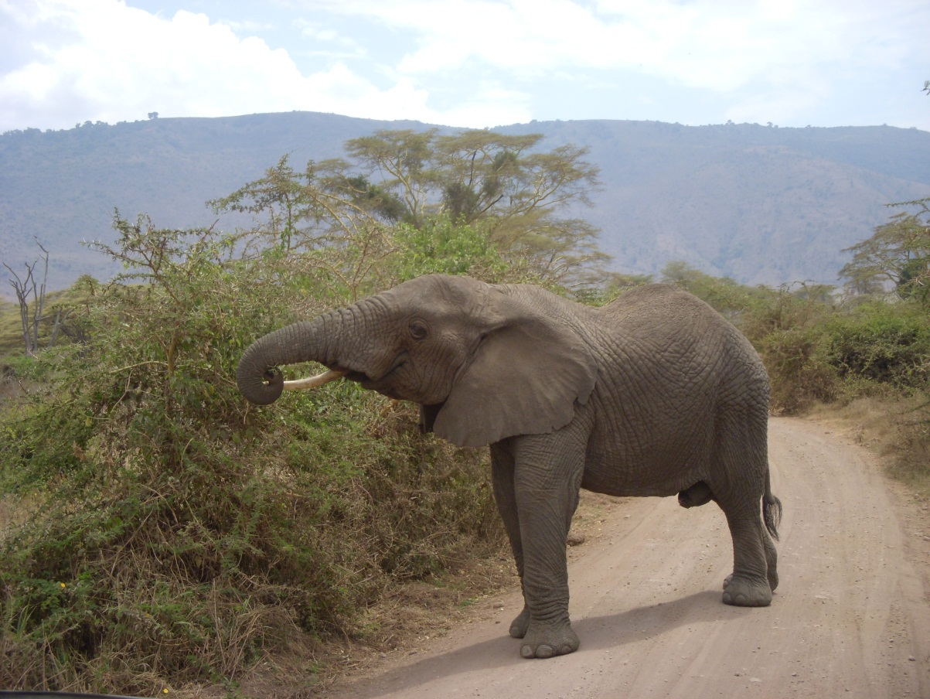
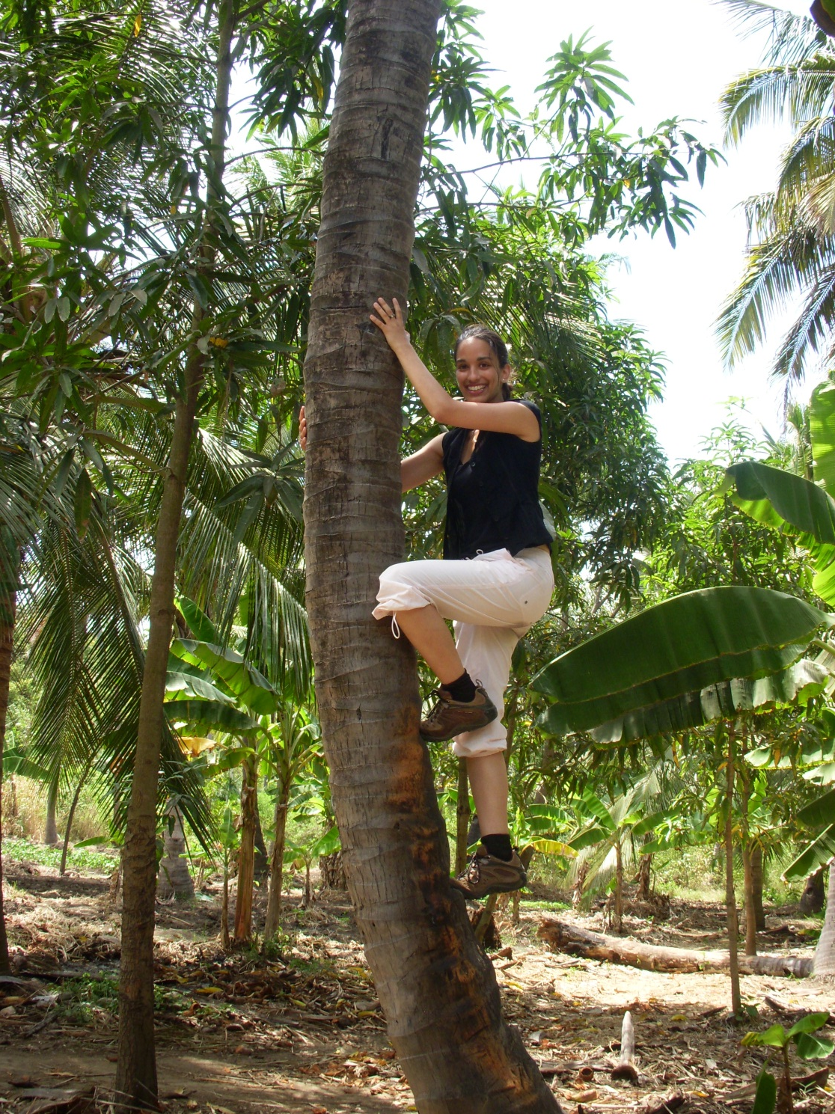
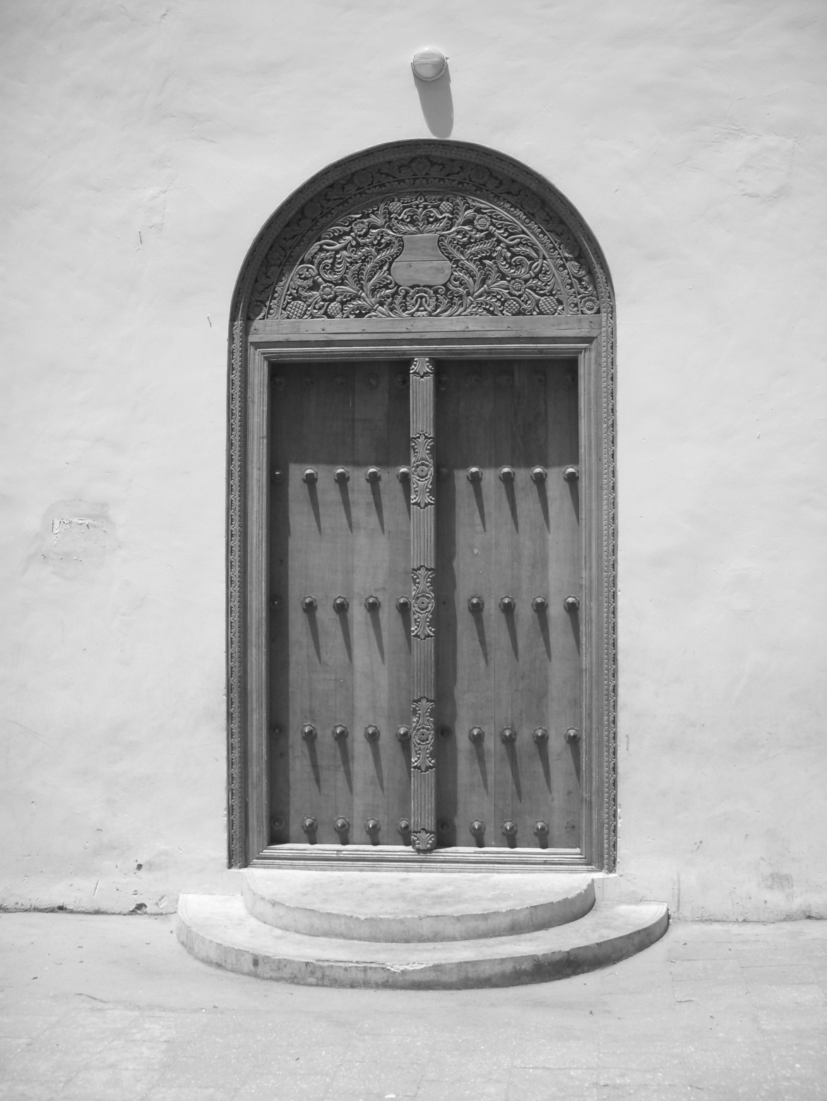
Fun things!

Slide 14
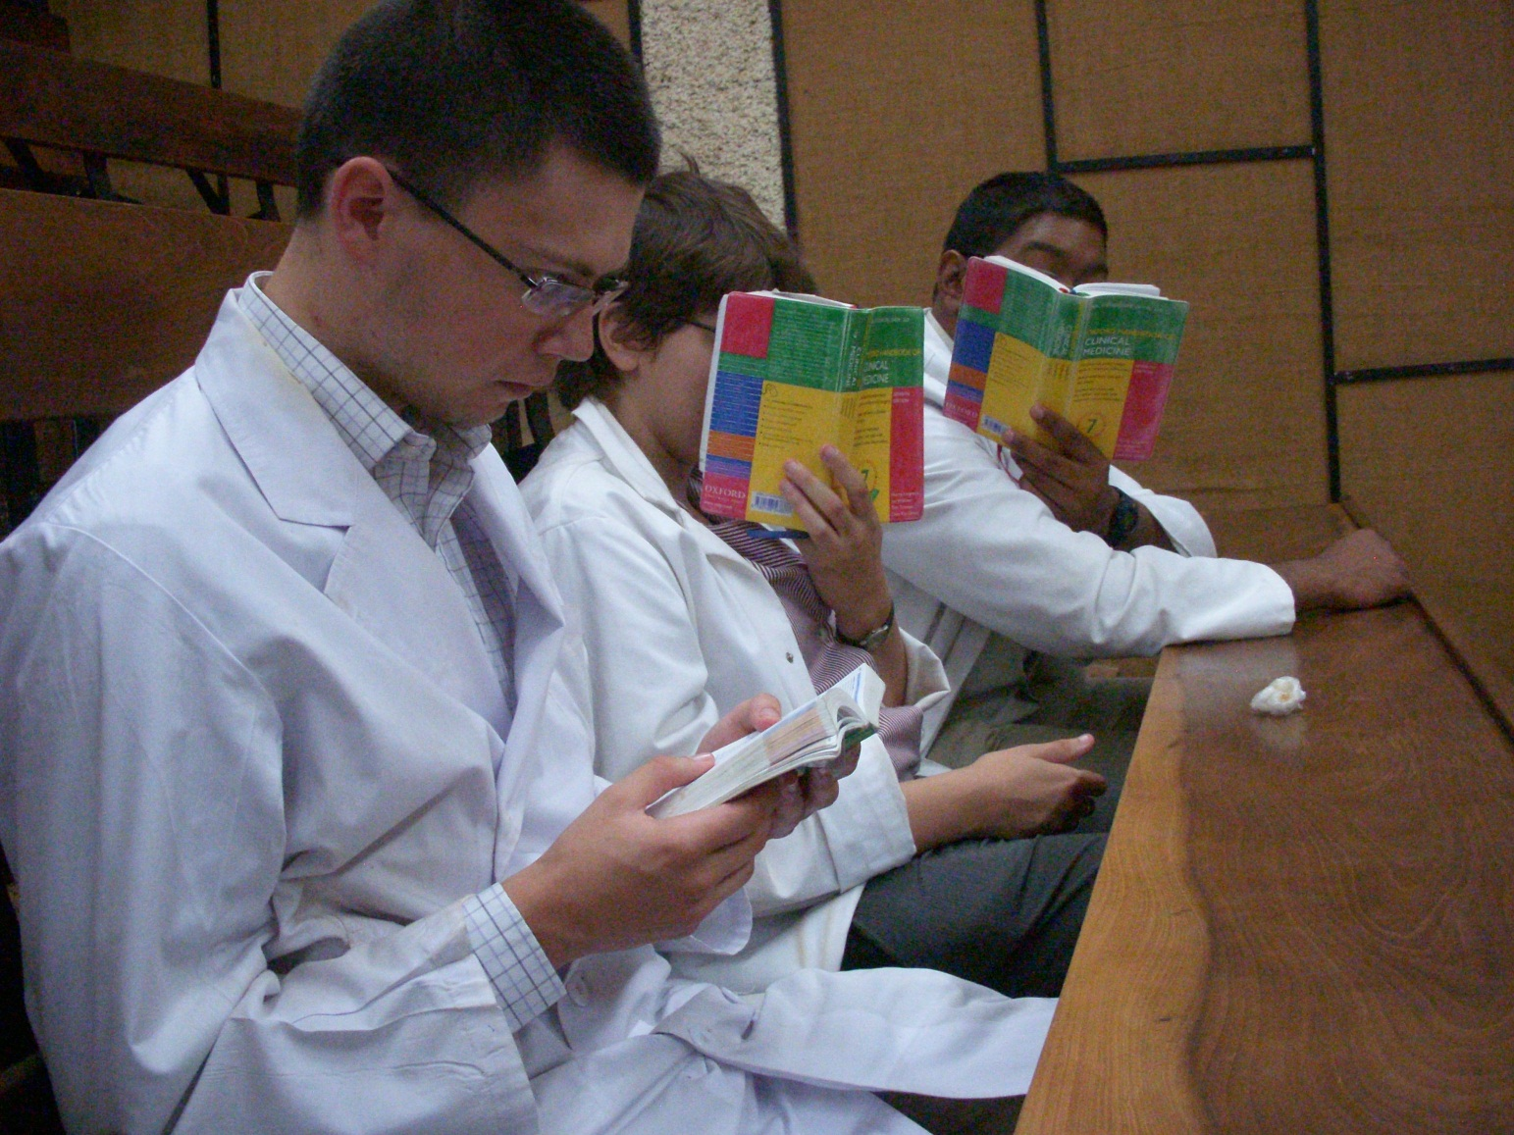

Slide 15
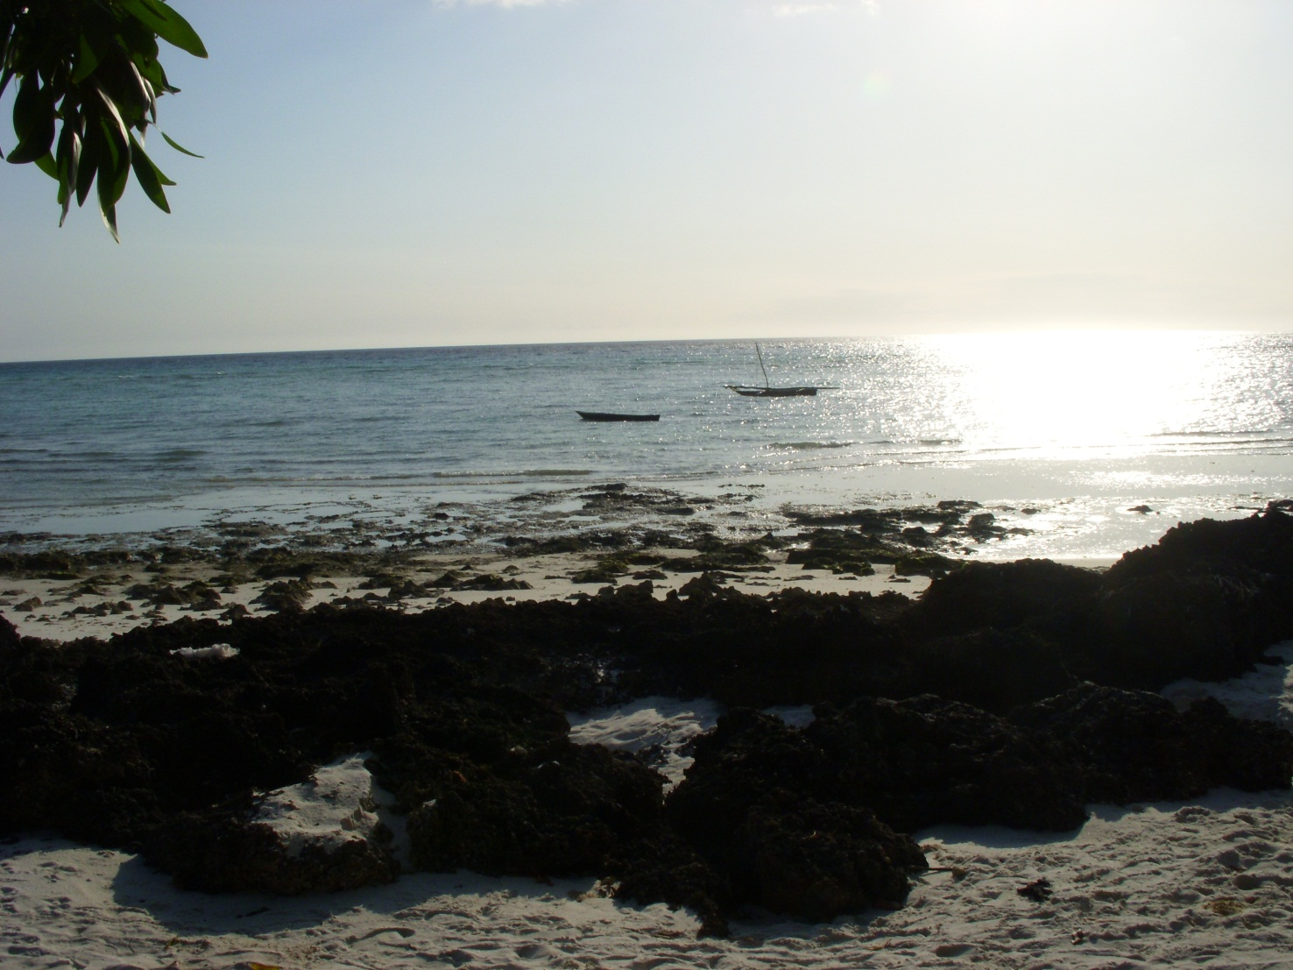

Slide 16
Tips!
MDU- The Electives Network
Free access to database of >2500 hospitals
Electives with a difference
Several reviews
Funding
Plan it yourself rather than through an organisation
Plan your funding
Write a diary!

Slide 17
The End….
nln06@ic.ac.uk
international@kcmc.ac.tz: Aneth Nkya
With thanks to the Frank Denning Memorial Fund and the Internal Medicine team at KCMC.

Slide 18
Contact details
nln06@ic.ac.uk
international@kcmc.ac.tz: Aneth Nkya

