Slide 1
Innovation in Neurosurgical Training: MARTYN
Claudia Craven

Slide 2
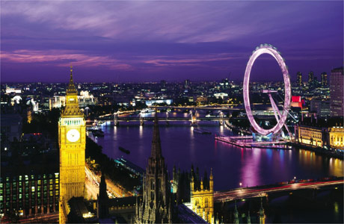
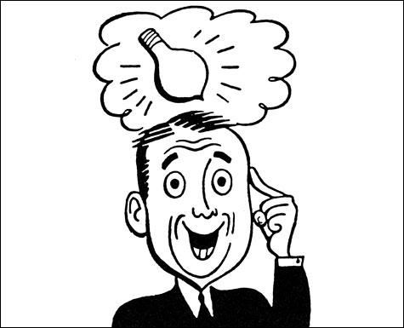
Elective Location.....Zone 1!
Notes:
Not tropical! But you might have to stay in the UK for a variety of reasons, my reason was a horrendous lack of money....
Not such a bad thing...had an idea , now was a chance for me to implement it. London is fantastic for simulation work – St Mary’s being one of the best!

Slide 3
Simulation in Neurosurgery
PATIENT SAFETY!
European Working Time Directive – IMPROVE TRAINING (both technical and non-technical)
What simulations are available? – virtual, haptic, one model (microsurgery)
What isn’t? A decent tactile 3D training model for emergency Neurosurgery (THE TYPE OF OPERATION THAT MOST NEEDS SIMULATION!)
Low cost, portable and distributable
To make a model that ALL UK trainee Neurosurgeons will have access to before their operation.

Slide 4
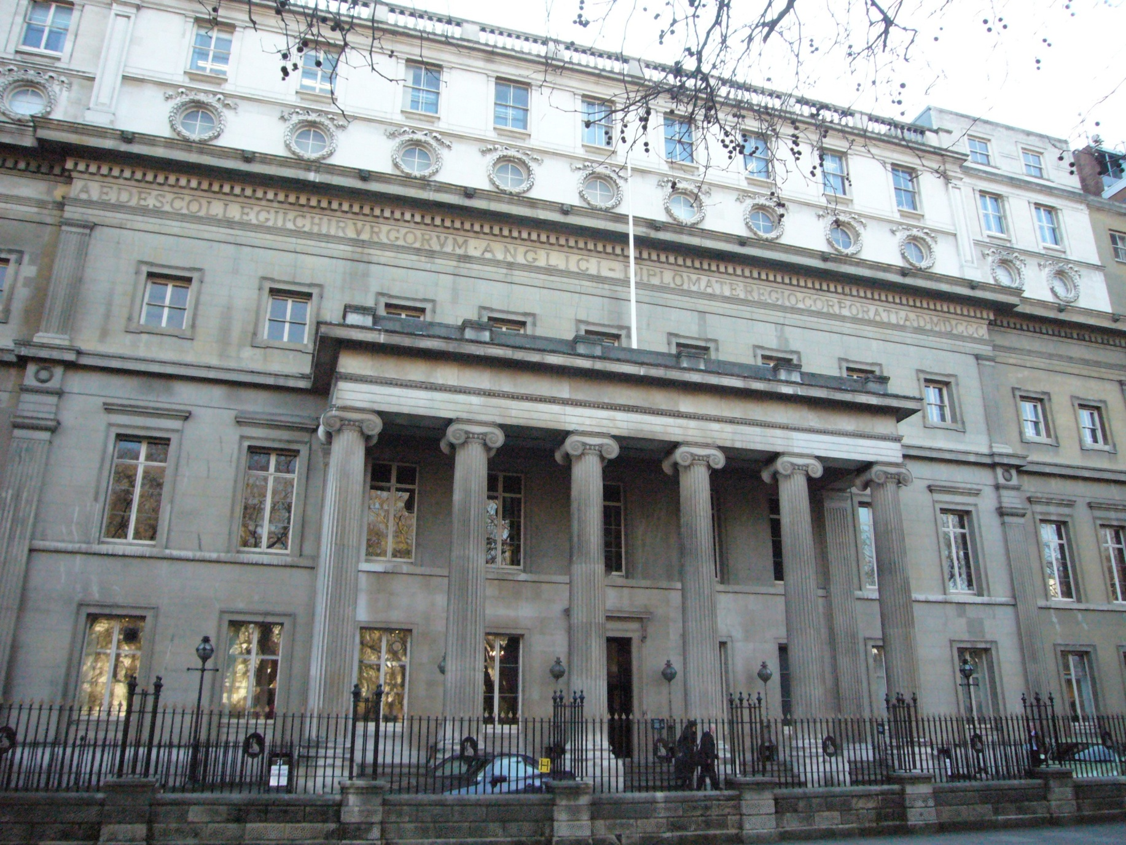
Royal College of Surgeons, England

Slide 5
MARTYN
MODEL OF:
Scalp
Skull
Dura
CSF
Brain
Ventricles (containing CSF)
Modeled
Anatomical
Replica for
Training
Young
Neurosurgeons

Slide 6
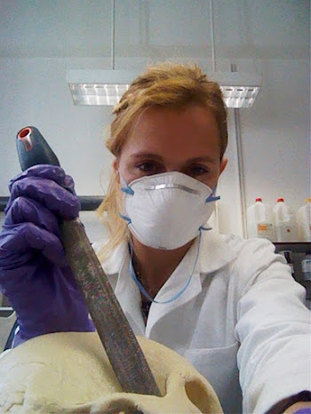
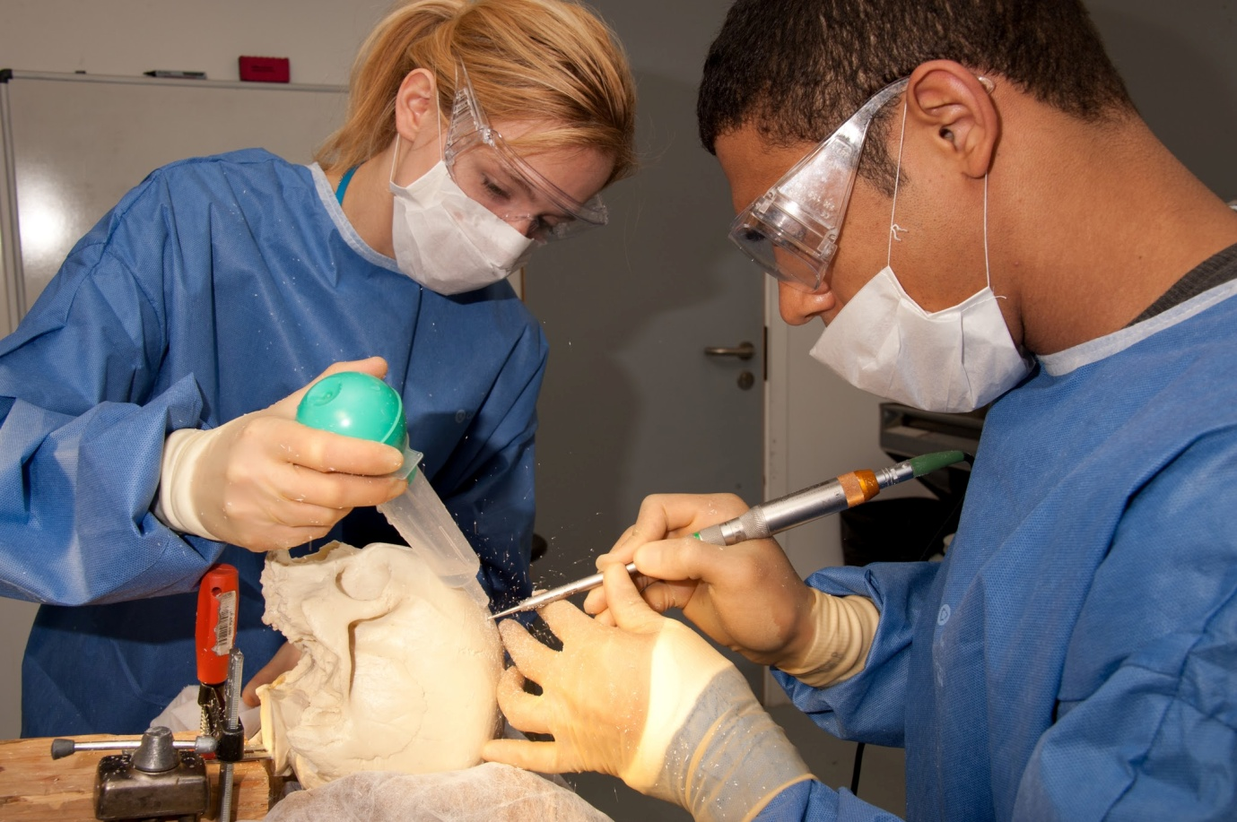
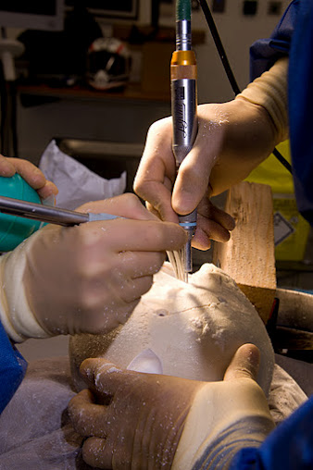
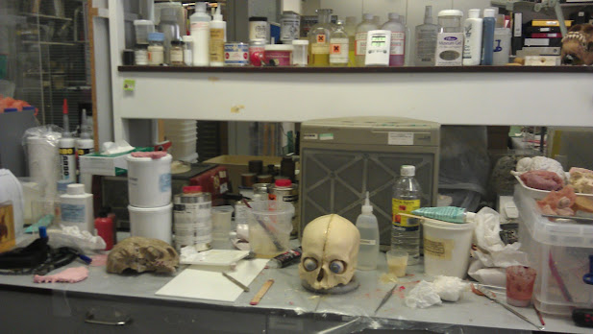
Make the components…e.g. Skull
Test (operate on model!) for Realism
IS IT GOOD ENOUGH? NO…then BACK TO THE LAB!
Re-test

Slide 7
Crazy Lab

Slide 8
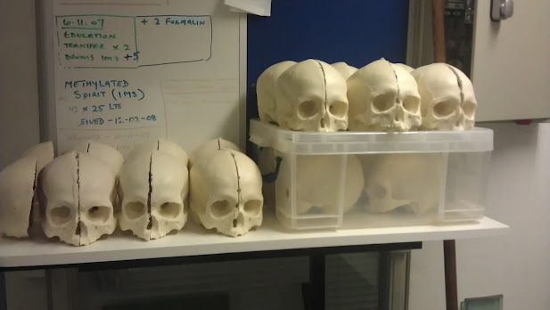
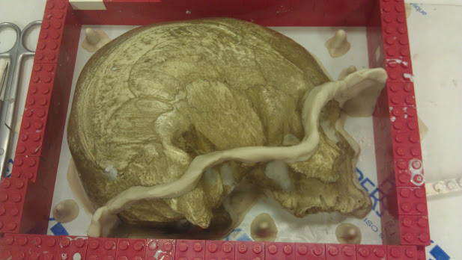
Skull
Skull Cast from real skull.

Slide 9
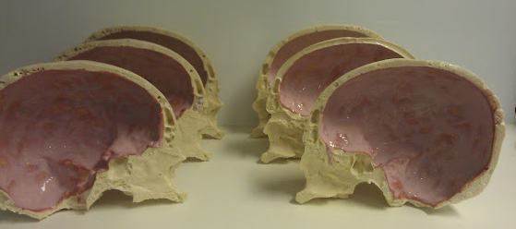
Dura
Dura (Latex painted inside skull) – NOTE....it is pink because it is still drying!!! Will dry to be red/brown..

Slide 10
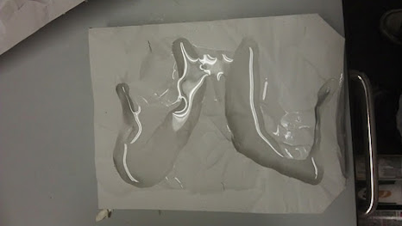
Ventricles
Cast a ventricle...then made cast of a cast in silicone!

Slide 11
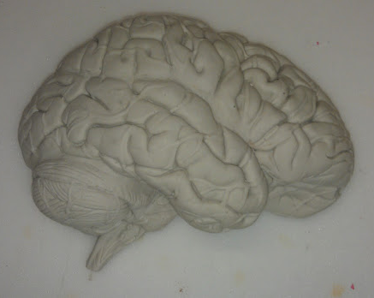
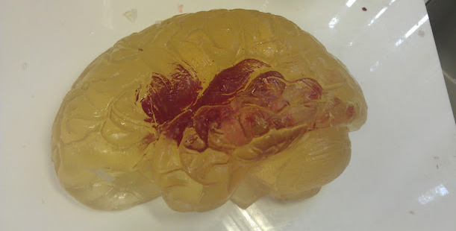
Brain and Ventricle (red CSF!!)
Gelatine composite brain
Red parafin ventricle (Water would dissolve the brain!)
OK...so...colours not quite right, but for training we want to know if we have hit CSF, so we made it bright red

Slide 12
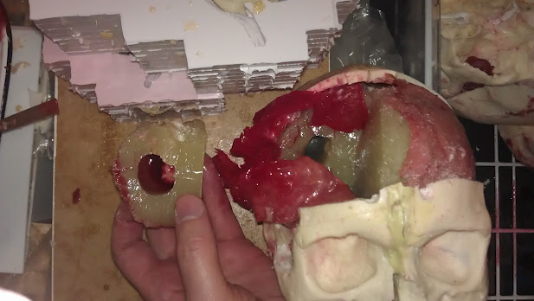
Cross Section showing ventricle (without CSF)

Slide 13
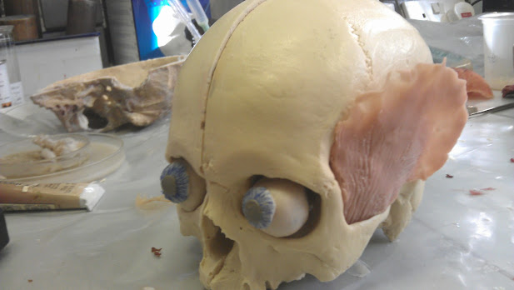
Our first prototype...Juan!
Skull, comedy eyes, temporalis, dura, brain....

Slide 14
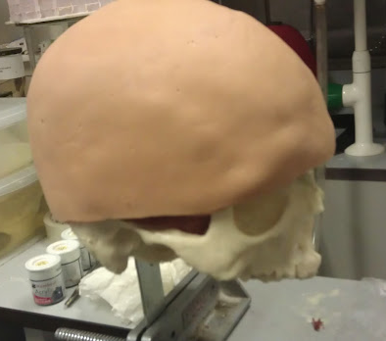
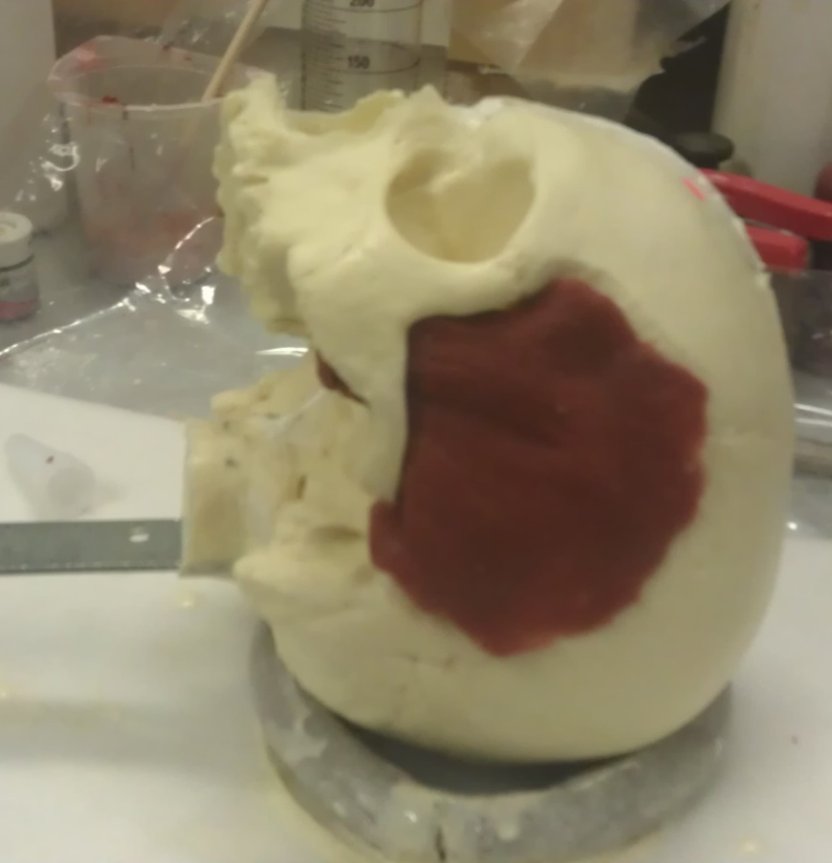
Skin & Temporalis

Slide 15
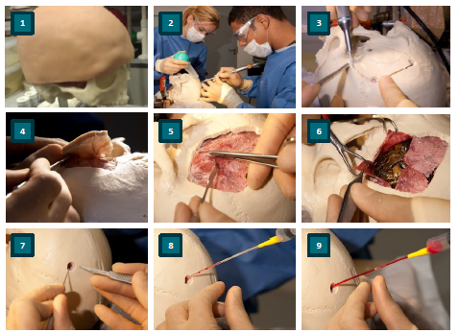

Slide 16
Did we meet our aims?
Portable!
Distributable (materials can be bought in the highstreet)
Low Cost? Yes!
Each MARTYN costs only £20 pounds material wise
Each MARTYN is 100% recycleable!
Each MARTYN takes 10 hours to make (by hand)

Slide 17
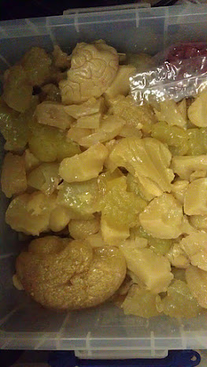
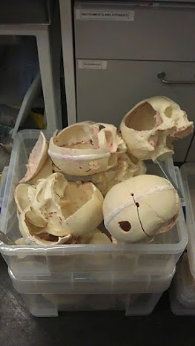
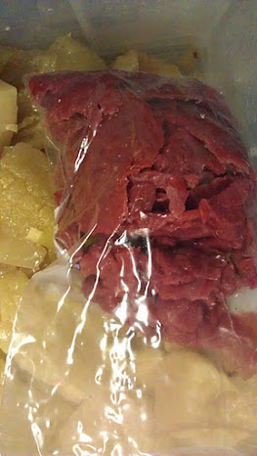

Slide 18
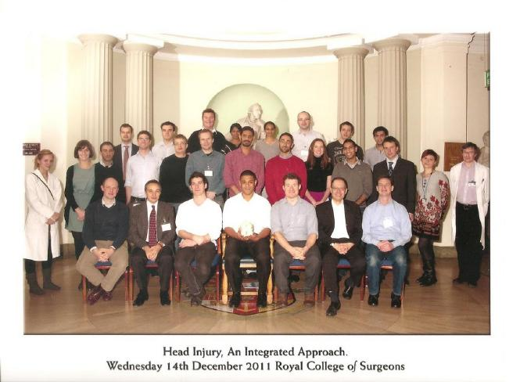
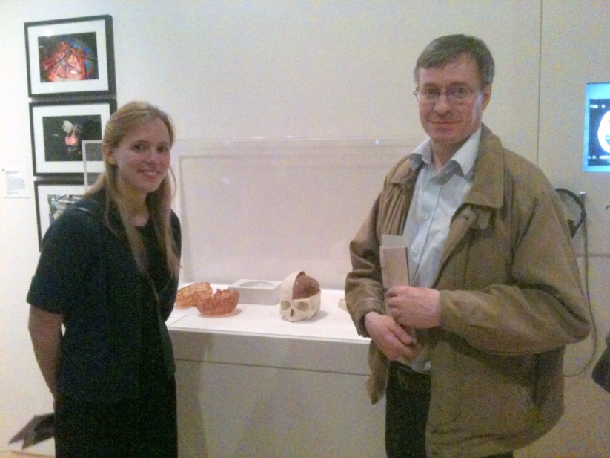
Outcomes…
Research project established: Posters, publications etc.
RCS course: Head Injury
Museum Exhibit!: MARTYN is Currently in the Wellcome Museum Brain Exhibit
Clinical: Learnt how to perform a variety of emergency neurosurgical operations
Learnt a lot about simulation research!
Learnt to handle and manage cadaveric specimens...
Neuro & Head anatomy! You need to know it to make one!
...and about that Holiday....Got an all expenses trip to Istanbul :D
Notes:
Neuro and Head anatomy! You need to know it to make a 3D one.
To make really good models for simulation purposes! Along with some exciting art and craft skills!
To handle and manage cadaveric specimens...
To establish an ongoing project and write grant proposals.
The concept of validity and important educational factors in simulation and training.
That you can apparently work next to a man’s severed head in jar for 6 weeks and not even notice.
That rats do not have gall bladders.
That Lego is well worth investing in around November (if you have shares).
That an ice cube can in fact be super glued to another ice cube ...and that if you decide to make a simulation model be pre-pared for much crazy trial and error!
That Intellectual property is very complicated!
That Hari Krishna Priests serve free curry every Friday at LSE campus....but the Imperial Campus is still much better!
That patient safety really should be a high priority when learning neurosurgery. The consequences of error are high!

Slide 19
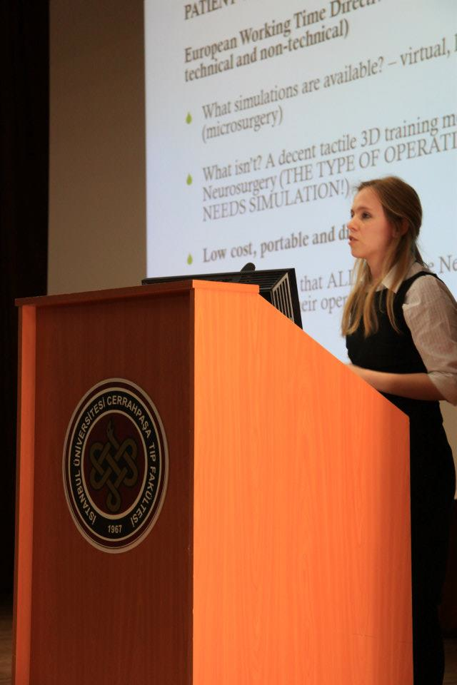
……and research sprouts holidays :D

Slide 20
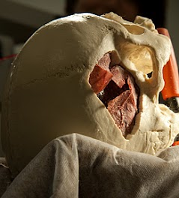
Thank you
Any questions ?

