Slide 1
Organising your elective
Mark Chamberlain
March 2011

Slide 2
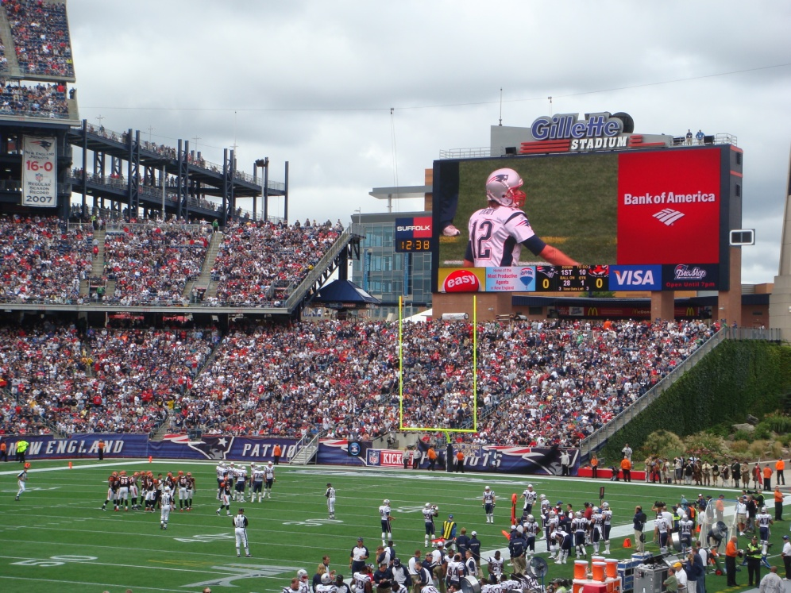
introduction
I’m no expert
Lots of you will have electives fall through
Don’t be disheartened
It can be the most annoying thing in the universe to organise

Slide 3
purpose of the elective
Experience and appreciate of different healthcare systems
Experience of working abroad
Helping in a developing country
Furthering skills and interests in research or speciality
A break from dirty, smoky, smelly London
Doing things in parts of the world you wouldn’t be allowed to in the UK

Slide 4
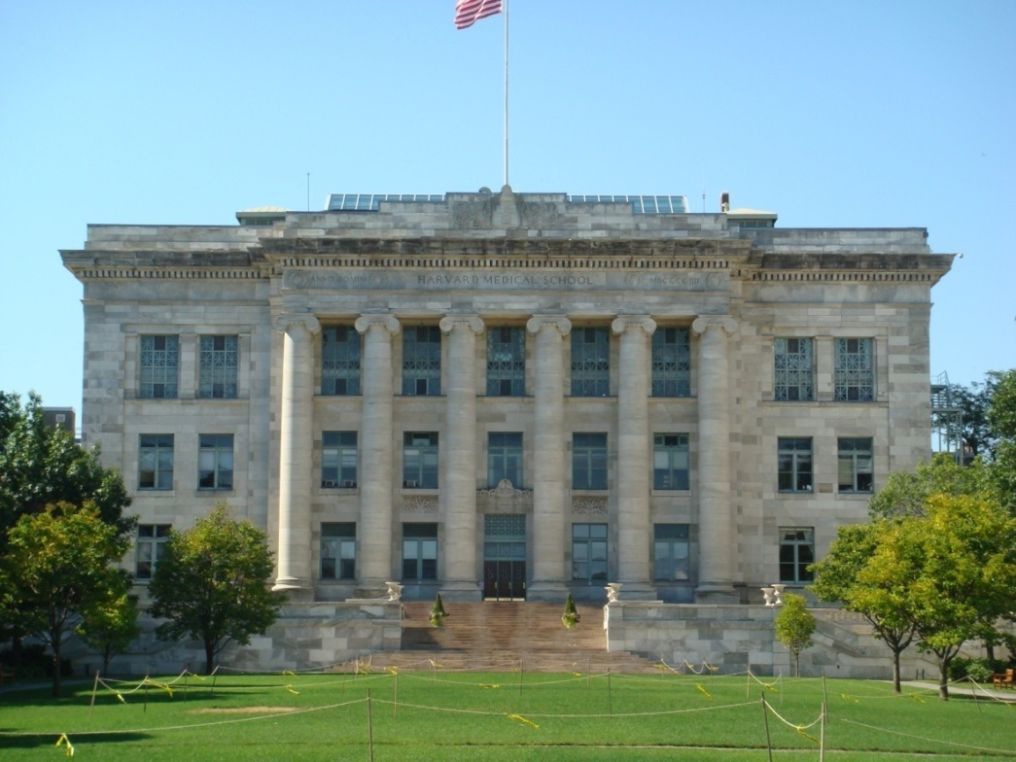
first steps
What do you want from your elective?
How much money have you got?
What are your careers aspirations?
Where would you like to travel to?
Who would you go with?

Slide 5
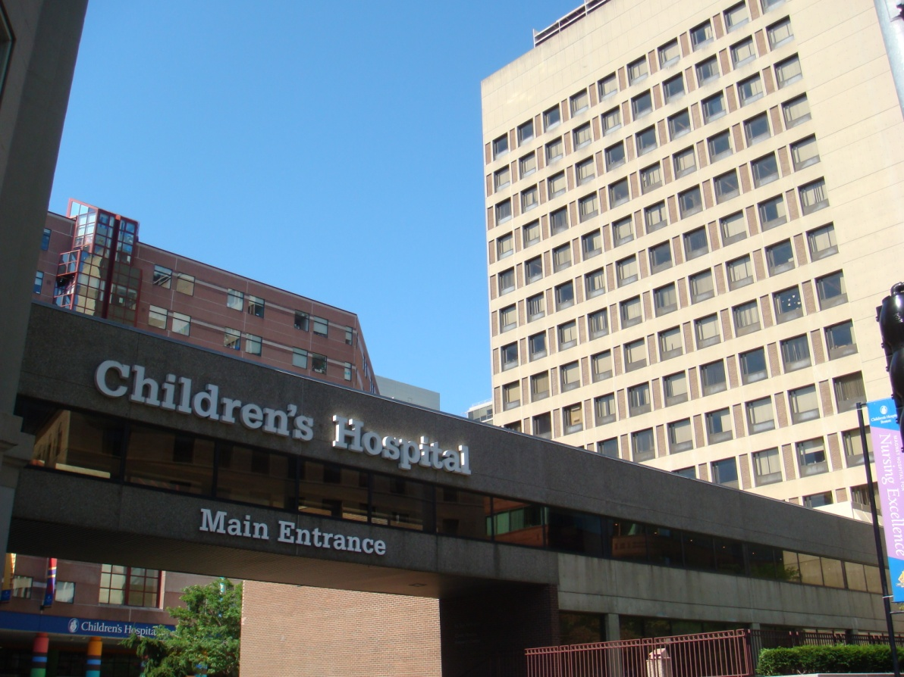
what to do
Something you’ve enjoyed
Something you’ve missed out on
Future career plans
The noble cause
Research
work vs play

Slide 6
where to go
Financial – Fees, flights, accommodation, living
Some places won’t take students unless you know someone
Grasp of the local language
Ability to tolerate climate
Developed Vs. Developing
English Vs. non-English speaking
Popular places - Australasia, USA
Safety - eg War Zones - Foreign Office Advice
extra-curricular activities
The world is massive, there are lots of places to go
Don’t forget UK - opportunities all over the country
Notes:
can you drive

Slide 7
flight of the phoenix 2010-11

Slide 8
resources
Talk to people – older years, other doctors
Written Elective reports at St. Mary’s
Consultants with contacts – eg BSc supervisor
The Medic's Guide to Work and Electives Around the World by Mark Wilson
Get Career Savvy - education.med.ic.ac.uk/careers/index.htm

Slide 9
resources
Electives intranet - education.med.ic.ac.uk/electives/index.htm
MDU Electives guide - www.the-mdu.com/section_medical_students/topnav_your_elective_2/index.asp
BMA Electives guide - www.bma.org.uk/careers/medical_education/medicalelectives.jsp
worktheworld.co.uk
electives.net
globalmedicalprojects.co.uk
medicstravel.co.uk
projects-abroad.co.uk
medicalstudentelectives.org

Slide 10
finances
Can cost thousands of pounds!
Medical School Electives Awards - Apply, apply, apply
External sources - Royal Colleges, charities, etc – all on intranet
Bank of mum & dad
Professional Studies Loan – Really think about whether this is right for you

Slide 11
approval and booking
Ping Pong
Can appear to take forever! 7 Weeks minimum
Approval from Personal Tutor - That person you’ve never met!
Split elective form
Institutions will ask for different things
Some won’t let you apply until late in the day
Proof of student status/Transcripts/References – from St Marys
Indemnity – MDU online
insurance - college
Occupational Health
CRB

Slide 12
occupational health
South Kensington
Some countries/institutions will ask for additional information
Chest Radiographs
Medicals
Can be expensive and time consuming
PEP & PPE – check what your hospital provides
Anti-malarials & vaccinations
Needle-sticks

Slide 13
flights
Earlier = Cheaper
Trailfinders, STA Travel or book directly via internet
Airlines have lots of sales on their websites!

Slide 14
accommodation
University halls
Hospital accommodation
Backpacker Hostels
Electives offices
Sub-letting
Family/friends
Rented accommodation near hospital

Slide 15
before you leave
Documentation
Passport – check expiry!
Medical Indemnity
Travel Insurance
proof of payment/contacts
medical student ID
Customs
Visas
Entering USA – Online customs form weeks before you travel - www.cbp.gov/esta
Proof of elective/residence
Finance
Internet Banking
Credit Card
FCO LOCATE website - www.locate.fco.gov.uk/locateportal

Slide 16
tips for hassle-free elective
Leave copies of everything at home and scan onto your webmail
Keep a diary (money and of experience)
Find out what your hospital will provide (gloves/ARV’s?)
STA Exam Cover
Enjoy it – things will go wrong

Slide 17
boring but important
Be sensible & safe
People get tropical infections
People have accidents
People come back with STIs
people get mugged

Slide 18
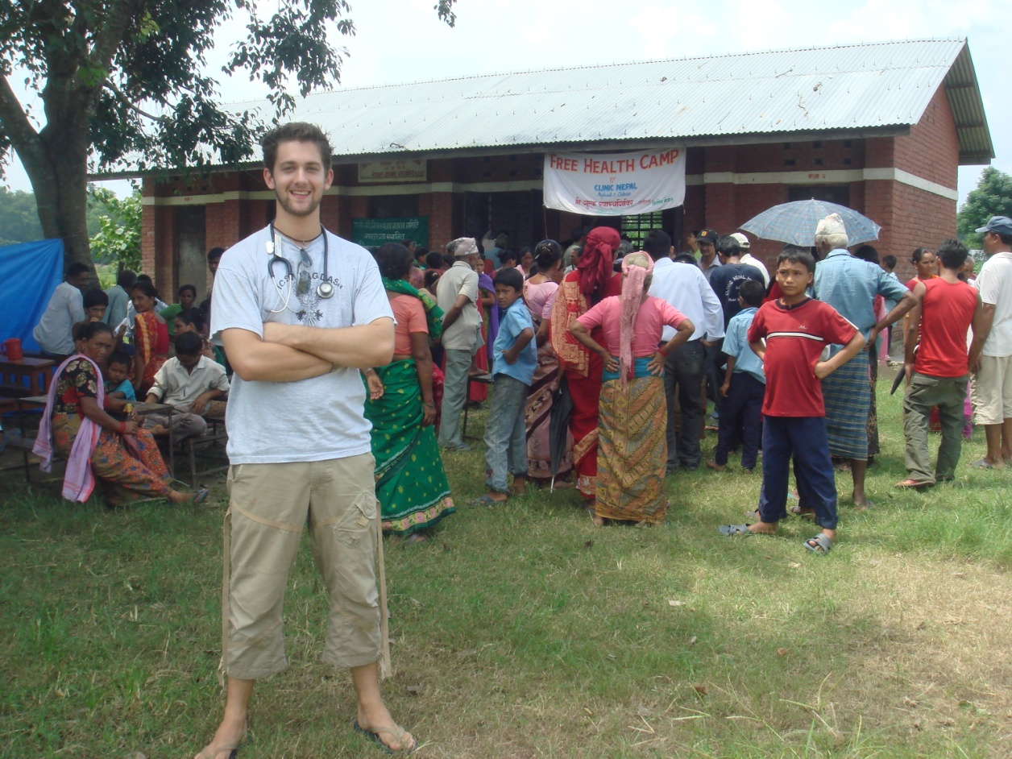
good luck
It really is one of the best things you do at medical school

Slide 19
any questions?

