Slide 1
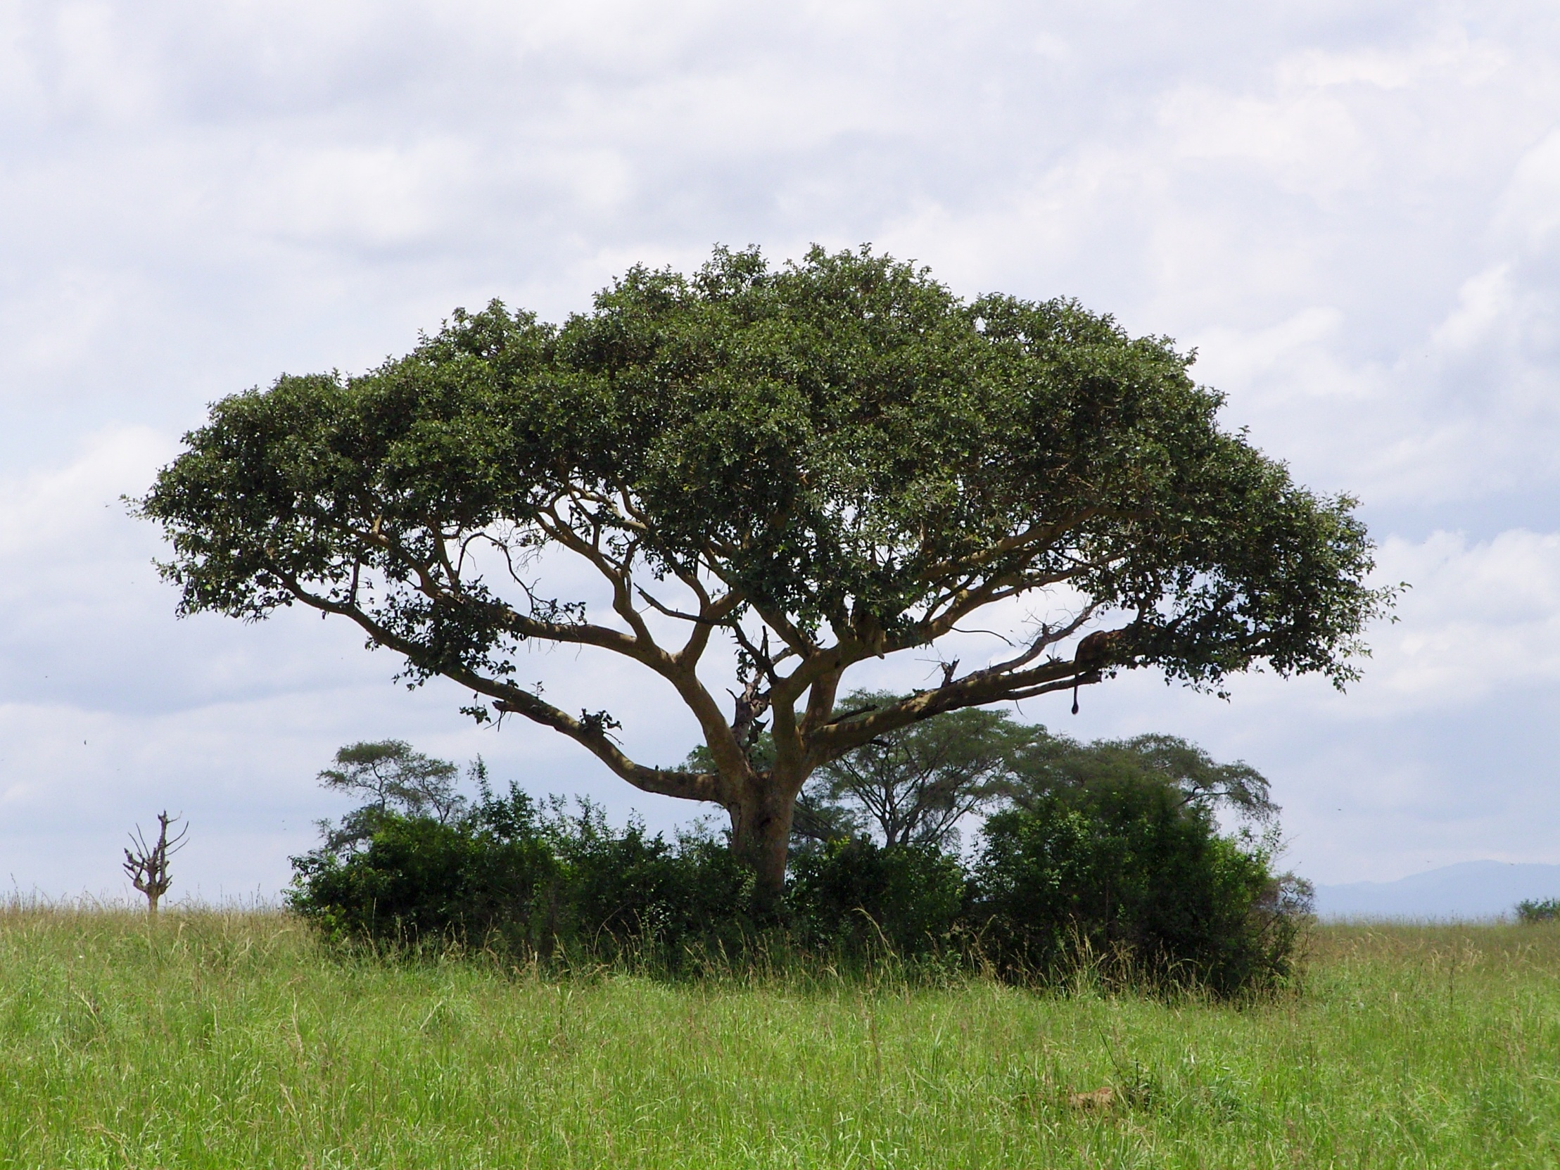
Kilembe Mines Hospital Uganda 2010
Joseph Sawyer

Slide 2
What is the elective?
Need to start enjoying yourself now!
Your interview…
Stress!!
Elective?
Why do we study medicine?
Money?
Respect?
A challenge?
What do you want from your elective?
To escape and relax?
Research?
Improve my surgical skills?

Slide 3
Today's highly interdependent world
Health
Politics
Economics
Religion/culture
People

Slide 4
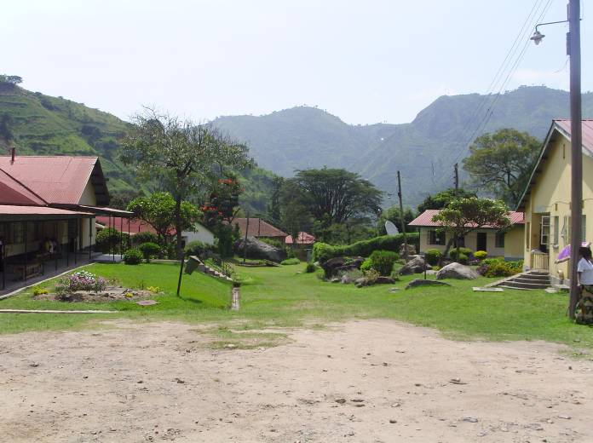
Kilembe Mines Hospital
Operating Theatre
Paediatrics
General Medicine
Maternal Unit
Outreach Service
Outpatients

Slide 5
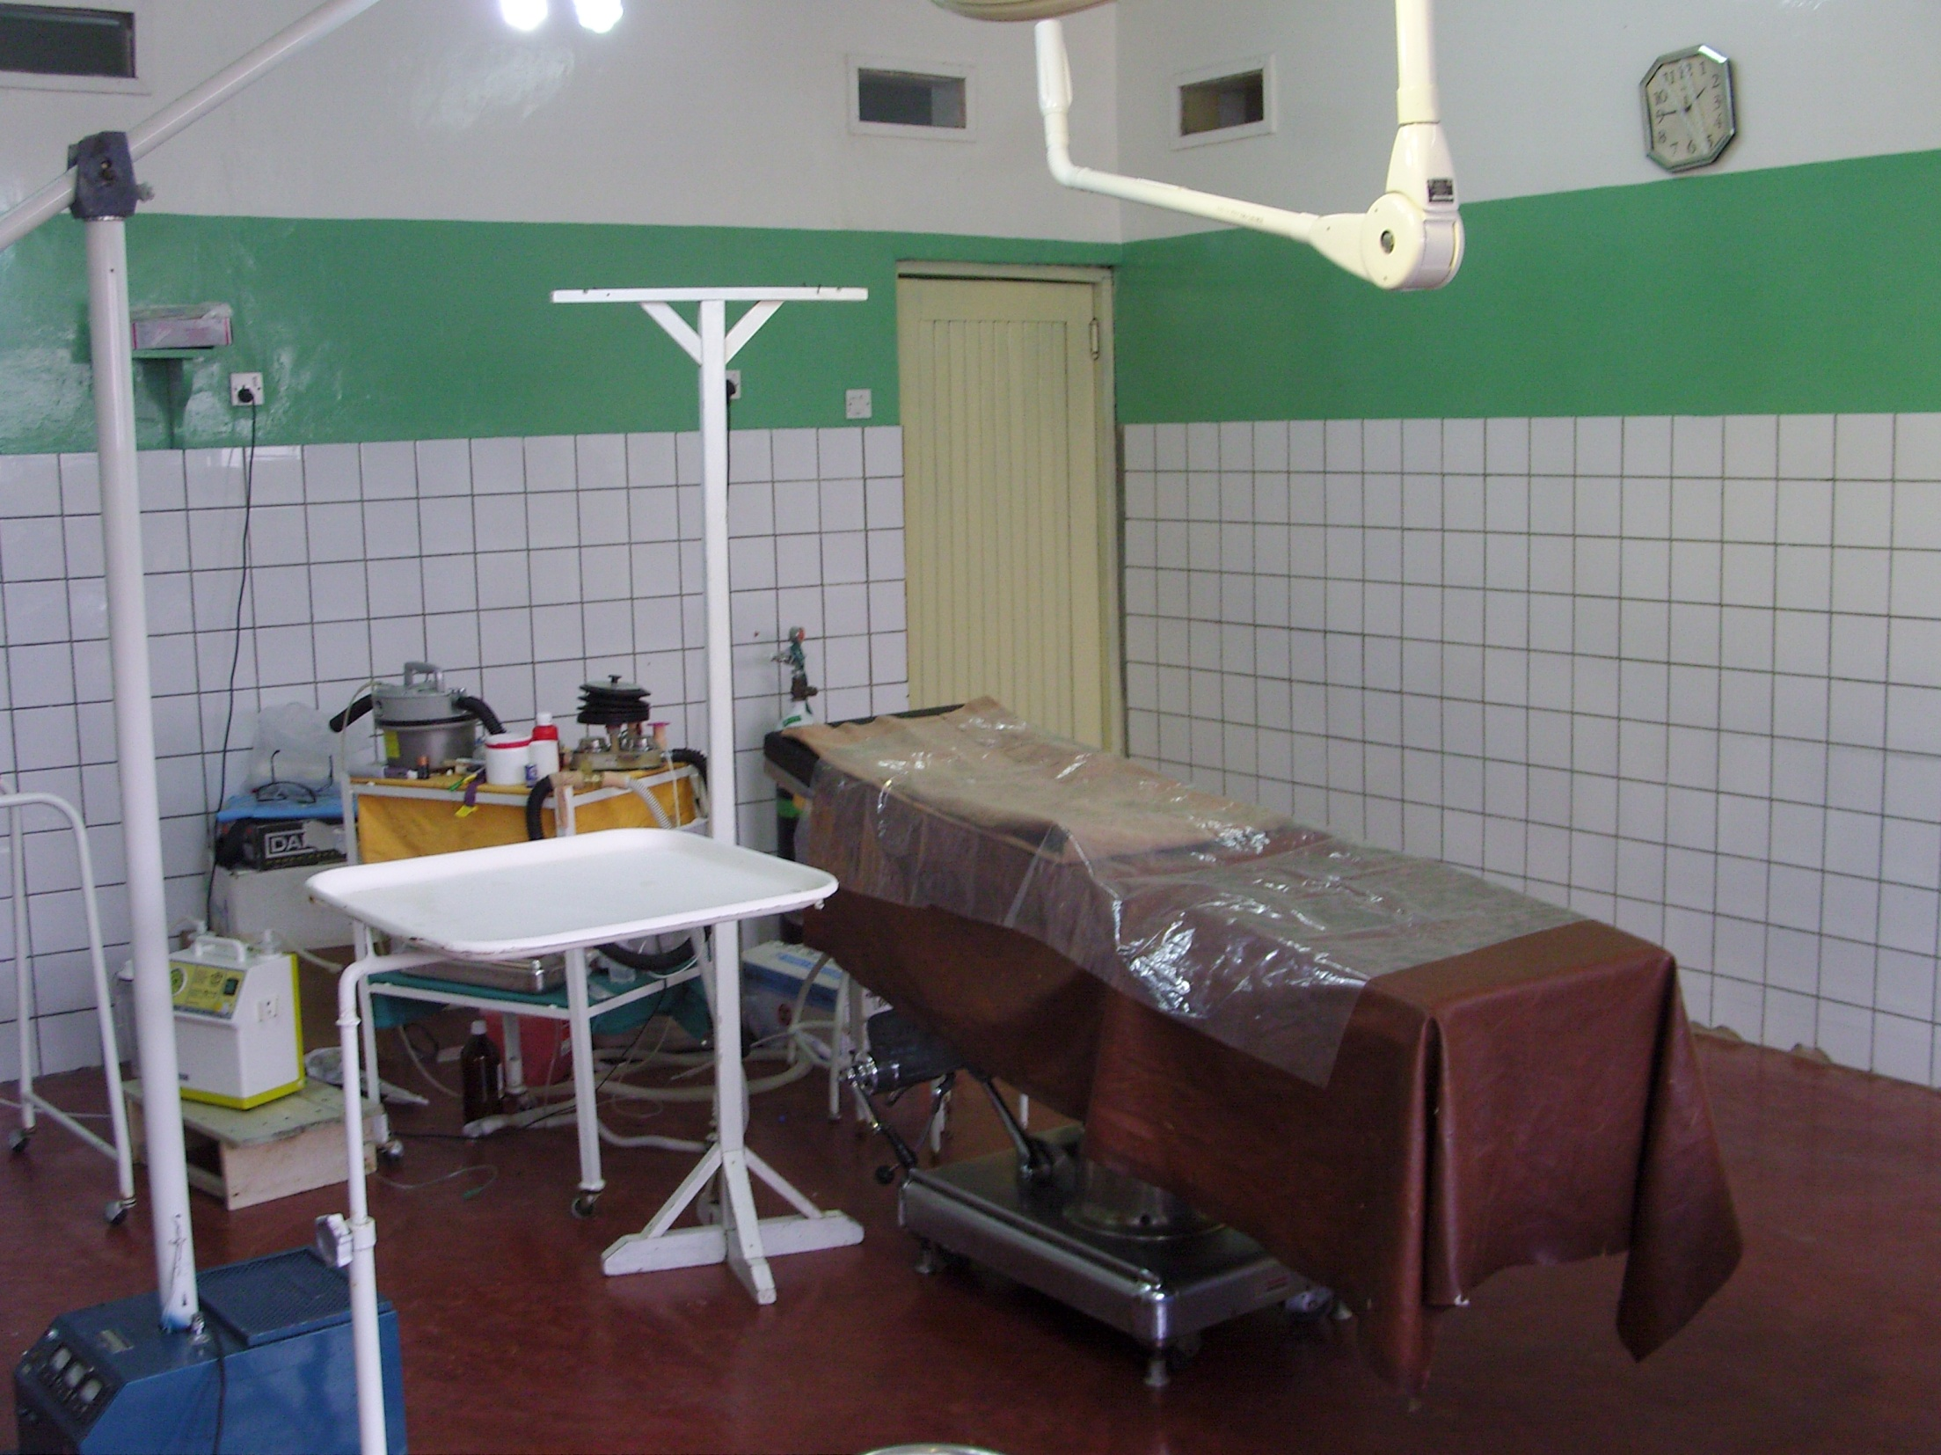
Theatre
Gut perforations secondary to Typhoid
Trauma - Secondary to RTA
Hernias – often recurrent
TB – spine, joint, testicular
Common pathology
Closing on all operations you assist
Secondary sutures
Surgical toilet and suture
Wound Debridement
Plaster casts
Wound dressings
See lots of anatomy!
What can you do?

Slide 6
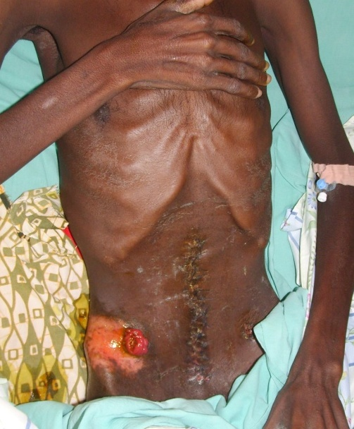
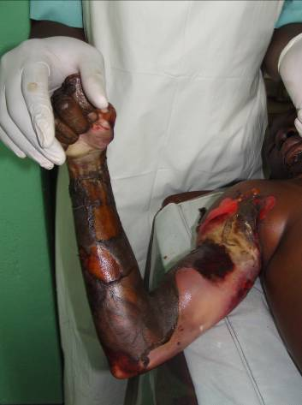
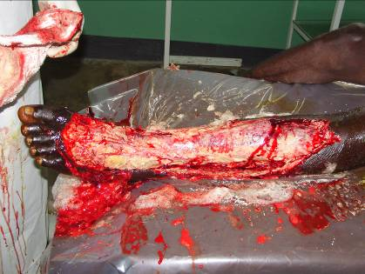
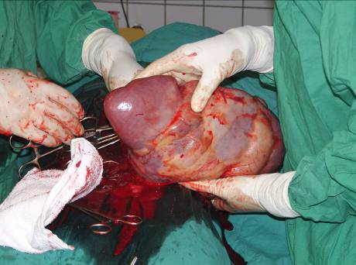
Some interesting cases
‘..Typhoid, it started as an epidemic but now it is endemic’.

Slide 7
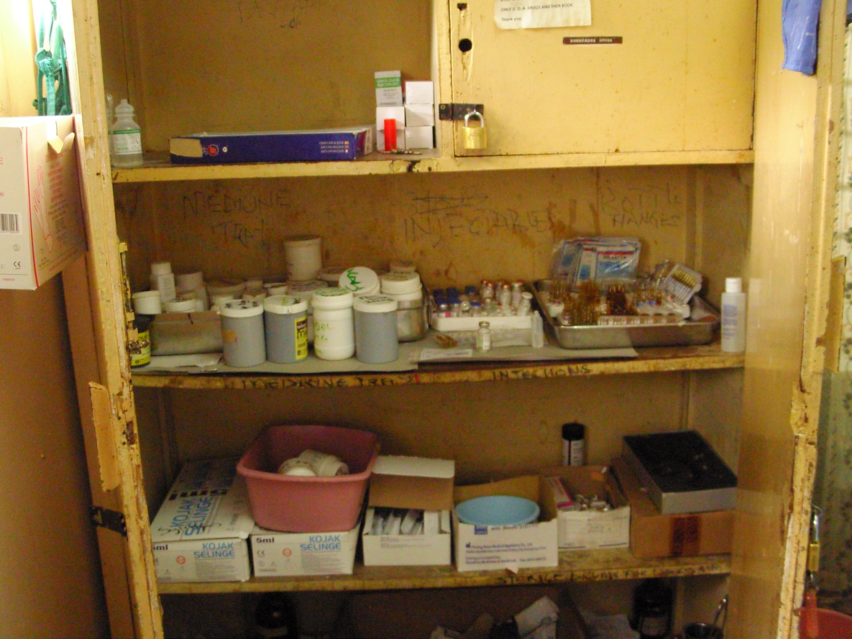
Medicine
HIV TB
Malaria Typhoid
Heart failure Crazy infections!!
Common pathology
Interpret histories Management
Cannulation NG tubes
Catheters Ascitic taps
Lumber punctures
What can you do?

Slide 8
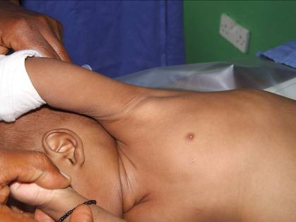
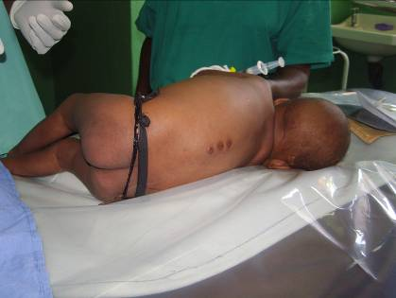
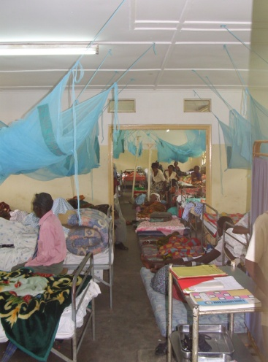
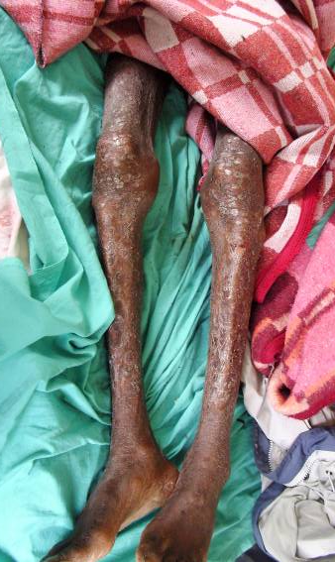
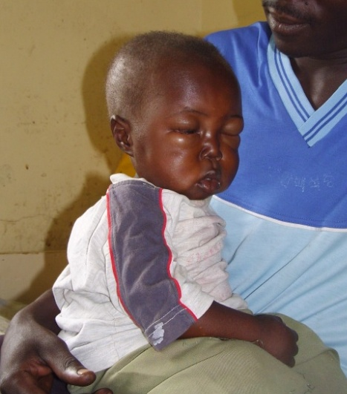
Some interesting cases
“As if HIV isn’t enough, as if TB isn’t enough, as if typhoid isn’t enough but malaria as well?....my friend someone is joking me!”

Slide 9
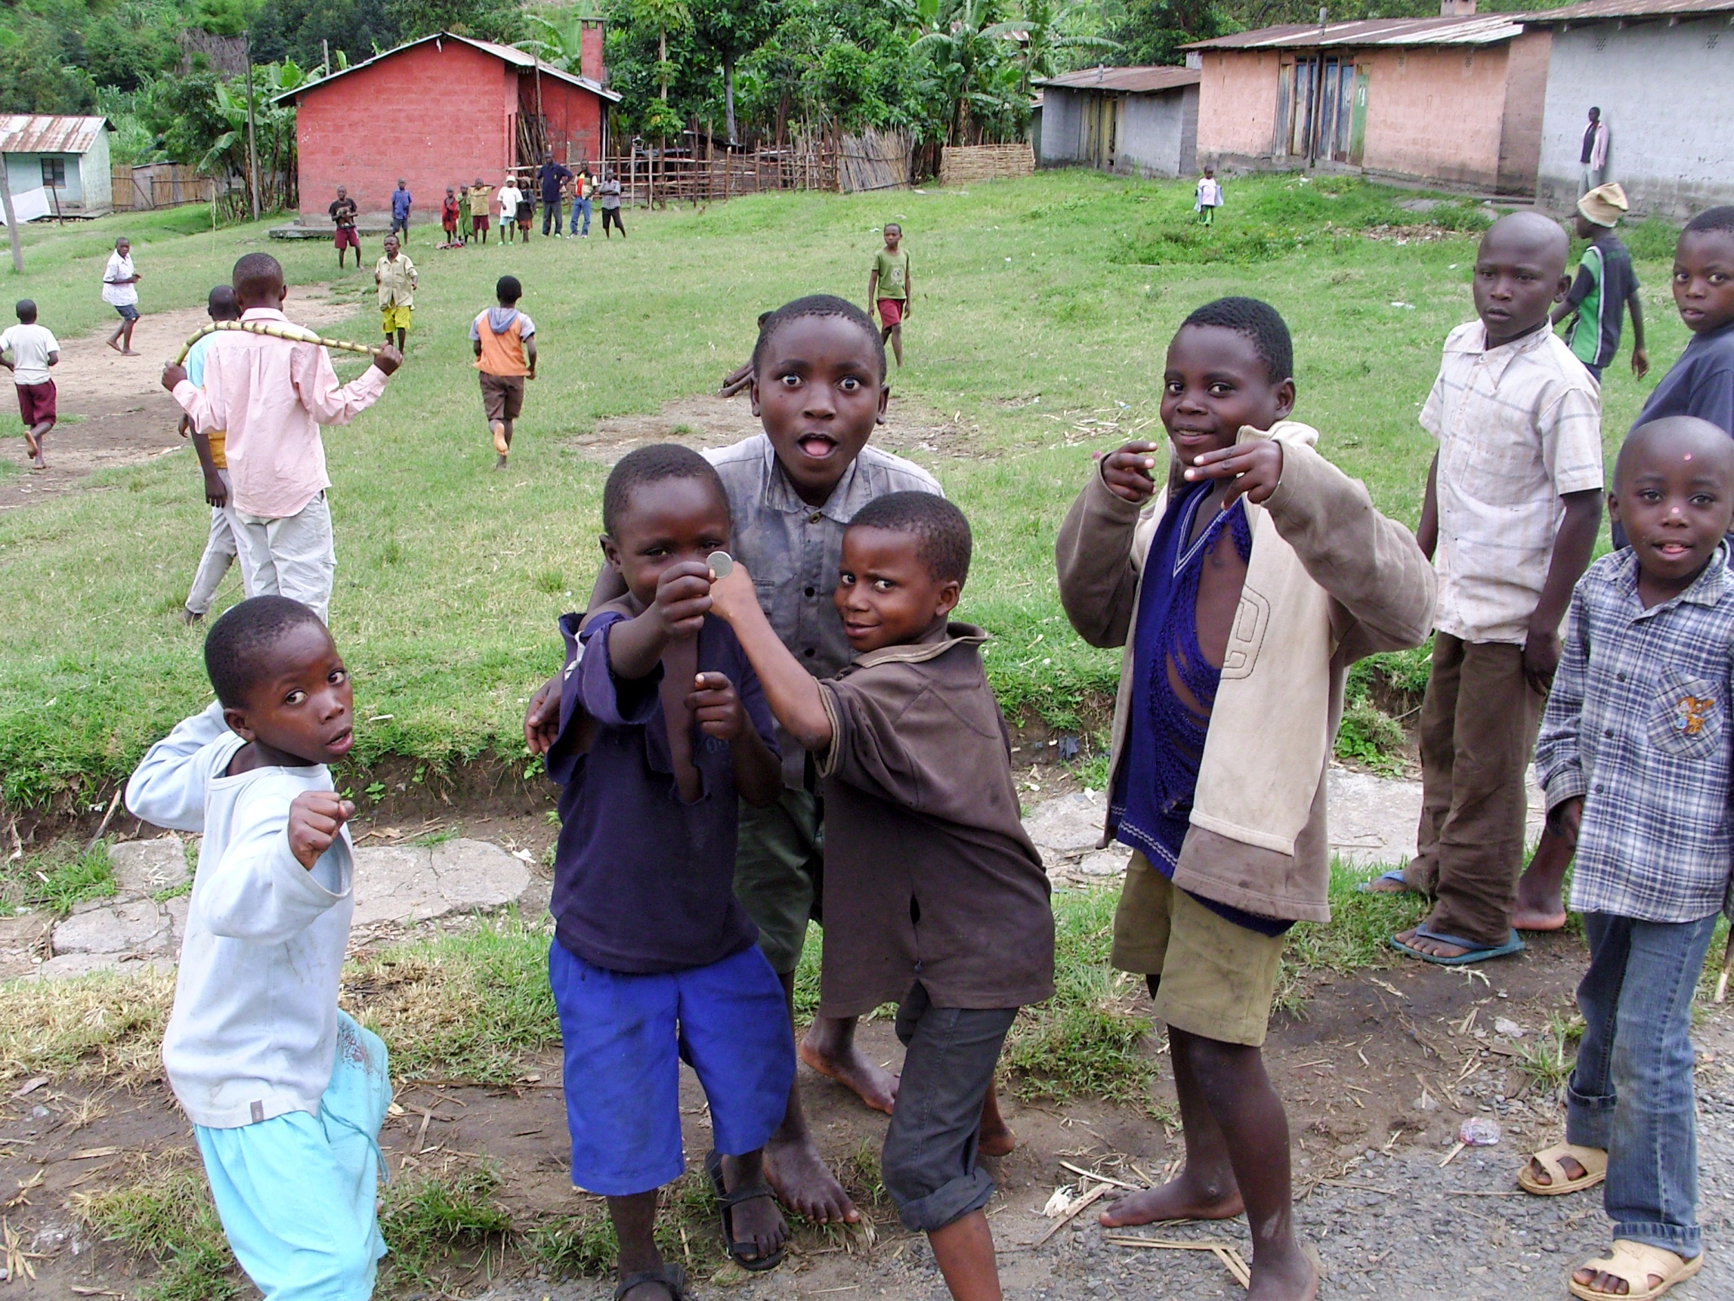
Obs and Gynae/Paediatrics
Paediatrics
Malaria
Burns
TB
Kwashiorkor
Cerebral palsy
Obs and Gynae
Ruptured uterus
Pre-eclampsia
Miscarriage
Obstructed labour
Common pathology
Labour ward
Cesarean sections
Interpret histories
Management plans
Your suggestions will be valid!
What can you do?

Slide 10
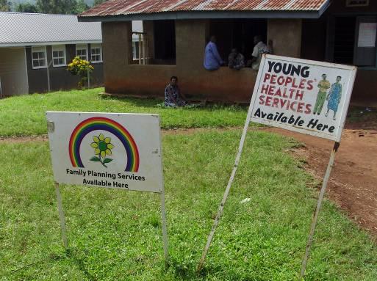
Primary care/Outreach service
Common problems
What can you expect to do?

Slide 11
What is there to be gained?
Clinical Skills
An appreciation of need
An understanding of why
Building relationships

Slide 12
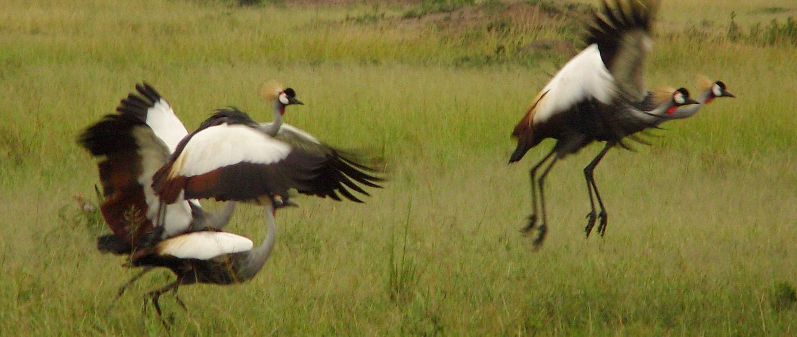
Seamless effort
Actually requires a lot of work

Slide 13
Thank-you

