Slide 1
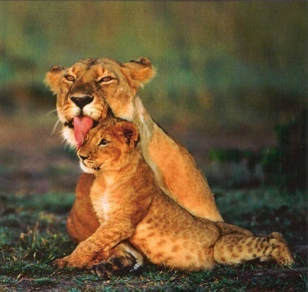
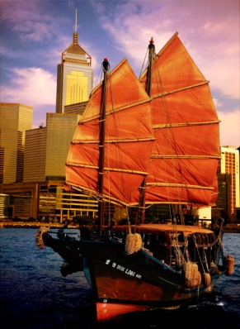
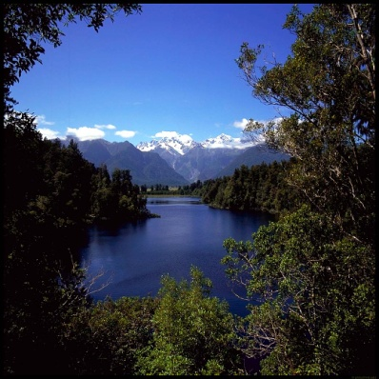
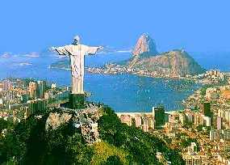
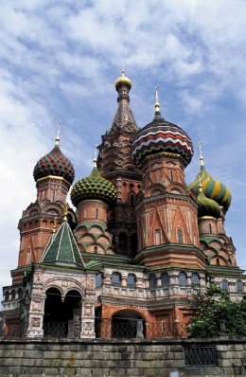
School of Medicine
Elective Travel Awards
2011

Slide 2
The Faculty Education Office (Medicine), St Mary’s Campus, administers
The School of Medicine Elective Awards annually.
The application process is now open to all medical students whose elective falls within the period:
July 2011 to February 2012
Purpose of Awards
These awards are provided to support medical students in undertaking their medical elective; students
who consider themselves eligible under the categories listed below are strongly advised to submit an
application.
Does the Elective have to be confirmed before I can apply for an Award?
Students planning projects or whose electives have not been confirmed can submit an application with
confirmation to follow. Please give detailed information regarding project proposals, details of the
stage of planning that your elective has reached and when you expect the project and/or elective to be
confirmed.
When are Awards determined?
Awards are made at a meeting of the School of Medicine Elective Awards Group in April/May. There is
a great deal of competition for awards and students should not make elective plans in expectation of
an award. The decision of the Elective Awards Group is final, and there is no right of appeal.

Slide 3
How to Apply:
Completed application forms should be submitted either as a hard copy or by email.
Hard copy - to the Faculty Education Office at the Charing Cross or St Mary's campuses by 3pm on Tuesday 22nd March 2011, or preferably by:
Email - to feo-nwtfs@imperial.ac.uk by 12 noon on Wednesday 23rd March 2011
If you are submitting by email, please ensure you type your name in the signature section of the application form(s) and enter the date. Your email should also be headed with the subject line ‘Application for Elective Travel Award 2011’
Note:
Students applying for more than one category of award must submit their applications in one email.
Changes to application forms will not be permitted after they have been submitted: applicants are therefore advised to thoroughly check their application(s) before submitting.
Any applications submitted after the deadline will not be considered.
Further Information and the application forms can be found on the School of Medicine teaching intranet – Electives – Grants and Awards - School of Medicine Elective Awards 2011
(https://education.med.imperial.ac.uk/Electives/Travel-Awards.htm)

