Slide 1
Paediatrics in Tanzania
Amina Al-Yassin
Electives evening 2011

Slide 2
Overview
Why Tanzania?
The hospitals I worked in
Conditions seen
Experiences gained
Other things to do in Tanzania
How to fund your elective and other advice
Contact information

Slide 3
Aim of my elective
“Health is a state of complete physical, mental and social well-being and not merely the absence of disease or infirmity”
Notes:
To appreciate the state of healthcare in Tanzania from a wide range of angles, and to learn more about the social/ political/ religious/ etc factors that contribute to health

Slide 4
Why Tanzania?
Very different to the UK
Probability of dying under five 118/1000 live births (UK:)
Total expenditure on health per capita $45
1 doctor per 25’000 people, only 50 medical students enrolled per year
Wide range of pathology, including HIV and infectious diseases
Relatively safe
Hospitals were easy to contact and welcoming!

Slide 5
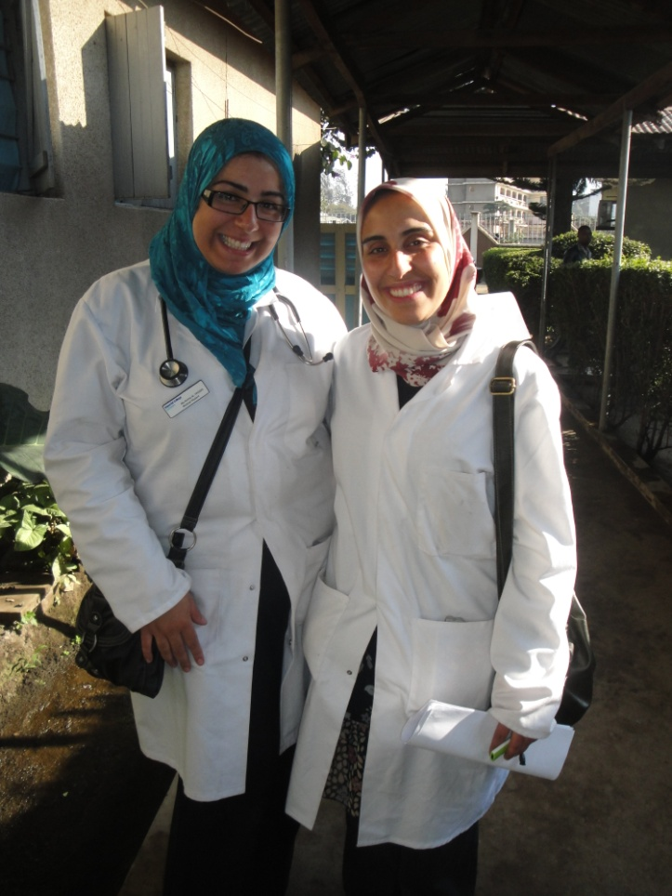
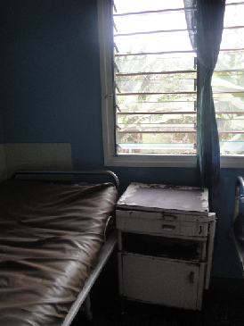
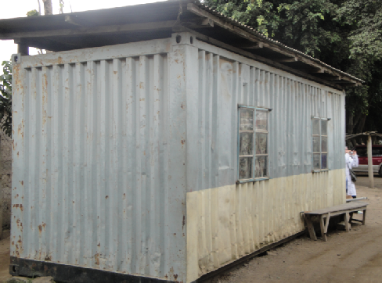
St Elizabeth’s hospital- Arusha
Notes:
100 bed private hospital
10 healthcare staff in total
Large outpatient HIV clinic

Slide 6
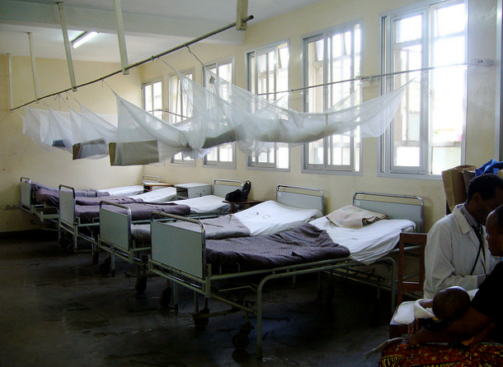
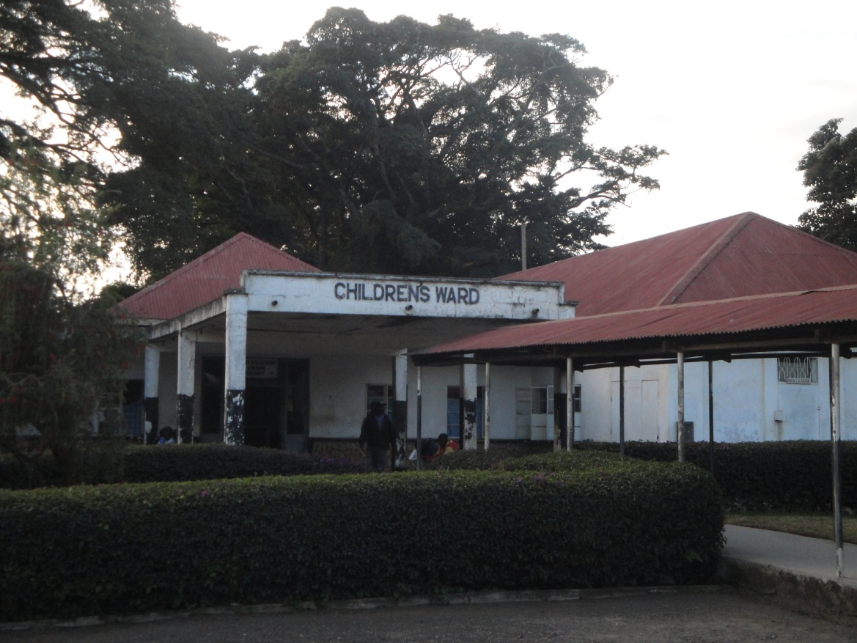
Mount Meru hospital
Private/ State-run hospital contrast was very interesting. Think about the type of hospital you apply to as well as location

Slide 7
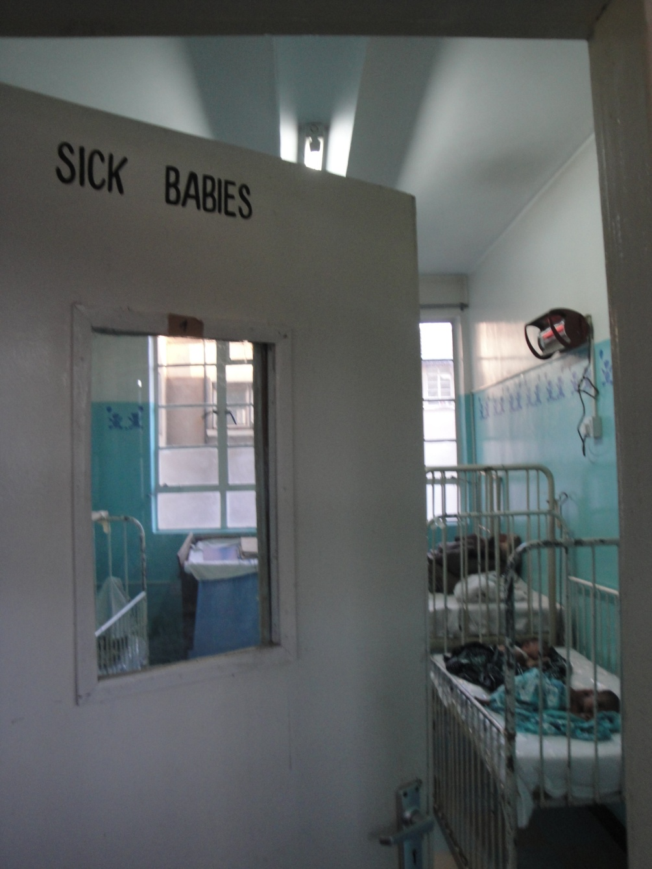
Conditions seen

Slide 8
Adult conditions
LOTS of infectious diseases: malaria, typhoid, brucellosis, tuberculosis and HIV infection
Extrapulmonary TB
Cryptococcal meningitis
Cryptosporidial diarrhoea
Kaposi’s sarcoma
Wasting syndrome
HIV encephalitis
Alcoholic hallucinosis
Myocardial infarction
Steven Johnson syndrome

Slide 9
Paediatric conditions
Tetanus
Malnutrition: Kwashiorkor
Severe sickle cell disease with chronic osteomyelitis and severe skin wounds
Cholera
Teratology of Fallot
TB: Pulmonary, peritoneal, pleural and abdominal
Nephrotic syndrome
Severe pneumonia
70% body burns
Severe diarrhoea, Cholera
Cerebral palsy and Downs syndrome
Hepatoma in a two month old baby
Aplastic anaemia
Guilliam-Barre
Pneumocystis carnii pneumonia
Read up on tropical diseases before you go! The Oxford handbook of tropical medicine will be more useful than the OHCM

Slide 10
Malnutrition and anaemia

Slide 11
Premature baby, very ill, CPR

Slide 12
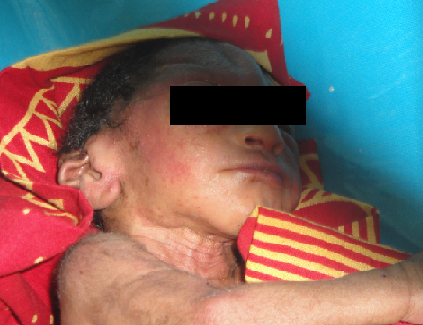
Microcephaly

Slide 13
Hydrocephalus, Spina Bifida and Sun setting eyes

Slide 14
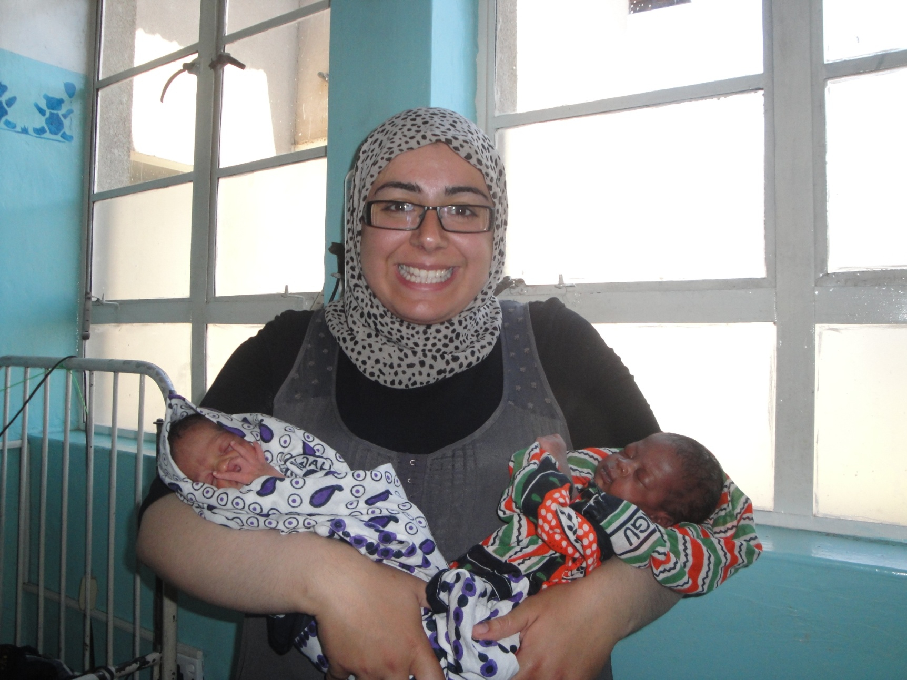
Many happy stories too...

Slide 15
Ethical scenarios
Children with severe pneumonia turned away as couldn’t pay for treatment
Patients imprisoned in hospital as couldn’t pay fees
Running the neonatal unit and prem’s arresting
Dealing with and certifying patient deaths
Using the hospital’s scarce resources e.g. Scrubs and disposable equipment
Try and think about the ethical issues you’ll encounter and how you will deal with them

Slide 16
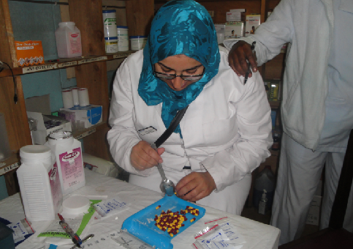
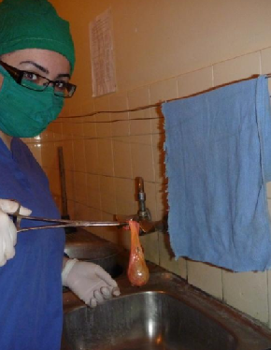
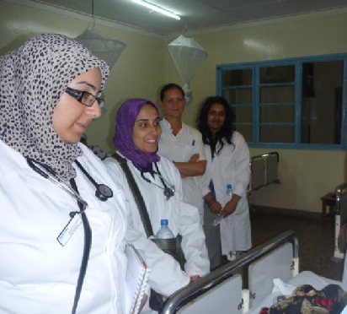
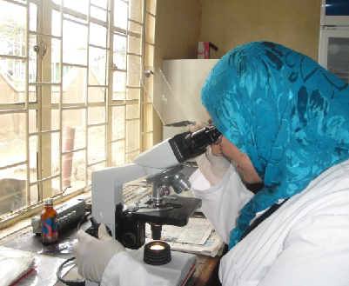
Experiences available
You can tailor your experiences to your interests
Notes:
And discuss a typical day

Slide 17
Health is a state of complete physical, mental and social well-being and not merely the absence of disease or infirmity

Slide 18
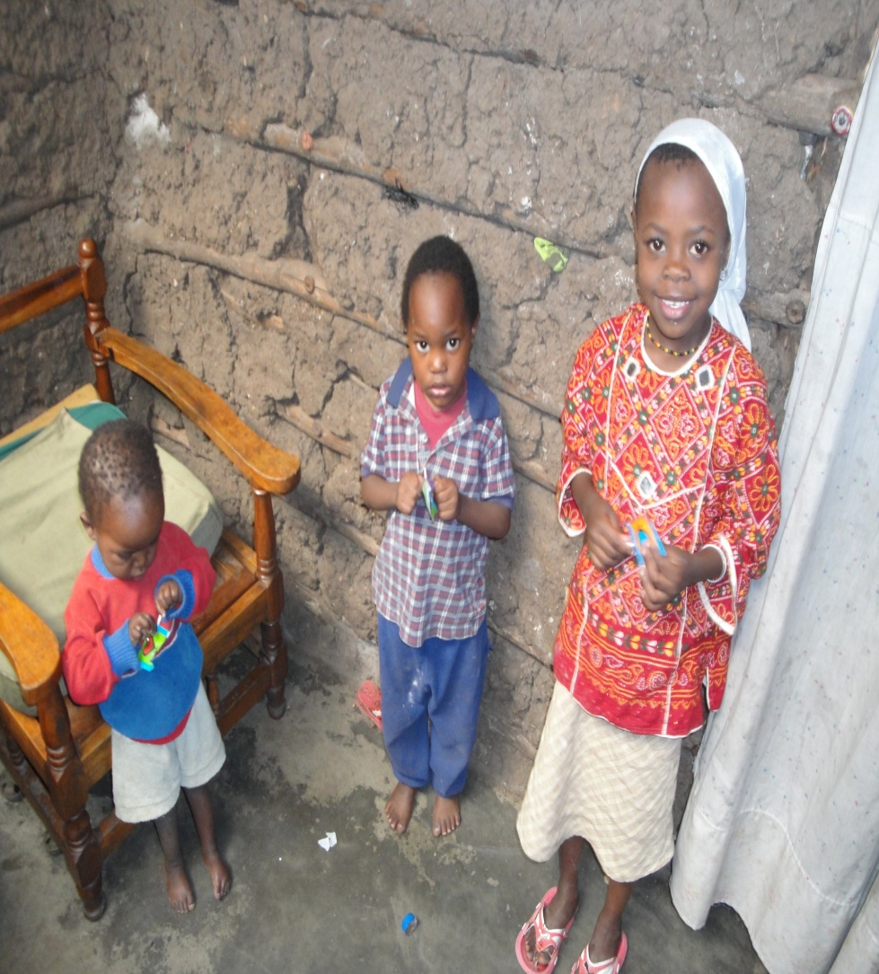
Orphanages
Notes:
Visited lots of orphanages
HIV orphans

Slide 19
Slums
Try and get in contact with the communities you are visiting before you get there to see if there is anything you can bring with you

Slide 20
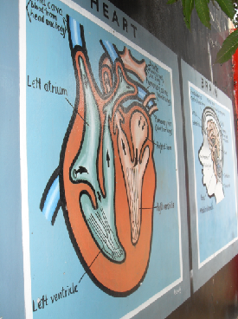
Education

Slide 21
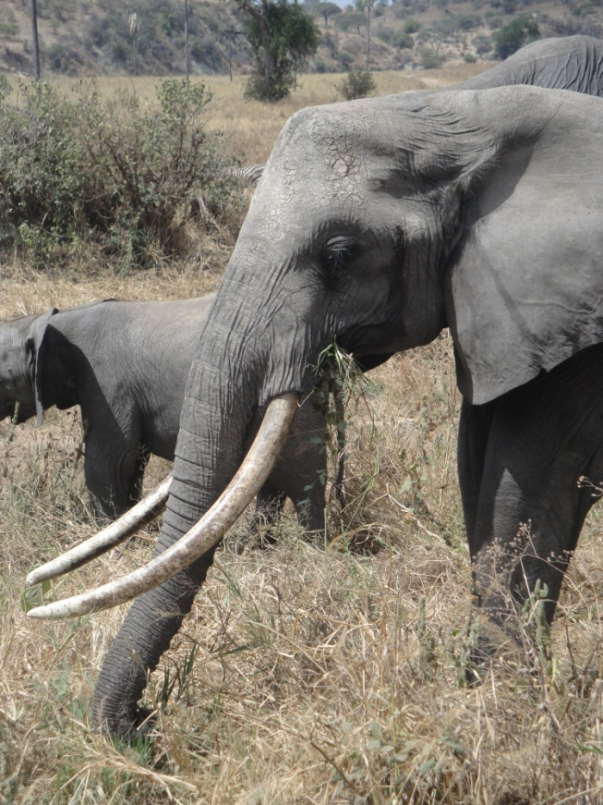
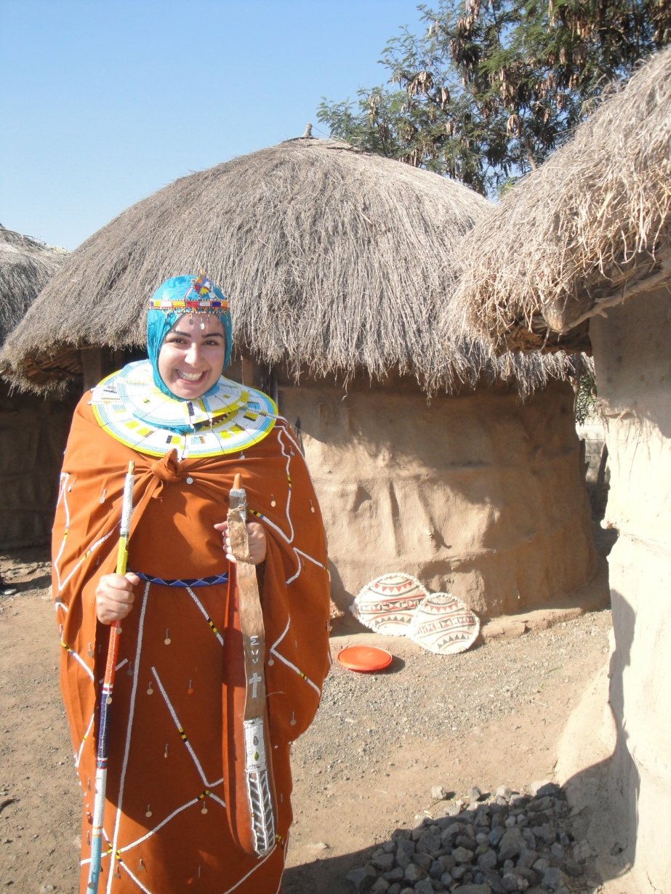
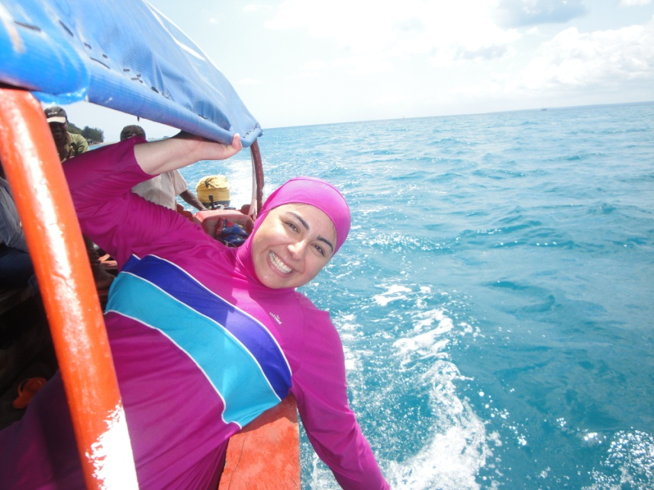
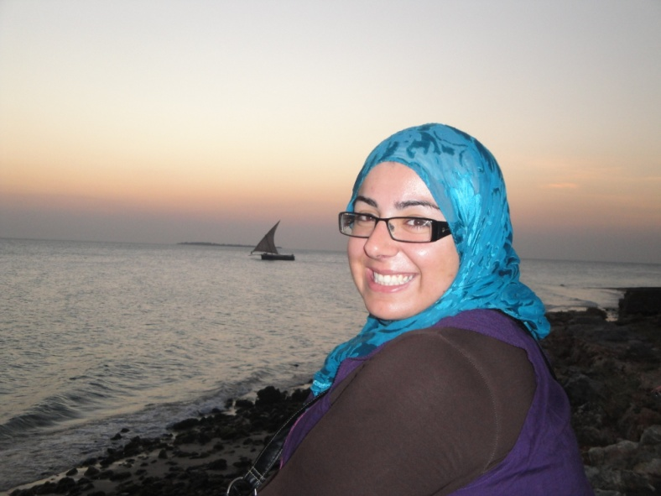
Fun
BUDGET! And (try to) stick to it!!

Slide 22
Practicalities
Flights to Tanzania (around £500) Accomodation (£8 a day) Stay with locals
Think about how you’ll fund your elective
£1000 bursary from “Wellbeing of women/RCOG”
£500 bursary from “Edward Boyle memorial trust”
Start applying early!
UCL elective pack (great airplane reading!) http://www.ucl.ac.uk/cihd/undergraduate/elective_info/elective_pack
Always have a back-up plan! (just in case)
Get in touch! (aa1708)
HAVE FUN!!!!

