Slide 1
‘Solomon Times’
Lily Topham
Notes:
Hi my name’s Lily and I’m going to give a brief talk about my elective in the Solomon Islands.

Slide 2
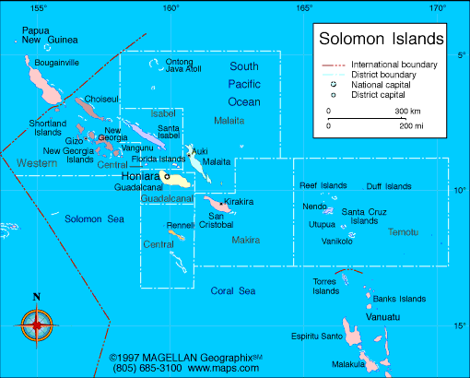
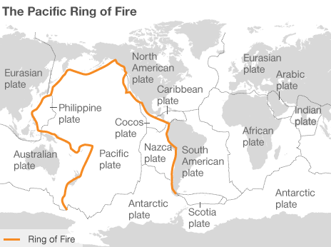
‘Wow, that’s cool......er, where is it?’
Population: 500 000
1000s of islands
1500km ‘long’
Melanesians
Notes:
So this is generally what I heard when I told people about where I was planning to go!
Ancient island archipelago (never connected – incredible wildlife – in the water and out! )

Slide 3
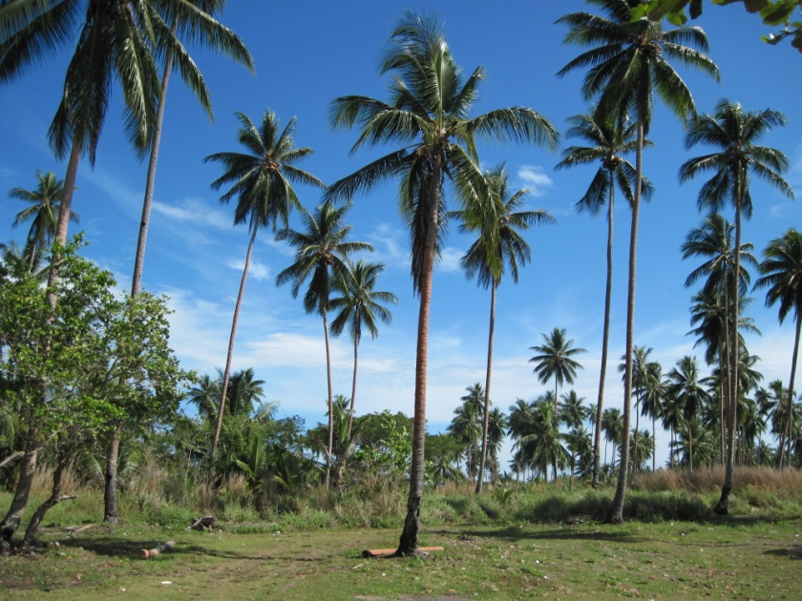
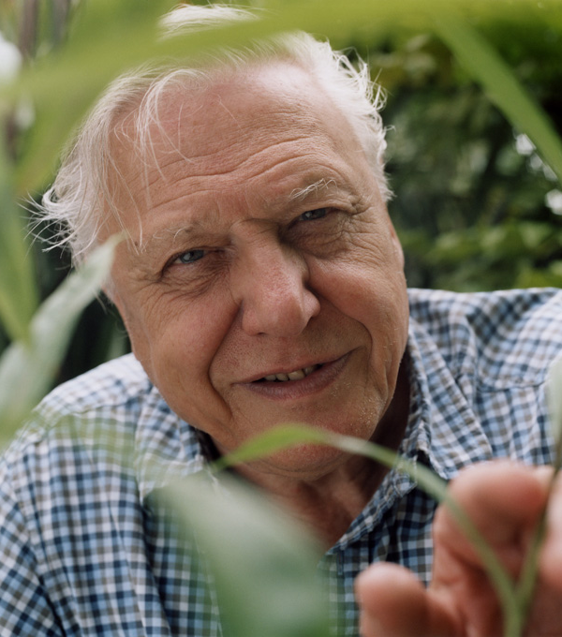
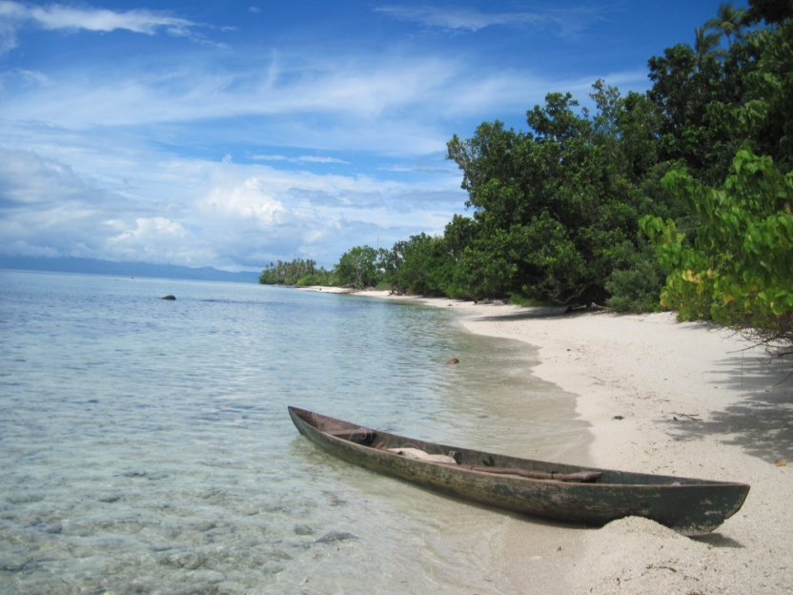
Why the Solomons?
Different!
Developing country
Speak English
Safe
Good reports
Different hospitals
National Referral Hospital (capital)
Gizo Hospital (rural)
Notes:
Exciting wildlife and exciting culture

Slide 4
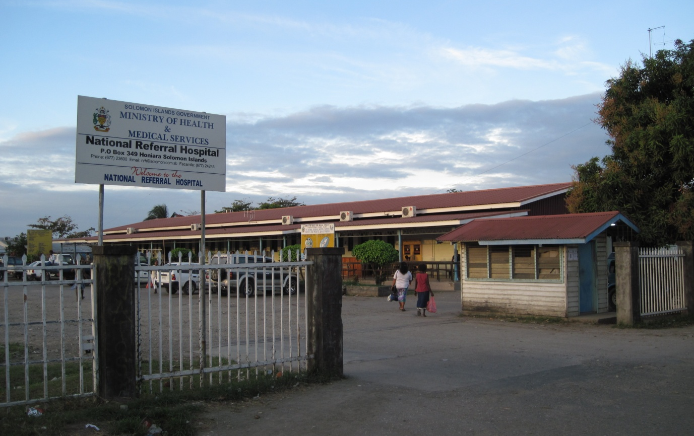
National Referral Hospital
Notes:
The only referral hospital in the Solomons, by far the largest and best equipped, situated in the capital Honiara – right up against the sea.
Has most of the departments which you’d expect
Spent my time there in the A&E and O&G departments- though it’s really flexible – all departments are open to medical students.

Slide 5
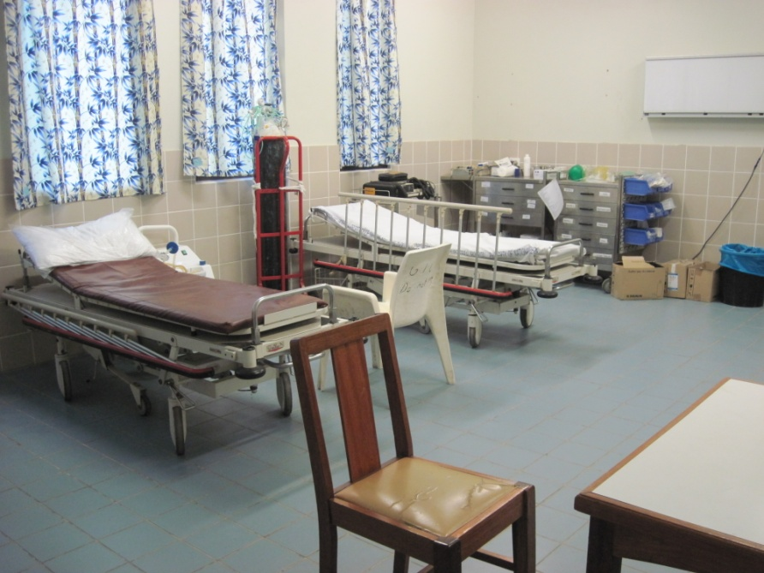
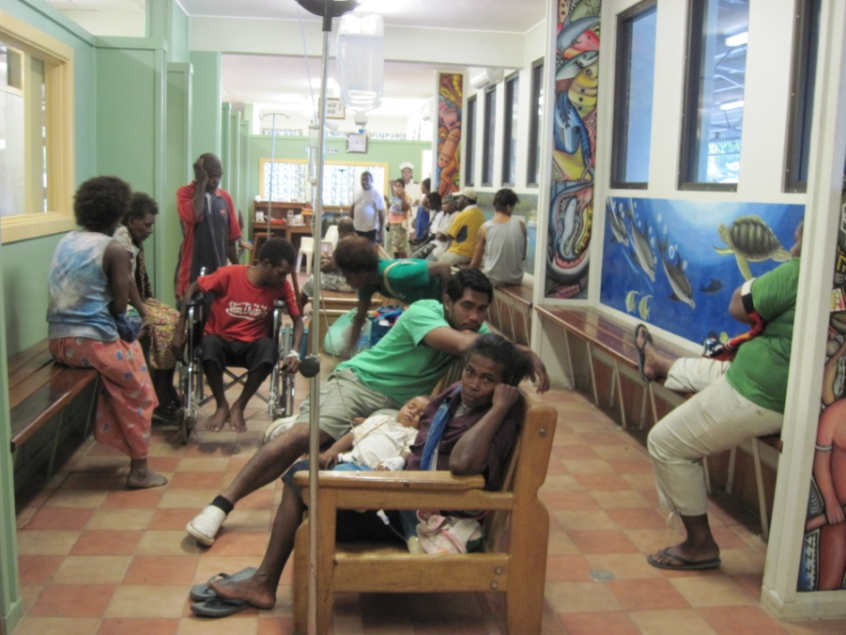
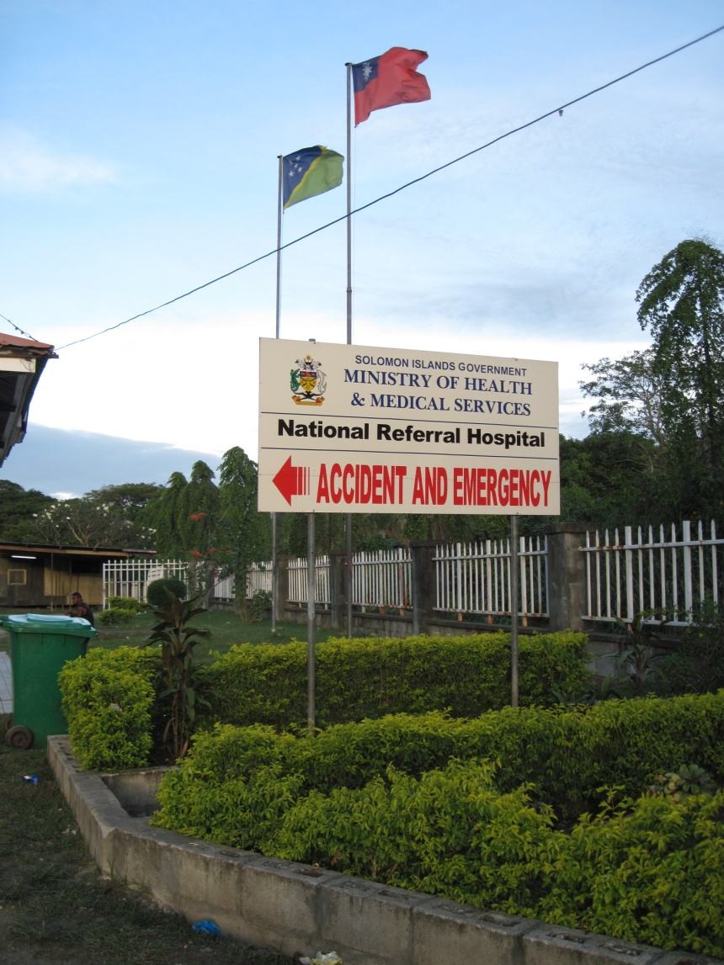
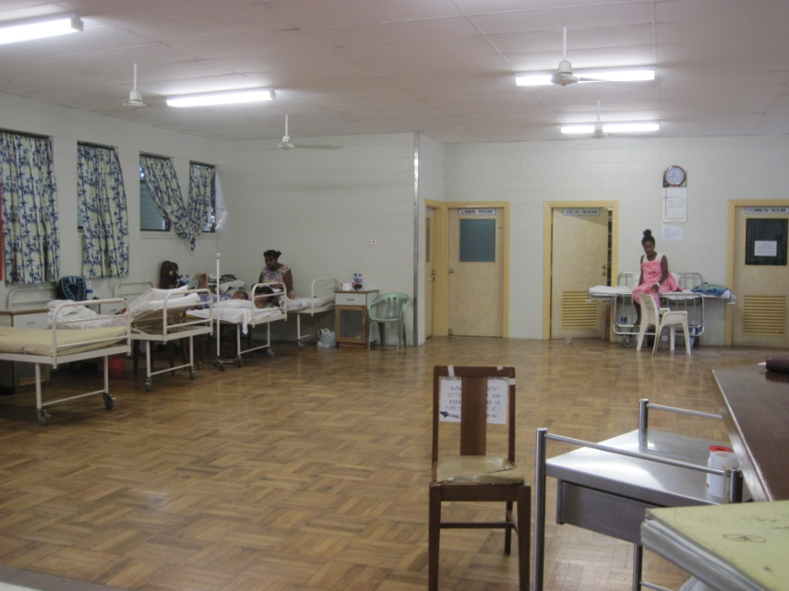
A&E
Lots of flexibility
Lots of responsibility
Treated as a doctor
Lots of clinical and practical experience
Limited resources
Pressure
The tray of doom!
Notes:
Resus, main A&E (they called it outpatients), MAU
Given as much responsibility as you could take – also able to ask for help, nurses amazing – highly qualified and v experienced, doctors v helpful
Shortage of doctors – often only one other there, and that person was often the equivalent of an F1. Also, while I was there, there was no consultant for A&E – so an F1 (and me) in charge of the whole of A&E – puts things into perspective!
I spent a lot of time in charge of ‘Outpatients’ – other doctor would hop between areas as required, but also got experience in minor trauma – suturing, debridements, as much cannulation experience as one could hope for – including paediatric!
Huge range of things – lots of gastroenteritis and dehydration (kiddies), lots of accidents, often involving children (puts a new view on H&S) – e.g. Paeds burns, worms, lots of asthma, also saw my first cardiac arrests – quite a traumatic experience in the resus room with a severe asthma attack, an MI and a trauma patient – one pulse oximeter between them, not enough staff. Horrid.
Limited resources
Medications – cloxacillin, lamotrigine (young girl who had come in post-fit, known epileptic after falling from a guava tree at 4yr, with v poor control – erratic phenobarbitol and phenytoin, seizures approx 1x/week, v small for her age, FTT – hadn’t been on medications for weeks as the family had run out, subsistence farmers miles away from the hospital)
Investigations – means you really do have to rely on your history (therefore why learning pidgin was vital) and examination
People and infrastructure – lack of primary care as we know it
Pressure – you learn a lot about yourself, have to be imaginative

Slide 6
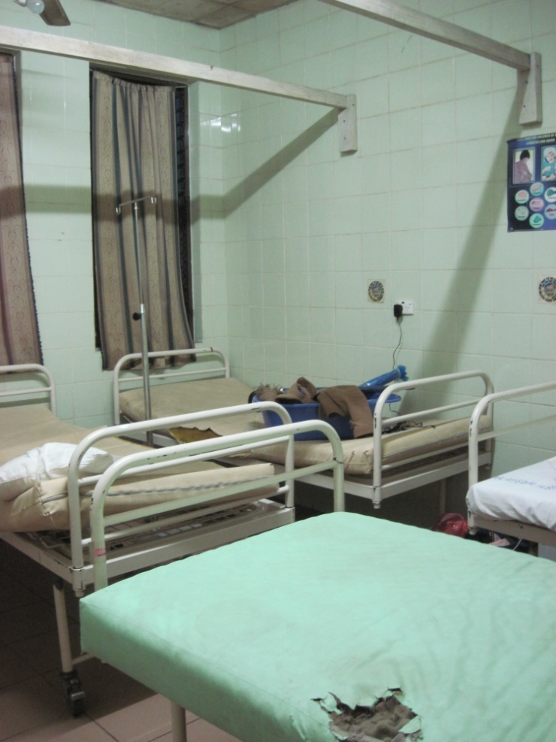
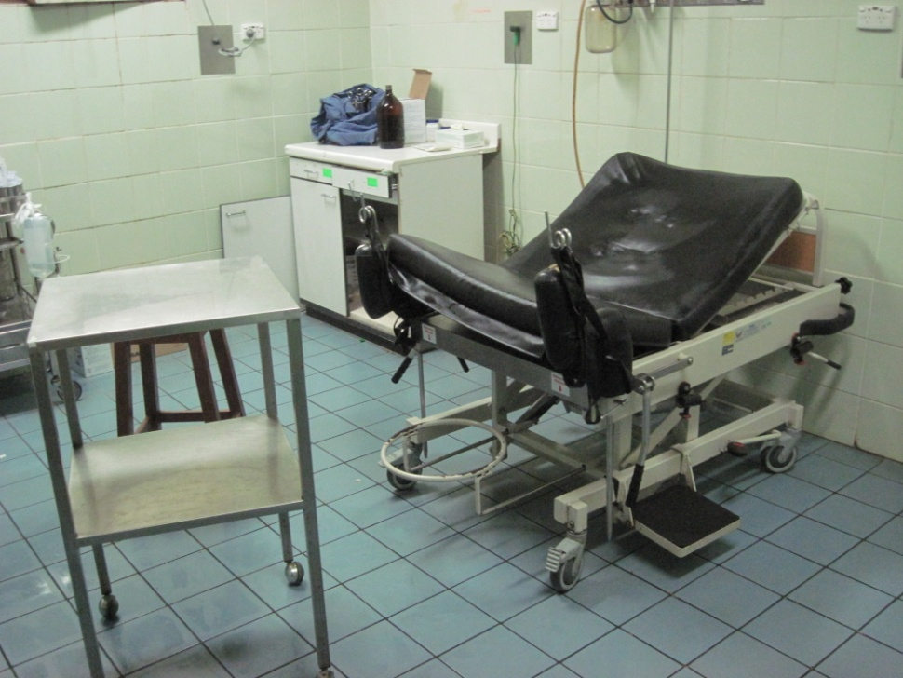
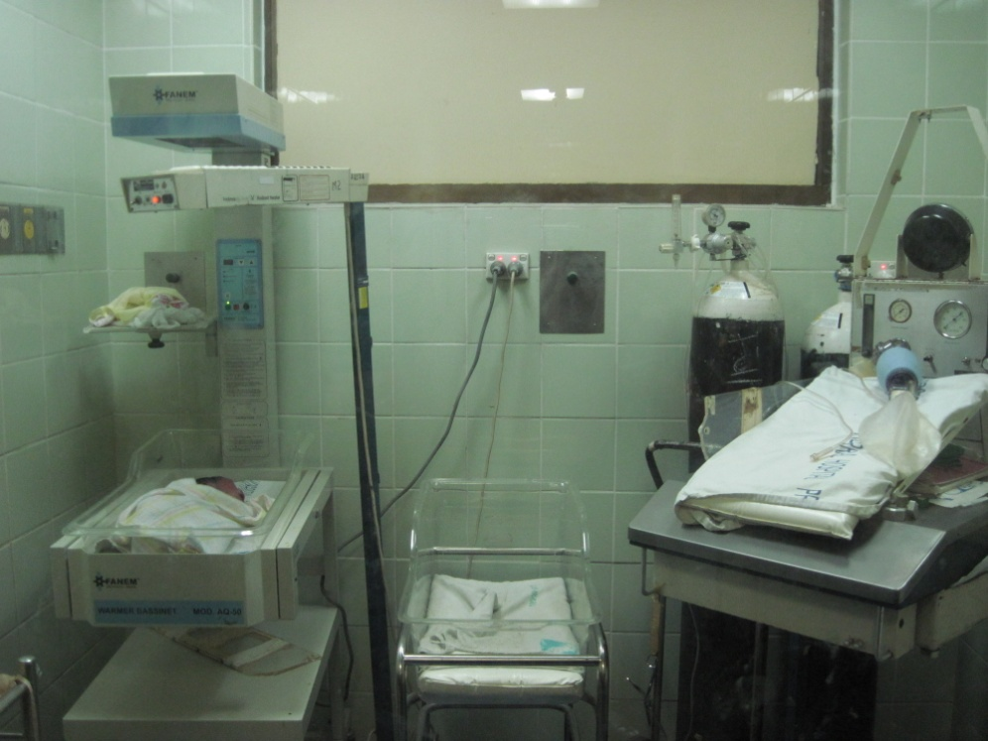
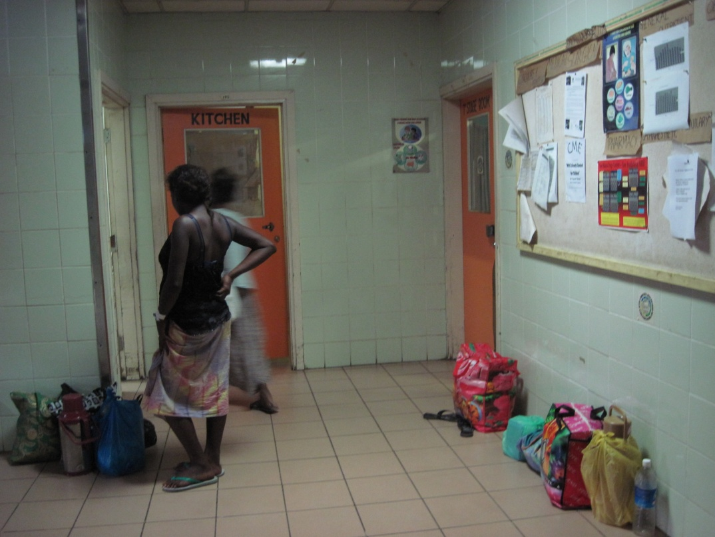
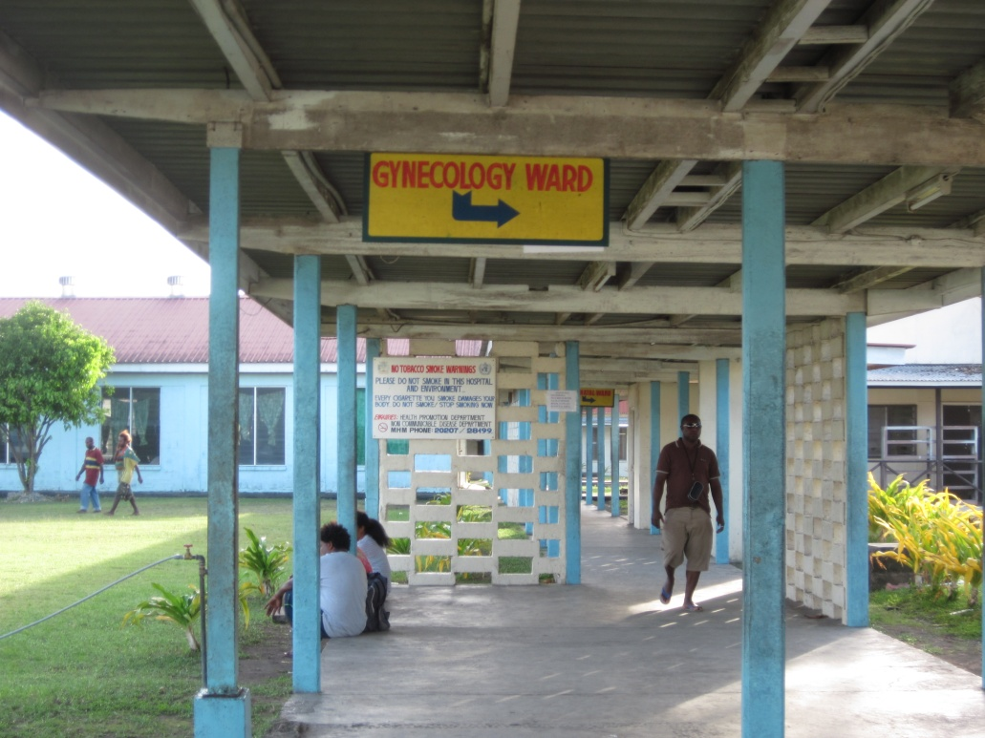
O&G
Solomon Time!
Notes:
A real eye-opener – v young women as well as lots of grand multips who had had 8+ children. No pain relief.
Lots of practical clinical experience – lots of malaria and huge spleens in a lot of the women admitted to the antenatal ward, HAVE to be good at assessing lie, engagement, rate of contractions and FHR, vaginal examinations, normal deliveries, episiotomies, suturing, experience in theatre, post-partum heamorrhage and also the rather overlooked aspect of how to care for a woman throughout a pregnancy with no pain relief!
V busy department – women on floor, babies in the rescusitors
High thresholds for intervention, some of which was quite distressing and frustrating
Solomon Time – chilled out people, relaxed attitude to timekeeping which is usually cool and arguably makes for a happier bunch of people and is quite a good thing for someone like me who’s a bit OCD to learn from. However, also more negative aspects – mainly seen in the speed at which urgent procedures/interventions are carried out. E.g. A primip who had decelerations on foetal heart rate monitoring, poor maternal effort and station = 0 for an hour despite full dilatation and 1hr of active pushing, having to wait for the doctor on call to be driven in from home (by the patient’s husband as the doctor did not have a car!) to perform a ventouse delivery
Some wonderful, if sweaty times, with lots of happy outcomes, with some very sad outcomes, and lots of insight into the culture, and challenges faced.

Slide 7
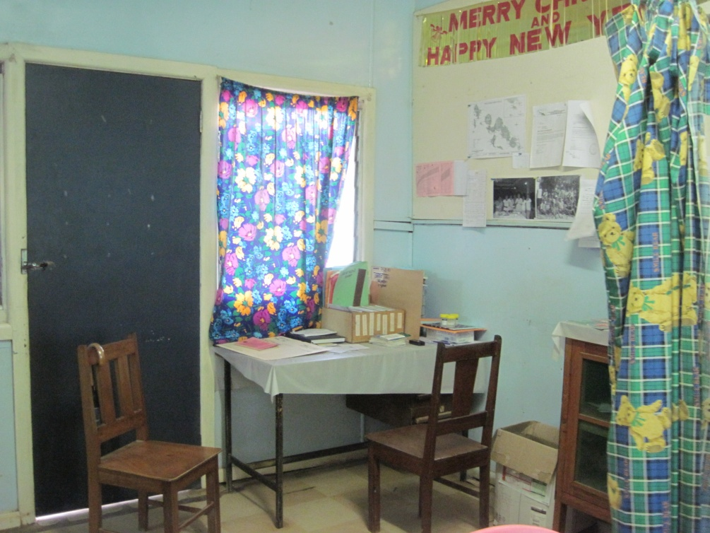
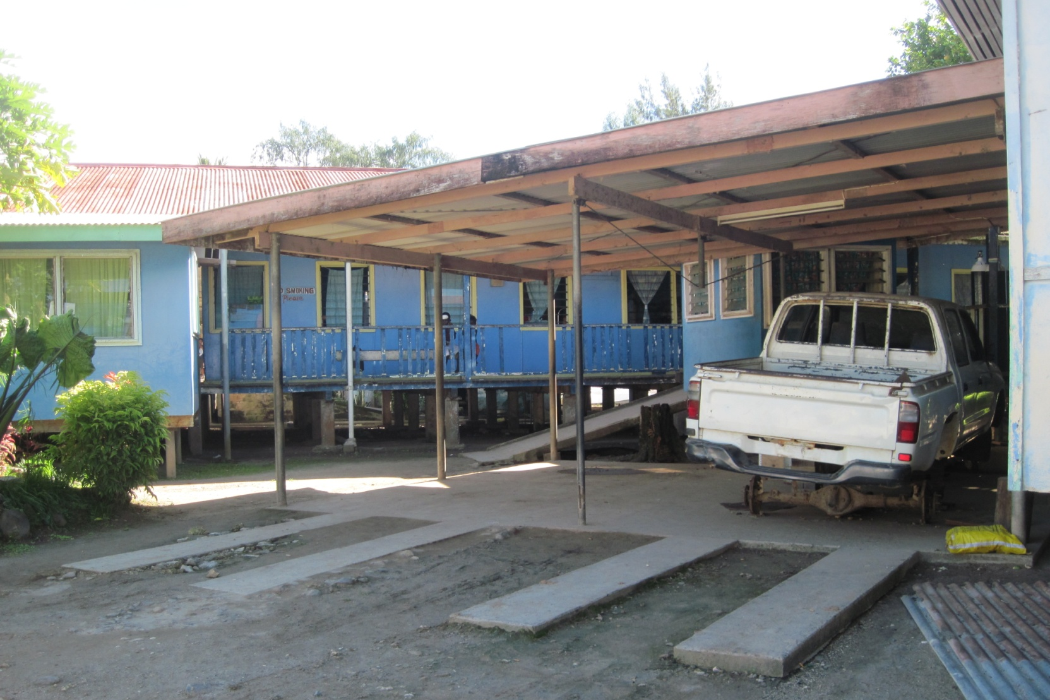
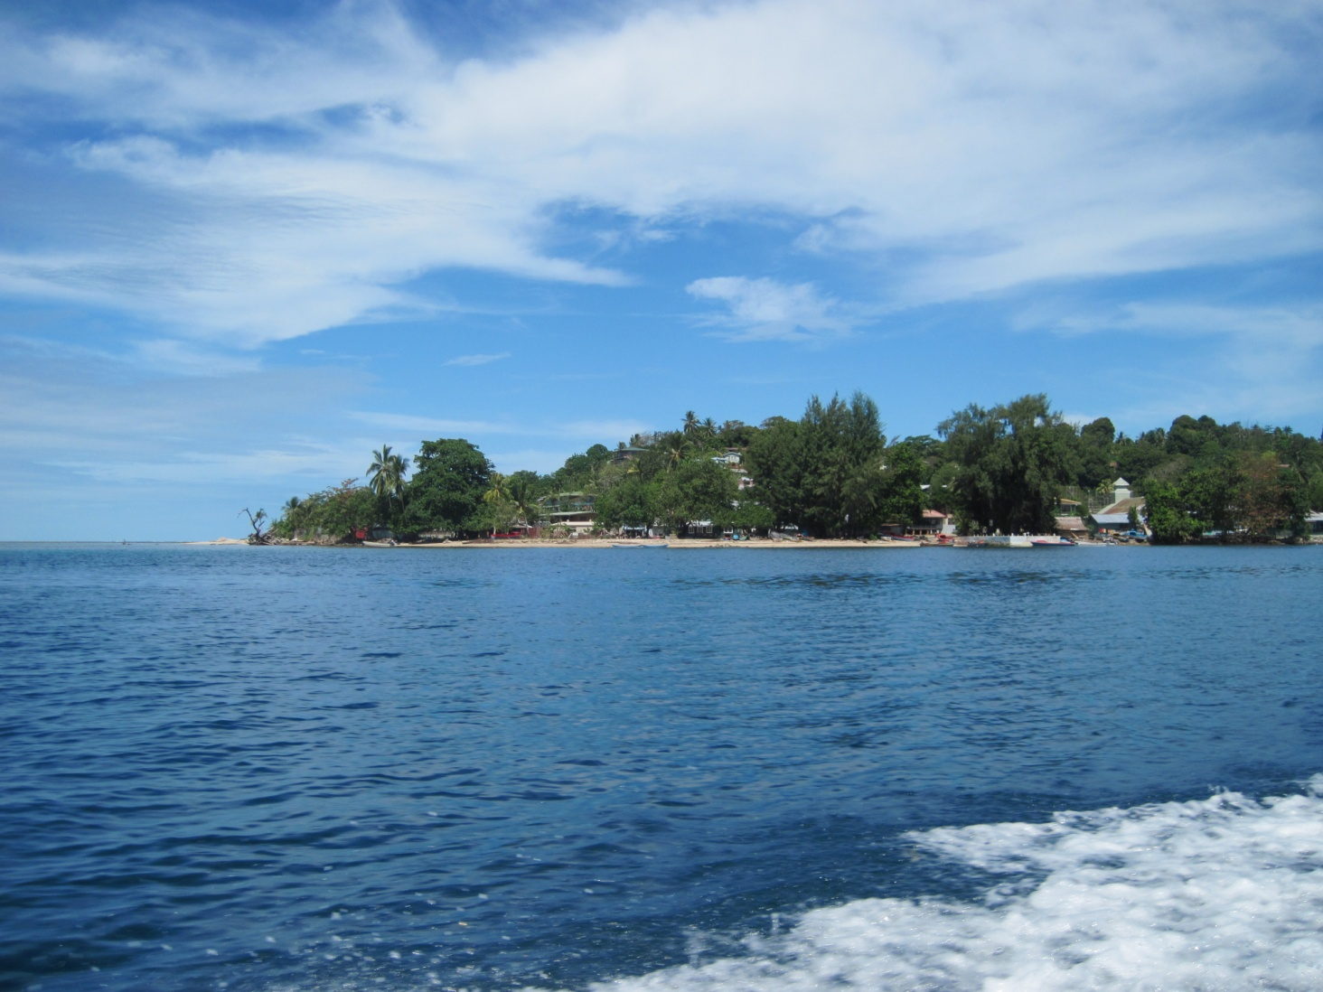
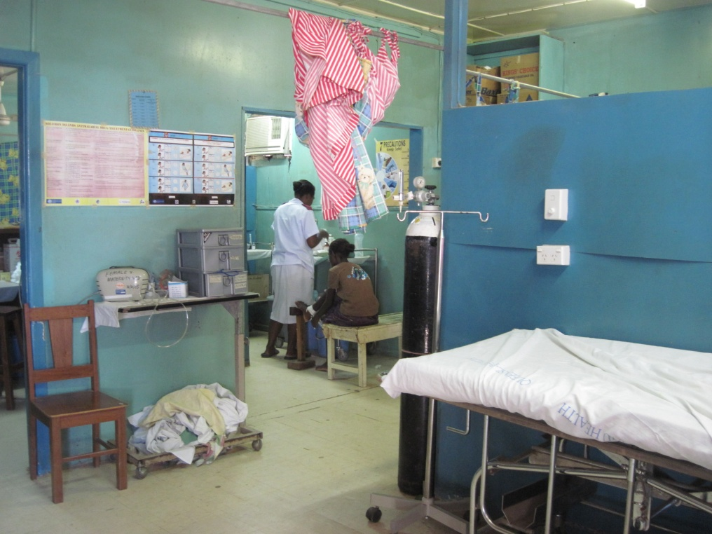
Gizo Hospital
Notes:
Hospital v small – town and surrounding islands devastated in 2007 tsunami, new huge hospital being built funded by the Japanese government. A few wards, one theatre, A&E, maternity ward.
Only 5 doctors – have to be jacks of all trades, operating, looking after the wards, in A&E
Issues of geography and limited resources even more apparent here
Theatre – limited to what could be done under promethadine and pethidine sedation – it’s fairly memorable experience doing a bilateral tubal ligation as quickly as possible with an increasingly conscious patient
Lots of patients come in from distant islands – e.g. A woman who had been gored by her pig, woman with septic secondary PPH
Even more limited Ix and Rx
Often unless basic, had to refer patients on to Honiara – e.g. Pig woman which would take days – didn’t pay for flights, did for boats, but those were not reliable, and certainly not comfortable for sick patients.
Really have to think on feet and be imaginative – e.g. Man who’d swallowed petrol
Also the haphazard nature of ‘assistance’ – e.g. The random availability of drugs partly dependent on whther a stock of donations would last, maybe not such a problem with things like antibiotics, but much more problematic with chronic medications because once the donations finish, that’s it.
Wld see literally everything – and no other departments to refer on to, in casualty (there it’s called Outpatients), you see the patients, examine, do any investigations, decide whether to admit them, issue prescriptions, organise followup

Slide 8
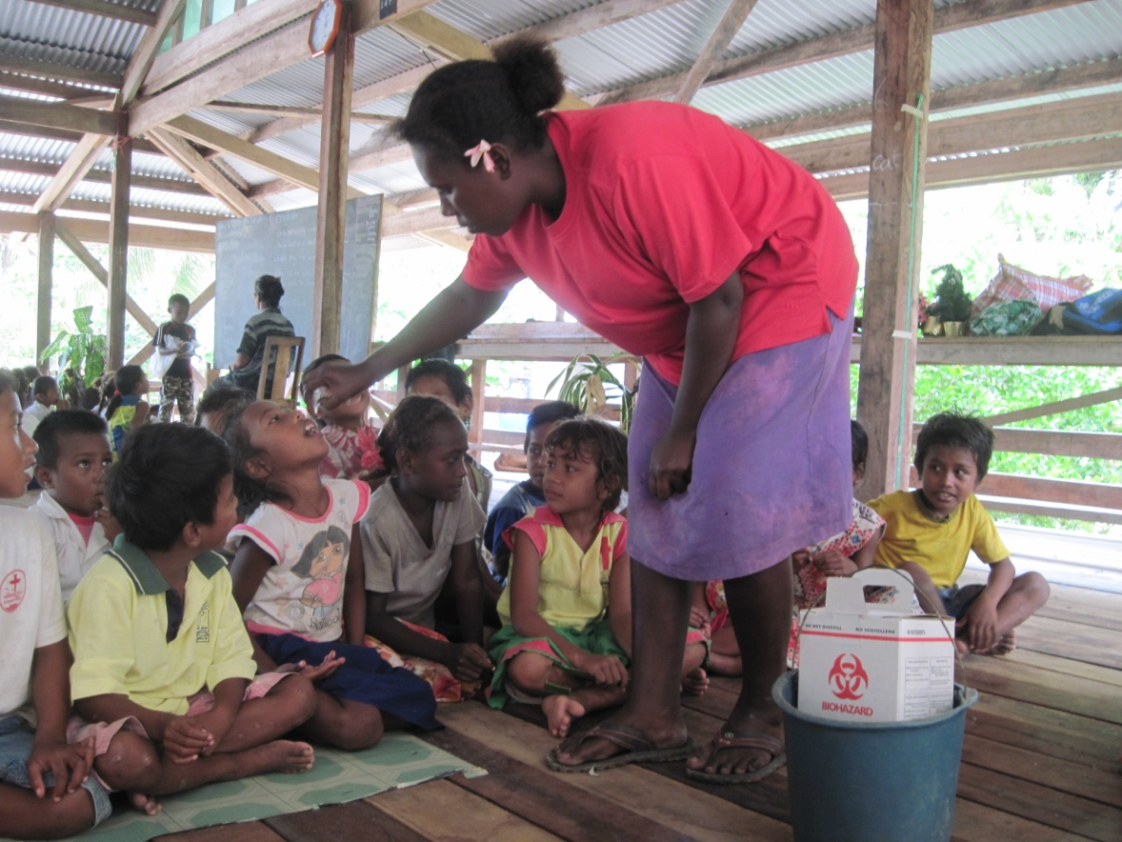
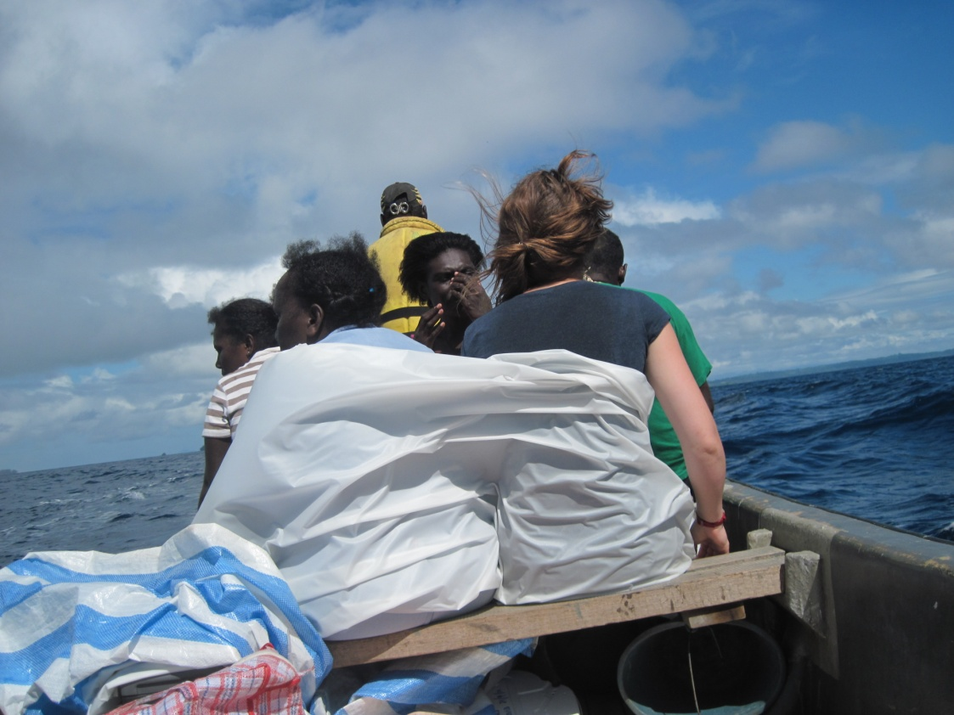
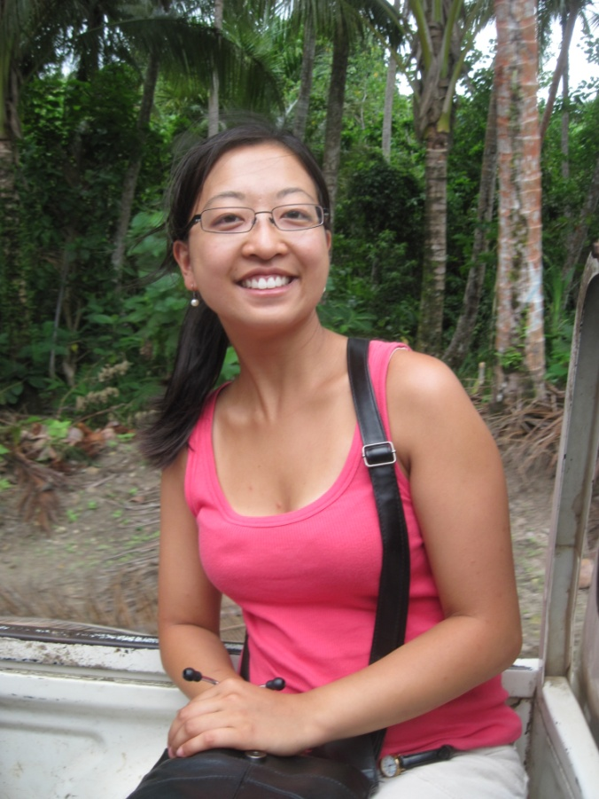
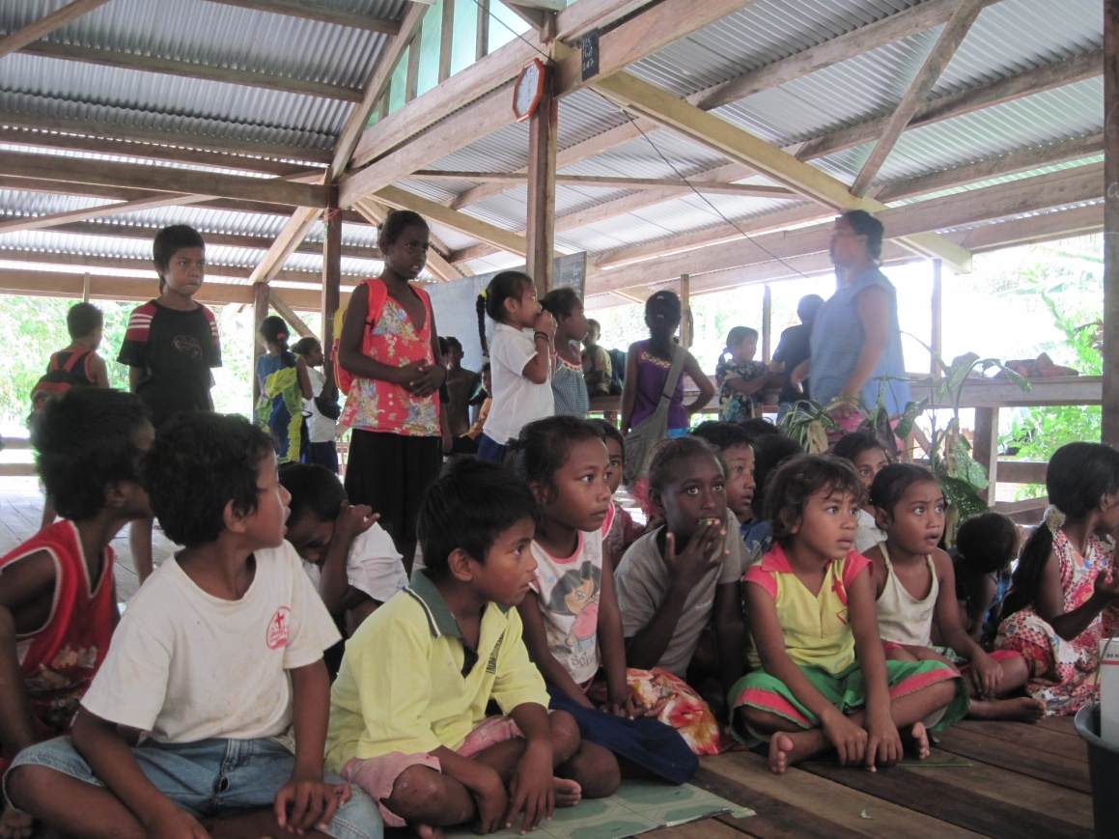
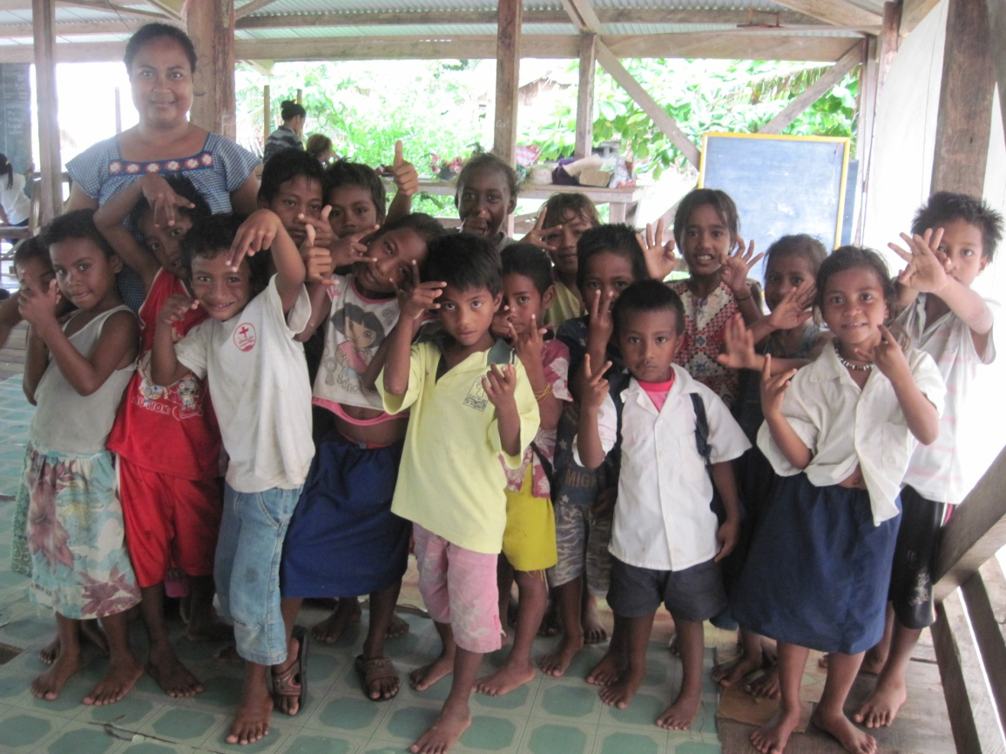
GUNS Clinic
Notes:
Community clinic – nurse-led
By boat and truck to more isolated communities around Gizo – inc Kolombangara (volcano which towers over the surrounding countryside and Titiana village (a Gilbertese village (Kiribati) – different ethnicity and culture - micronesians)
Brilliant times but also serious experiences – young boy who had active preacordium, palpable thrill and pansystolic murmur, suspect VSD, v small for his age – looked about 6yr
Ultumately referred to Honiara – but made me think a lot about what could really be done for him.

Slide 9
What I got from my elective
A boost after a tough year!
The challenges of limited resources
Both people and money
The challenges of geography and infrastructure
Practical clinical experience
Thinking on your feet and a bit of imagination!
Notes:
Reinvigorated after a tough year!
Different type of medicine and the impact and challenges of limited resources – in terms of people, and money
Challenges of geography and infrastructure – lack of primary healthcare as we know it, management of chronic conditions problematic, overwhelms the hospitals, difficulty of accessing healthcare, especially for a country that hasn’t much money (and how do you pay for it all when you’ve limited inductries, without selling off all your fishing rights and/or chopping down all your virgin forests for the logging industry), and it’s not so simple as saying oh just build some decent roads when the country’s a network of islands!
Practical clinical experience
Thinking on your feet and a bit of imagination – lots of challenges and pressure, but you learn a lot about how you function as a person and a medic, and think outside the box!
I was really happy to go in the summer (despite occasionally regretting it when I looked at flight prices!), and it feels a very long time ago, but
functions in terms of its healthcare, huge insight into another culture that I was so privileged to be welcomed into - insight that you’ll never get just as a tourist,

Slide 10
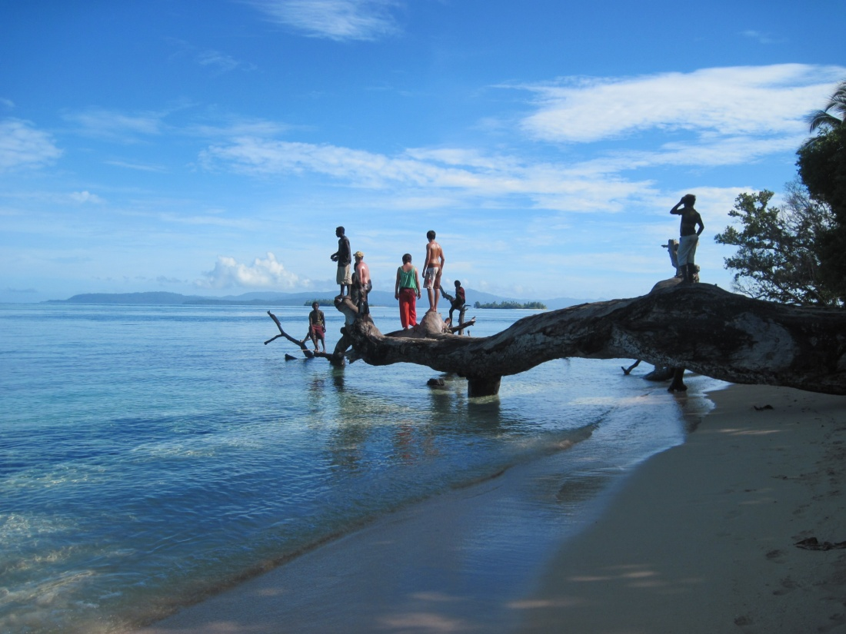
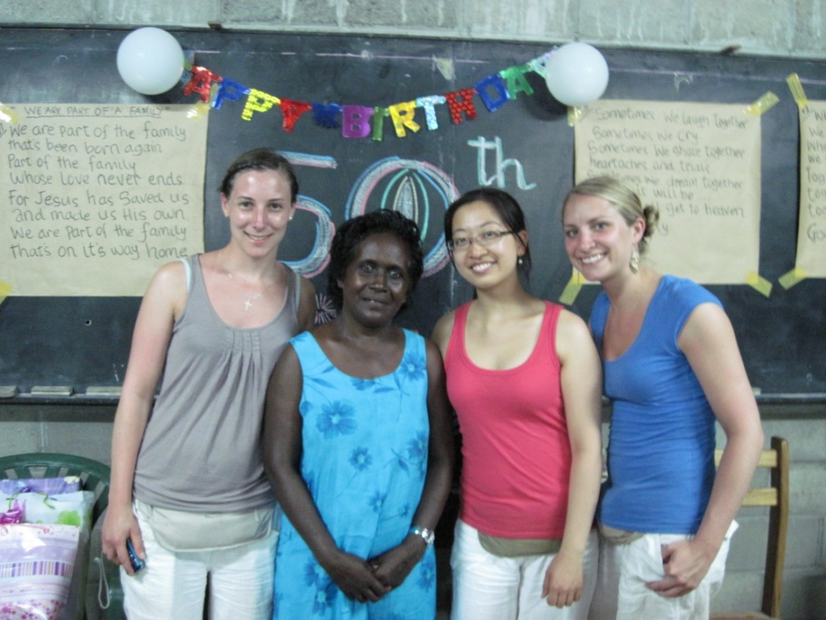
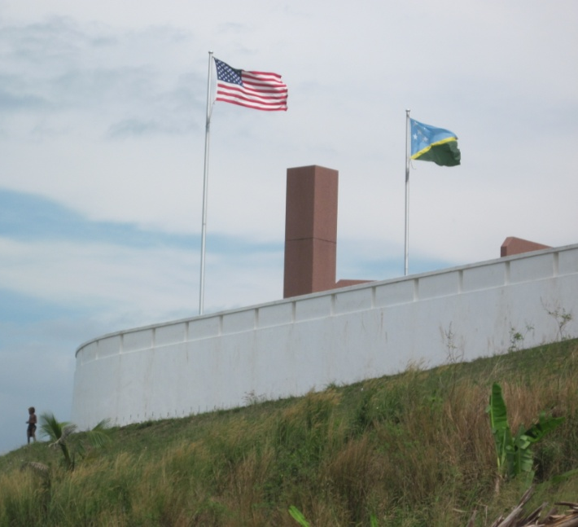
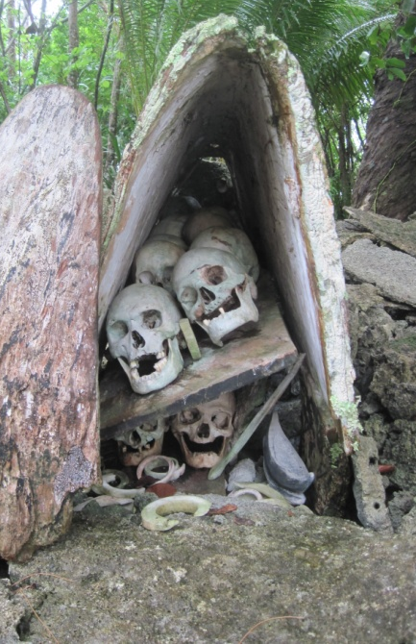
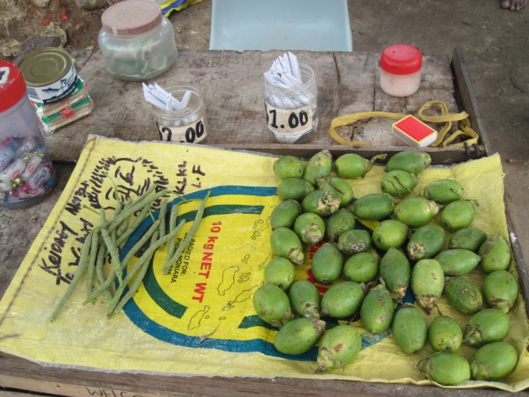
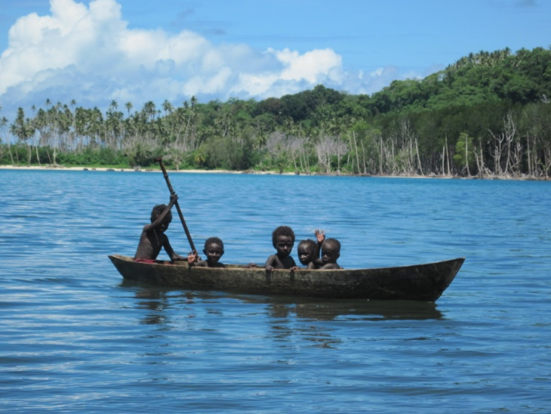
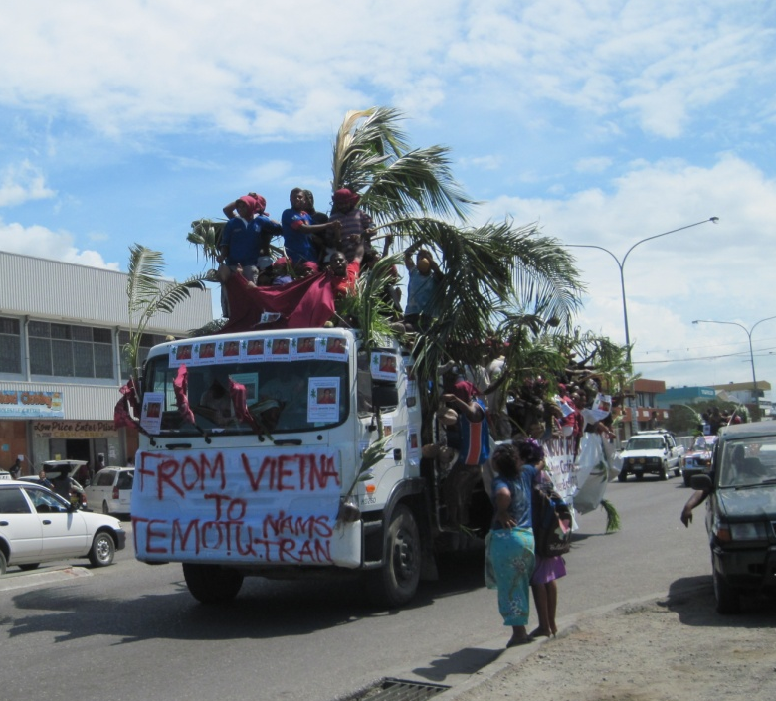
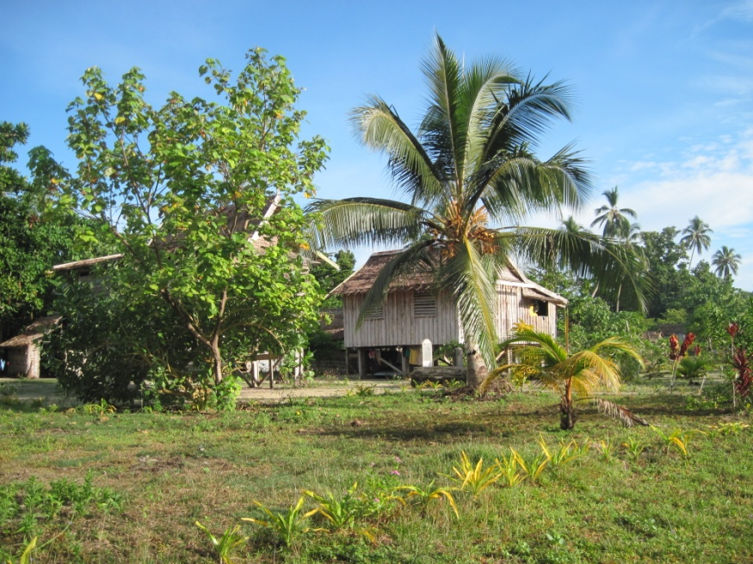
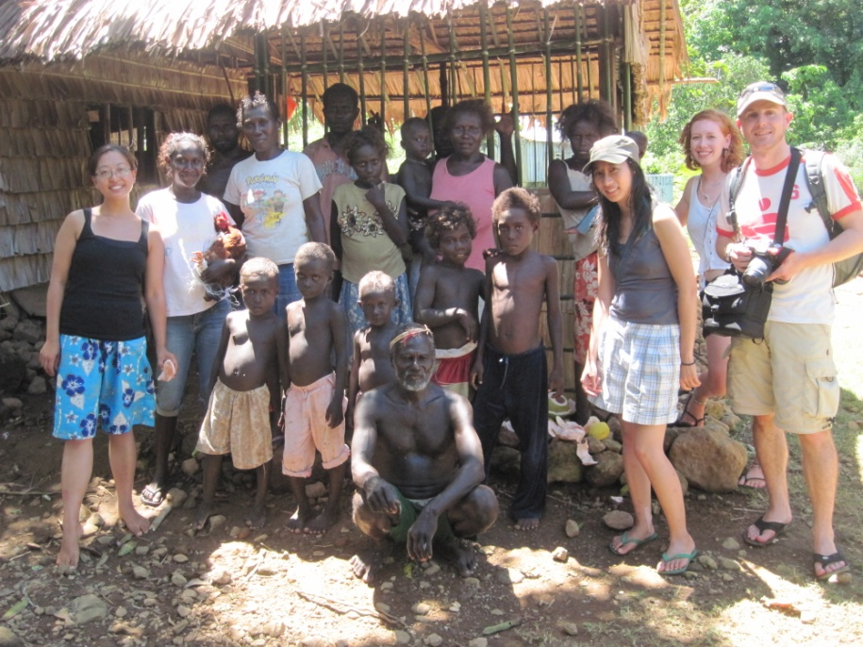
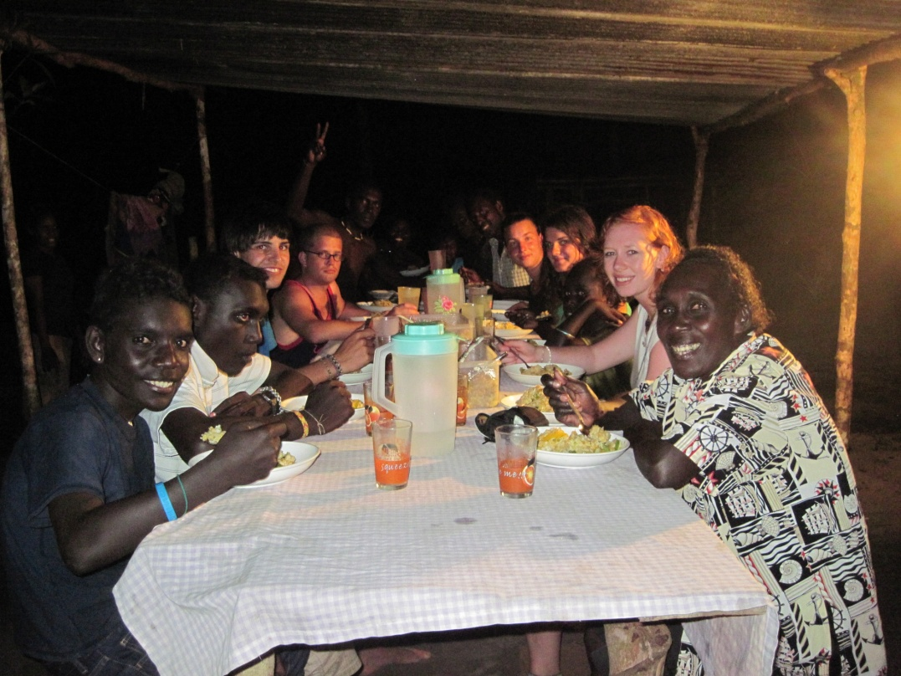
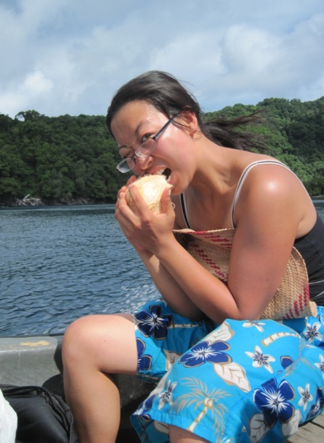
A different culture and wonderful friends
Notes:
Most importantly, get an incredible insight into a another country and another culture.
On a lot of electives it’s quite easy to just get signed off in your 1st week and then go on holiday, but that’s not really the point of elective. I think we’re all really priviledged that we’re welcomed into another country’s hospitals and homes and from the experiences in hospital, the people that you meet there – patients, relatives, doctors, nurses, midwives etc, that’s how you get an real insight into another culture that you’ll never get if you’re just a tourist.
And the people that you meet in the hospitals were the ones that I shared wonderful, unforgettable moments with – the incredible SI hospitality and warmth of heart in the 50th bday of Yvonne the electives coordinator full of music, singing and food, the perfect final day I spent in Gizo visiting Simbo the home island of one of the theatre nurses (this is her village and Lali’s the one with the chicken!), to a family who lived in the tiny village of Searhaghi who adopted us elective students – unforgettable paradise evenings eating with them by kerosene lamp under an increible sky, after a day of island hopping and learning to reef fish with improvised coke cans and line.
You learn a lot about yourself and about others – and it’ll never be so easy again! So take advantage of it!

Slide 11
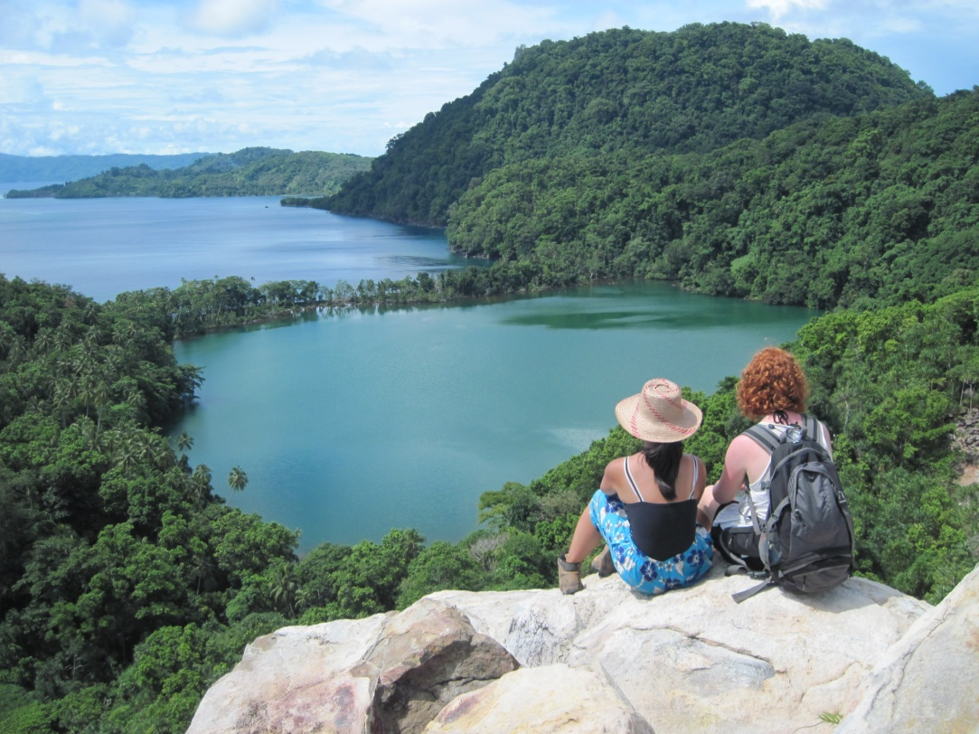
Any questions?
llt104@imperial.ac.uk
With thanks to the Matthews Wrightson Charity Trust
Notes:
Most of us could witter on for hours about what we got up to on our electives, so this is going to be an overview of some highlights of the things I got up to and saw on my elective and the main things that I got out of it, and hopefully it will interest you, and maybe inspire you when you’re thinking about what you want to do and where you want to go.

