Slide 1
Medical Protection Society Elective Indemnity
Kristi Smith-Edhouse
Regional Membership Co-ordinator

Slide 2
About MPS
World’s leading indemnifier of health professionals since 1892
Offers peace of mind to more than 270,000 health professionals and their patients worldwide
Members commonly seek help with clinical negligence claims, complaints, medical council inquiries, legal and ethical dilemmas, disciplinary procedures, inquests and fatal accident inquiries
Mutual not for profit, financially independent
Discretionary cover – flexibility
International organisation – 40 offices world wide

Slide 3
Elective Indemnity Cover
Only UK based international indemnity provider
Free worldwide elective indemnity cover
Claims of clinical negligence/malpractice
Telephone advice – ethical and medico legal problems
Good Samaritan Acts
24 hours a day, 7 days a week any where in the world

Slide 4
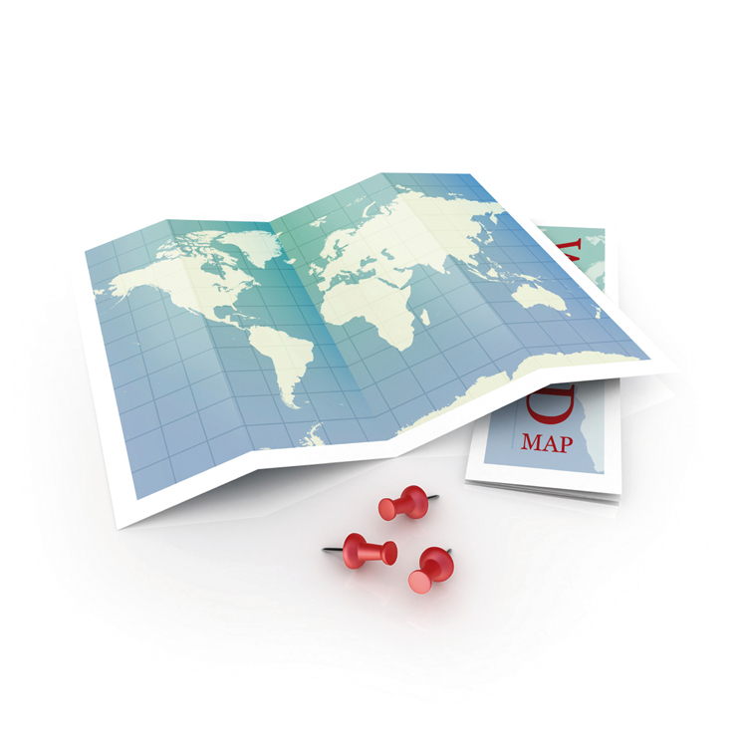
MPS Worldwide
Republic of Ireland
Caribbean
Hong Kong
Malaysia
New Zealand
Singapore
South Africa
United Kingdom
Rest of World

Slide 5
Electives in Australia
MUST arrange indemnity via MPS
MIPS (Medical Indemnity Protection Society)

Slide 6
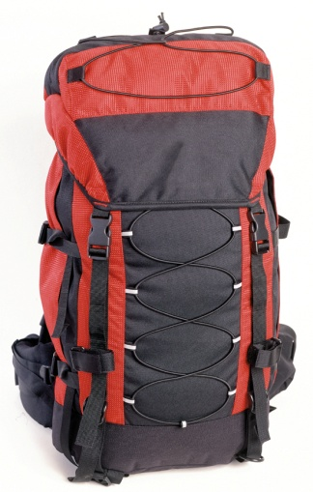
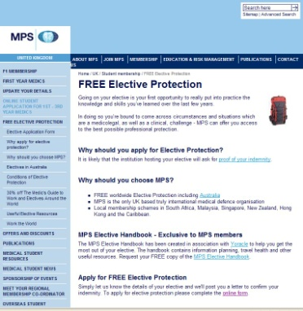
Electives Handbook
Free guide to planning your elective
Collect now or go to our website –www.mps.org.uk/elective
30% off The Medic's Guide to Work and Electives Around the World
Notes:
Section on preparing for a research or audit project
Read the student testimonial

Slide 7
Confirmation of cover
www.mps.org.uk/elective
Email: elective@mps.org.uk
Tel: 0845 900 0022
Give us a couple of weeks notice!
ENJOY!

