Slide 1
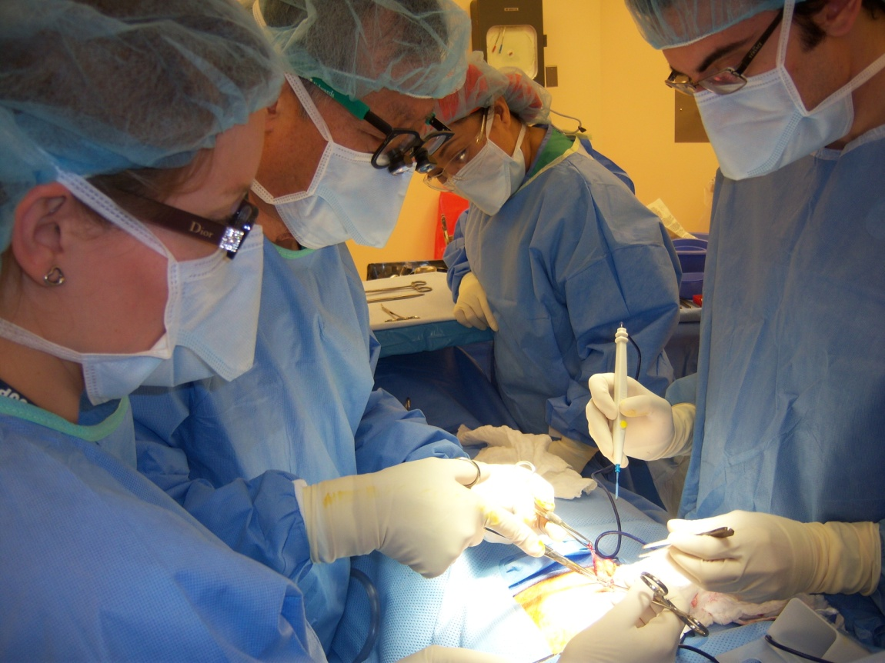
My Elective in New York
Maresa Brake
(maresa.brake@imperial.ac.uk)
Notes:
Decided to spend my elective in NY
This picture shows me in OR
My email address for any questions

Slide 2
Outline
Why New York (Mount Sinai) and application process
Accomodation
Typical days in hospital: Neurology vs Surgery
US healthcare system
What to do at the weekends/ End of elective holiday
Notes:
I will spend most of my time talking about my typical days in hospital
Compare the two
Negatives
Briefly about healthcare debate – very topical when I was there

Slide 3
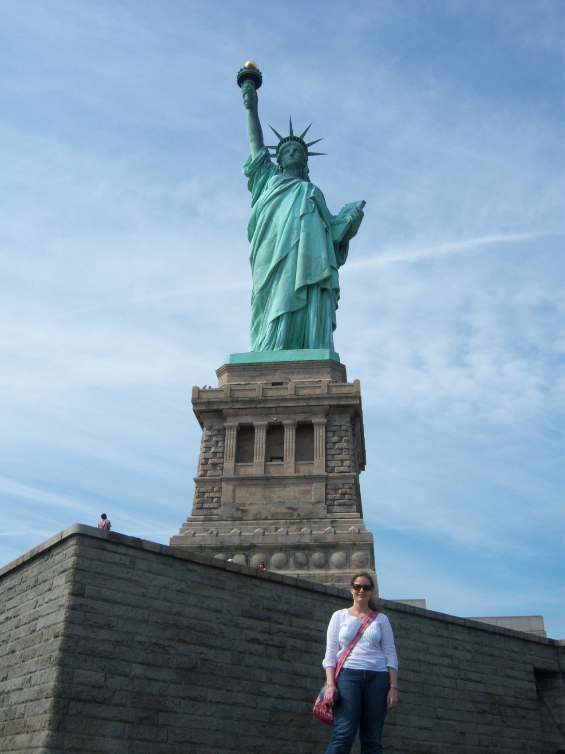
Why New York?
Developed vs developing country
Type of work eg specialty
Holiday vs Work
Finances (Total: $7,800)
  $1,500 Mt Sinai + Visa
  $1,800 accomodation
  $1,500 Flights
  $ 3,000 Expenses
Notes:
Decision where to go, which friends to go with, if to go with friends. A country more similar to UK, or completely different experience. In the end decided on NY, partly as well because I was thinking of working there for a few years.
Specialty – very different types of things you see. Ties in with Developed vs developing. I knew I wanted to be a surgeon, so where do I get better hands on experience. People say in US because of malpractice issues only observatorships. As you will see that is not true.
Whether you want a holiday or not. NY is intense, a lot pressure and a lot is expected of you. But can always do just one month or split elective. Plus if you are in Group 1 or 3 , still 3 weeks of holidays. You also have weekends to do lots of stuff. US very diverse, lots to do and easy to get around
US elective are expensive because of fees, and NY because of accomodation. Car rental etc very cheap.

Slide 4

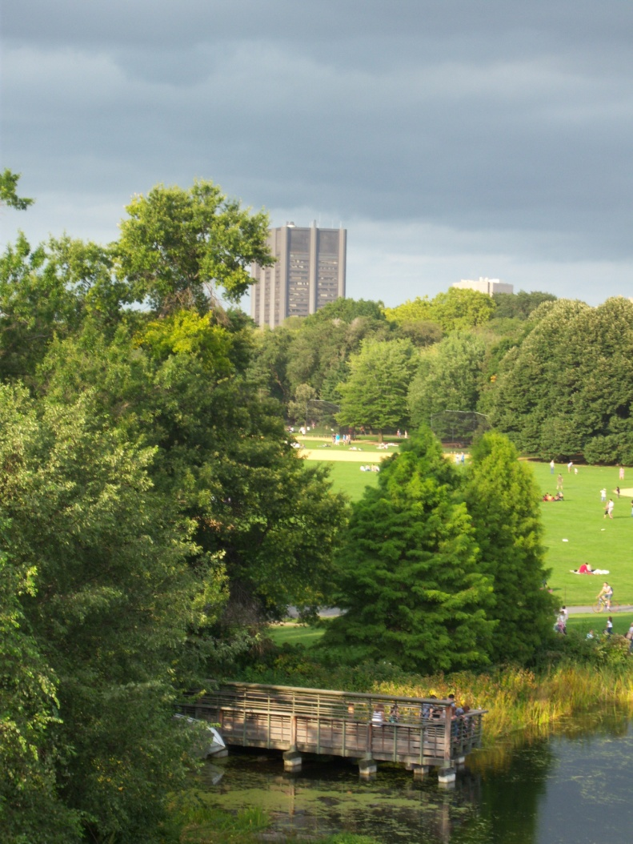
Why Mount Sinai? (Application process)
Application process:
  Use google
  Differs between hospitals
  Get started early and be organised, make sure you are aware of deadlines
  Visa
  Occupational Health
Notes:
I wanted to be in NY, rather than California, or Boston
Considerably cheaper at $500 than for example Harvard at almost $4000 per month. Rather spend that money on holiday. Also, my experience was very similar to Harvard people.
Find our very late usually that accepted. Some of my friends were in the middle of Year 5 revision when they found out (group 1) that they had been accepted at Harvard etc. Leaves little time to organise back up plans. I had found out in February. Ties in with application process. BE ORGANISED. Google the hospitals, and have everything ready by the time you can apply. Then you can just send it off. I had everything ready two months before I could apply. As soon as I could apply I sent everything off. Lengthy process: need to go to Occ health etc
NYU- difficult to get into, but free, email people personally. I had a space for Neurosurgery, but decided I’d rather go to Mount Sinai for other specialties

Slide 5
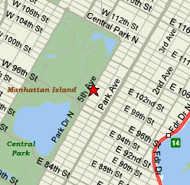
Accommodation – Park Avenue
Student accommodation - $900 per month
Upper East Side
Next to Central Park
In the middle of Manhattan
Notes:
Student accomodation: be pushy, they tell you nothing available, but they usually do have spaces
2 share a kitchen, bathroom and lounge

Slide 6
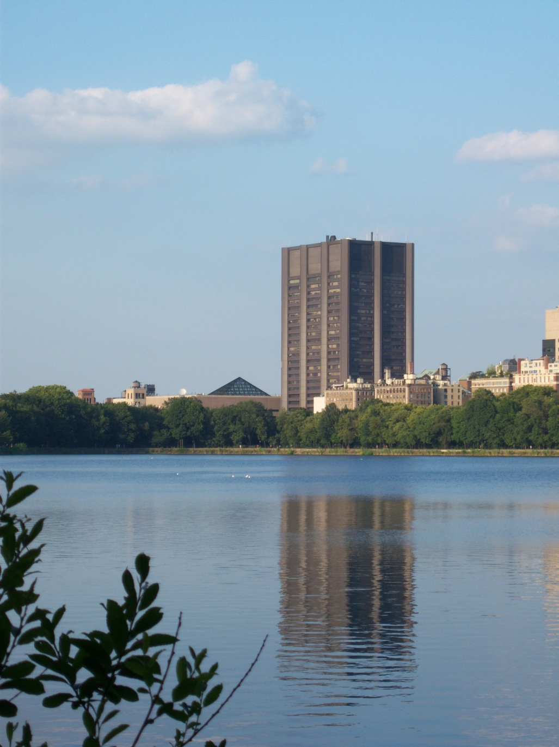
Neurology - a typical day
6am Wake up
7am Pre-round patients
8am Meeting w/ on call team
9am Ward round
12am Academic meeting
1pm Teaching
2pm Ward round, jobs
5.30pm home
7pm Dinner with friends
Notes:
Picture of mt sinai overlooking central park

Slide 7
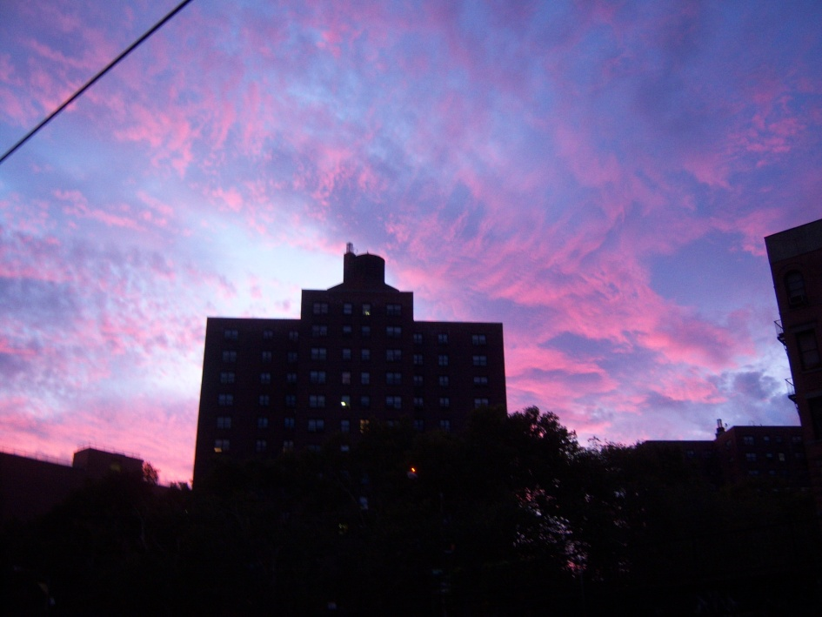

Slide 8
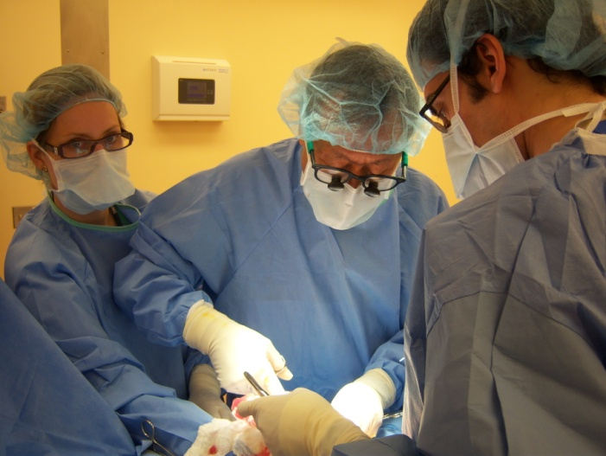
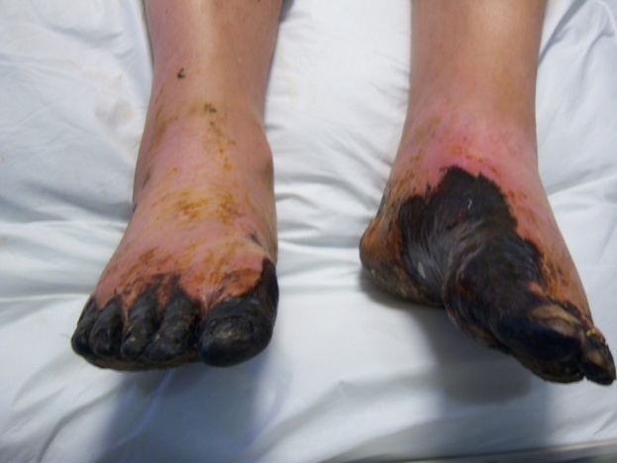
Surgery - a typical day
(Vascular and General Surgery)
Mount Sinai vs Bronx VA
5am Get up
6.30am Ward Round starts
7.30am OR – be proactive
4pm Ward Round
6pm See patients in ED
10pm get home
On other days, asked to join intern surgical training
Notes:
Free shuttle transfer
Pictures of me assisting presentation

Slide 9
US healthcare system
Healthcare debate
American medical students
VA vs Mount Sinai
Notes:
American medical students: very hard working, mature and older, get more responsibilties, more team spirit
Medicaid vs Medicare, in NY at time Obama healthcare reform, and debate in UK
VA vs Mount Sinai system

Slide 10
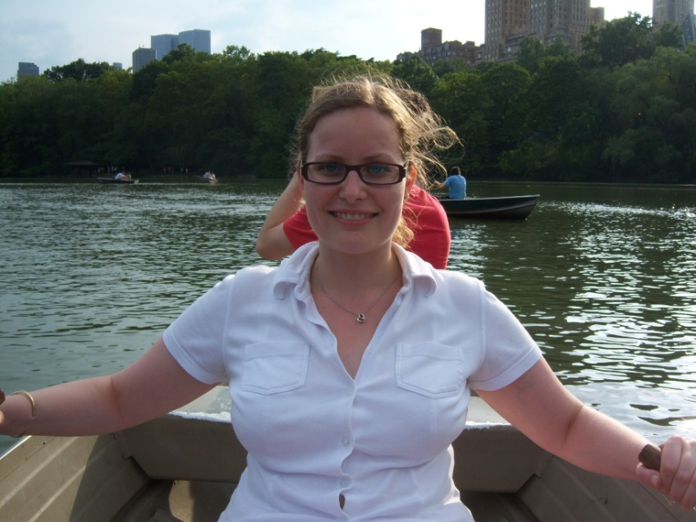
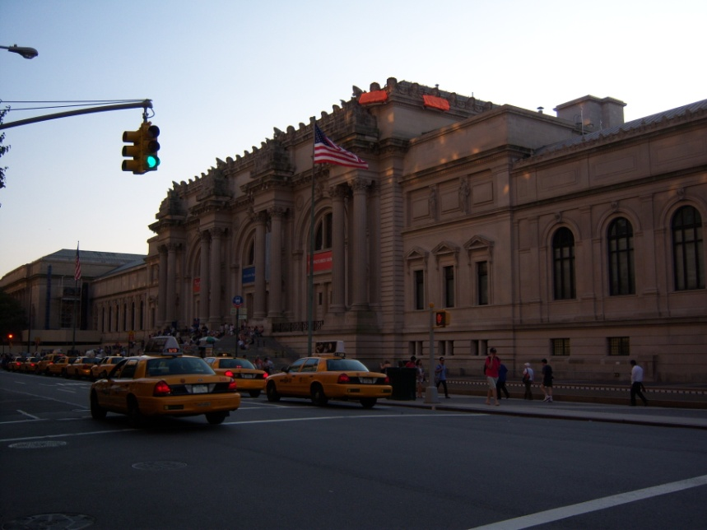
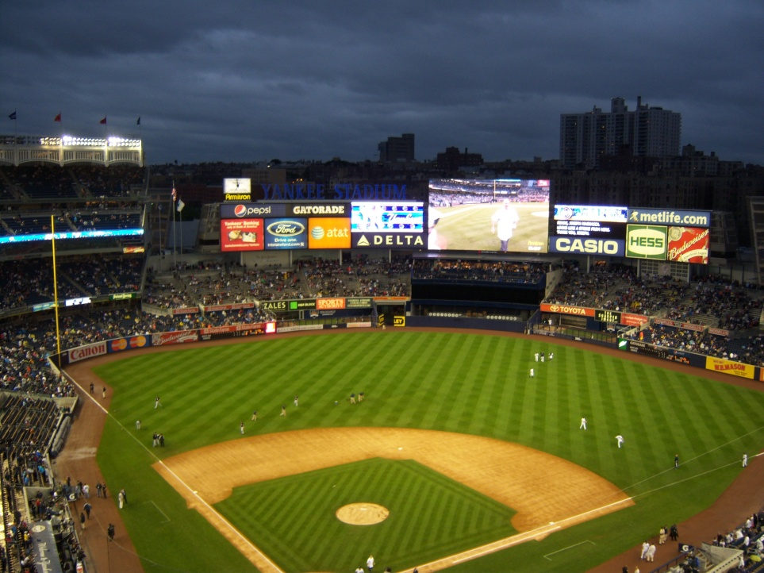
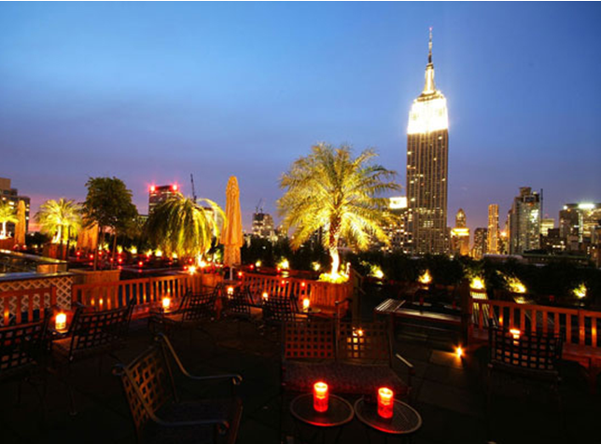
Weekends – Enjoying NYC

Slide 11
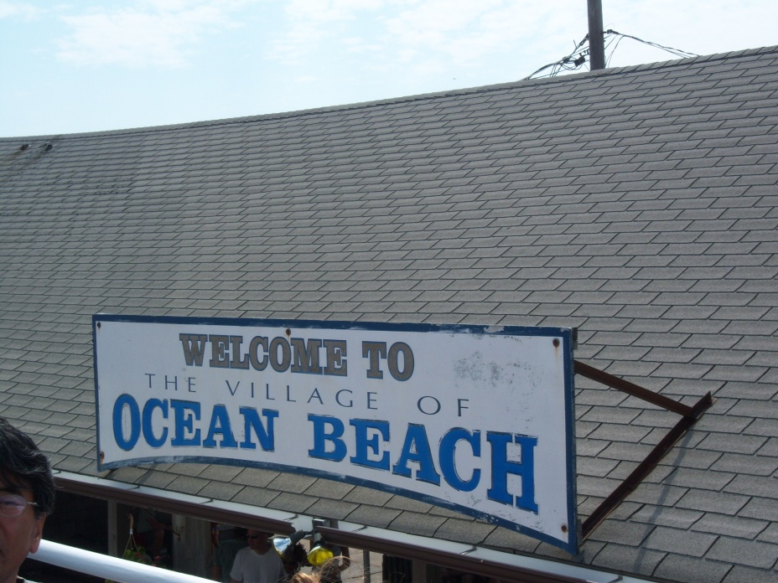
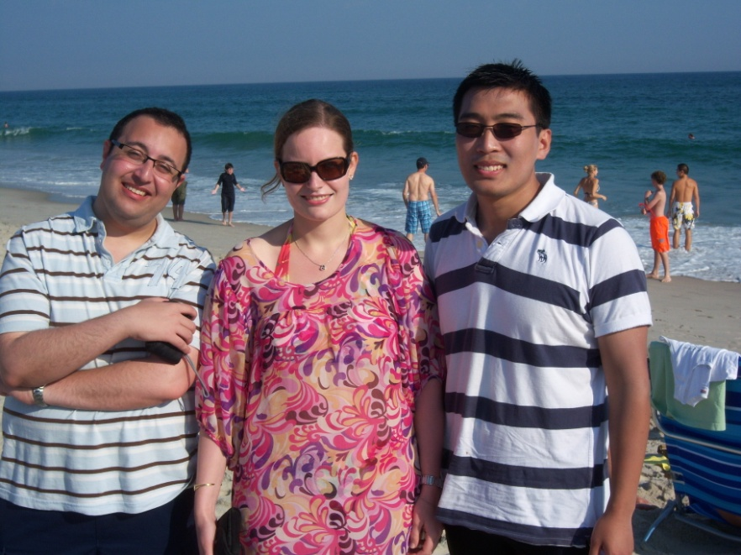
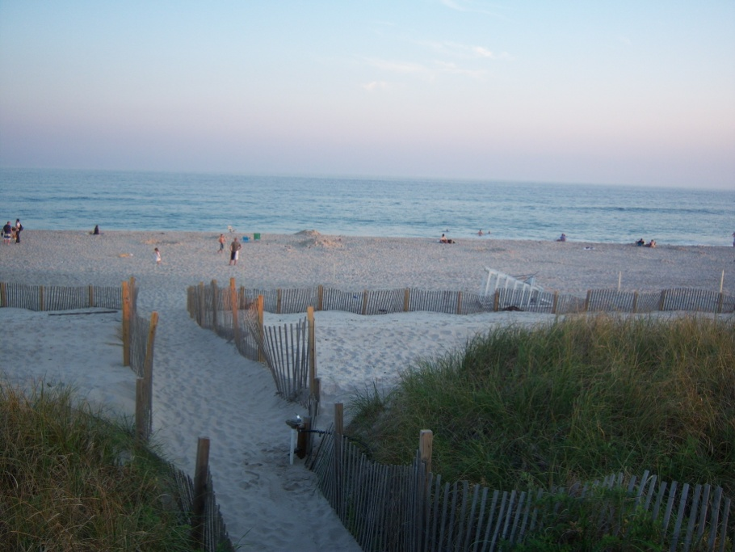
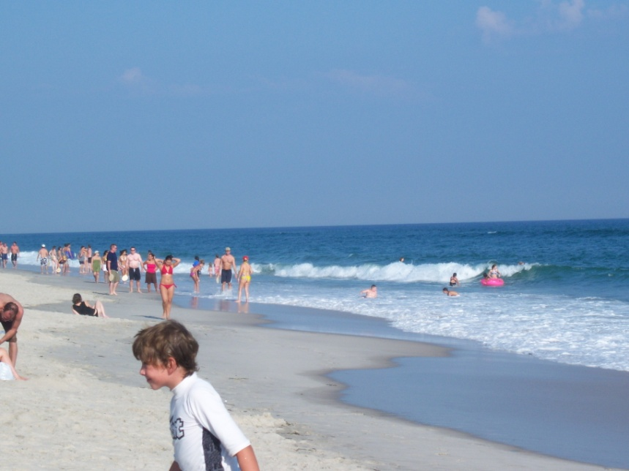
Weekends – Getting out of NYC

Slide 12
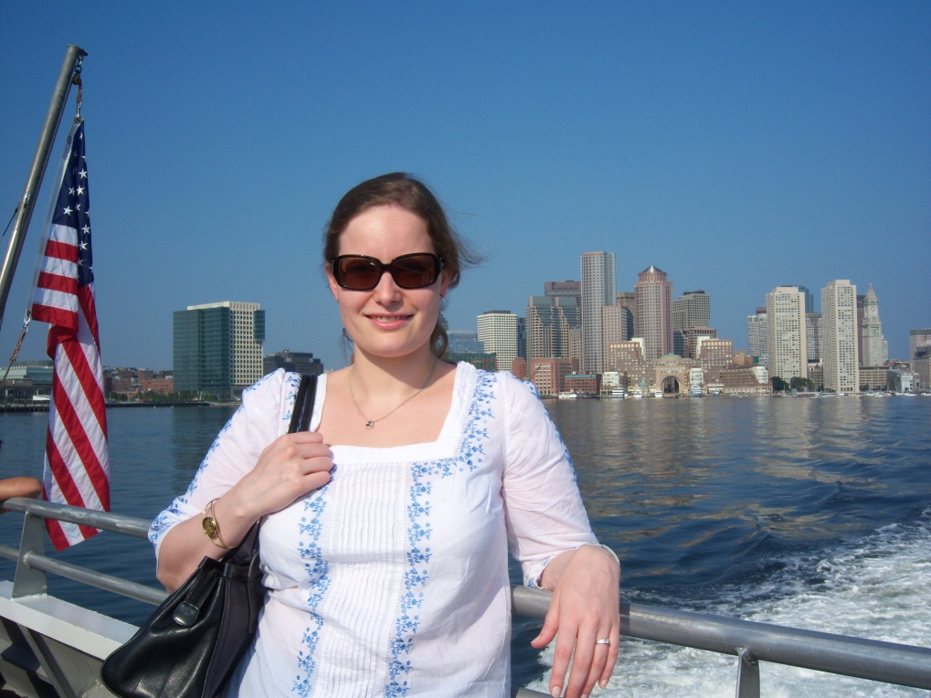
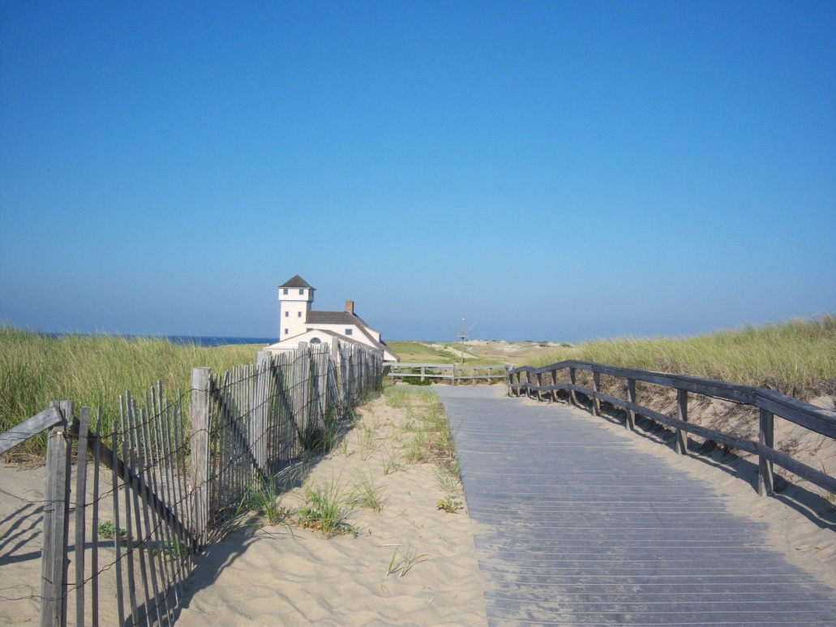
Weekends – visiting friends
Notes:
S few IC students went to the East coast, visited them at Harvard
Imperial college community on the East coast

Slide 13
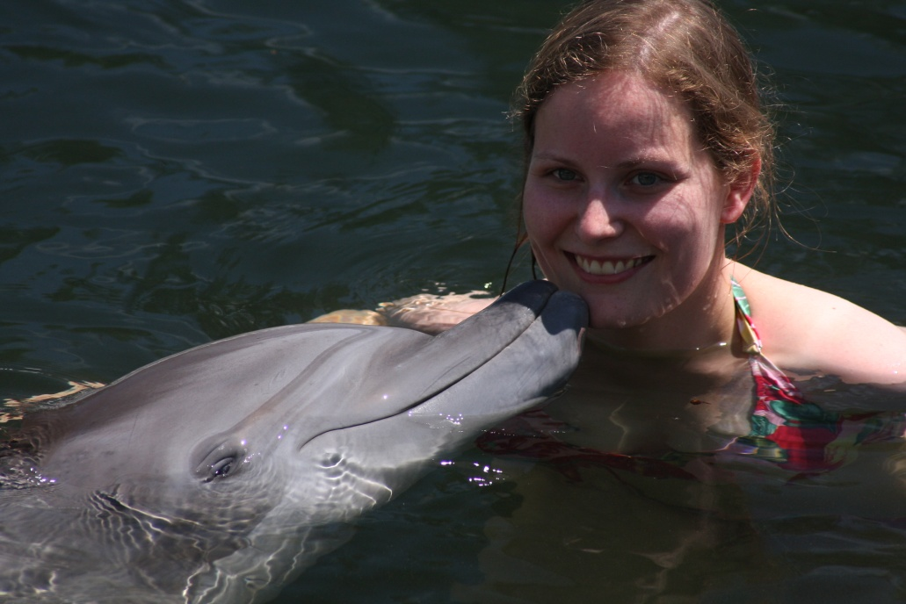
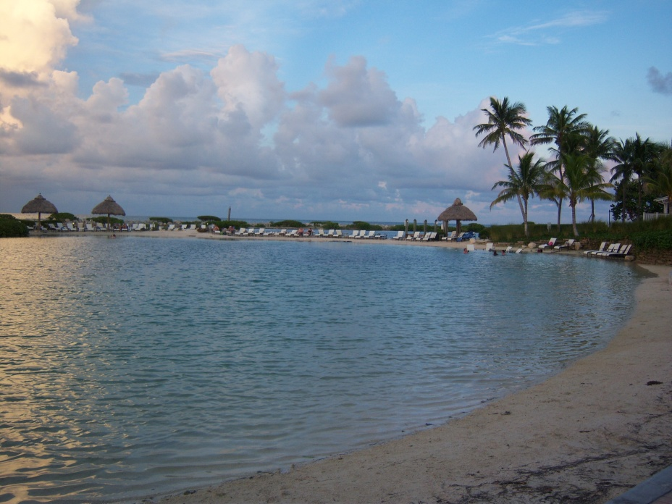
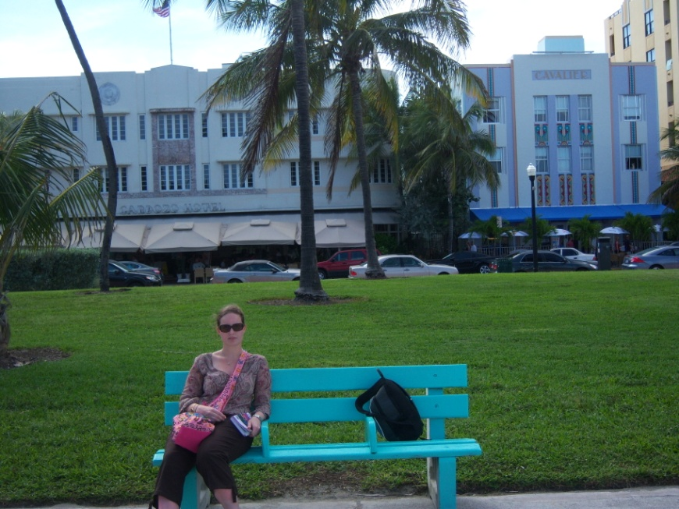
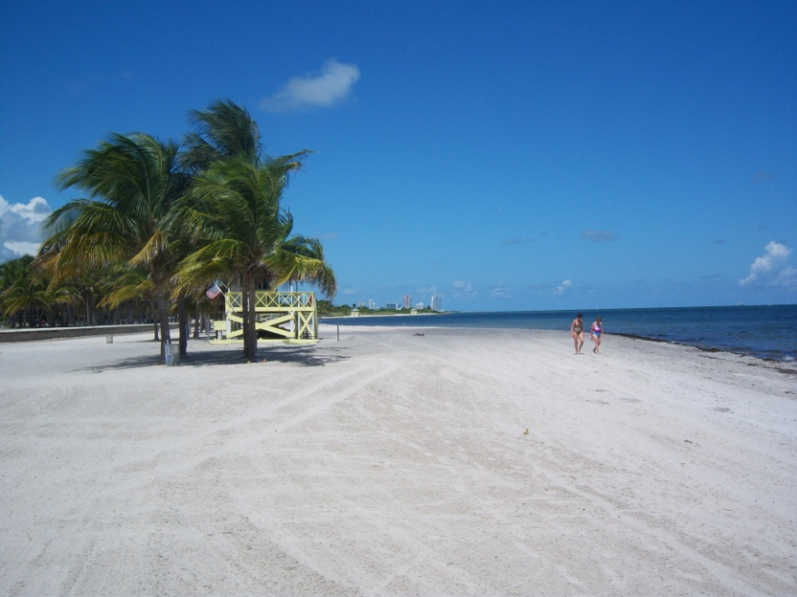
Florida & Florida Keys

Slide 14
My Elective in New York
Maresa Brake
(maresa.brake@imperial.ac.uk)

