Slide 1
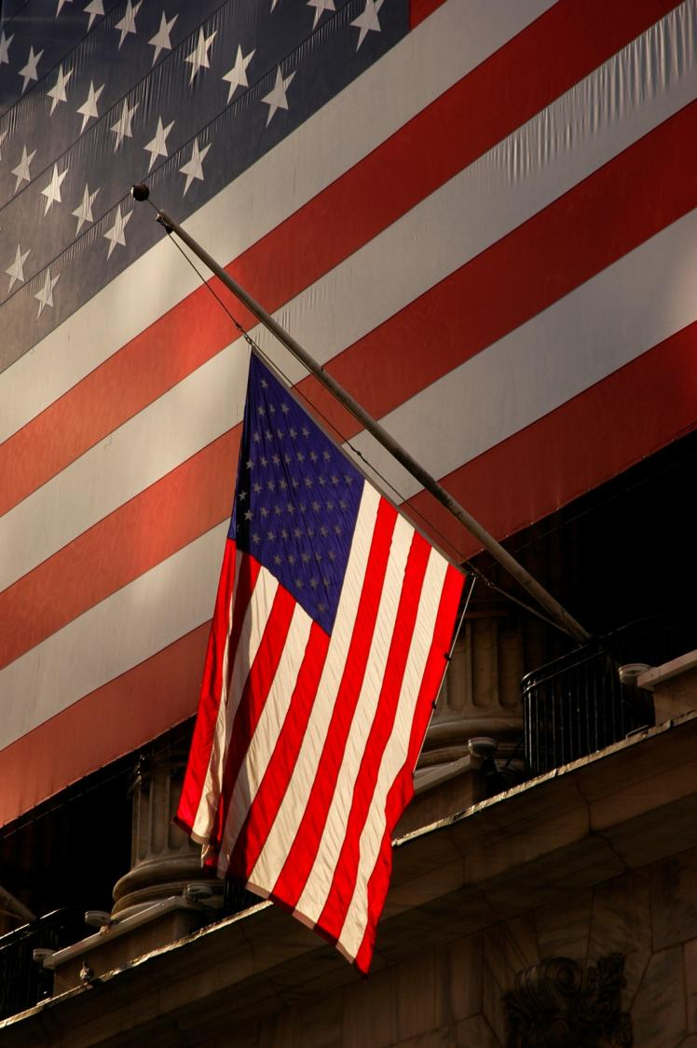
USA 2009
Ammar Waraich
Notes:
Hope I can encourage some of students to apply to the US for elective!
Also hope you enjoy my photography of America featured in this presentation.

Slide 2
Contents
The Application
MICU @ Yale
CTS @ Cornell
My conclusions on America as a place to train and work

Slide 3
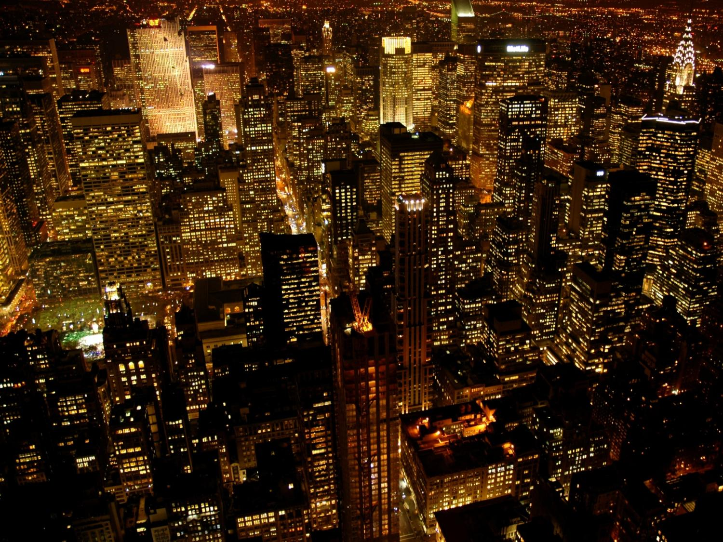
Notes:
Why America...?
- Being born and bred in Pakistan and having already been to rural Kenya for rural ID clinics after third year, I had some experience of developing world medicine and wanted something more academically rigorous and advanced.
- Considering possible career in USA – could explore without any risk to career path.
Could try new specialties
- Satisfy my interest in health policy and explore alternative health setups

Slide 4
My Choices
Notes:
Applying to primarily the Ivy League medical schools, I was keen to experience the best the US had to offer to be able to draw as direct a comparison as possible with Imperial whilst gaining some experience of the most highly regarded training programmes there.
Challenge of risking any placement at all due to the high competition - something which very nearly happened as I got my confirmations 8 days before my first placement started.
So apply early and to many places but be prepared to pay fees and do USMLE at some places.

Slide 5
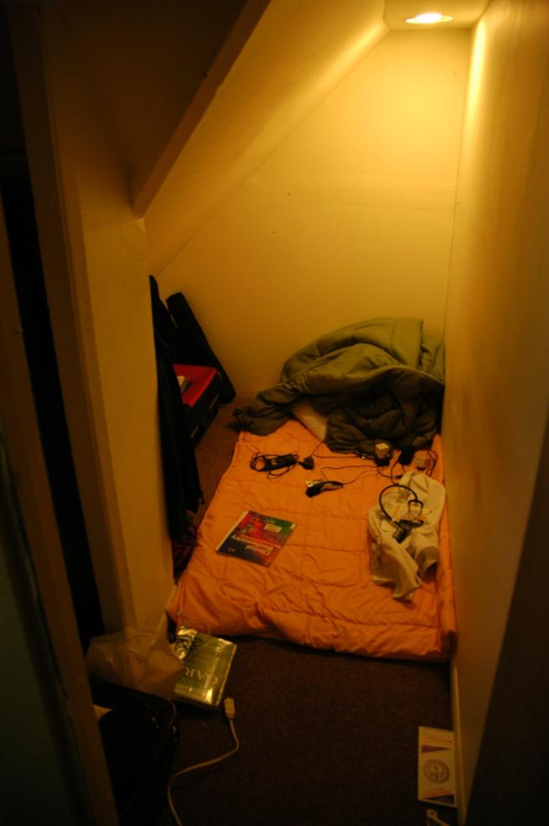
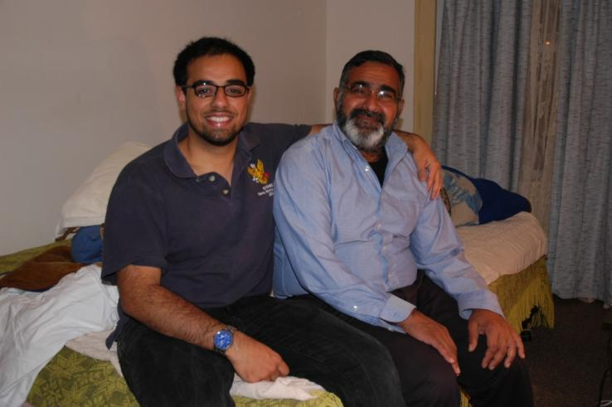
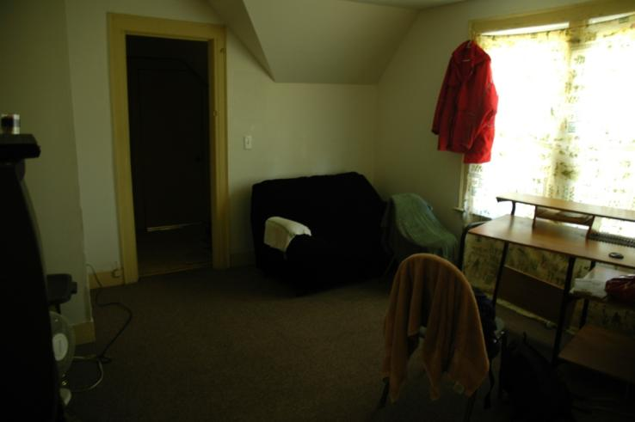
Fail to Plan = Plan to Fail
Notes:
Do not leave things late. Due to poor planning, I arrived without accommodation the night before I was due to start and ended up going to the local mosque in New Haven where I made a plea for help... This kind gentleman decided to help me and gave me a small room where I slept for the entire month on the floor

Slide 6
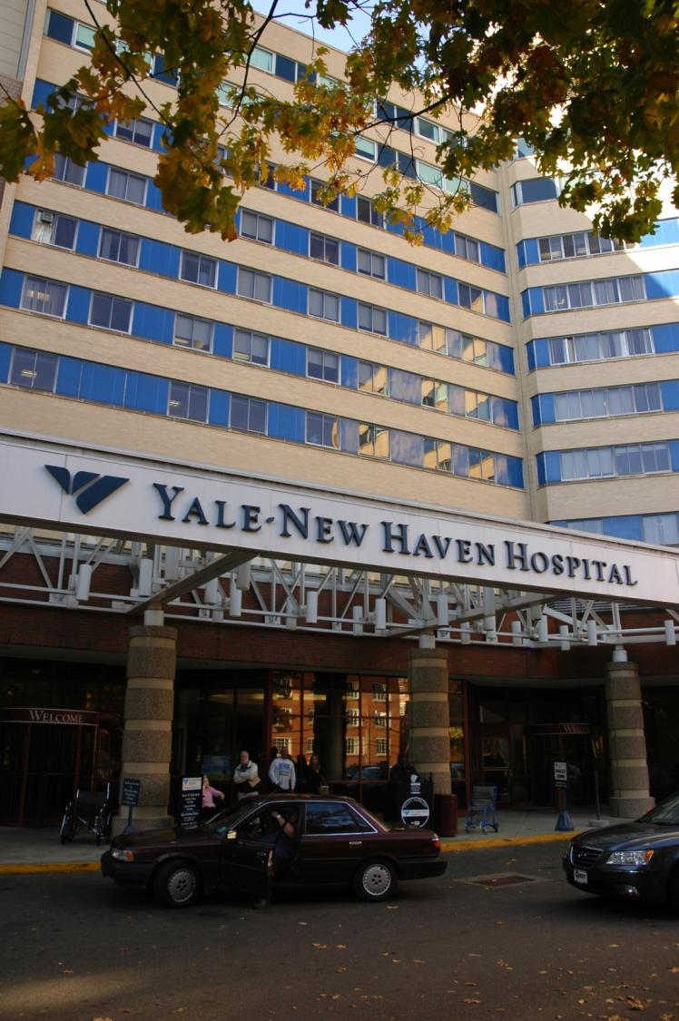
Advanced Elective in the Medical Intensive Care Unit
Yale New Haven Hospital
Connecticut, USA
12th October 2009 to
6th November 2009
Notes:
The MICU was a large department split over 2 floors, staffed by 3 large teams covering the often delicately ill patients including Neurosurgery ICU, the Cardiac ICU, and the Cardiothoracic ICU in addition the general medical intake.

Slide 7
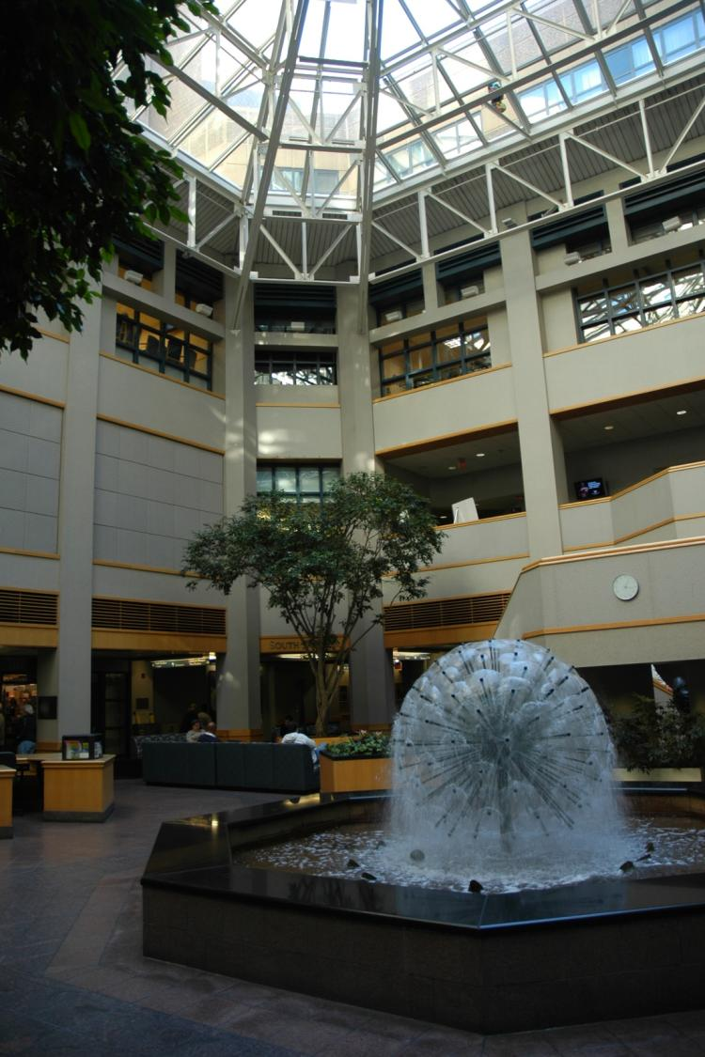
Timetable
Daily teaching seminar
LONG ward rounds
Meanwhile, ready for any emergency!
Spend the remaining day doing tasks
LONG Hours:
7am to 7/8pm

Slide 8
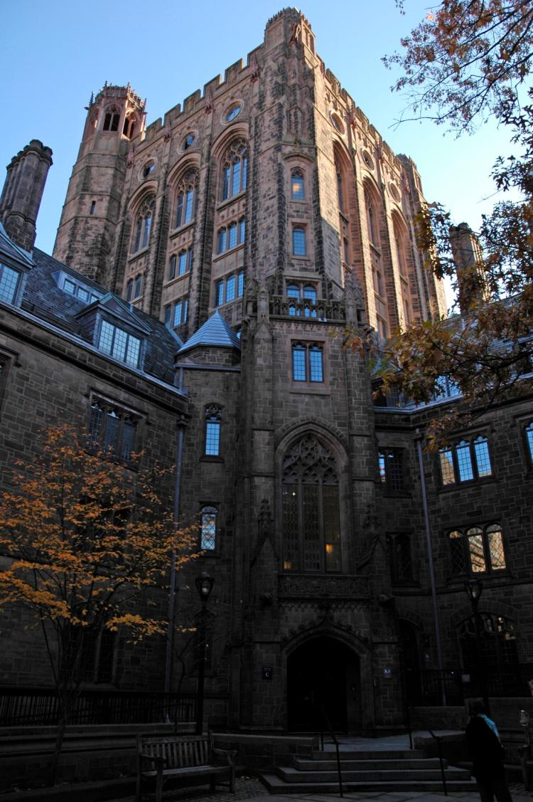
My role
Regular on-calls
Admit from E.R.
Hx; o/e; ∆∆
Management plan
Responsible for 2 to 3 patients until discharge
Pre-rounds & follow up
Present daily to team

Slide 9
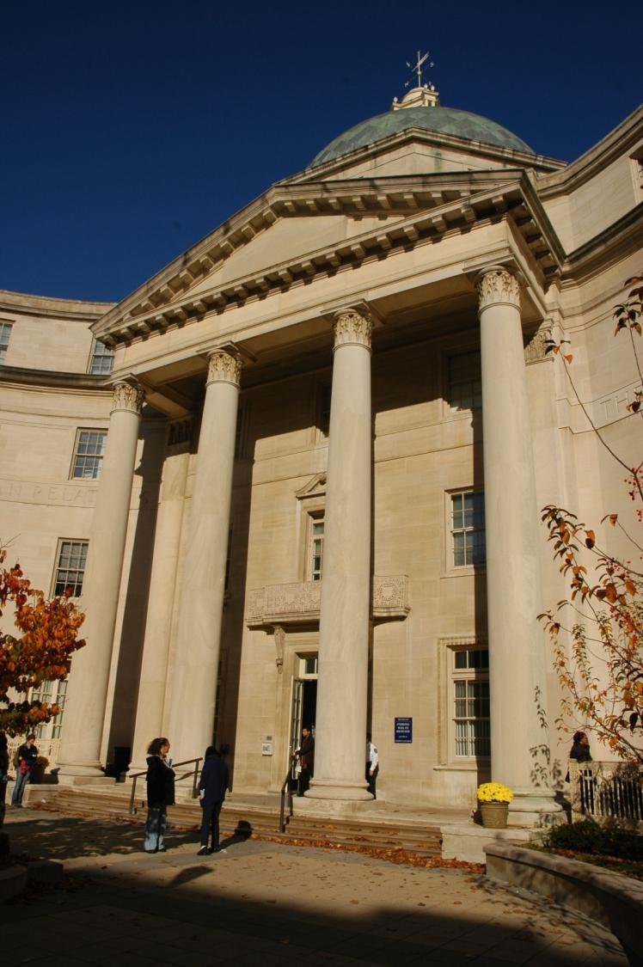
MICU = great learning
Complex pathology and presentations
Many memorable cases
Great signs & symptoms
Many acute and sub-acute medical emergencies
Time critical decisions and management
Practical procedures - ABGs; arterial lines; venous and central lines; ventilation

Slide 10
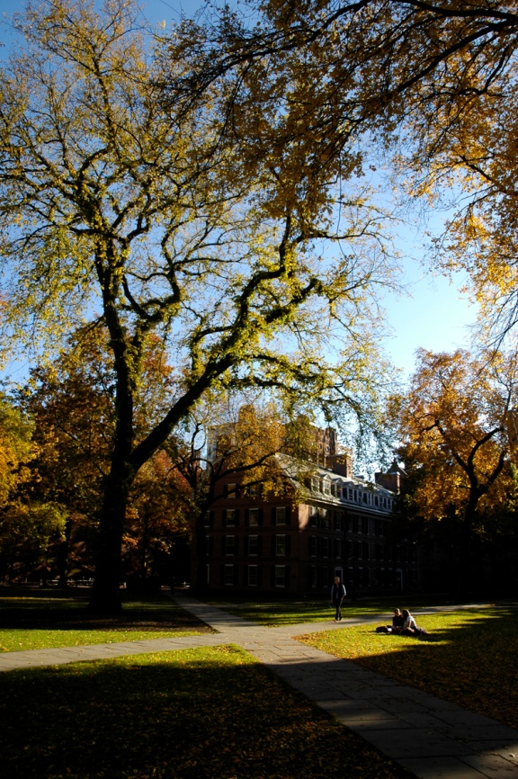
Types of cases seen:
Respiratory Failure
Sepsis/Septic Shock
End stage disease/ malignancy
Various organ failure
Poisoning/Suicide/Psych
Rare syndromes
PUO
Metabolic cases: DKA
CVA/CVS
Massive Bleeds
Post-op patients

Slide 11
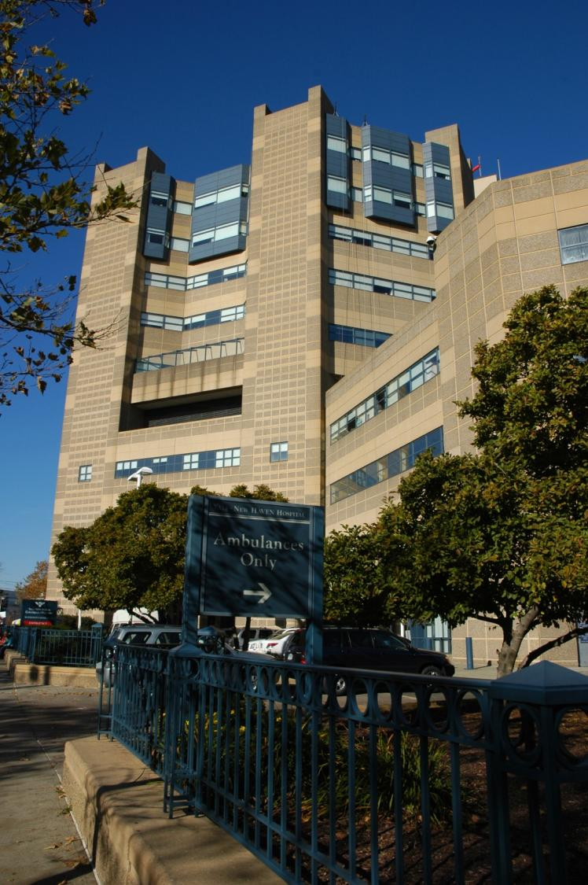
Some situations faced:
Patient deaths
Unexpected serious developments
Managing crash ‘codes’
Ethical dilemmas
End-of-life decisions
Notes:
One patient changed his status to a DNR and DNI as he was not improving, before extubating himself forcibly in front of us and then sadly passing away.
I was able to participate in many codes, and even start one off myself where I founf my patient totally unresponsive on a pre-round

Slide 12
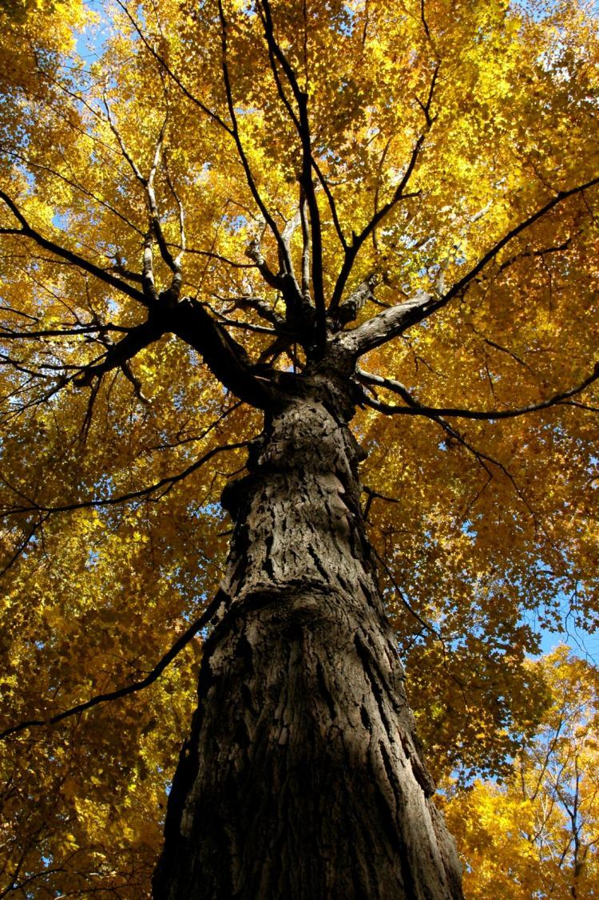
Why MICU is worth it
My clinical impressions were seriously sought for diagnosis & management, even as a student.
Sense of responsibility was a great motivator.
In Summary
...“MICU is like trying to take a drink from a fire hydrant”
Notes:
Quote from my fellow

Slide 13
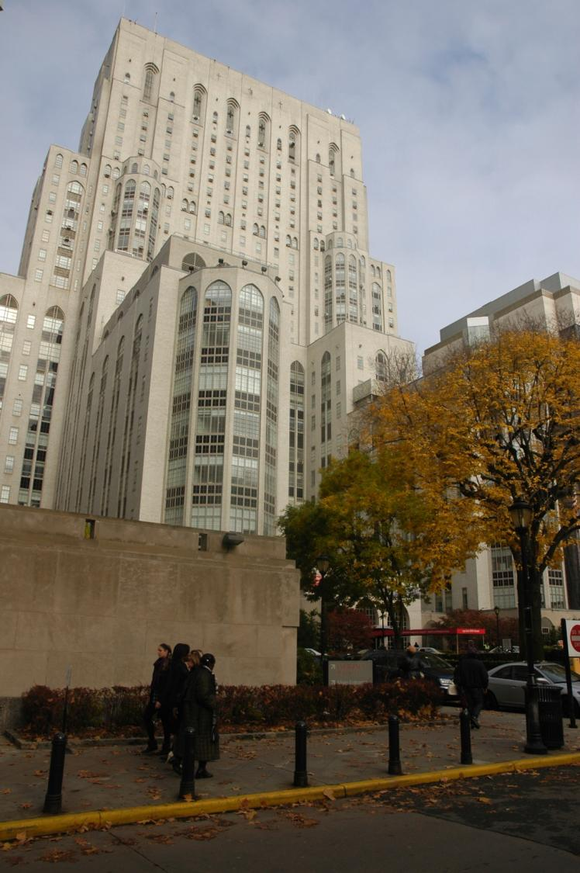
Sub-Internship in Cardiothoracic Surgery
NYC Presbyterian Hospital
New York, USA
9th November 2009 to
20th November 2009

Slide 14
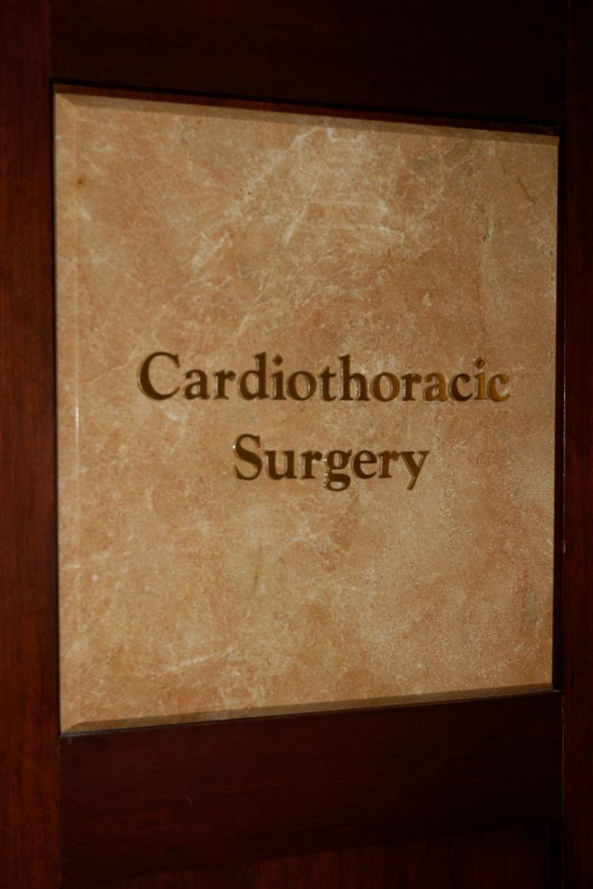
Timetable
Wake at 4am for 6am pre-rounds!
8am to 6/7pm O.R.
Lots of hands-on scrubbed-in surgery
Opening up chest
Cannulating heart
Cauterising
Stitching /closing up
First/Second assisting
Notes:
- One week in cardiac surgery and one week in thoracic surgery, I got the opportunity to do a lot of hands-on surgery; an opportunity that I would not have gotten as a student in the British system.

Slide 15
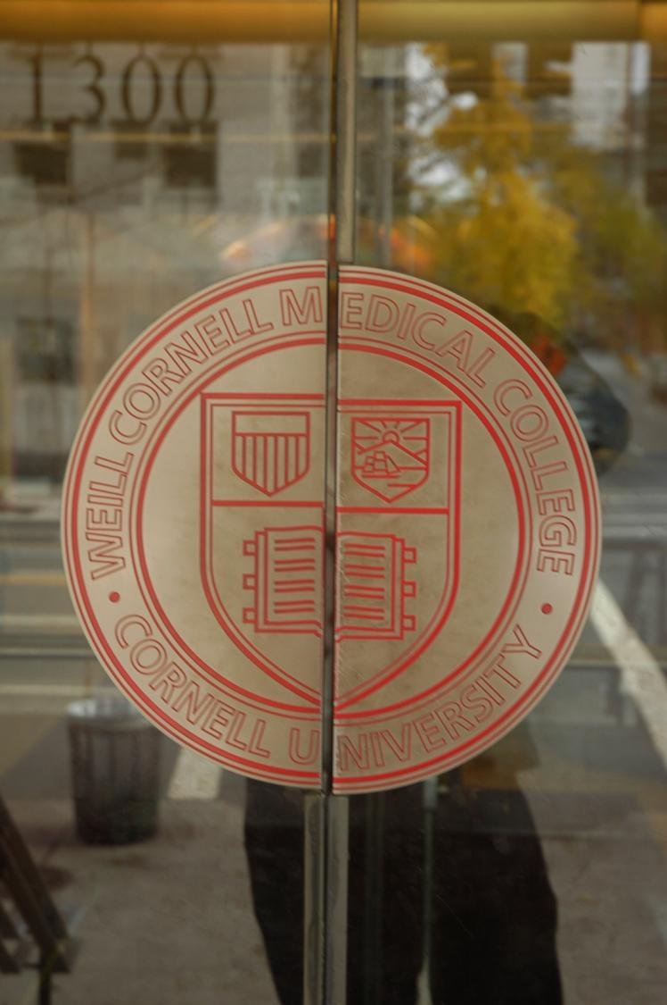
Cases seen:
CABG
Valve/Aneurysm Repairs
Thoracic Cancers
Lobectomies
Pneumectomies
Thymectomies
Oesophagectomies
Paediatric cases
Follow and Manage Pre/Post operative patients
Notes:
Surprising amount of physiological and medical knowledge needed for pre & post op.

Slide 16
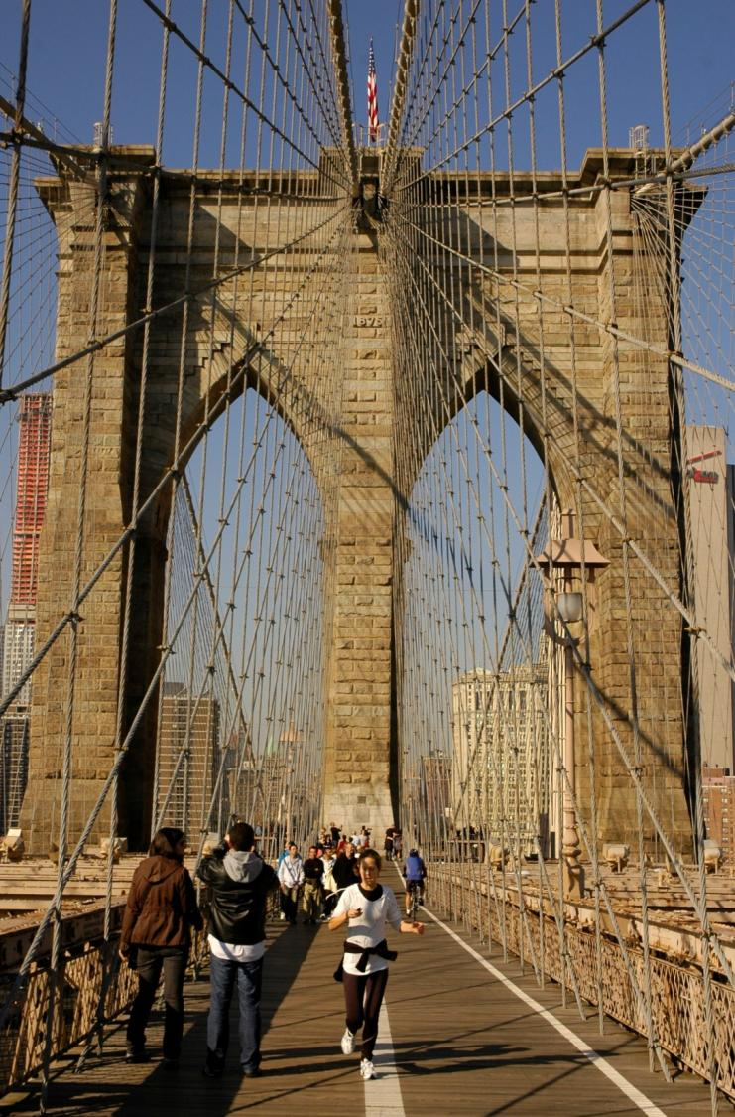
Experience
Clinics – radically different setup and peculiar doc-patient relations
Teaching seminars; M&M’s
Tumour Board conferences
Notes:
- Very different way the private clinic system in the states worked.
- D/P relationship where money seemed to allow the patient to demand any desired service without time being considered a limiting factor at all and where tremendous belief in the surgeons’ ability was almost palpable.
- ‘tumour board’ where the department heads would gather to discuss the more complex cases. This was a remarkable place to watch medico-surgical interactions and absorb knowledge simultaneously.

Slide 17
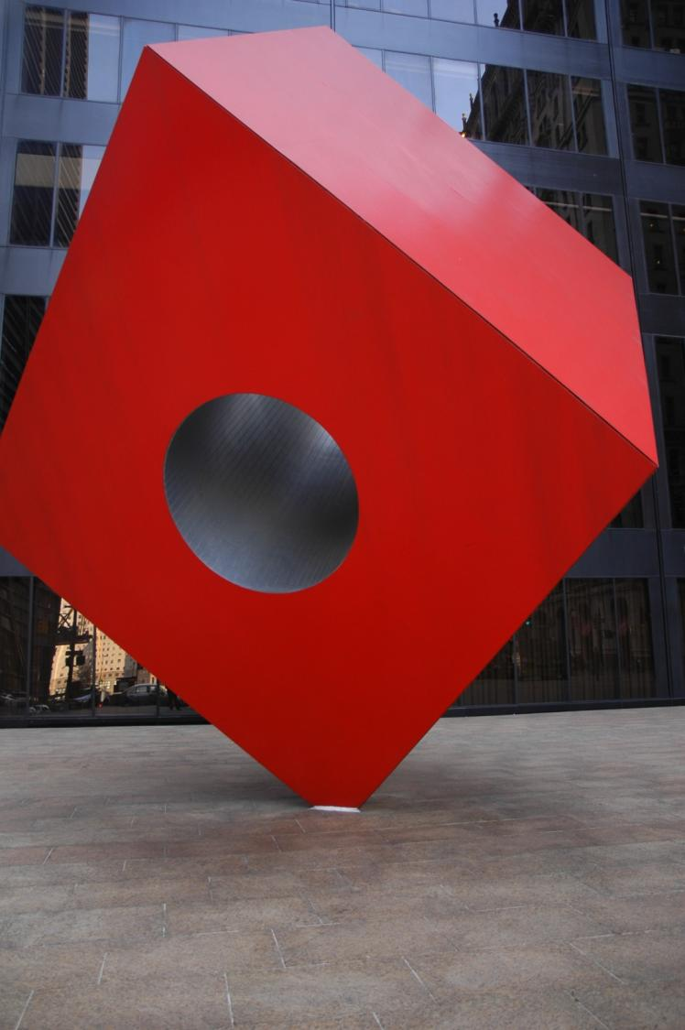
In Summary
First real intensive surgical experience as a student.
Most practical surgery I have done
Many opportunities to scrub in and willing teachers (but some typical surgeons)
Allowed my to make a decision regarding surgery as a career

Slide 18
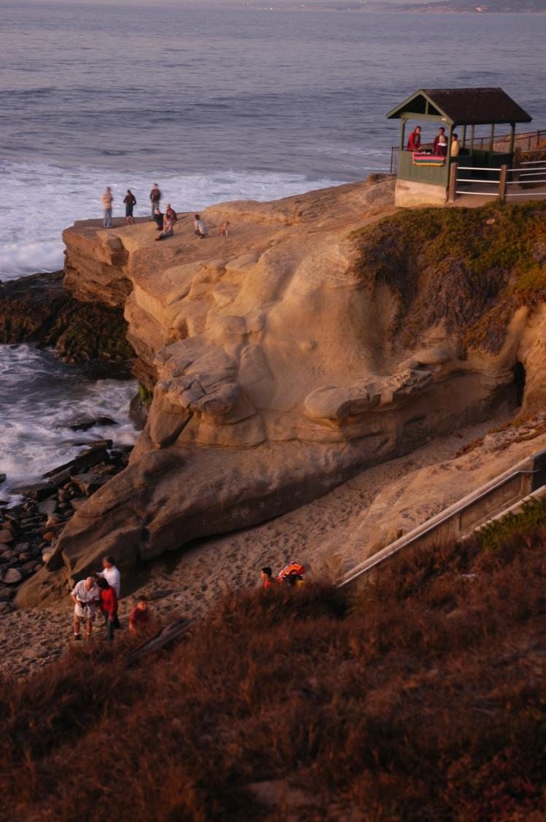
Conclusion
Surprises
Hours of work too much = no time for reflection = poorer learning
The private health and insurance issue
Reliance solely on investigations and so poor Hx & o/e

Slide 19
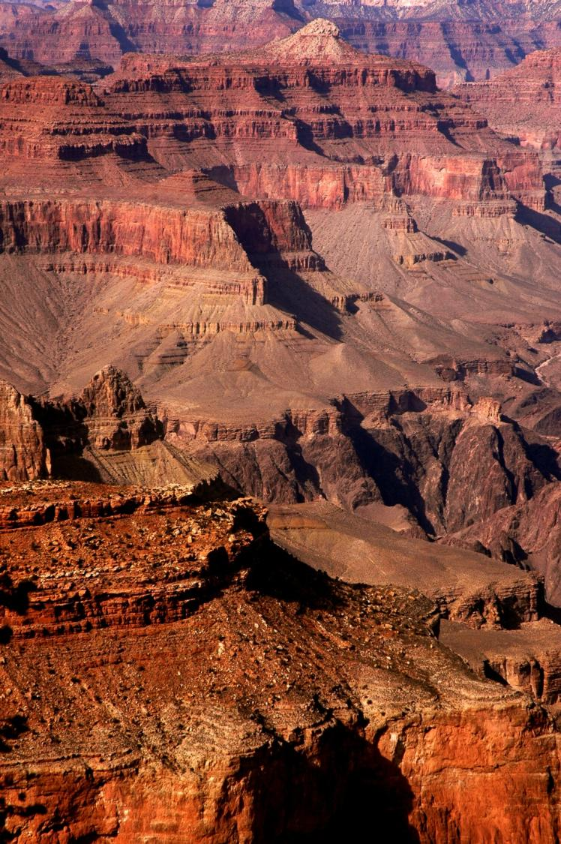
Conclusion
Positives
Structured training
Good specialists with fast ascension of the career ladder
Excellent clinical exposure and emphasis on teaching
Impressive scientific knowledge base and application
Robust IT system.
Very friendly attitude

Slide 20
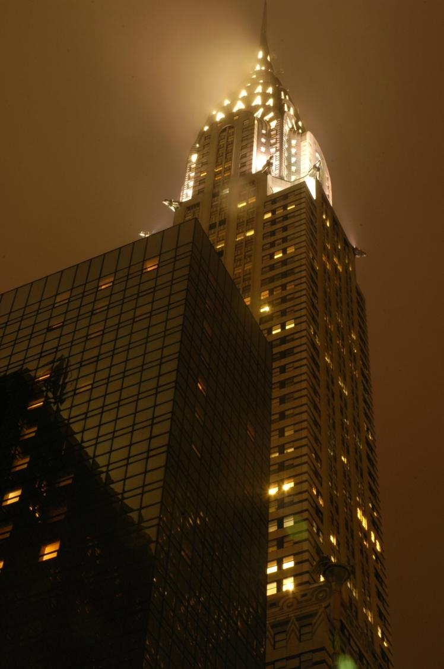
OVERALL...
Notes:
- Some great advantages to training in the USA, but advantages do not outweigh the weighty negatives – especially the excessive working hours.
But I do feel that there are valuable lessons that can be drawn and be incorporated into UK training and most certainly I have learnt things that I can bring back with me for my training here.
I still have not ruled out doing a fellowship in the USA in my chosen specialty later in my career, as I feel this may allow me to acquire the best of both worlds and benefit myself and patients under my care in the future.

Slide 21
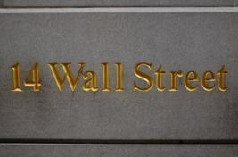
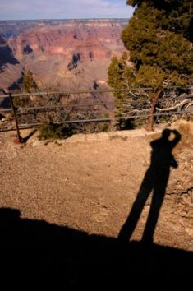
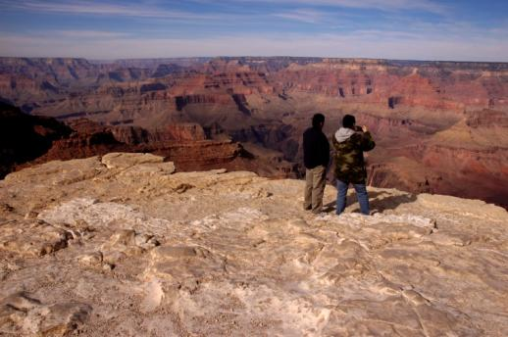
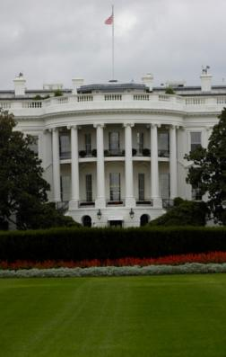
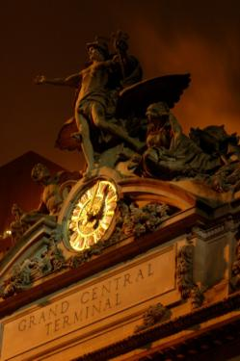
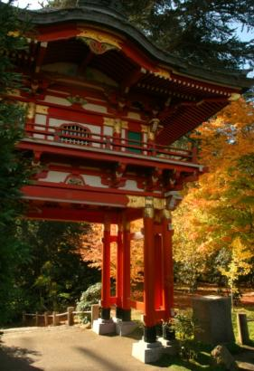
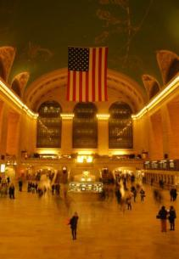
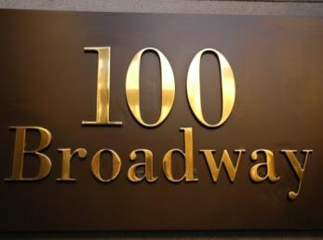
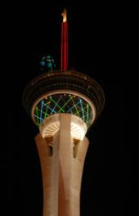
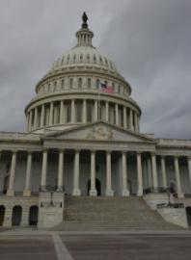
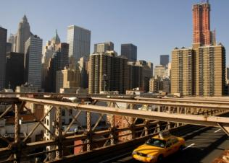
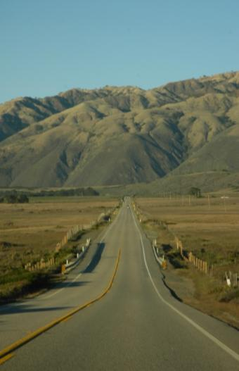
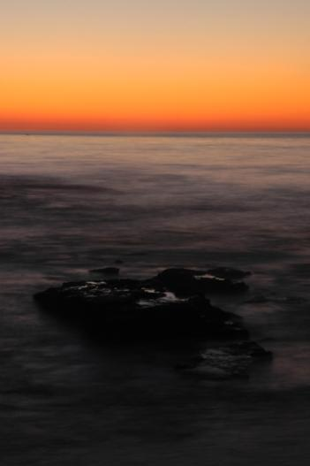
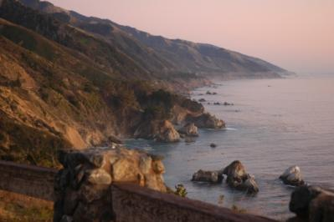
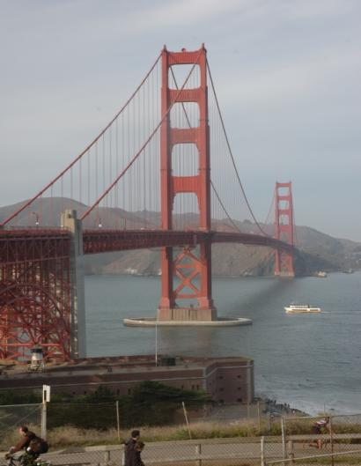
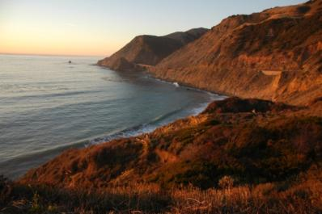
Notes:
Wish I could tell you guys about my awesome holiday too along with a credit/debit card fraud that complicated my journey immensely and nearly left me stranded at Las Vegas, had me sleeping in my car and using random uni gym toilets/showers, but alas, no time!!!

Slide 22
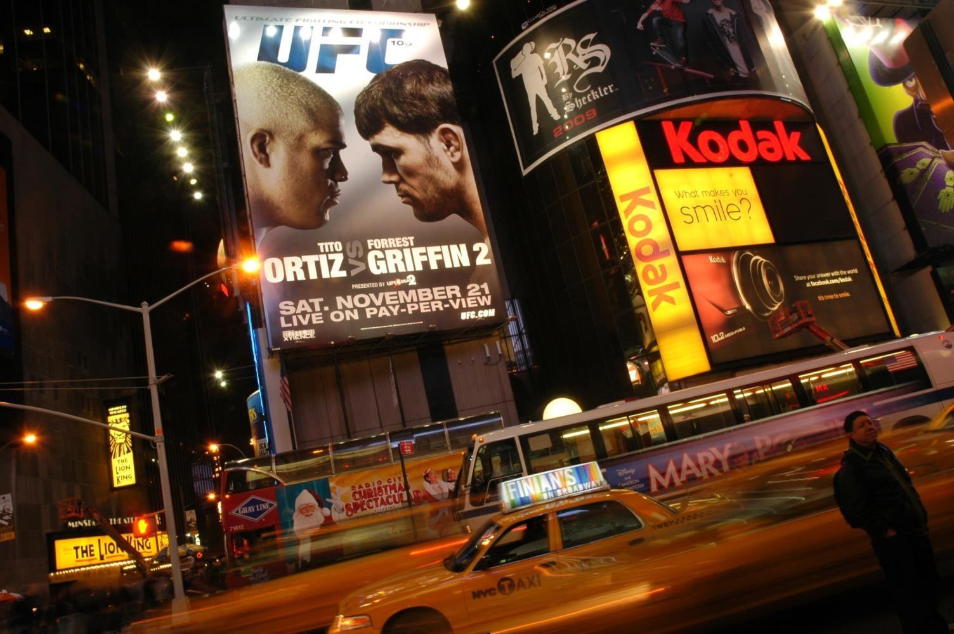
THANK YOU
(ammar.waraich@imperial.ac.uk)

