Slide 1
Organising an elective
Daniel McGuinness

Slide 2
Organisation & Why?
I’m no expert
Appreciate different healthcare systems
Lots of you will have electives ‘fall through’
Don’t be disheartened
It can be the most annoying thing in the universe to organise

Slide 3
What to do
Something you’ve enjoyed
Something you’ve missed out on?
Future career plans?
The noble cause
Research????

Slide 4
Where to go?
Many factors
Financial – Fees, flights, accommodation, living
Group 1, 2, 3 - Do not worry about UKFPO
Logistical
Some places won’t take ICSM (Johns Hopkins)
Unless you know someone who knows someone
Safety
Grasp of the local language
Ability to tolerate climate
Who to go with?
UK?
Opportunities all over the country

Slide 5
Where?
Developed Vs. Developing
English Vs. non-English speaking
Popular places
Australasia, USA
War Zones/Foreign Office Advice
The world is massive, there are lots of places to go

Slide 6
Ideas
The Medic’s Guide to Work & Electives Around the World – M. Wilson
MDU Electives Network
Electives Pages – ICSM Intranet
Consultants with contacts
Google
Reports – St. Mary’s UMO
Talk to people – Bigger boys and girls

Slide 7
Finance
Can cost thousands of pounds
Global financial turmoil
It can throw your budget down the loo
Medical School Electives Awards
Apply, apply, apply
External sources
Royal Colleges, charities, etc
Bank of Ma & Pa
Professional Studies Loan – Really think about whether this is right for you

Slide 8
Approval and Booking
Ping Pong
Can appear to take forever!
7 Weeks minimum
Approval from Personal Tutor
That person you’ve never met!
Institutions will ask for different things
Some won’t let you apply until late in the day
Proof of student status
Indemnity
Occupational Health
Transcripts/References
CRB

Slide 9
Occupational Health
South Kensington
Some countries/institutions will ask for additional information
Chest Radiographs
Medicals
Can be expensive and time consuming
HIV Post-exposure prophylaxis
Anti-malarials, etc

Slide 10
Flights
Earlier = Cheaper
Trailfinders, STA Travel, Internet
Recession = Less people flying = Airlines have lots of sales on their websites

Slide 11
Accommodation
University halls
Hospital accommodation
Backpacker Hostels
Electives offices
Sub-letting

Slide 12
Other Details
Documentation
Passport
Entering USA – Online customs form weeks before you travel,
Customs
Proof of elective/residence
Insurance – College has you covered
STA Cover Re: Exams
Nationwide
Internet Banking
Back up finance
Indemnity
MDU
Doing things in parts of the world you wouldn’t be allowed to in the UK

Slide 13
Uncle Danny moment
Be sensible & safe
People get tropical infections
People have accidents
People come back with venereal disease
EVERY YEAR!

Slide 14
My Elective
3 Weeks CCU St. Paul’s Hospital, Vancouver
4 Weeks GIM Mt. Sinai Hospital, Toronto
Fantastic experience, teaching, responsibility, ‘call’
2 Weeks New York (Christmas & New Year)
2 Weeks California

Slide 15
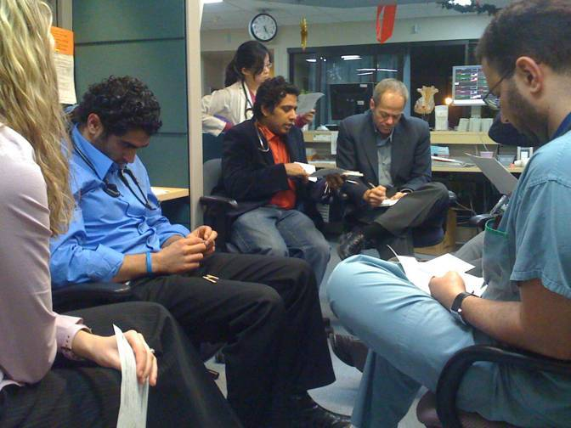
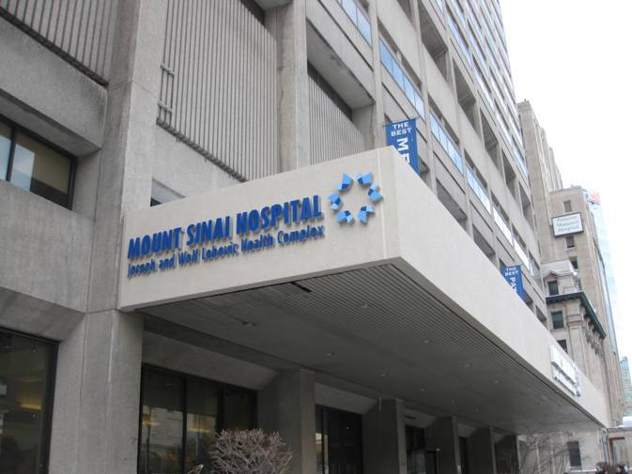
Elective
Vancouver
Toronto

Slide 16
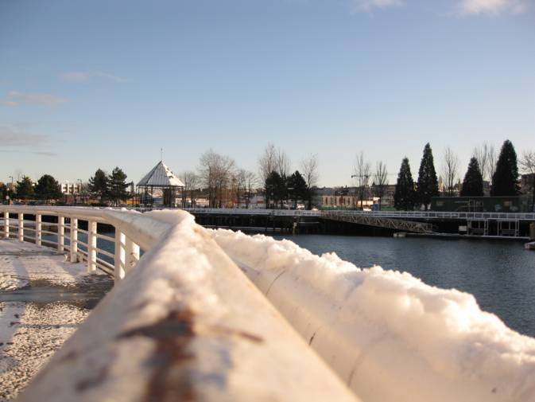
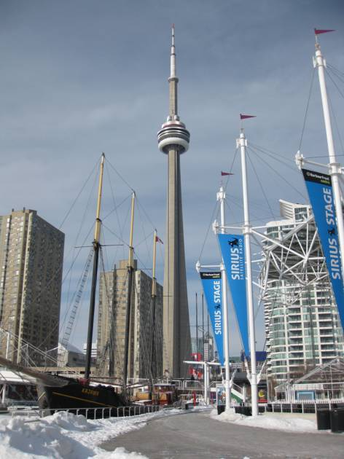
Vancouver
Toronto

Slide 17
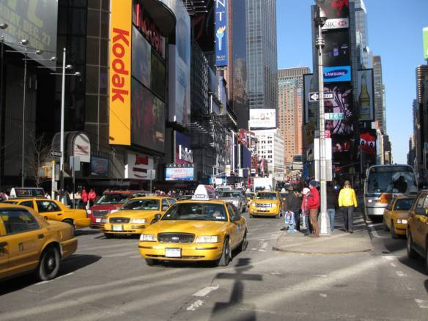
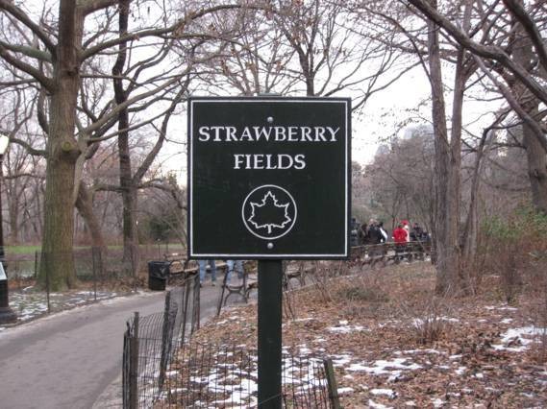
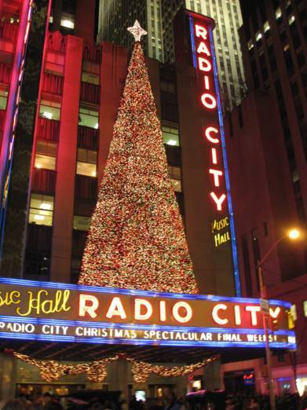
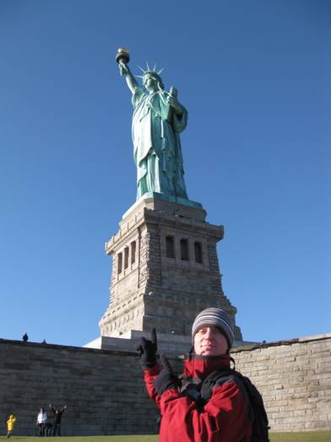
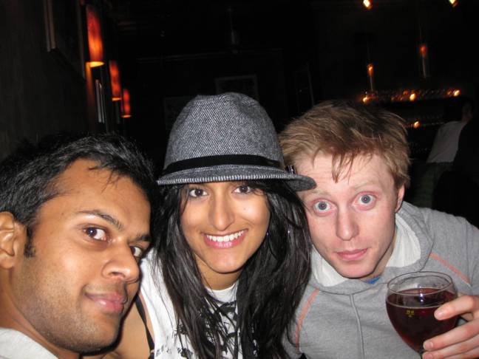
New York

Slide 18
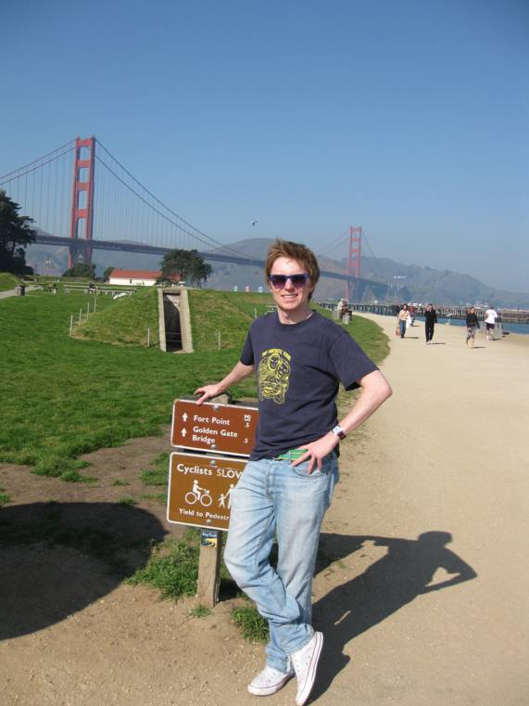
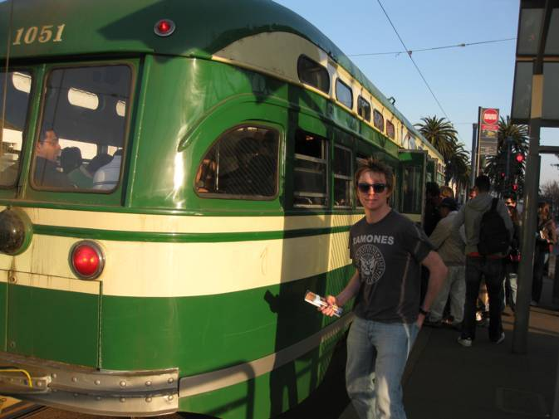
San Francisco

Slide 19
Good Luck
It really is one of the best things you do at medical school

