Slide 1
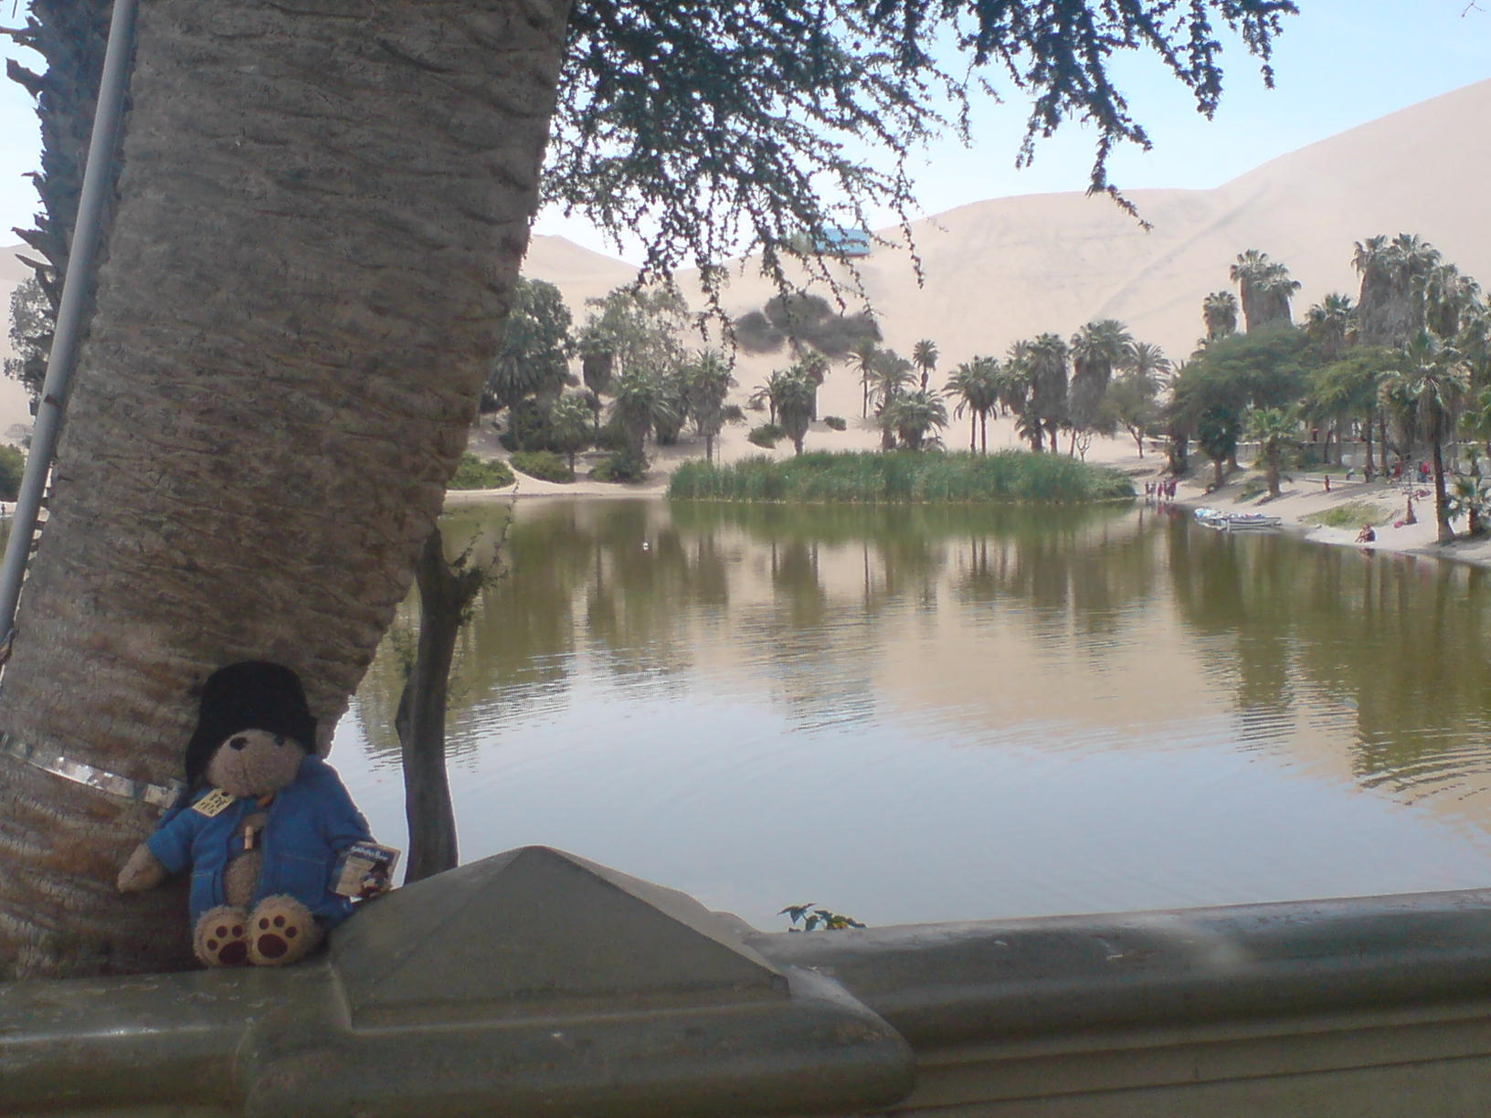
From Paddington to Peru ......
....... an Incan elective
Jennifer Hart
Sept - Nov 2008

Slide 2
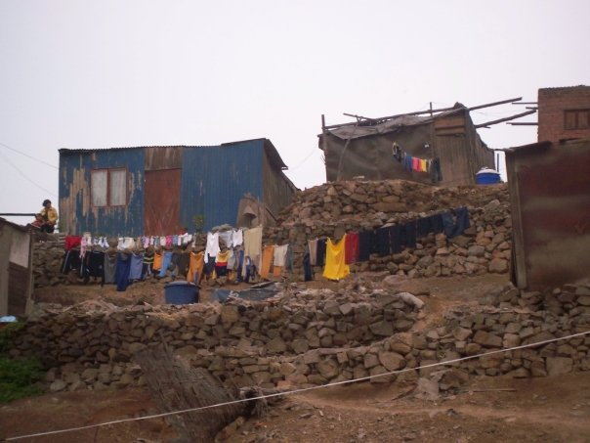
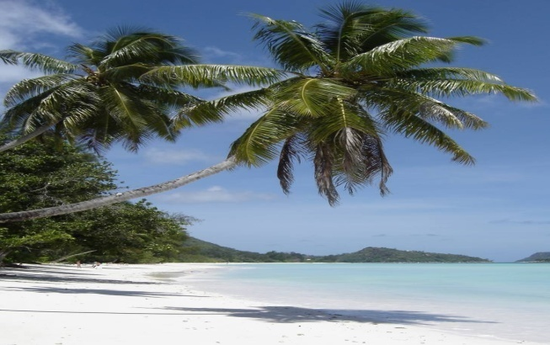
The big decision
Lima shanty towns vs Tropical paradise?

Slide 3
Why Peru?
Exciting infectious diseases
Limited hospital facilities
Lots of clinical examination practice
Chronic shortage of doctors
Any assistance welcomed
Impact of social conditions on disease

Slide 4
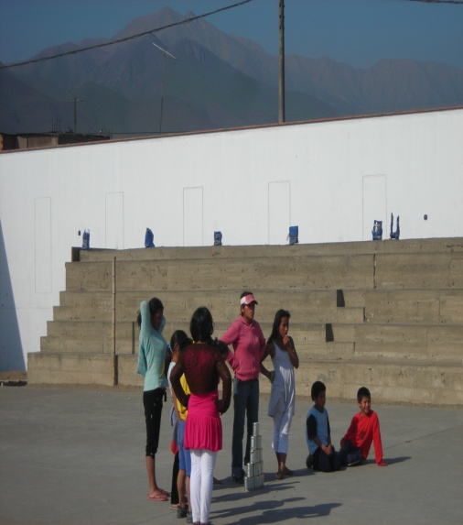
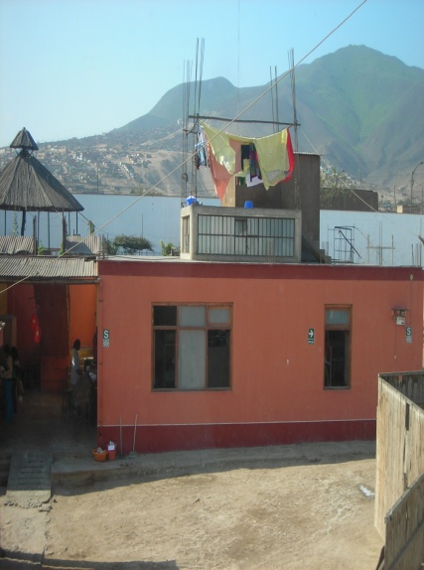
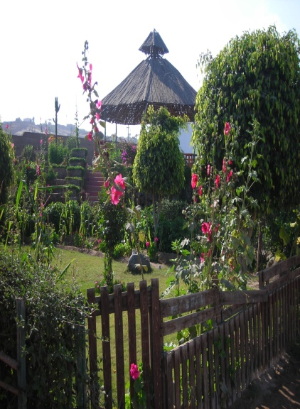
Casa Hogar
Children's Refuge
Run by Project Peru
Home to 32 children
Aged 5-18

Slide 5
Typical Day
5 am – Wake up call
6 am – Breakfast
6.30 - 7am – Leave for placement
8 -12 am - Clinic
12 -2pm – Lunch
2 -5pm – Clinic
6pm – Dinner
Evening – Help with activities

Slide 6
The Clinics
Centro de Salud Materno-Infantil
Government run polyclinic
O&G, Paeds, A&E, General Medicine
Centro de Salud San Martin
Comparable to GP
General Medicine, Radiology, Laboratory
Eye campaign with Moorfields team
Las Laderas de Chillon

Slide 7
The Patients

Slide 8
The Patients
Case 1
47 year old gentleman
2/12 hx
Cough
‘Nightime fever’ (/ night sweats)
Weight loss
PMH TB
Rx course not completed

Slide 9
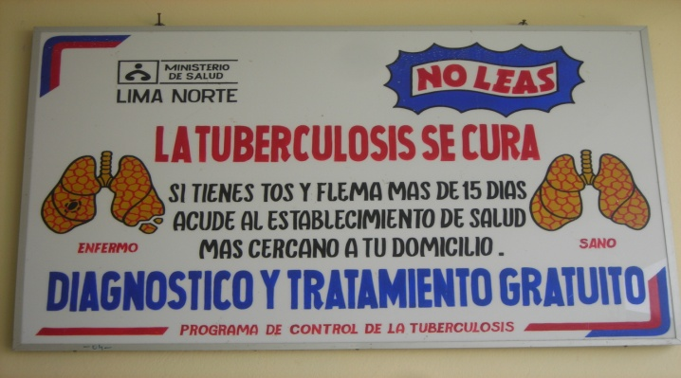
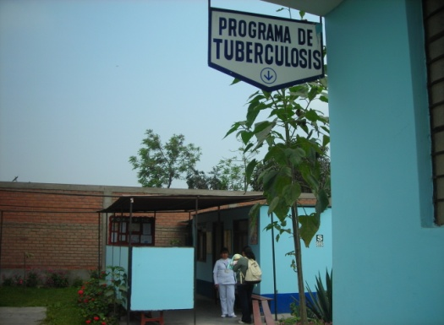
Tuberculosis

Slide 10
The Patients
Prescribed chicken soup !!

Slide 11
The Patients
Sole breadwinner
No sick pay
Hand to mouth economy
Family would go hungry
Malnourished
Doctor sanctioning food
(also reinvestigated for TB...... eventually)

Slide 12
The Patients
Case 2
7 year old boy
Persistent diarrhoea
4/52 hx
Not dysenteric
Anaemic
Underweight for height

Slide 13
Giardia Lamblia

Slide 14
The Patients
Poor water supply
No piped water
Available supplies unchlorinated
Inadequate hygiene practice
Faecal-oral transmission
Little health knowledge amongst parents
Hand washing rare

Slide 15
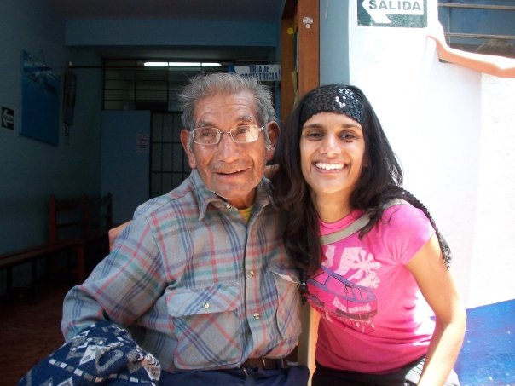
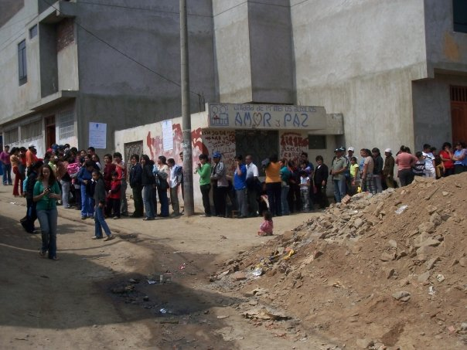
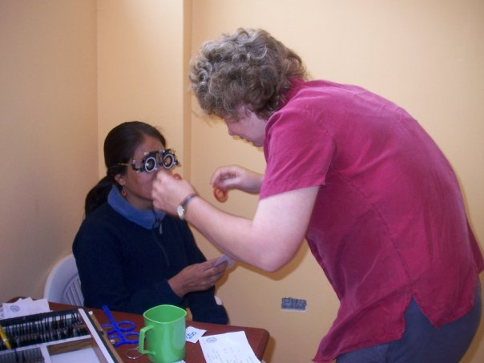
Eye campaign
1650 patients seen
Glasses given to 800 patients
Acuity and fundoscopy in everyone
Basic eye care advice

Slide 16
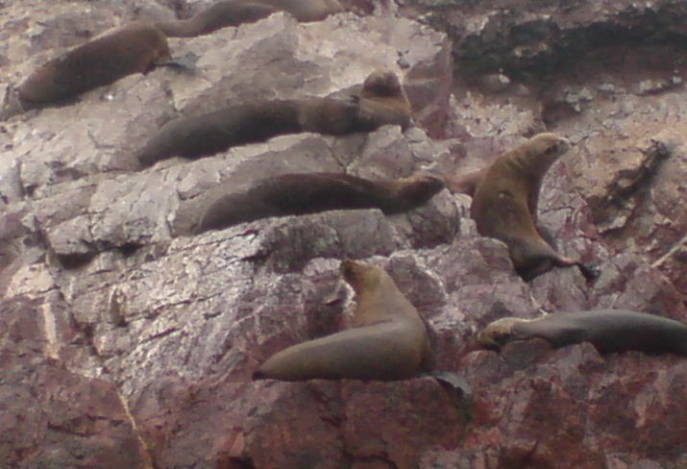
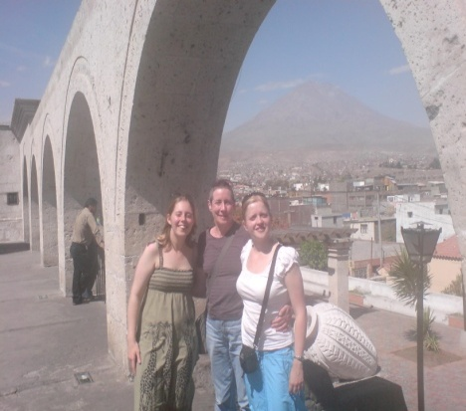
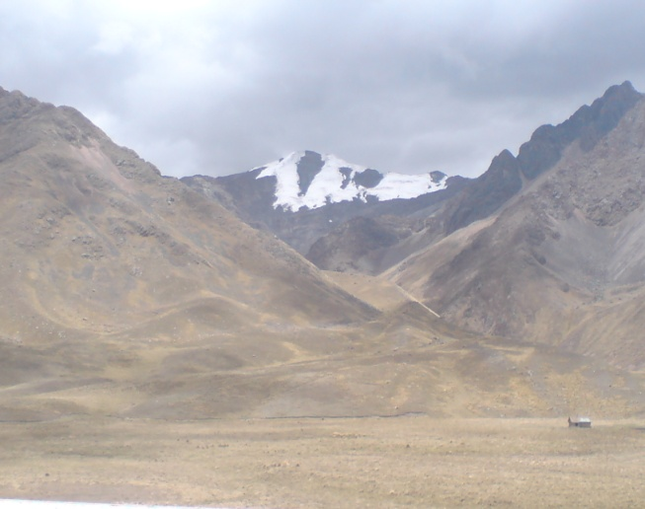
‘Gringo Trail’
Islas Ballestas
Arequipa
Huacachina
Puno

Slide 17
‘Gringo Trail’
Machu Picchu

Slide 18
Elective Advice
LEARN SPANISH!
‘Do as the locals do’
Boil tap water
No credit cards
‘Know before you go’
Vaccinations
Earthquakes
Climate
Have fun!

Slide 19
Conclusion
Massive impact of social conditions on disease
Wide differential diagnosis for common presentations
Tailor treatment to suit patient
‘Experience of a lifetime’

Slide 20
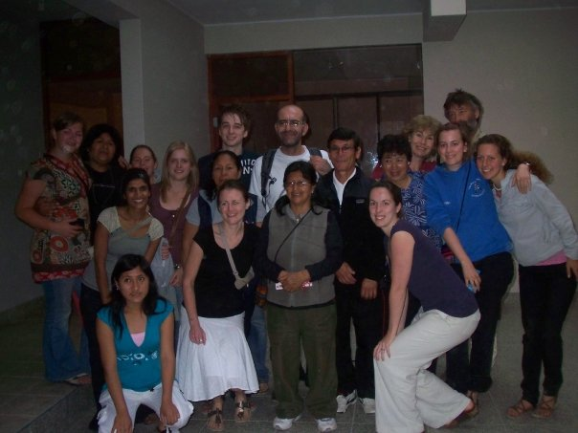
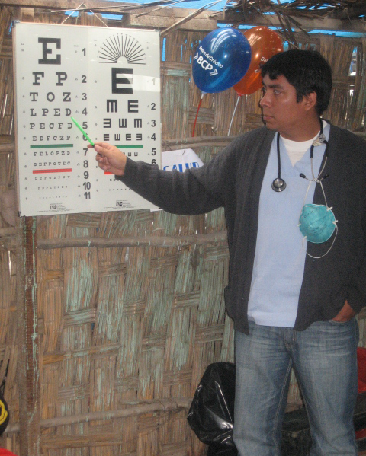
With Thanks to....
All the staff and volunteers from Project Peru
Hyde Park Place Charitable Trust
Centro de Salud Zapallal and San Martin
Jen Smith and her team of optometrists and ophthalmologists

Slide 21
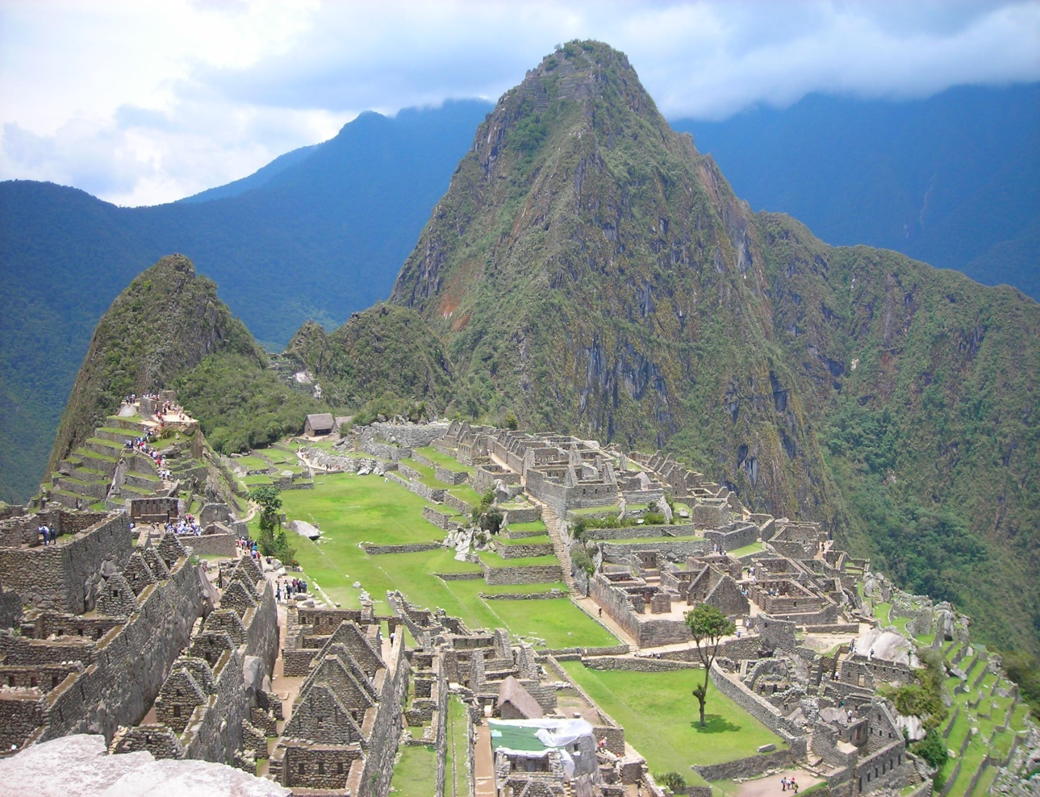
Questions
Email me on: jh103@ic.ac.uk

