Slide 1
An elective in Botswana
Gregory Froome
Notes:
I am indeed Gregory Froome, and this is a presentation on my elective in Botswana. This is not me. It’s an elephant. In case you were wondering.

Slide 2
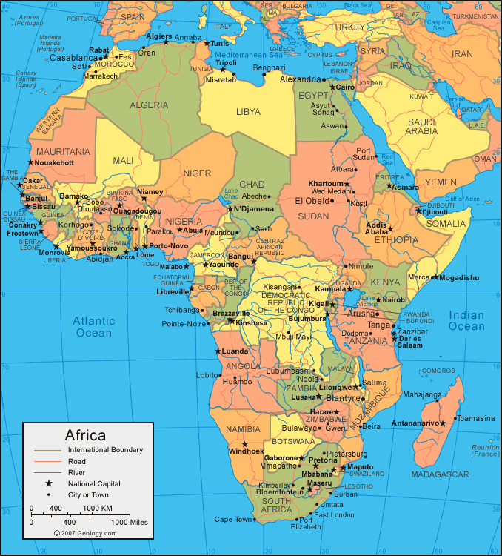
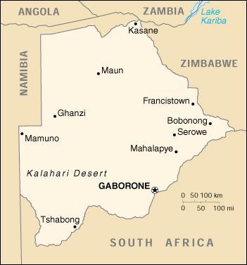
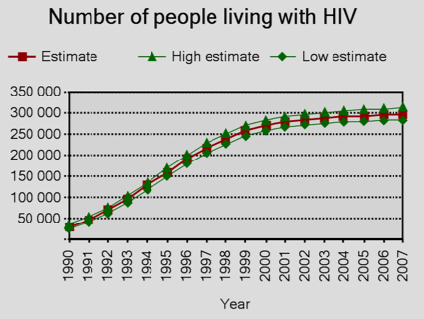
Er… Botswana?
www.map.freegk.com
1.86 million people
600,000 km²
www.architectafrica.com
www.who.int
Notes:
Some of you might be thinking just this. Well, in case you were off sick the day they taught Geography at school, this is Africa (it’s just to the south of here), and if you look closely at this part of Africa, you might well see an lemon-coloured country that goes by the name of Botswana. Up close, it looks like this.
Its population is about that of 9 London boroughs, in an area about three times the size of Great Britain. Most of the middle is empty, taken up with the scrubby Kalahari, with most of the population down the east side.
Botswana’s main claim to dubious fame is its long-term title as the country with the highest HIV prevalence worldwide. Although Swaziland’s recently snatched that title, there are still around 300,000 people living with HIV in Botswana.
The promise of interesting medicine complicated by the greatest epidemic known to the modern world was one reason I was drawn to Botswana, but there was a more mundane reason as well. Some people have long-held dreams to go to one place or another, but didn’t really. So instead, I based my choice on a book: some of you may have read it. I figured that it was as good a reason as any.

Slide 3
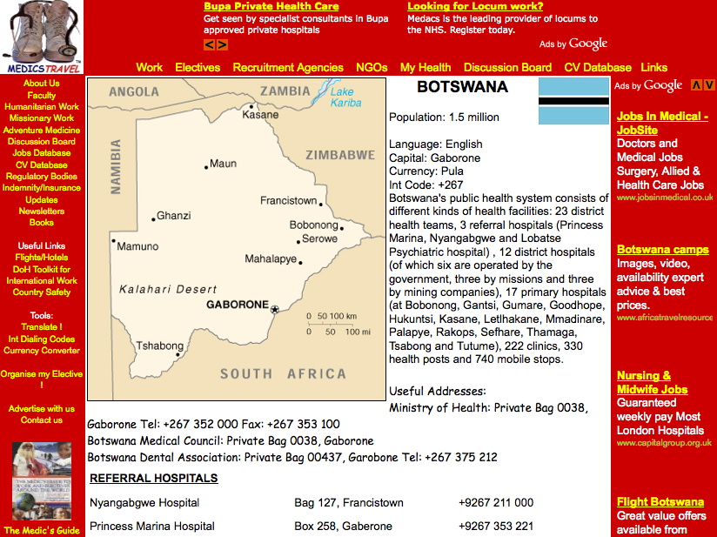
Er… Botswana?
www.medicstravel.co.uk
Notes:
Once I’d decided, I looked to see if other ICSM people had visited Botswana before, and found that they hadn’t, so searched the internet and found this very useful site, medicstravel.co.uk, that has contact details of many hospitals around the world. I arranged everything over the phone and internet from there.

Slide 4
Nyangabgwe Hospital A&E
Diarrhoea & dehydration
Asthma attack
Threatened miscarriage
Hepatic encephalopathy
TB
Foreign body in the ear
Facial laceration
Head injury
Snake bite
Pneumonia
Fractured bones
Scalds & burns
Jaundice
Ectopic pregnancy
BID
Notes:
So it was that I started work at Nyangabgwe Hospital, firstly in A&E. This is it: pretty much the A&E department for the whole of northern Botswana: six bays, one of which was this gloriously ordered and tidy resuscitation area here, and one side room. This last bay here was the paeds bay, often filled with five or more screaming children with mothers and various other relatives.
I encountered loads in A&E. Some cases are particularly memorable.
Amongst the children with dehydration, pretty horrific scalds and broken bones, I saw a toddler with a cotton wool bud stuck quite deep in his ear. I took a history, examined, all the time worrying about the lack of an ENT department. The doctor on the other hand was more practical, unfolding a paperclip and fishing it out before striding off to another case. Don’t think that’s quite the NICE guideline.
Another day a man came in who’d been bitten by a snake whilst getting out of bed. He felt well afterwards, but came to A&E anyway, bringing with him a black plastic bag which, it transpired, contained the snake. The man described how he had splatted the snake’s head with a shoe shortly after the bite occurred – there’s a lot of hatred of snakes in Botswana – yet it still took considerable courage to take it out and look for signs as to whether it was poisonous or not. As it turned out, it was a house snake, even more harmless in life than in death, but it was still a pretty tense situation, although it did make me remember what to look out for in a poisonous snake.
Before you get worried that BID is a disease that you haven’t yet learned about (I know how geeky you lot can be), it actually stands for Brought In Dead. We saw quite a few of these – DOAs that the police brought in for certification – culminating in a gory decapitation that I’ll tell you about some other time as it’s really rather depressing.

Slide 5
Notes:
And then of course there was AIDS. On my first day, I saw two men so emaciated by it that ribs, sternum and clavicle were all visible in perfect, painful relief like living anatomical model. The wasting between one’s ribs was so pronounced that I couldn’t find an area flat enough for the diaphragm of my stethoscope.
Before I went out, I imagined every consultation would revolve around HIV, but in reality, such florid cases were rare and, to my surprise, HIV almost always took a back seat in A&E consultations. At first, I’d ask everyone I saw about their status, but as more and more people replied positive, I went the way of the doctors and asked less and less.
I suppose that something so common is no longer a distinguishing feature so, unless directly relevant, it’s best left entirely to those who are used to treating it. So we sorted out people’s presenting problems and left AIDS unmentioned. I’m still not sure that was the best way to deal with it, but it seemed to work for everyone concerned.

Slide 6
Jubilee Psychiatry Clinic
Notes:
I then spent a little time at a psych clinic on the other side of town. Here too there were many interesting cases which helped to rekindle my interest in psychiatry.
For example, one day revolved almost entirely around a young schizophrenic named John, who was told by God, his angels, Abraham and Seretse Khama to smash the windscreens of three cars and, worse, a BMW (which reveals a lot about the admiration the Batswana have both for their first president and for BMWs). He had also killed a puppy, which is proof enough I think of gross mental disorder.

Slide 7
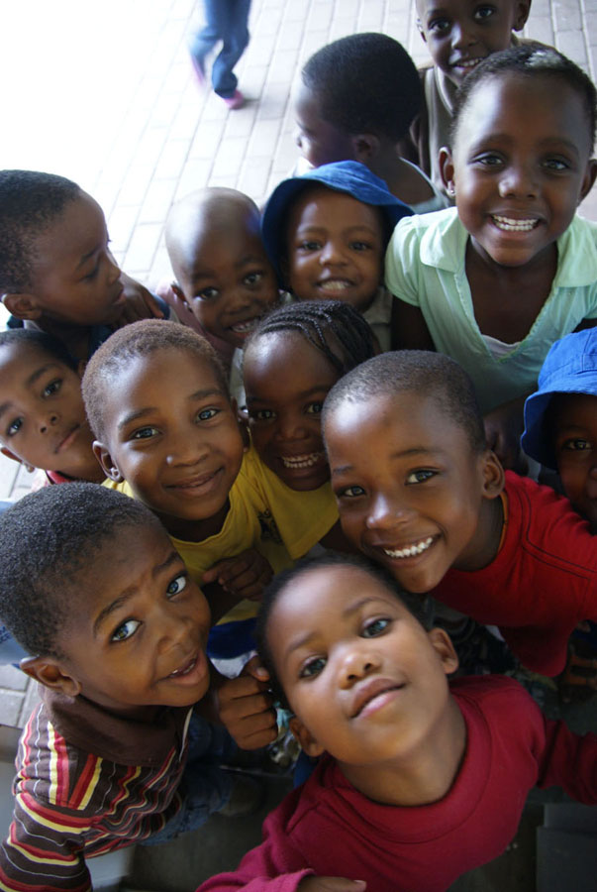
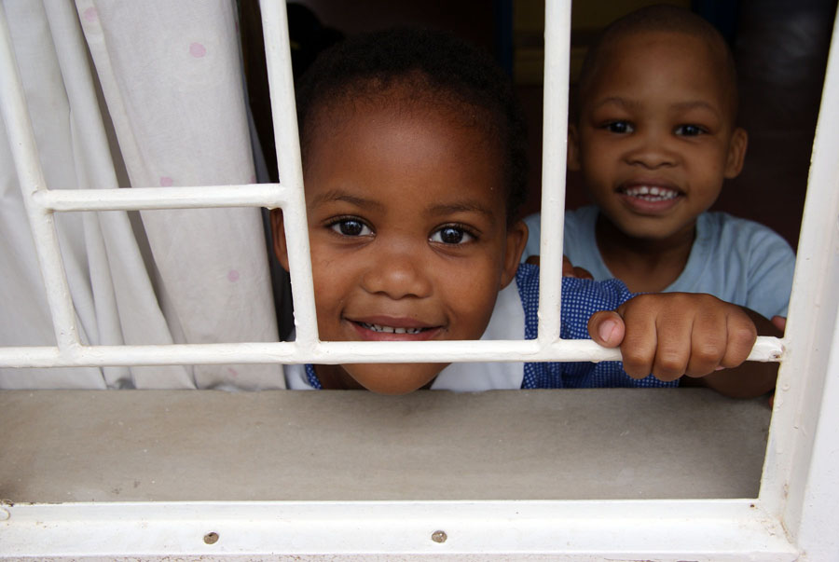
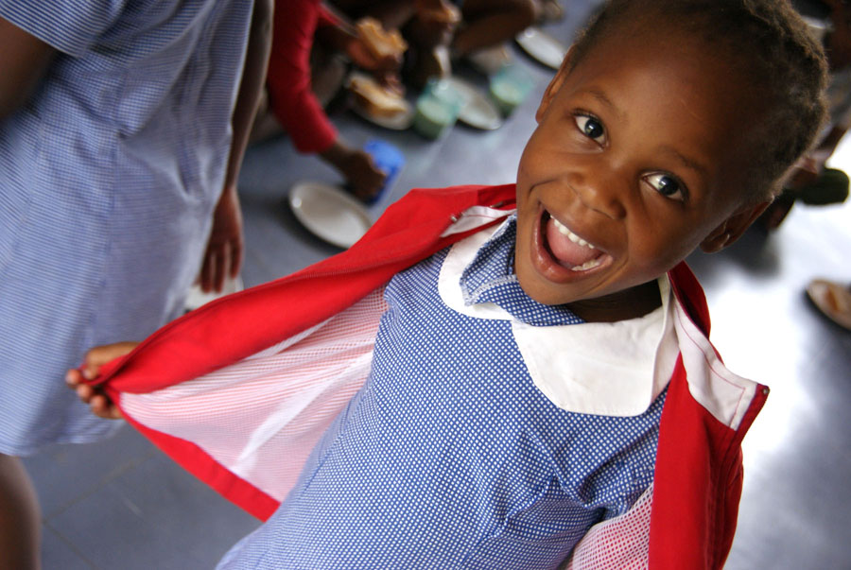
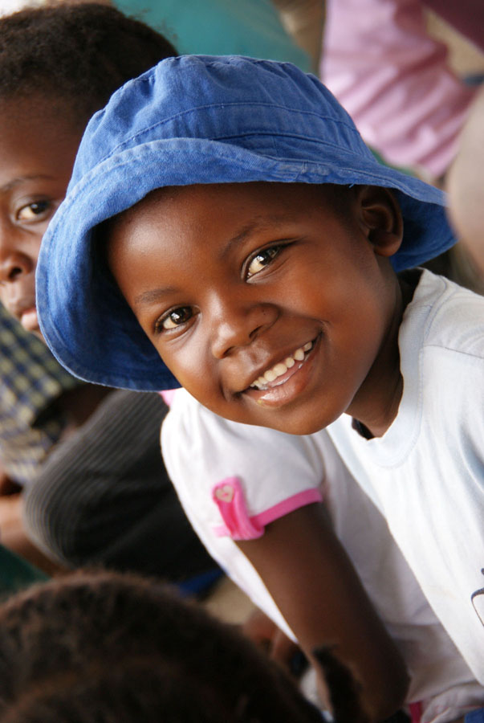
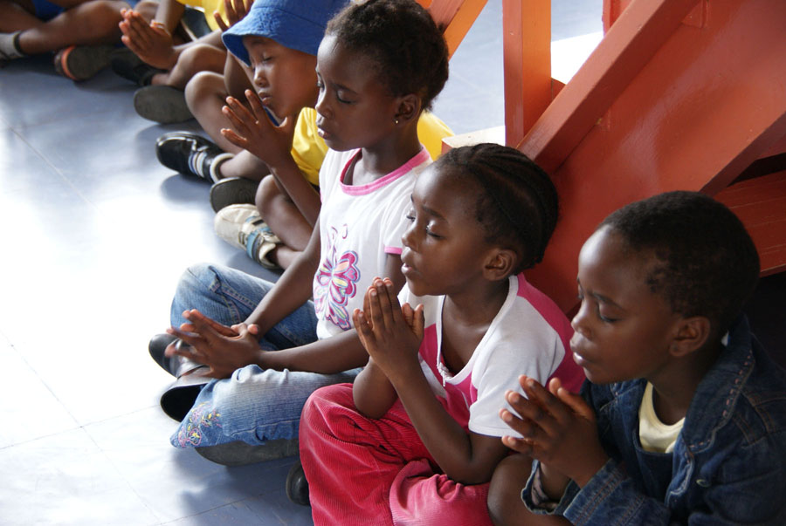
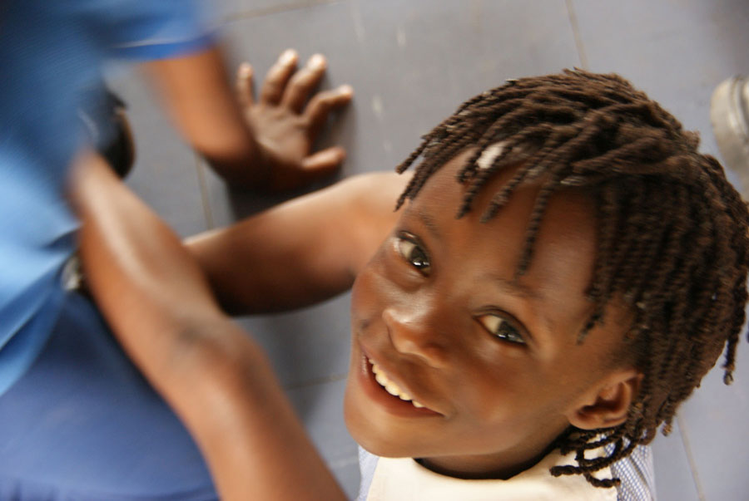
SOS Children’s Village
Notes:
I also volunteered for a few days in the kindergarten of the SOS Children’s Village in Francistown. I say that mainly just as an excuse to put up some pictures of cute children, many of whom, given half a chance and maybe a bigger baggage allowance, I’d have brought, Madonna style, back to England with me.

Slide 8
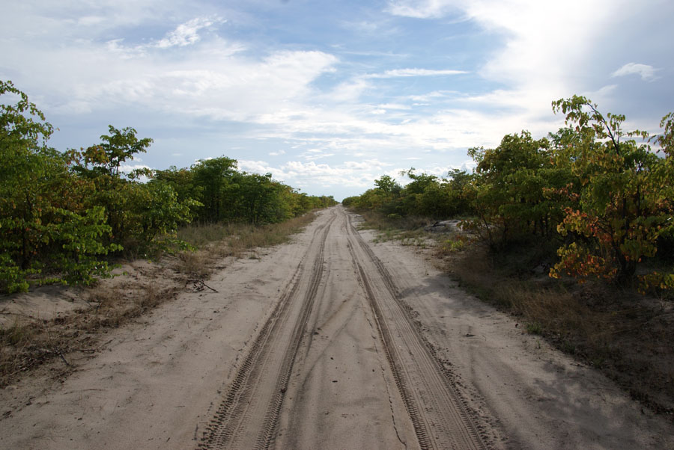
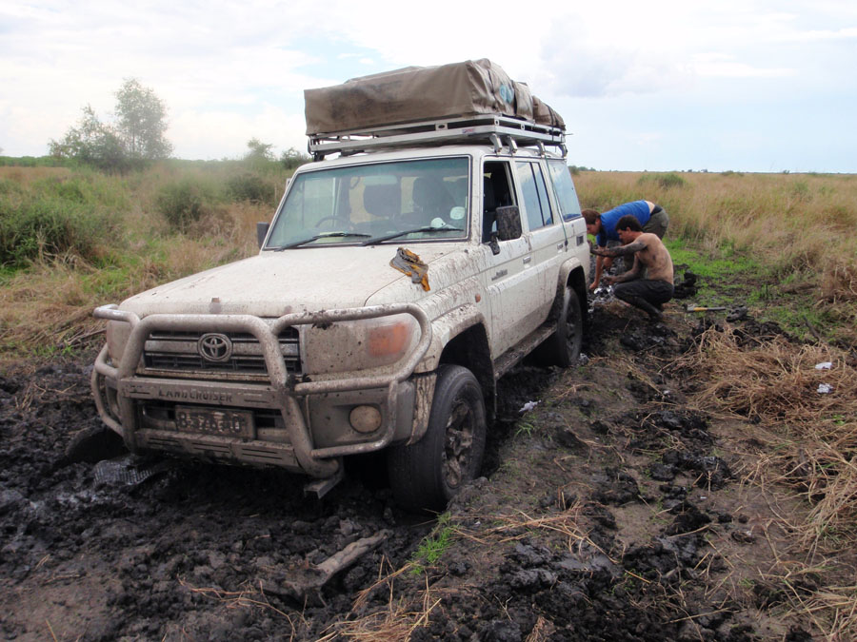
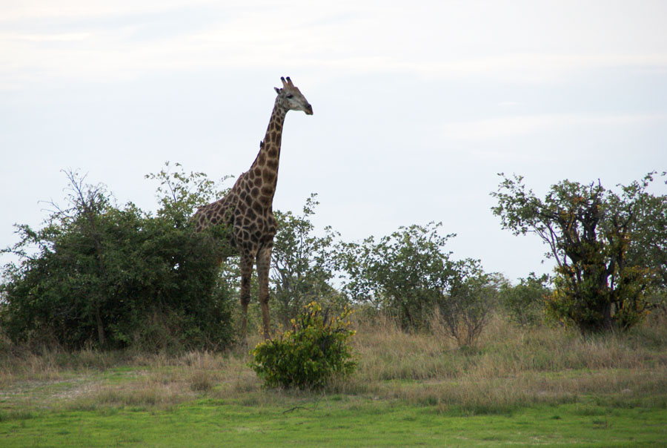
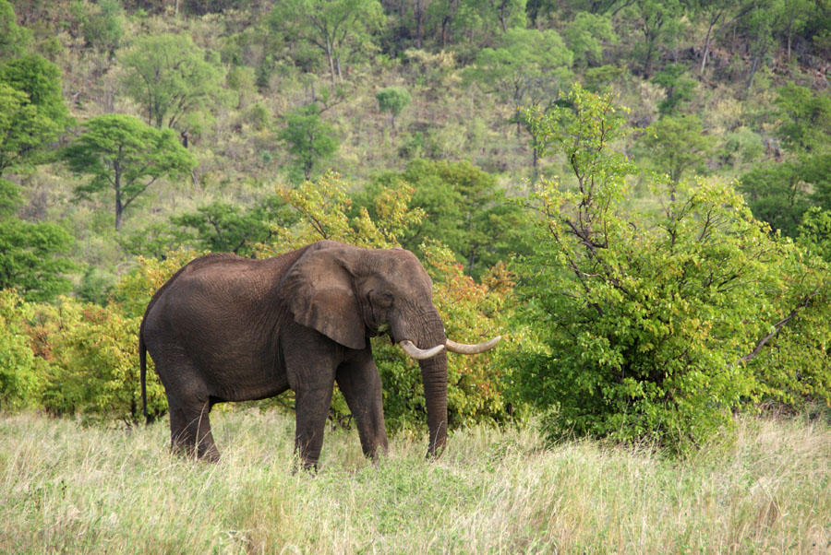
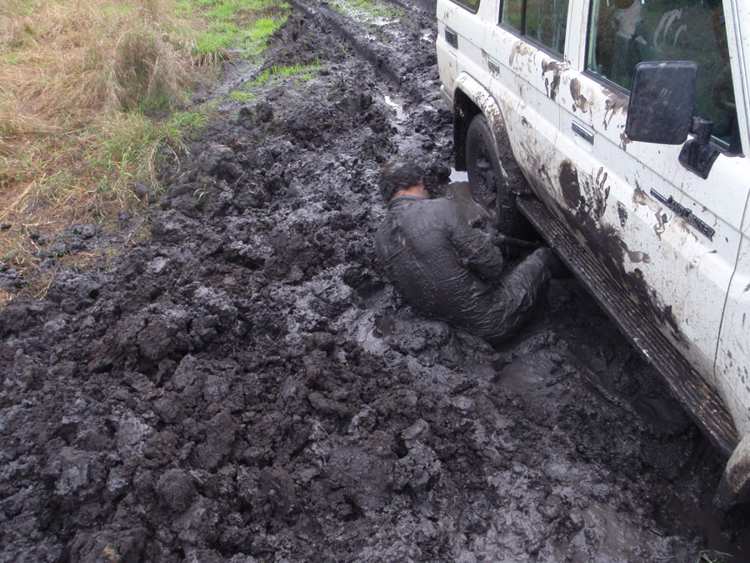
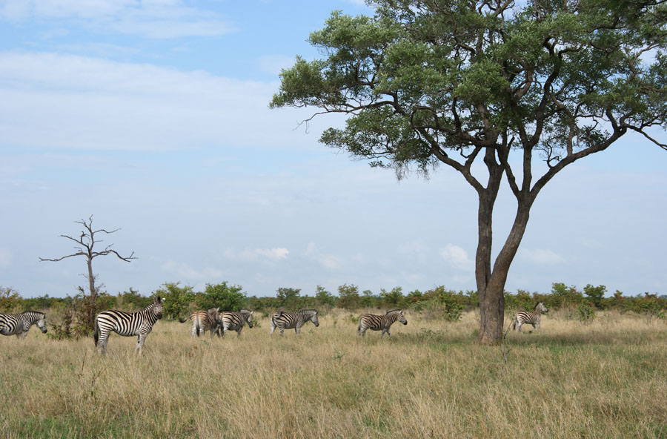
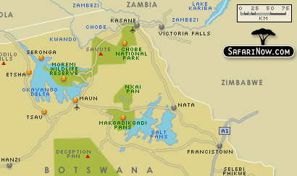
The Big 4x4 Adventure
Notes:
But it wasn’t all work, obviously. This was just one of our many adventures. We hired a 4x4 and drove it up to Kasane, on the banks of the Zambezi river.
The plan was to take this road that leads through the Chobe and Moremi parks down to Maun, on the Okavango Delta. So we set off from Kasane and, despite a few rainy nights here and an alligator within spitting distance of our campsite there, the first few days went well. The track was good and we saw elephants, not to mention giraffes, the zebra migration and plenty else. In fact, it was going so well, we’d put The Lion King soundtrack on the CD player and were feeling truly part of the great circle of life.
Then a wrong turn around Savute led us into some marshes where we promptly got bogged three times in the clay mud. The last time, we spent six long hours digging ourselves out, in the middle of the bush, surrounded by long grass perfect for concealing hungry lions and with a lone bull elephant grazing maybe 500m away. By the time we were out, it was dusk, and everyone had told us “If there’s one thing not to do in Africa, it’s drive in the dark”, but we decided to risk driving back to the camp we’d stayed in the previous night.
It turned out it’d been raining all around us all day, and as we got closer to the campsite, the road got wetter and wetter, until we were fording wide, deep puddles of water that splashed up over the headlights as we drove in, plunging us repeatedly into complete scary darkness. They got wider and deeper the closer we got to the site, and the last one we crossed, we actually left the ground and floated, which was quite possibly the most horrible feeling ever. It was only lucky that our momentum carried us over to the other bank and we could drive on to the campsite. Not wanting to risk anything else, we drove back the way we’d come and took the long road back down to Francistown.

Slide 9
What I got from elective
Much needed time out
A taste of a different medicine
A lesson on how much can be done with so little
A lesson on how people cope
A lesson on the small details within the big picture
A lesson on the perils of underestimation
A lesson on a different culture
Notes:
So, what did I get from elective?
Well, firstly, I got much needed time out. Most of you will experience Final Year fatigue sometime soon. After the slog of 5th year, I was fed up and seriously thinking that medicine wasn’t what I wanted to do with my life, but the escape of elective revitalised me.
Even though it was by no means undeveloped, I still experienced a wholly different medical world. In terms of actual clinical knowledge, I don’t think I learnt anything that I couldn’t have learned here, except maybe how to examine a dead snake, but I don’t think that’s the point of elective. What I discovered about how medicine can be practised and is practised elsewhere is what I found the most valuable.
Working in the hospital, I learnt that great things can be done with very few resources, even with just an unfolded paperclip.
I discovered a little more about how people cope with death, and how I cope with it myself.
I learnt that, with a bigger picture, for example AIDS, it can sometimes be reassuring just focusing on the little details.
In our 4x4, I think we momentarily forgot we were in Africa, rather than in a safe safari park. And Africa didn’t like that much, so taught us a lesson: never underestimate. Always bear in mind that, however safe you feel, in a foreign country you’re bound to be a bit more vulnerable than at home. So just be sensible and take care.
Most importantly for me, I experienced another culture and another way of life. Although some people get signed off after three days and spend the rest of their time travelling or on the beach, I think that’s a bit of a shame. Working in a foreign country is really how you get under its skin. Elective provides such a great opportunity to work abroad and have experiences that would be impossible if you were just passing through with a rucksack, so by all means, do some travelling – it’d be silly not to – but take the opportunity to work as well.
After all, it’ll never be this easy to do something like this again, so make the most of it, wherever you go. And have fun.

Slide 10
Any questions?
Oh, and one
more thing…
KEEP A JOURNAL!
gregory.froome@imperial.ac.uk

