Slide 1
Building your portfolio
Yasmina Mallam-Hassam Careers Consultant Imperial College London
Y.Mallam-Hassam@imperial.ac.uk
Mr Shiv Chopra CT2 Plastic Surgery London- St. George's Hospital
Shiv.Chopra@imperial.ac.uk

Slide 2
What is a portfolio?
Extension of your CV
Summary of evidence of your achievements
Used in all work industries
Increasing use in medical field
Today we will start preparing you for your future path

Slide 3
Use in medicine
Student
CV for part-time jobs/ rotations/research posts
Electives
All attachments?
Future- Academic and ?FPAS
Foundation Doctor to Consultant post
Evidence of everything
Reviews/Revalidation
Interviews (20 – 40% of final mark)
Online and paper

Slide 4
Online Porfolio

Slide 5
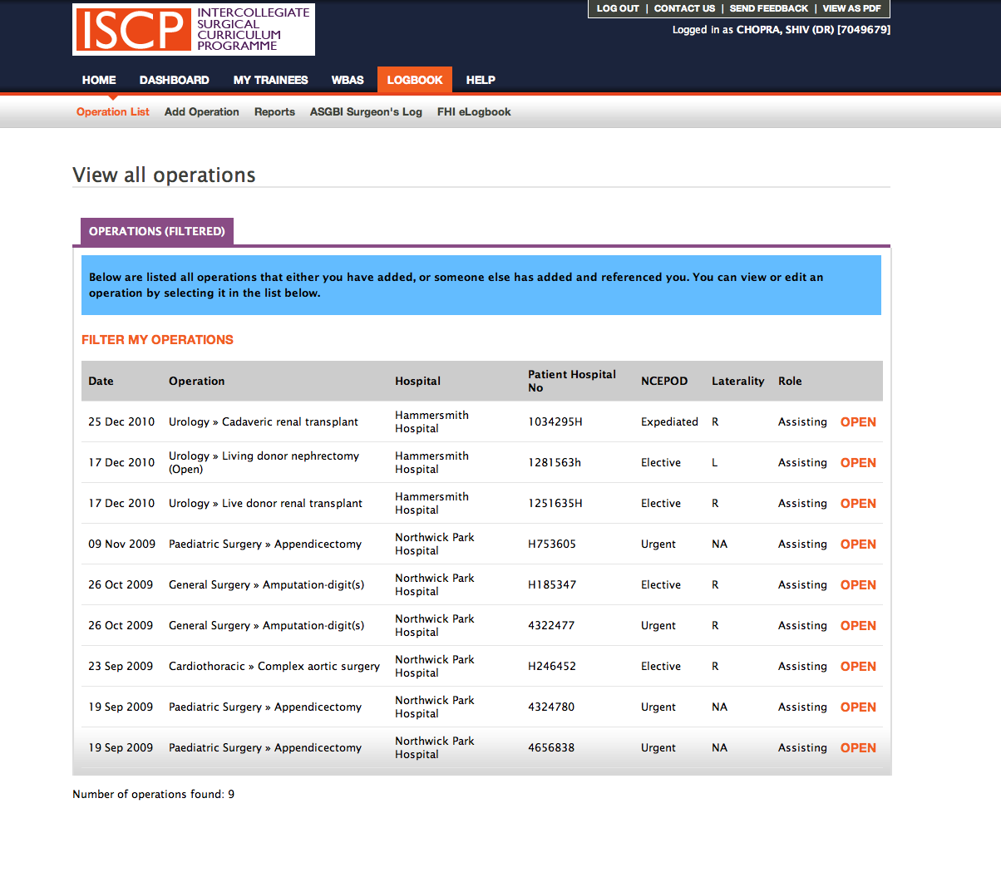
Online Portfolio

Slide 7
Portfolio Station
Usually friendly station
Opportunity to sell yourself
Example questions
“Outline your surgical experience to date…”
“How do you plan to improve your CV over the next year”
“Talk me through an operation that you are familiar with”
“Tell me about your audit/research/publications – which of your publications are you most proud of”

Slide 8
Making the right impression
Visual Impact
Clear, logical structure
Use of bold and bullets to highlight key points
Language
Action verbs e.g. relevant, achievement, responsibility
Check spelling and grammar e.g. UK not US spelling
Content
Give evidence and examples
Consistent font
Use layout to showcase the most relevant aspects of experience
Be concise
Check your spelling and grammar
Include results and quantifiers to show impact
Avoid jargon

Slide 9
Which candidate would you pick?

Slide 10
Key Sections of a medical CV
Personal details
Profile (optional)
Education
Awards
Medical Career History
Clinical skills and experience
Research, conferences and publications
Clinical Audits
Teaching experience
Professional Training
Interests
References
Notes:
Provide an example of a good CV
Elements of a CV are like the building blocks for your career
You have discretion over how you present them
These need to be presented in the priority order as required by the role, not in the order you deem important
A good idea to get into the habit of regular review and updating-can be done at the same time as the portfolio

Slide 11
Developing your portfolio
1)
Create your CV and buy a nice folder for your new portfolio
2)
Start to populate your portfolio with the evidence used to substantiate your CV claims
3)
Undertake activities to improve any weak areas.

Slide 12
Activities to boost your medical employability
As a medical student
Attend careers events to understand and shortlist specialty options
Ask medical team to get involved in audits/research while on placement
Search Royal College/Specialty websites for prizes/awards and bursaries
Join specialty interest groups within professional bodies
Join clubs and societies to develop transferable skills e.g. leadership, teamwork/teaching/communication
Attend local/regional/international conferences
As a foundation doctor
Attend specialty taster days
Conduct information interviews and shadowing with doctors in different specialties
Use study leave/free time to build evidence through courses

Slide 13
Sources of help
Careers Advisory Service http://www3.imperial.ac.uk/careers
20 minute consultations-bookable daily through Jobslive
40 minute consultations for careers guidance bookable by contacting 020 7594 8024 (Skype and hospital campus consultations possible)
Events and employer sessions book through Jobslive
London Deanery Careers Unit http://www.londondeanery.ac.uk/var/careers-unit
NW Thames Foundation School
http://www1.imperial.ac.uk/medicine/teaching/nwtfs/infofrfds/carsgdnce/
IC Medical Students’ Union
http://www.icsmsu.com/exec/careers/

Slide 14
Resources
Royal Society of Physicians
http://www.rcplondon.ac.uk/sites/default/files/rcp-insight-how-to-write-a-medical-cv.pdf
http://www3.imperial.ac.uk/careers/ug/applicationandselection
Speculative applications
Writing my CV
Writing my covering letter
Psychometric tests
Online Portfolios
www.iscp.ac.uk
www.elogbook.org
BMA

Slide 15
Career options and managing your career
Managing your medical career
http://www.medicalcareers.nhs.uk/tools_and_resources.aspx
http://www.foundationprogramme.nhs.uk/pages/medical-students/your-career-path/resources
http://thequackguide.com/
Alternative careers for medics
http://www.medicalcareers.nhs.uk/tools_and_resources/alternative_careers_options.aspx
http://beyondclinical.thecareersgroup.co.uk/

